Slide 1
The Outsiders
6 Word Memoirs

Slide 2
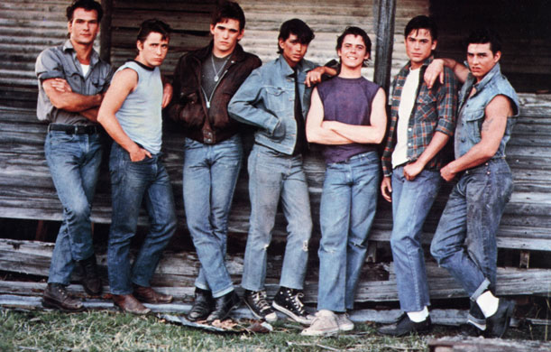
The Gang

Slide 3
Shouldn’t be labeled by our misfortunes.

Slide 4
We are who we are, greasers.

Slide 5
Never walk alone, it’s too risky.

Slide 6
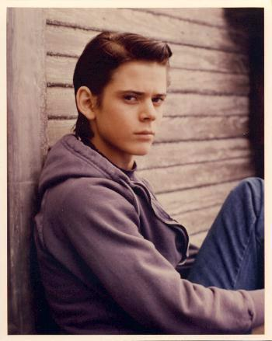
You know who I am; not.
Gang
Ponyboy

Slide 7
You know who I am; not.

Slide 8
Academics, sports, hair grease. That’s all.

Slide 9
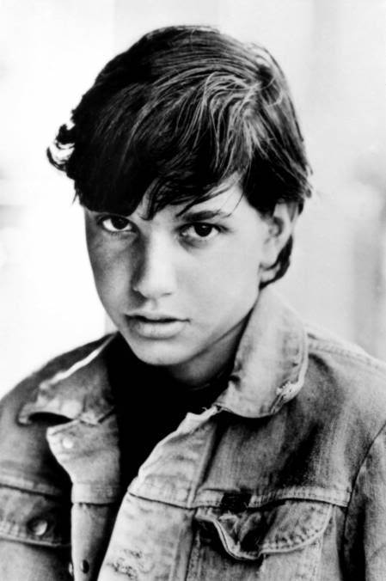
Johnny

Slide 10
Back flips, sudden tricks, he’s dead.

Slide 11
Juvenile Delinquents – Secret name for heroes.

Slide 12
“Sweet Baby Jesus! I killed him!”

Slide 13
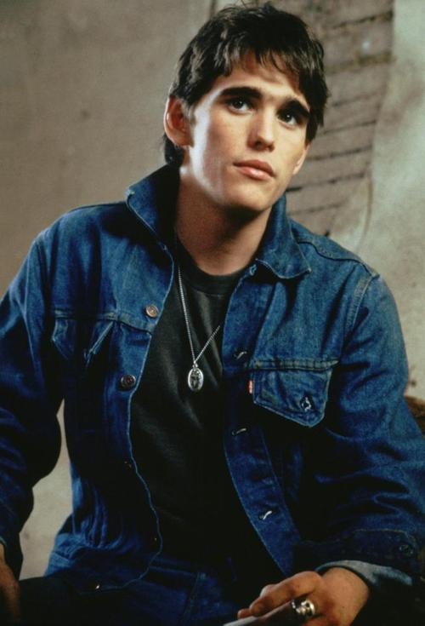
Dally

Slide 14
Danger. His middle name was danger.

Slide 15
His eyes were like broken ice.

Slide 16
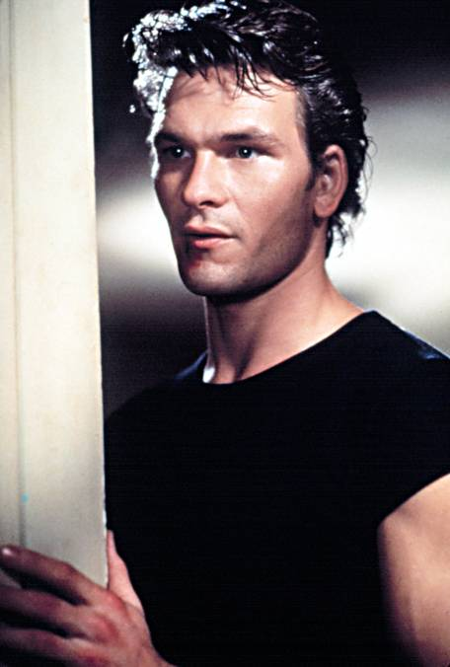
Darry

Slide 17
Tough as nails, soft like cashmere.

Slide 18
“I do love him,” tough love </3

Slide 19
Worked hard – never had a break.

Slide 20
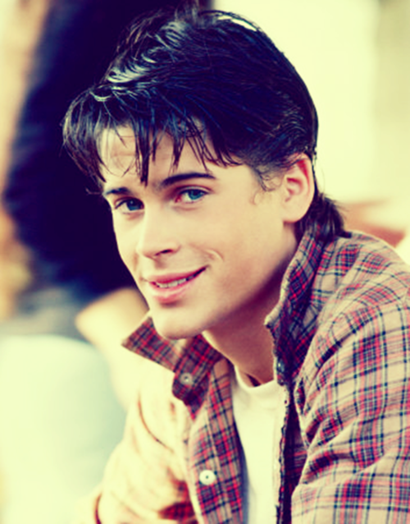
Sodapop

Slide 21
The happy ones, hold back most.

Slide 22
Carefree, reckless eyes, torn a part heart.

Slide 23
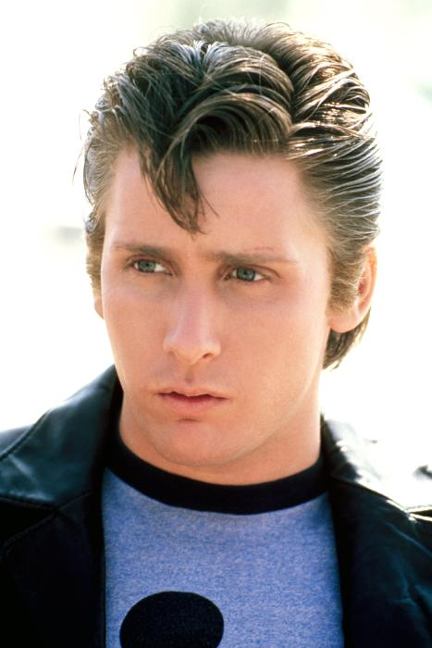
Two-Bit

Slide 24
“I’m happy go lucky, you dig?

Slide 25
Note to self – Watch Mickey Mouse

Slide 26
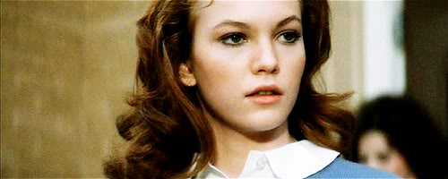
Cherry

Slide 27
It only takes one to change.

Slide 28
It’s hell all over, don’t judge.

Slide 29
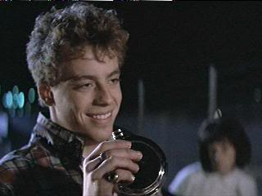
Bob

Slide 30
He’s dead – I kid you not.

Slide 31
Drunk every night, only wants discipline.

Slide 32
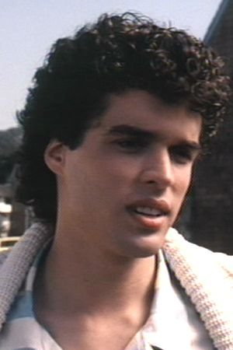
Randy

Slide 33
Too scared to change, but cares.

Slide 34
Rumble, no rumble, nothing will change.

Slide 35
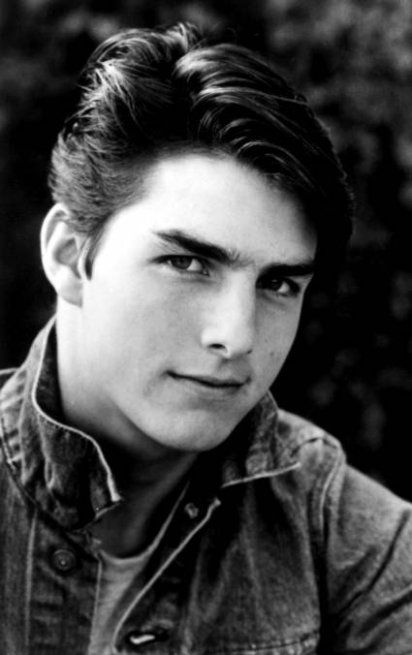
Steve

Slide 36
“Would he just stay home once?”

Slide 37
I should’ve gotten a bigger part.
(Tom Cruise)

Slide 38
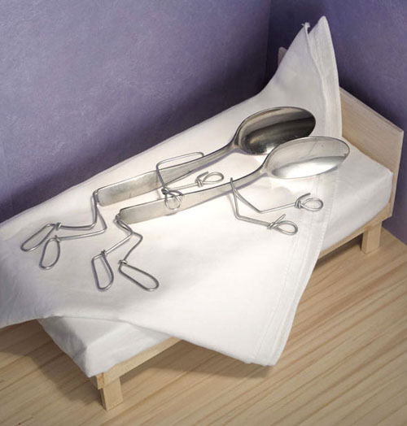
Spooning

Slide 39
Spooning: Pony, Soda, two brothers connecting.

