Slide 1
By: Laura Hogan & Randi Vanderbeck & Michaela McGrath

Slide 2
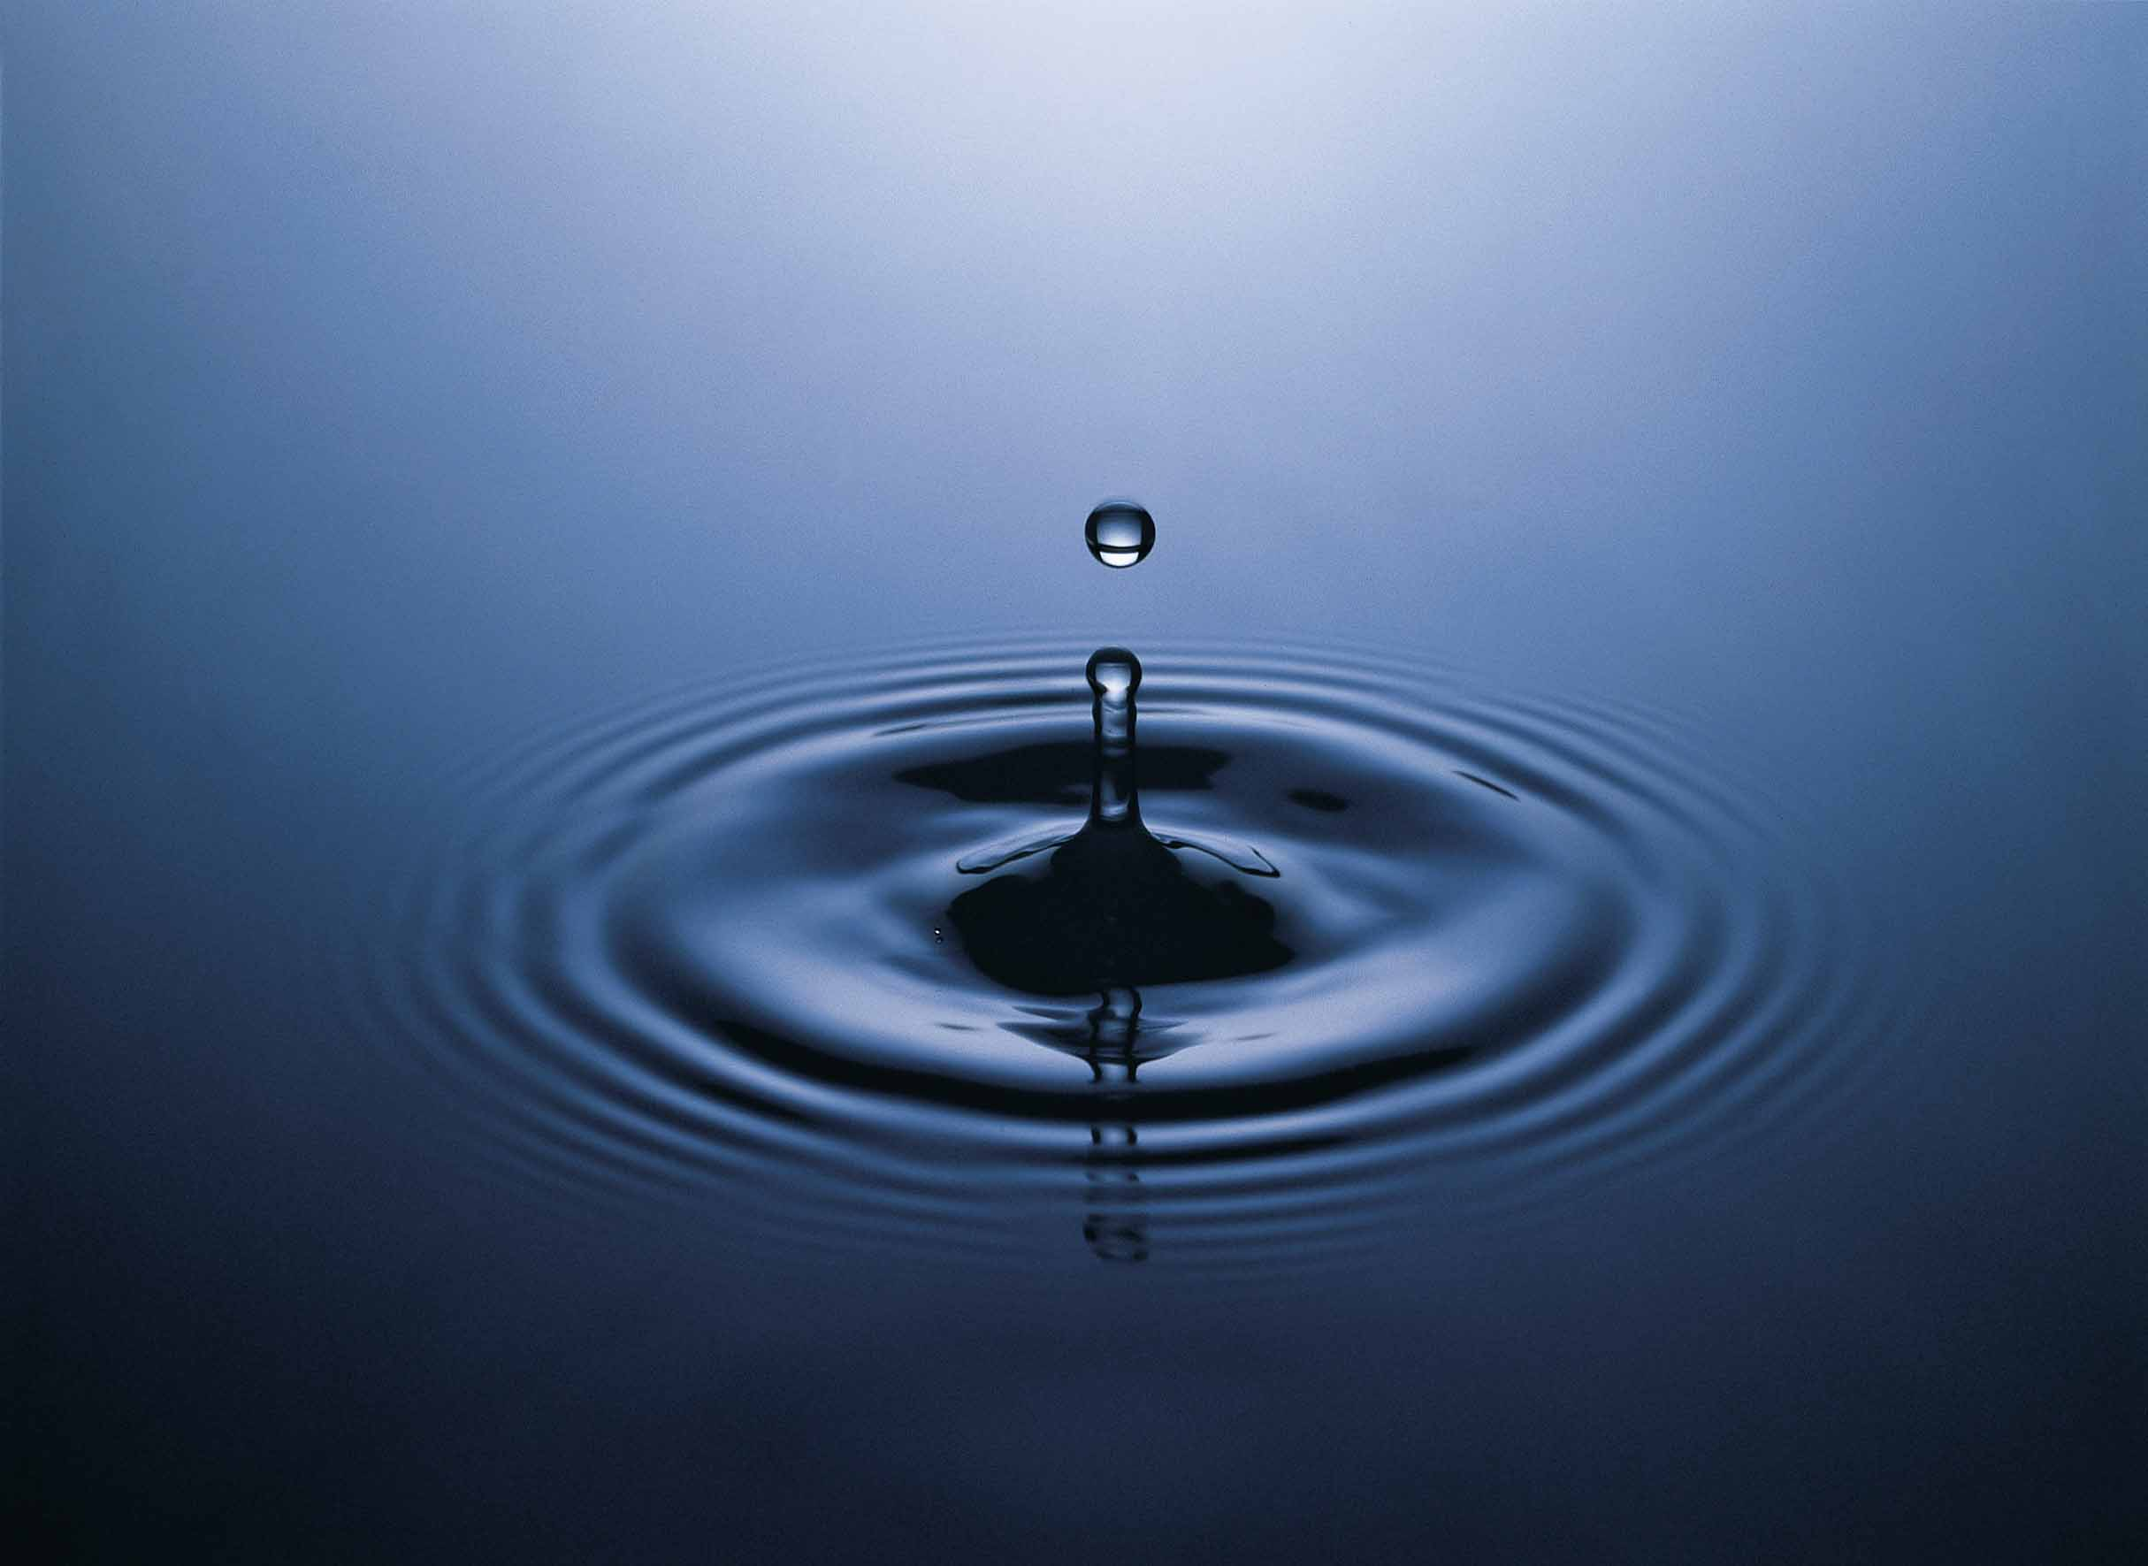
Vital Functions of Water
For most people, 50-75% of their body weight is water. Muscle tissue consists of 75% water, and fat tissue contain 20-35%. “This means that the total percentage of body weight from water depends on the ratio of fat to lean body tissue” (pg.173).
Water is extremely important because it’s a main component in body fluids including blood, saliva, lymph, digestive juices, urine, and perspiration. Your body needs enough liquid in order to function properly.
Every cell in our bodies contain water. The water decides the shape of the cells, whether they are soft or firm.

Slide 3
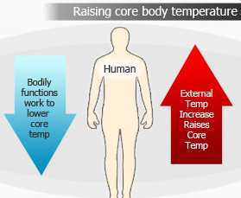
Water is vital for our bodies to produce sweat to cool
down. Not enough water causes body temperature to
increase and it can cause headaches, nausea, dizziness,
and loss of consciousness. If body temperature
continuous to rise, death will occur.

Slide 4
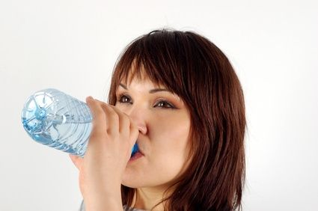
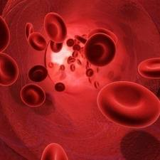
Almost all chemical reactions in the body need water
to take place.
Ex. Breaking down carbohydrates and proteins for energy
Water is often a reactant during many reactions in the
body.

Slide 5
Water is a solvent. This means that substances can be dissolved in it.
Ex. Water can dissolve amino acids from proteins, glucose from carbohydrates, minerals and water soluble vitamins.
Lubricates Surfaces- Water is a lubricant in our bodies that reduces friction.
Ex. Water in saliva lubricates food as it is swallowed
Water regulates body temperature. Body fluids that are responsible for this task are blood and perspiration.

Slide 6
Water Changes Everything

Slide 7
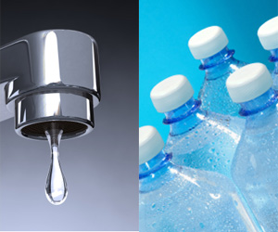
Tap water VS. Bottled water
Some people drink bottled water because it supposedly contains minerals that are healthy for the body. Research does not confirm that it is any better than regular tap water.
Bottled water has become very expensive especially brands like Fiji and Vas. However, bottled water is no different than tap water when it comes to health and safety.
Bottled water lacks an element called fluoride, which protects the teeth enamel. Fluoride is found in tap water.
Depending on where you live the minerals in your water can be different. Some places might contain more iron where as some have more sulfur. This may cause people to buy tap water because the minerals can cause the water to have a certain taste.

Slide 8
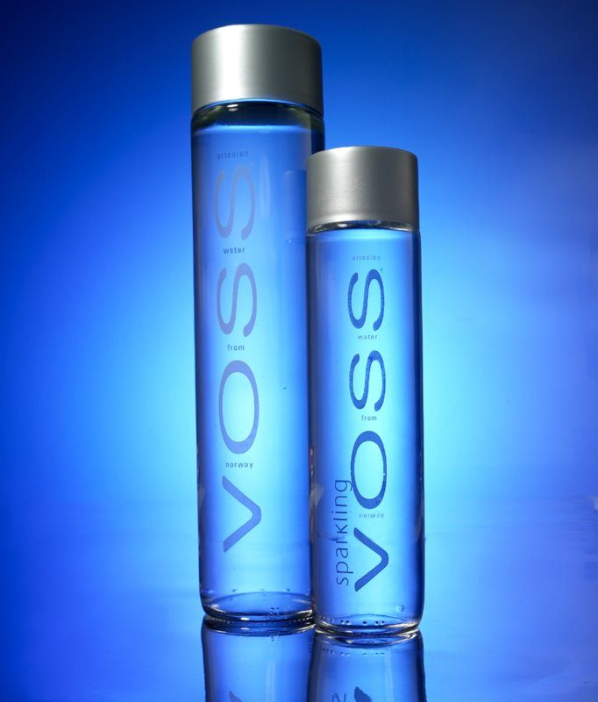
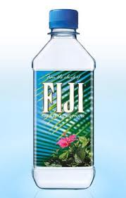
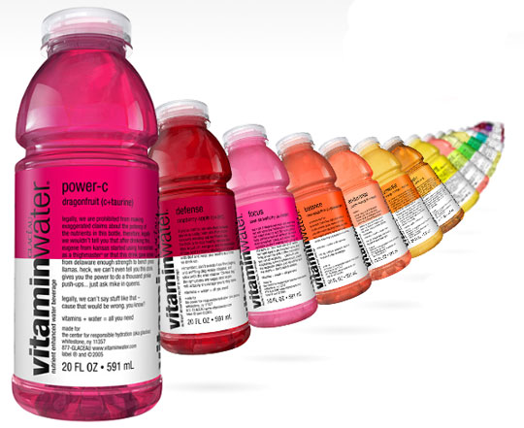
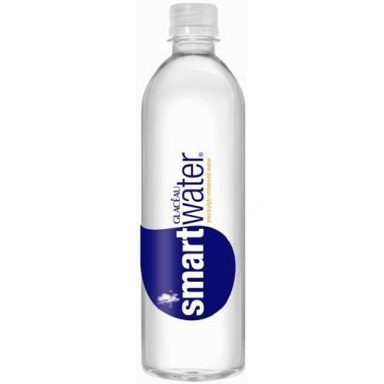
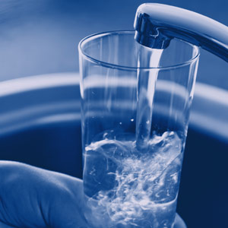

Slide 9
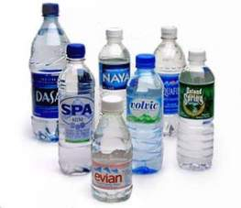
DANGERS OF BOTTLED WATER
Plastic bottles can release chemicals when it is heated up, frozen or reused several times.
As much as 40% of bottled water sold in the US is just filtered tap water anyways
By drinking tap water, you do not have to worry about the chemicals they put into it.

Slide 11
Tapped Trailer

Slide 13
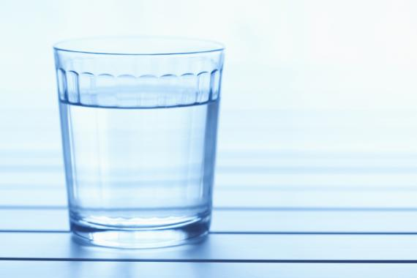
Water Intoxication
Can you drink too much water?
YES! The result is a condition called water
intoxication. Its quite rare but it still happens!
Drinking too much water causes the
concentration of electrolytes to go down.
Which can make you have headaches,
weak muscles, and even death

