Slide 1
FRACKING
By Julia, Becky, Kaitlyn and Brianne

Slide 2
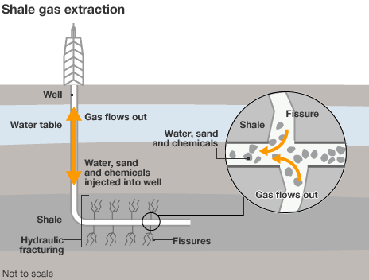
What is Fracking?
Hydraulic Fracturing or Fracking is the process of drilling and injecting Fracking Fluid at high pressure in order to extract Shale Gas.

Slide 3
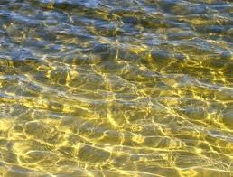

Fracking Fluid
7.5 million liters of water to 19 million liters of water.
Sand
Approx 600 different chemicals like Lead, Uranium, Mercury, Radium and Methanol.
Then 40,000 gallons of those chemicals go into the Liquid.

Slide 4
Seismic Testing
Seismic Testing is when they cause the ground to shake so much that the Shale Rock will expose the gas. There are two ways they complete this process:
Shot Hole Testing and Thumper Trucks

Slide 5
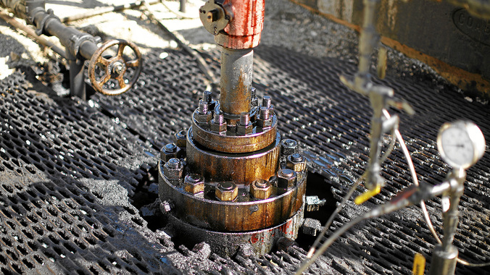
Hydraulic Fracturing History

Slide 6
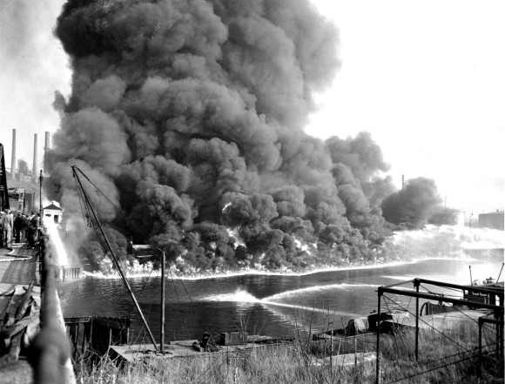
Fracking History
Hydraulic fracturing, or “fracking” was invented by Floyd Farris and J.B Clark. It was first performed in 1947 at Hugoton gas field in Grant Country of southwestern Kansas, but it was unsuccessful.
On March 17th, 1949, the first commercially successful extractions were carried out in Stephens County, Oklahoma and Archer County, Texas.

Slide 7
Precursors
In the 1860’s, fracking was used as a method of stimulating shallow, hard rock wells. It was performed in the states of New York, Pennsylvania, Kentucky and West Virginia.
Liquid and solidified nitroglycerin was used in this technique and it was later applied to gas and water wells

Slide 8
Massive Fracturing
Massive Fracturing, also known as high volume hydraulic fracturing, was first introduced in Stephens County, Oklahoma, USA in 1968 by Pan American Petroleum.
Massive Fracturing generally refers to treatments injecting more than 150 short tons of proppant (a solid object used to keep a induced fracture open)
In the late 1970’s, massive fracking spread to Western Canadian provinces.

Slide 9
Fracking History
Using acid as a non-explosive fluid for well stimulation was introduced in the 1930’s.
Starting in 1973, Massive Fracking was being performed in thousands of gas wells in San Juan Basin, Denver Basin, the Piceance Basin, and the Green River Basin.
Horizontal oil or gas wells weren’t common until the 1980’s.

Slide 10
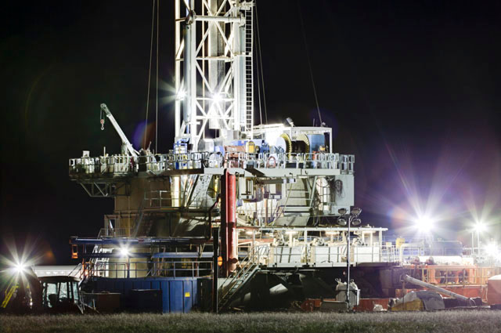
CONS OF FRACKING

Slide 11
What Fracking Causes
Most controversy surrounding natural gas has to do with fracking. Studies have shown that fracking does cause small earthquakes, which can damage homes. However, it should be noted that these earthquakes are relatively small, and some experts believe that these small earthquakes relieve pressure that could have caused larger earthquakes in the future.
Fracking also uses a tremendous amount of water that contains chemicals and other environmentally damaging materials. Runoff from fracking operations can cause tremendous environmental harm, and some regulators believe that current regulations are not strict enough to prevent this harm.
Fracking brings up a number of land rights issues. Since fracking involves horizontal drilling, disputes often arise over whether a fracking company has access to certain segments of land underground

Slide 12

WHAT FRACKING CONSISTS OF
To the site
Each gas well requires an average of 400 tanker trucks to carry water and supplies to and from the site.
Heavy Load
It takes 1-8 million gallons of water to complete each fracturing
Fracturing Site
The water brought in is mixed with sand and chemicals to create fracking fluid. Approximately 40,000 gallons of chemicals are used per fracturing.

Slide 13
http://www.youtube.com/watch?v=b0q_n63X438

Slide 14
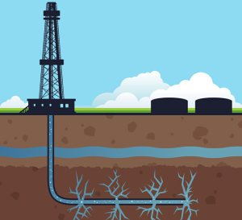
Benefits
of fracking

Slide 15
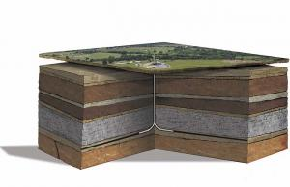
All Natural
So much natural gas has been extracted through fracking in most recent years that the US carbon emissions are falling!
The gas taken from fracking is all natural so more than a third of natural gas burned in the US is coming from fracking wells. This provides cleaner energy.
Notes:
http://www.elsevier.com/connect/fracking-the-pros-and-cons

Slide 16
Keeping it clean
the fuel from natural gas releases about half as much carbon dioxide as coal, and even smaller amounts of other dangerous chemicals.
Notes:
http://thetartan.org/2014/3/31/scitech/pugwash

Slide 17

Keeping costs down
Oil costs around $100 a barrel. In 2002, oil was about $20 a barrel. Natural gas is currently at 2002 prices.
Because burning natural gas emits about half of the CO2 of coal or oil, it means less of the greenhouse gases that causes climate change.

Slide 18
Keeping families together
Fracking has made a boom in gas drilling and production. It’s meant more jobs in certain areas. This means that parents are not having to work away.
The price of natural gas is half of what it was one year ago.
It’s meant families can heat their homes more cheaply

Slide 19
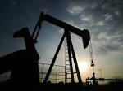
In Conclusion
Like anything fracking has its advantages and disadvantages but the benefits that fracking has are not enough to help us in the long run. It is up to us to help keep the environment clean and fracking will not help!

Slide 20
True or false
Fracking is being practiced everywhere in the world.
There are approximately 650 different chemicals in Fracking Liquid.
Companies take the water from oceans
They only recover 30-50% of the Fracking Liquid
There are 4 ways that they test for shale gas
Floyd Clark and J.B Farris invented Fracking
Fracking was First performed in 1947.
Oil costs around $300 a barrel.

Slide 21
References
http://en.wikipedia.org/wiki/Hydraulic_fracturing
http://en.wikipedia.org/wiki/Hydraulic_fracturing_proppants
http://www.elsevier.com/connect/fracking-the-pros-and-cons
http://thetartan.org/2014/3/31/scitech/pugwash
http://youngpetro.org/2013/05/06/the-pros-and-cons-of-fracking/

