Slide 1
Sea Lice

Slide 2


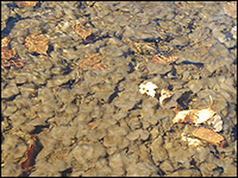
In New Brunswick we are very famous for our Salmon and a couple things that have been harming our famous friends are Sea lice and Rock snot. We are here to help explain the negative effects of these threats.

Slide 3
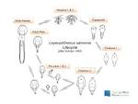
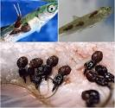
What are sea lice?
Sea lice are small naturally occurring marine parasites that reside on the bodies of both wild and farmed fish; they attach themselves to the skin, fins, and gills of fish and feed on mucus and skin
The sea lice are benefiting from feeding on the fish but, the fish aren’t because there are always negative side effects to having a sea lice on the fish.
Nauplius 1&2
Copepodid
Adult female
Adult male
Chalimus 1
Pre adult 1&2
Chalimus 2

Slide 4

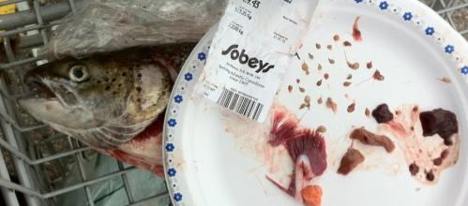
Facts about Sea lice
They grow depending on water temperature
survive up to 191 days, producing as many as 11 pairs of egg strings
13 known species of sea lice
a couple of lice on a juvenile salmon, can hurt them severely or kill them
When the infest salmon farms they will come back every year knowing there will be a food source there to feed on

Slide 5
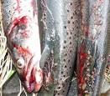
Is it hurting salmon populations?
they will come back every year knowing there will be a food source there to feed on
can cause serious fin damage, skin erosion, constant bleeding, and deep open wounds creating a pathway for other pathogens
Fish affected with lice can get extremely stressed, and this stress can even kill the fish.
carry diseases between farmed and wild salmon
‘spill over’ ‘spillback.’

Slide 6
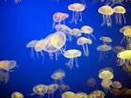
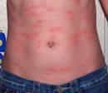

continued
The ACFFA industry has invested over $2 million dollars in a collaborative pilot project to lease and investigate the use of boats for the delivery of sea lice bath treatments – a green technology that reduces the amount of product required for treatments for the sea lice by 65 per cent.
Many are exposed to sea lice during their journey because fish farms are typically located in sheltered waters along wild salmon migration routes
Male sea lice are known to take the risk to find a different food source.

Slide 7

Conclusion
In conclusion sea lice can be dangerous and there is a lot of negative effects as to positive affects because there really are no positive affects to sea lice.
I believe that it is a big problem in salmon farming and more reasearch should be put into a better solution for the farms.

Slide 8
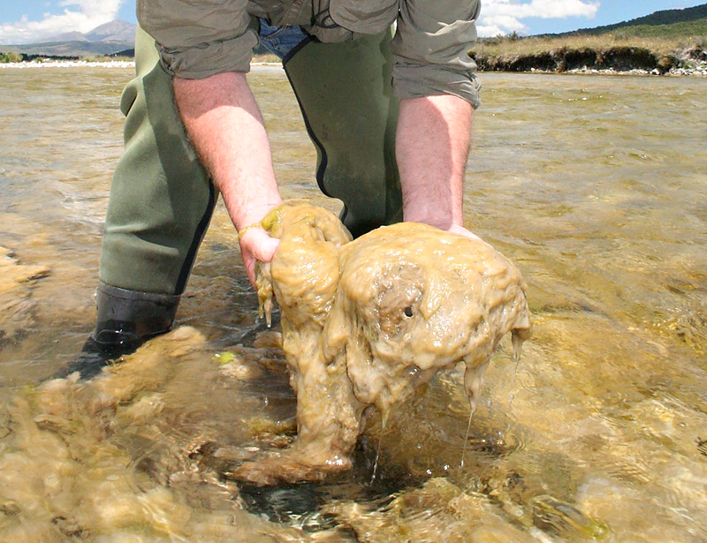
Didymosphenia geminata
Rock Snot
Sarah and Chase

Slide 9
Didymo can have dangerous effects on our water systems, what scientists are trying to do is figure out the actual cause for these blooms and find a solution……

Slide 10
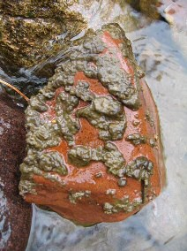
What is didymo?
(Didymosphenia).
(algae)
Didymo
Algae: “distinguished from plants by the absence of true roots, stems and, leaves” (algae)
Reproduces sexually and asexually. Asexually can cause stalk build up outside the cell.
It is a diatom

Slide 11
Background Information
Thought to have originated in North America, Europe and Asia
In 2006, didymo made an appearance in Quebec and New Brunswick
It was also the first time Atlantic salmon in North America became harmed by it
Matapedia River in Quebec
In New Brunswick didymo spotted in the Kedgwick, Patapedia, Upsalquitch, Matapedia and below the Matapedia which come together to make up the Restigouche drainage.
Shikatehawk Stream
(Didymosphenia)
(Bothwell, Spaulding)
(Didymo. New Brunswick)

Slide 12
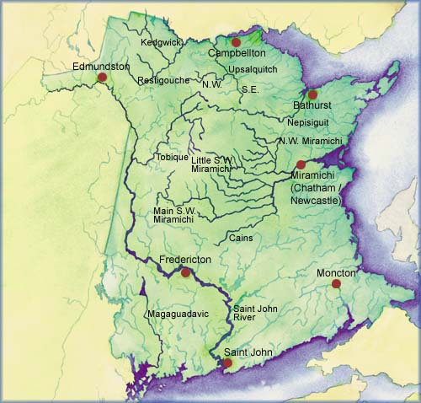

Slide 13
Cause of the blooms?
Scientists believed it came from another area, but didymo sediments have been found dating back to 1896, 1910 and 1970. Two studies were done with the hypothesis of global warming as the cause of the blooms.
Michelle Larvey’s study
Taylor’s study
Researchers analyzed the algae sediments from the bottom of a lake. They were wondering how populations of different algae fluctuate with time. They found a common trend when temperatures increase and what effects algae had on the lake.
Earlier springs cause the snow to melt and ground to thaw earlier than normal. That means even more nutrients from the ground are used up by microbes to survive and less nutrients are making their way into the water because of it.
(‘Rock Snot’).
(Moore).

Slide 14
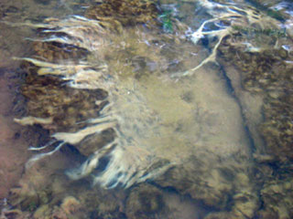
Phosphorus/nutrient rich water vs. nutrient poor water
(Invasive Species: Didymo)
(What).

Slide 15

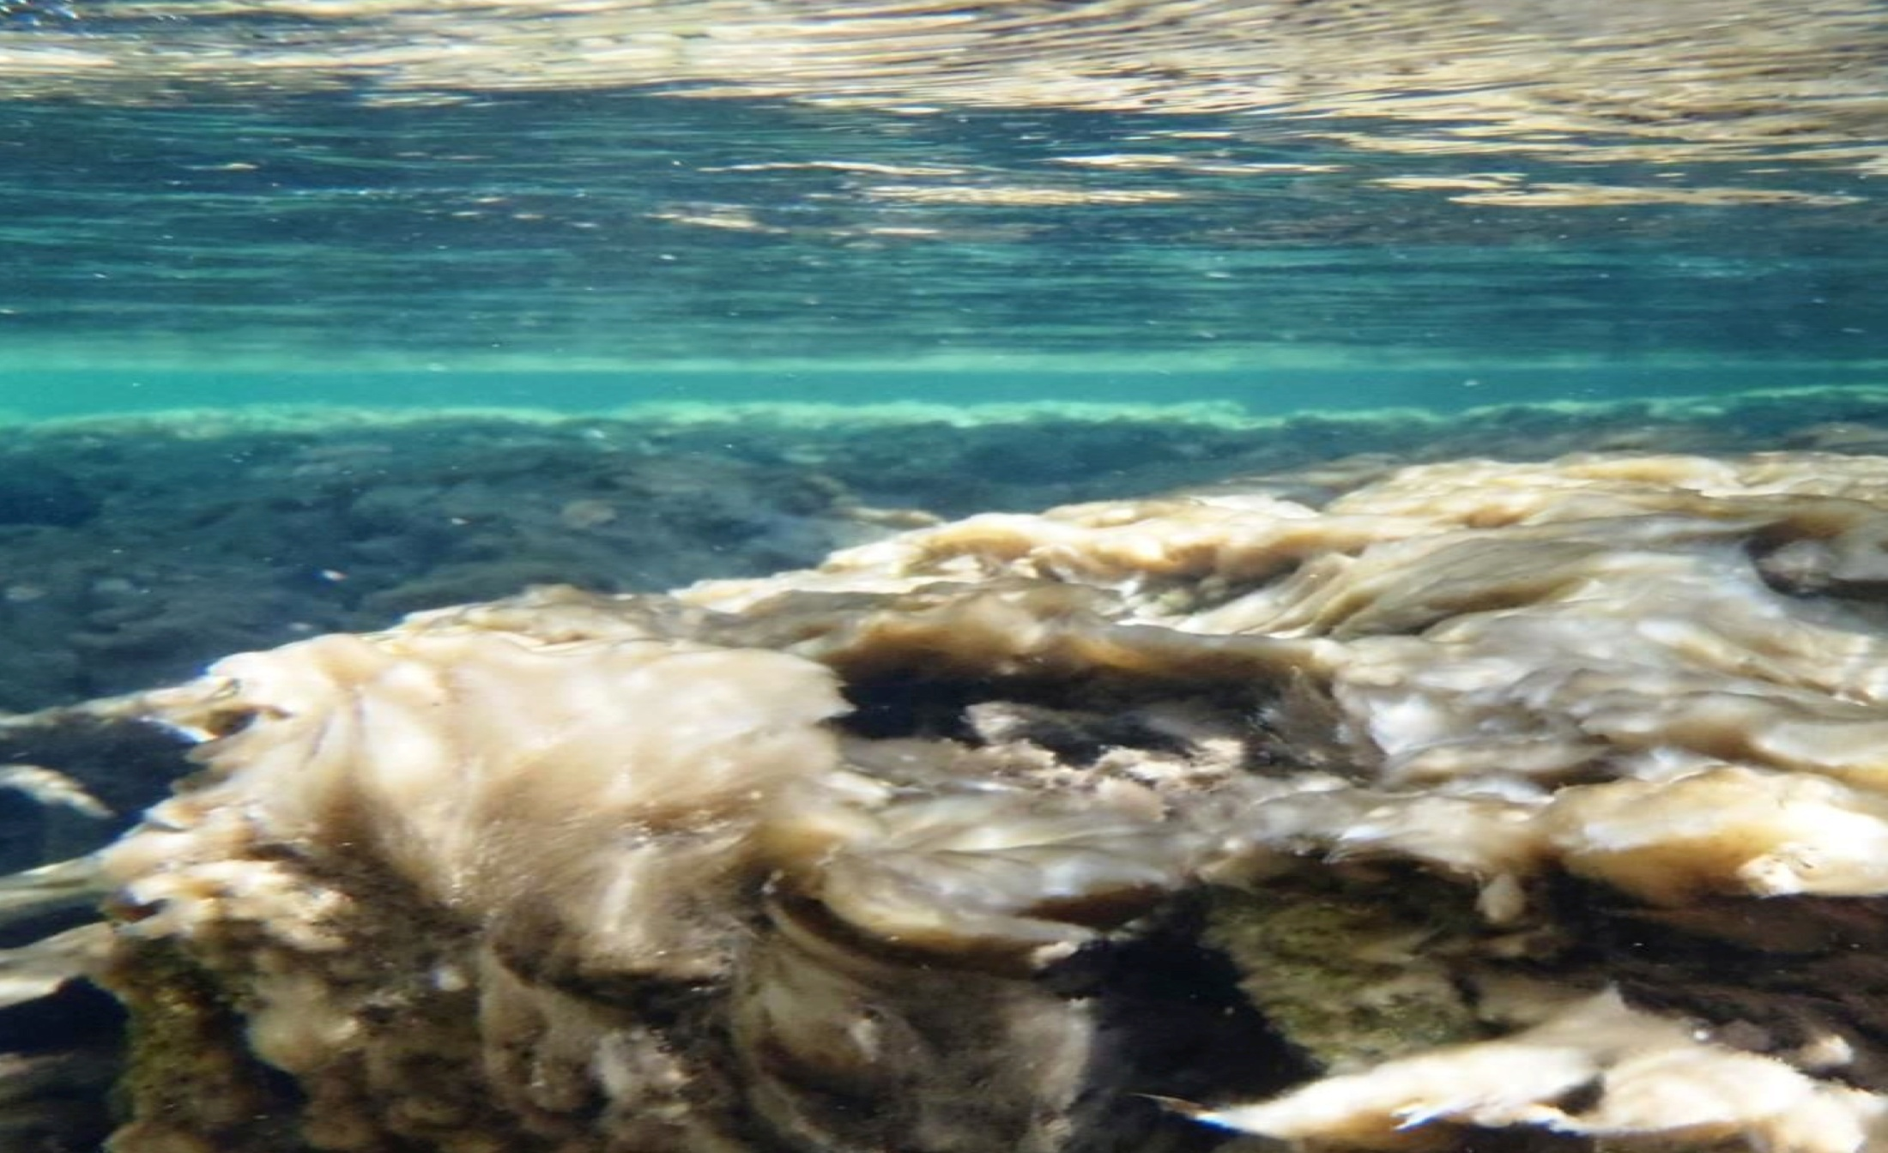
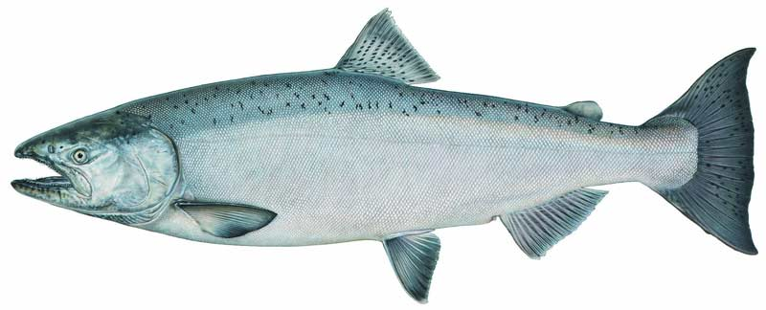

(‘Rock Snot’)
(Moore).
(Didymo (Rock Snot)).
The Dangers
(Invasive plants).
Clogged Gills
Blocks out sun’s energy
Whirling disease
Bugs
Decreases oxygen (when it decomposes)
Moves fish away from natural spawning range

Slide 16
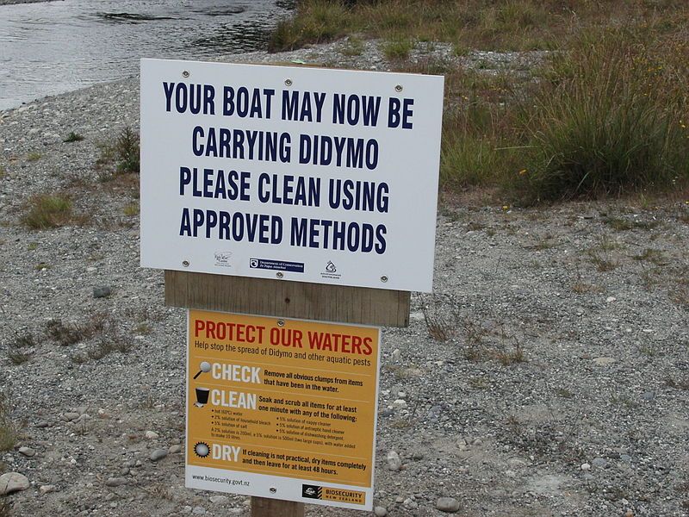
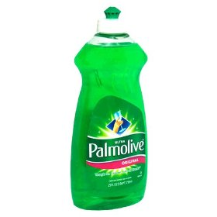
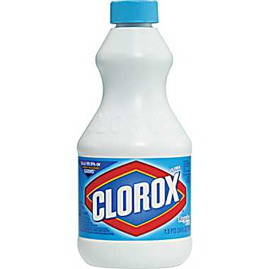
(‘Rock Snot’).
(Didymo/Didymosphenia).
(Invasive plants).
How to Clean Equipment
Didymo can survive up to 40 days out of the water; it does not simply rub off with a cloth .To ensure the didymo is diminished on the cellular level, scientists recommend that your equipment is cleaned with dish detergent or a household bleach then washing it through roughly in very hot water, of about 60 °C. Extremely cold conditions will also wipe out live didymo cells when the moisture from your boots or waders freezes

Slide 17
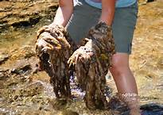
(Didymo/Didymosphenia).
Didymo is not lethal to humans and does not affect us the same way it does aquatic life but it can take a toll on our economy. Hydropower, recreational and occupational fishing and tourism are all affected when didymo blooms It also makes it impractical for swimming in the river in the summer time and to do any other water related activities.

Slide 18
Positions
Chase - Research on didymo and didymo extermination protocols should continue.
Sarah – If global warming is the cause, we should do more things to protect our environment.

Slide 19
Summary
It is a single-celled algae
Has been spotted in New Brunswick in the Restigouche and Upper Saint John River
Global warming suspected to be the cause
Poses a risk to fish, aquatic plants
Good conditions for whirling disease
Clean equipment with very hot water or very cold temperatures
Takes a toll on the economy
TAKE CARE OF THE ENVIRONMENT!

Slide 20
oxygen
Diatom
Matapedia
Chlorophyll
economy
Clog
Bugs
Didymosphenia geminata
Bleach
one
photosynthesis
Stalk
Microbes
equipment
globalwarming
Asia

