Slide 1
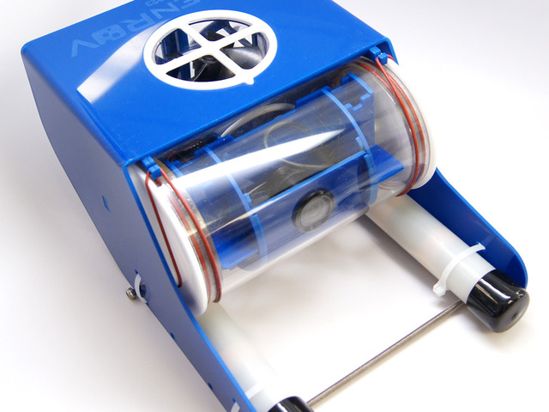
The Open ROV
Computer Science 110
Jonathan Ginnish

Slide 2
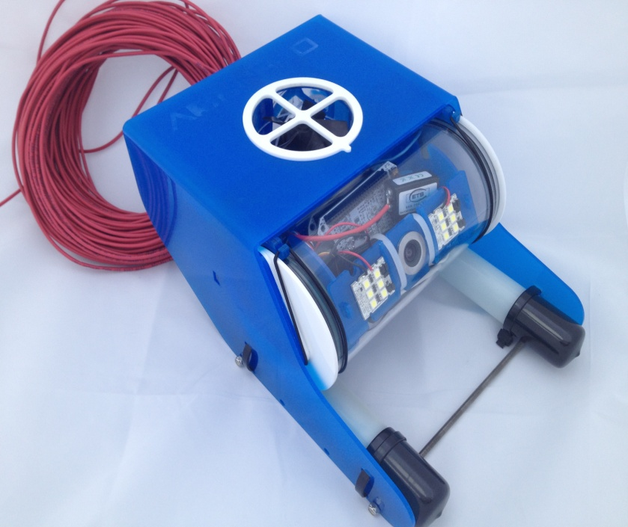
What Is It?
The Open ROV is a low-cost tele robotic submarine built with the goal of making underwater exploration and education affordable.

Slide 3
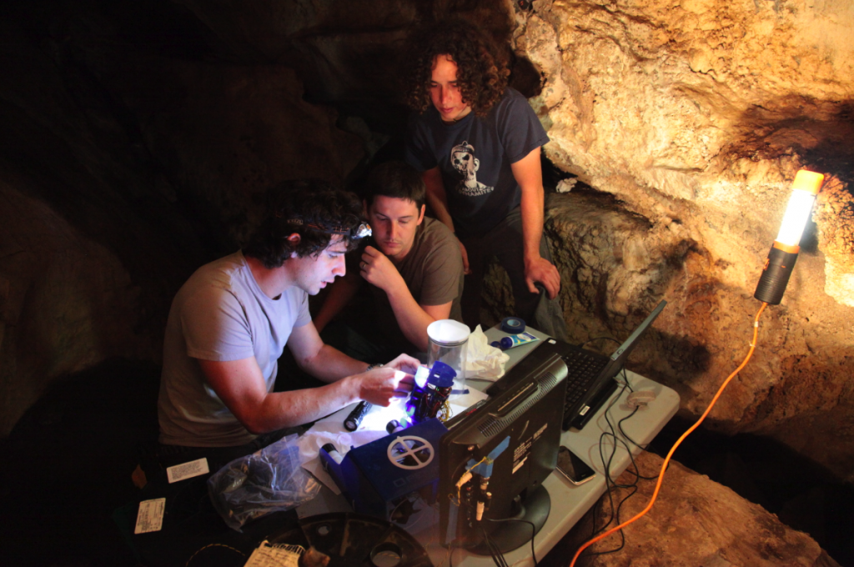
Developers?
The developers of the machine are David Lang, Eric Stackpole, Matteo Borri and DIY community.

Slide 4
Background Information
The idea to build OpenROV was pioneered by Eric Stackpole, an engineer at NASA at the time, to discover whether the legend about the hidden treasure of the Hall City Cave was true. David Lang, a self-taught sailor from Minnesota, heard about Stackpole building a small, cheap, and robotic submarine in his garage to search for the gold and became inspired to join. Matteo Borri designed and built the electronics, software and motor system for a prototype presented at the World Maker Faire in 2011. Lang and Stackpole co-founded OpenROV as an open-source hardware project, a startup, and a DIY community.

Slide 5
What It Consists Of?
Is consists of a Linux operating system, the power is run on 8 C batteries and the memory is a 256 MB chip. It has a HD USB webcam and two bright LED lights on a servo-tiltable platform. Lastly, its connection comes from a 10 Mb Ethernet data tether.

Slide 6
The Dimensions
The Open ROV’s length is 30 centimeters, height is 20 centimeters and width is 15 centimeters. It also weights in at 2.5 kilograms which is about 5.5 pounds.

Slide 7
Did You Know?
Did you know that the Open ROV stands for Open-source remotely operated vehicle? And that as of 2012, 118 units have been sold around the world? There has been even more sold in the year of 2014 but one of the many sold are in our very own Computer Science 110 class at Miramichi Valley.

Slide 8
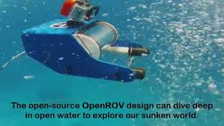
Possible Dive Site?
The Open ROV is a great rig to have at M.V.H.S. I, as student look forward to making adjustments to the vessel and finding a great dive site to test it at!!

