Slide 1
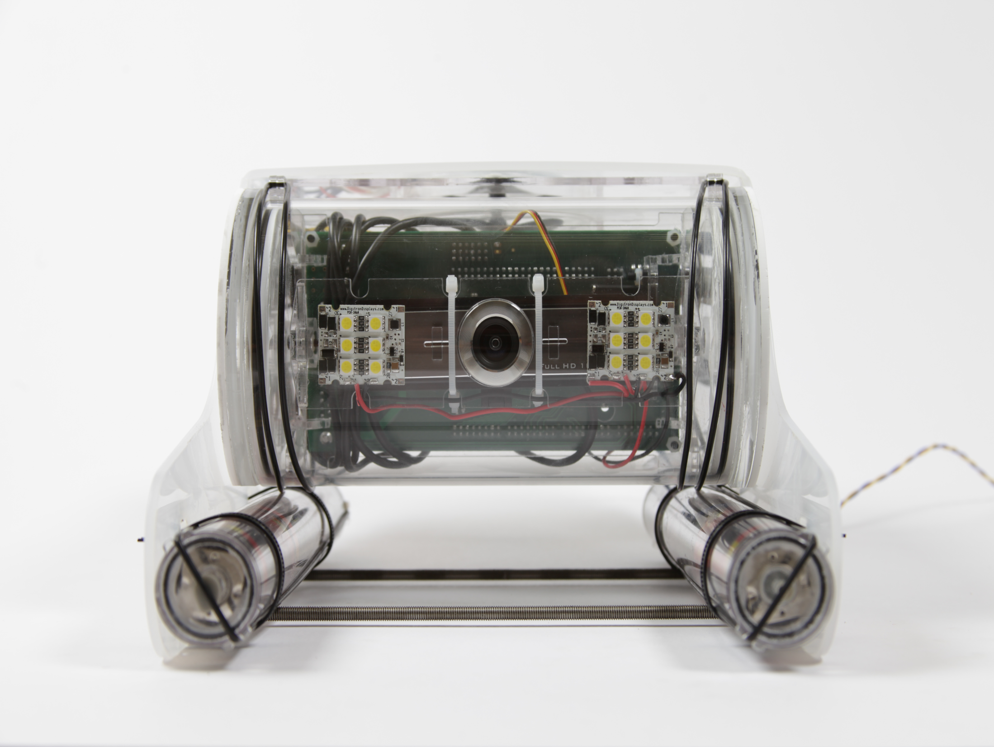
Under Water Robots on The Miramichi
Possible location for dive site
By : Julia Wierzchoslawska

Slide 2
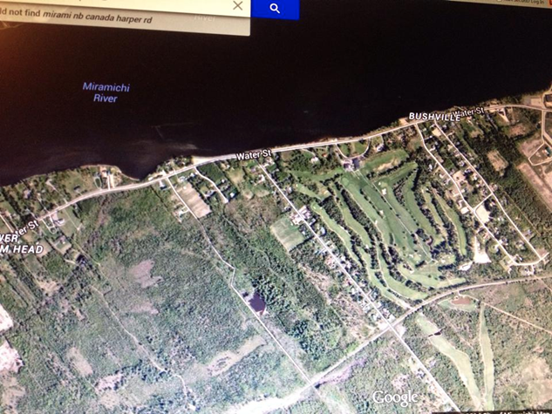
Location
Body of water(I’m not really sure what to call it) is located about a 7 minute walk from my house. Which is 96 Harper Rd , in Bushville right by Water street.
Body of water
My house

Slide 3
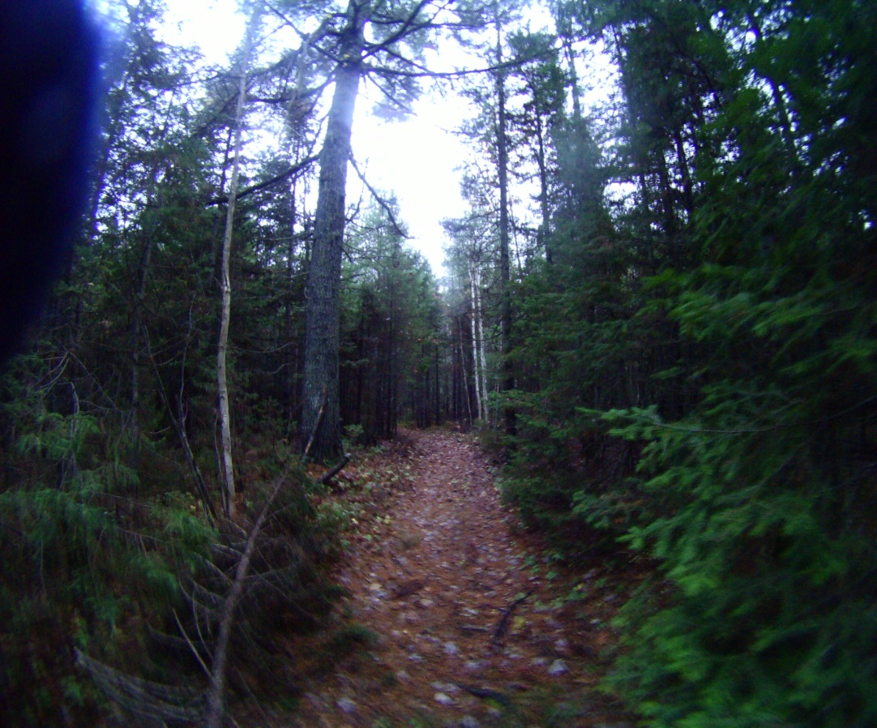
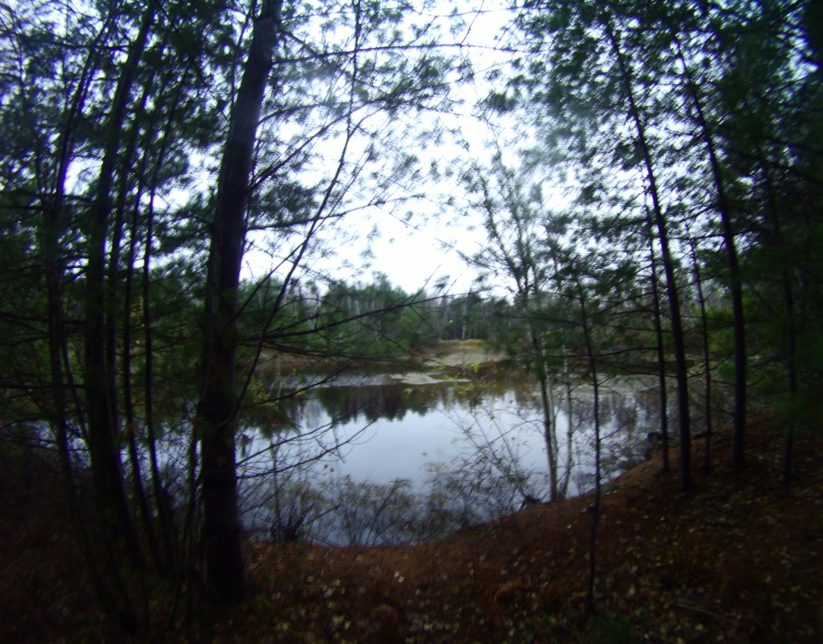
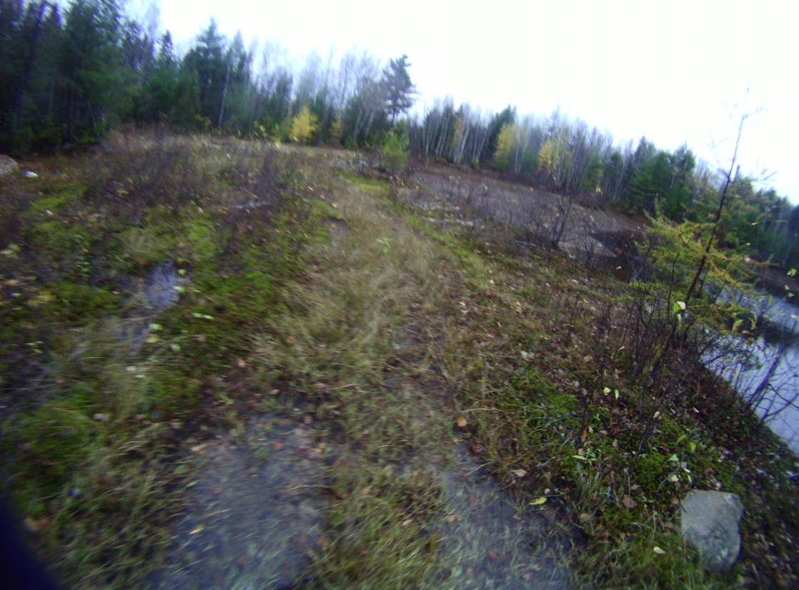
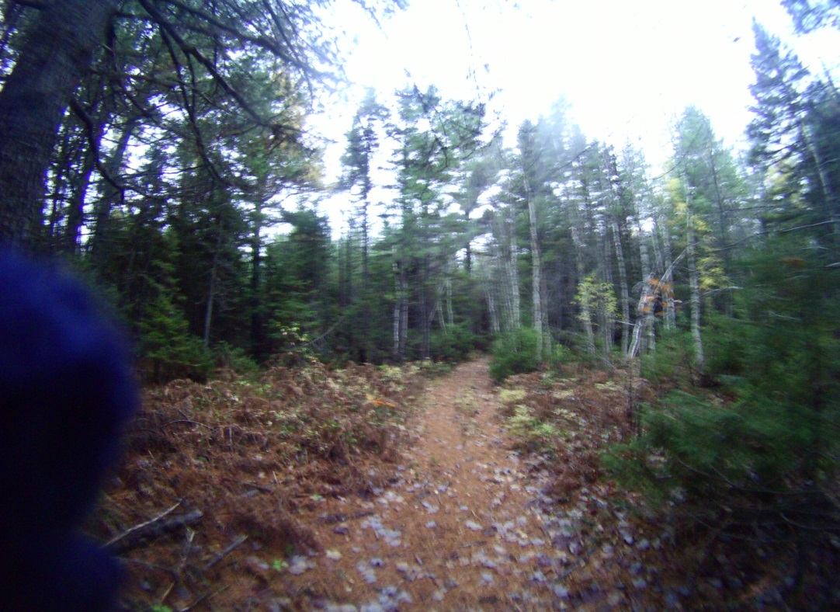
The Walk
The Walk

Slide 4
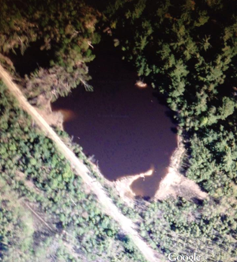
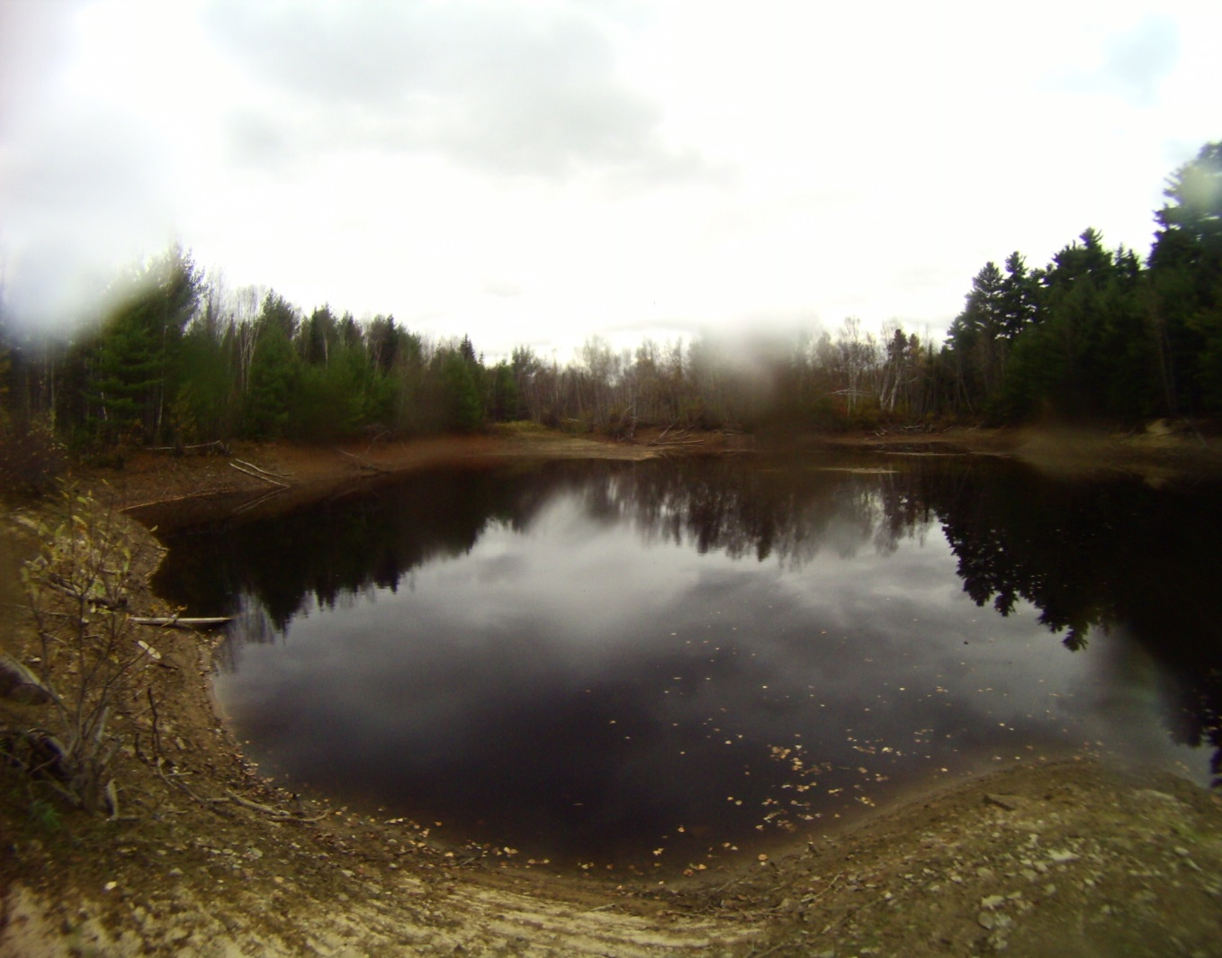
Dive Site

Slide 6
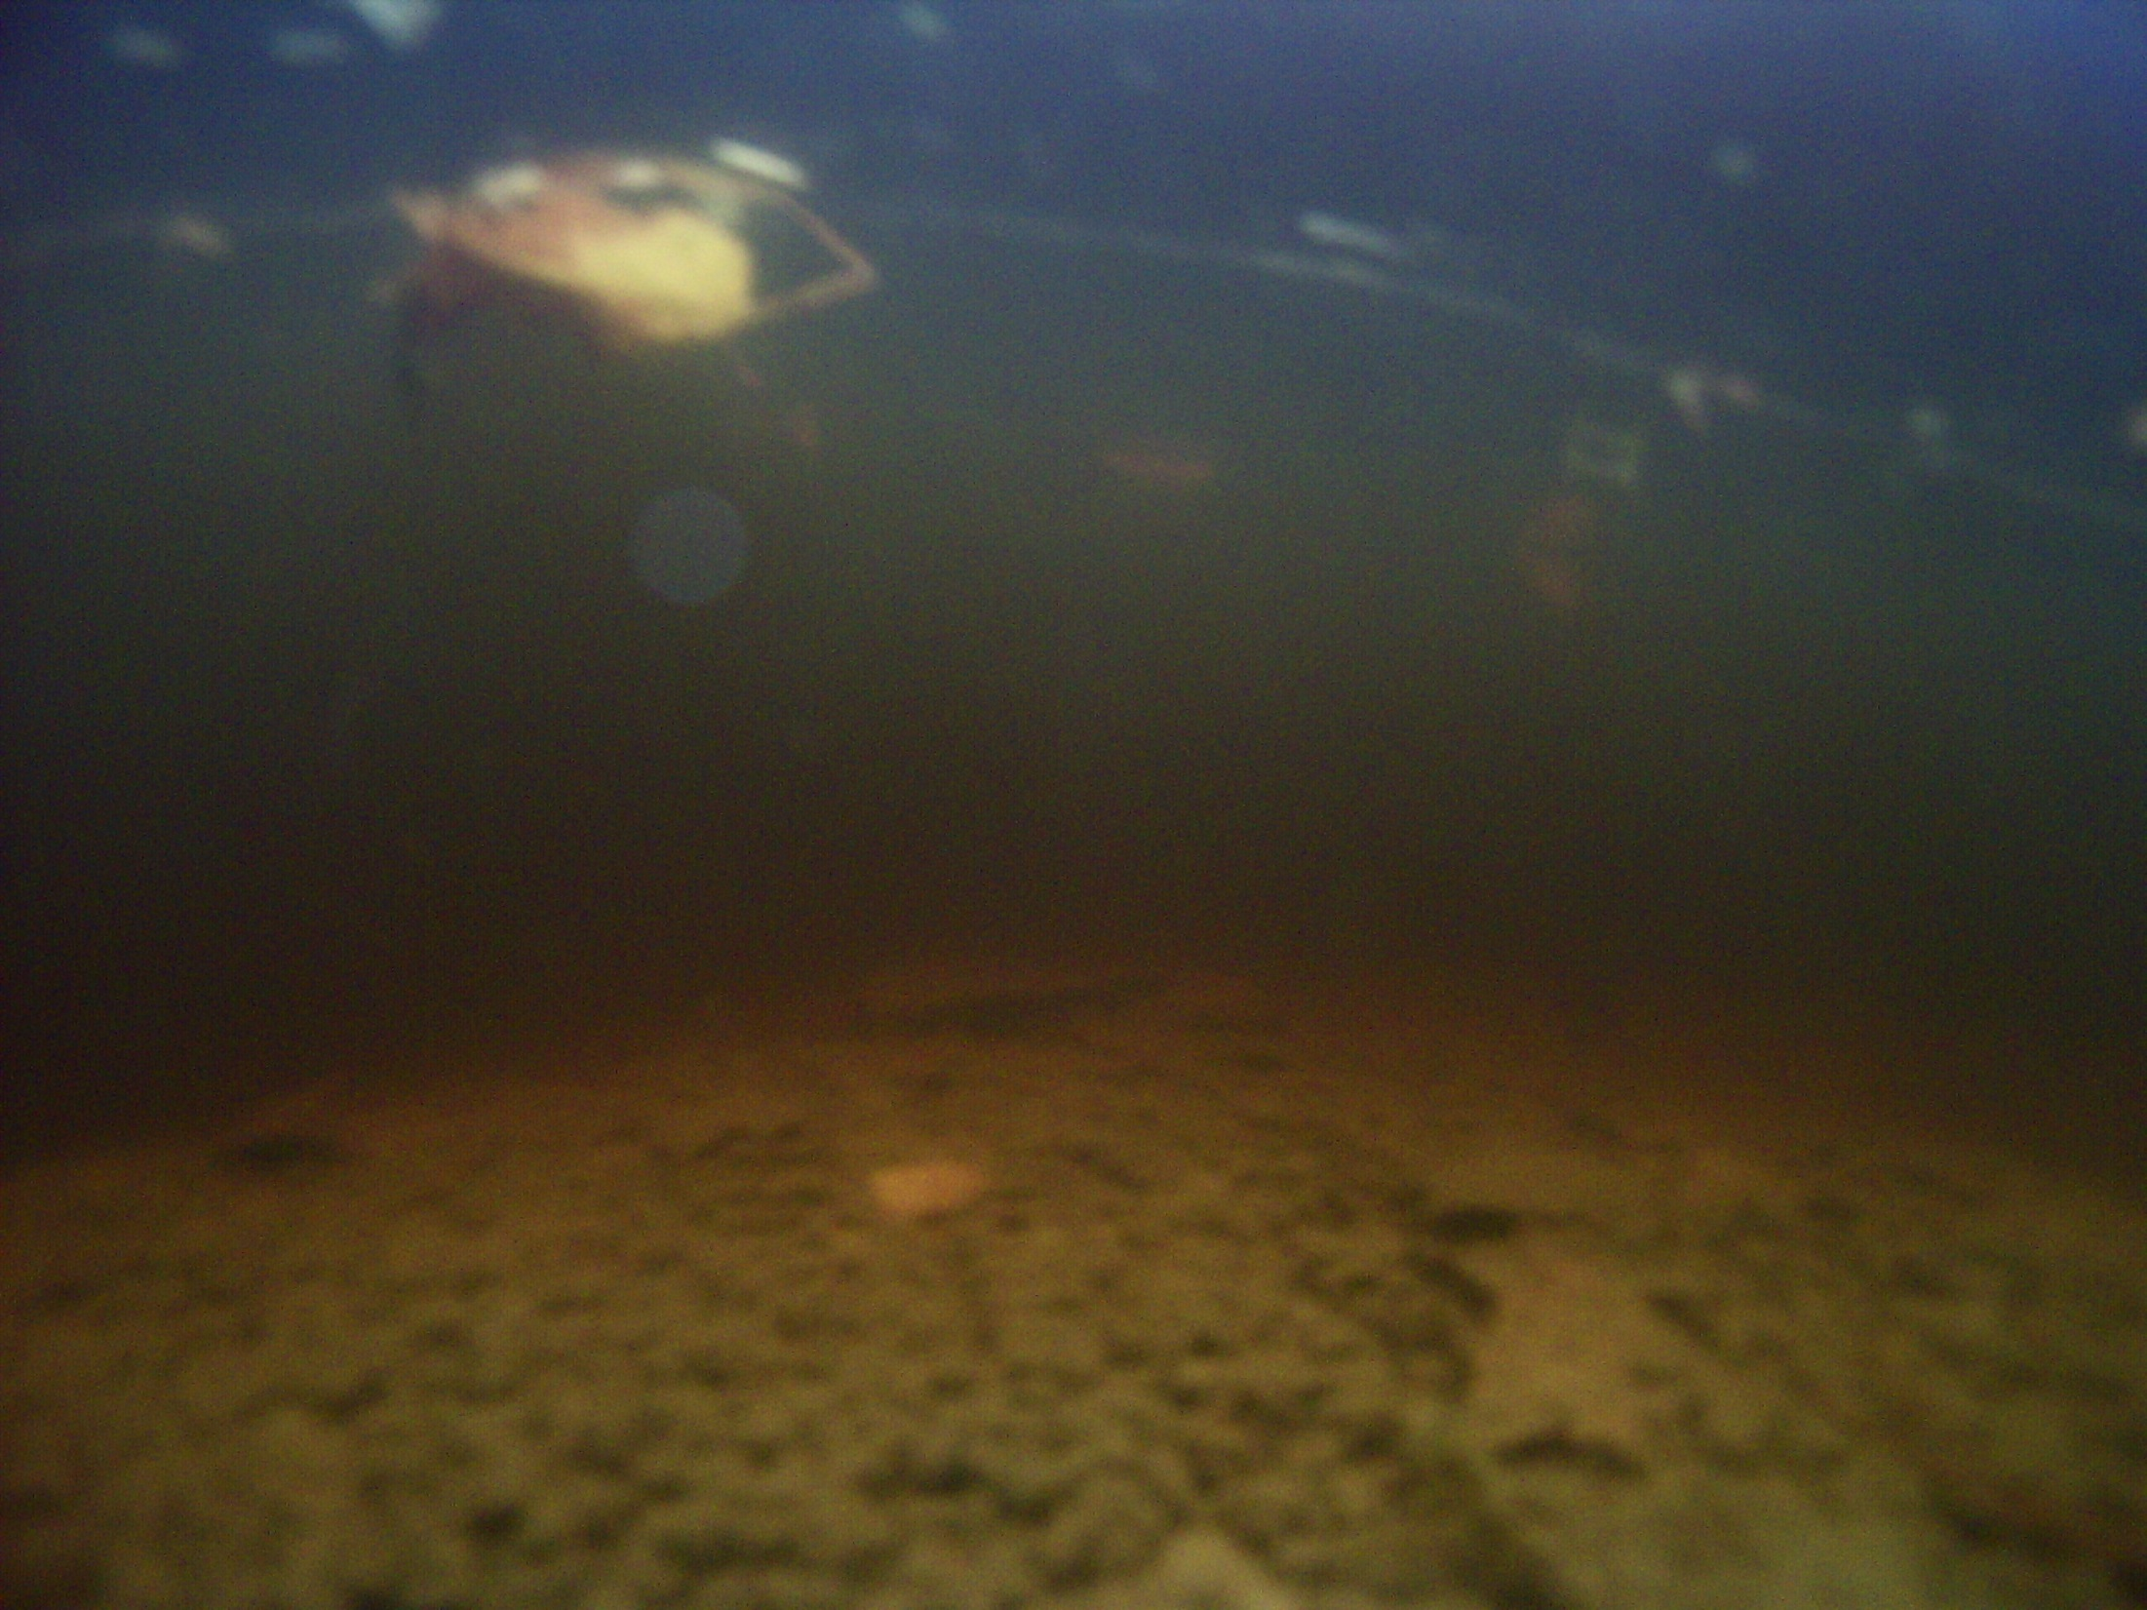
Water Condition
The water is completely still, and would be easy to maneuver the robot in. But the downside is that the water lacks clarity. We would most likely have to somehow accommodate additional lighting to the robot or the dive site.

Slide 8
Observations
One of my observations is that the ground around the water and in it is partly made up of clay.
I'm not really sure if there's any life in the water.
There used to be beavers living there, but I haven't seen them in a while.

Slide 9
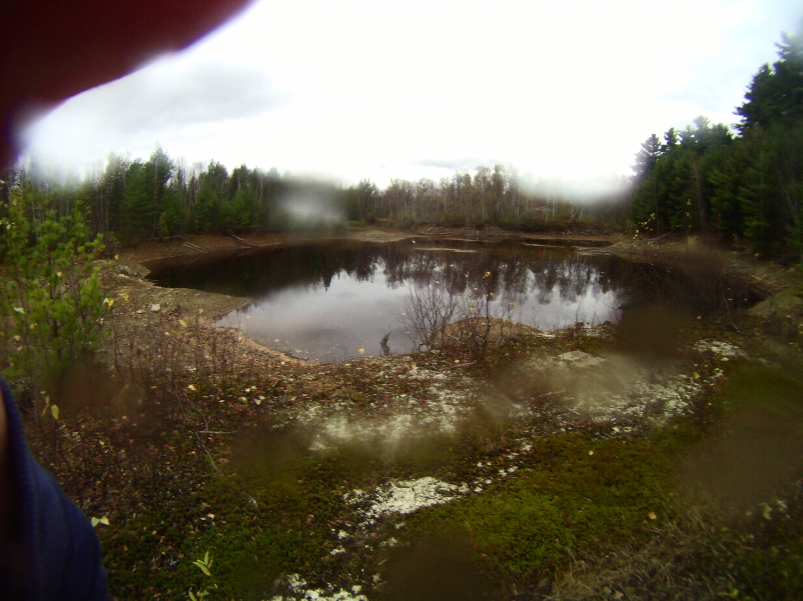
Bringing the robot to explore the water would be pretty cool. There is no current and we would get to find out if there is any life underwater. The only problem would be lighting and maybe the soil. It would be good place to test the robot because I really don’t think the waters to deep either. So all in all I don’t think it’s the worst choice or the best.

