Slide 1
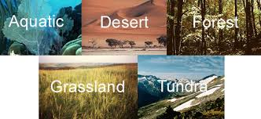
Biomes of The World

Slide 2
What is a biome?
A biome is a place on earth that has the same climate, plant life and animal life over a vast area of land.
There are five major biomes in the world: aquatic, desert, forest, grasslands and tundra.

Slide 3
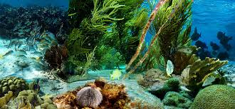
Aquatic
Water covers nearly 75 percent of the earth's surface making it the worlds biggest biome.

Slide 4
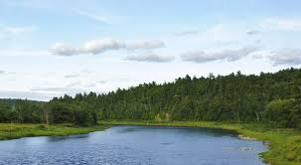
The Miramichi River

Slide 5
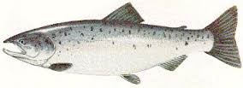
River System
The Miramichi river system is an example of an aquatic biome.
It supports many different types of life including the most popular species the Atlantic Salmon!
The river also has over 18 Tributaries.
A tributary is a branch off of the river like smaller rivers or streams.
Male or Female?

Slide 6
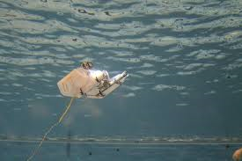
Under Water Robots

Slide 7
https://www.youtube.com/watch?v=rBJ0H4UPgzQ
https://www.youtube.com/watch?v=so9E9DAGEAo

Slide 8
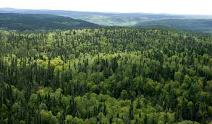
Forest

Slide 9
Approximately 85% of New Brunswick's land base is productive forest, providing wildlife habitat, landscape, recreational opportunities, and high-quality water and air. Forestry is the economic backbone of the province, directly employing 16,000 people, with wages of more than $500 million annually.

Slide 10
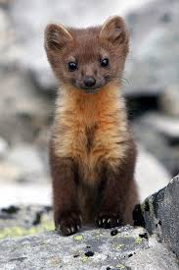
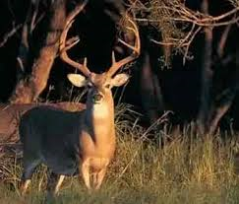
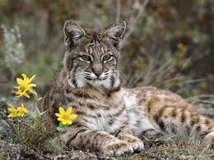
Wildlife
?? ?? ??

Slide 11
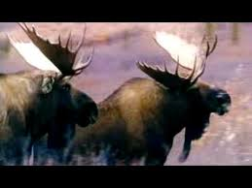
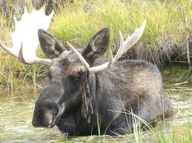
MOOSE!
There are two types of moose commonly found in New Brunswick they are the Ridge Moose and the Swamp Moose. The Ridge Moose’s antlers run out from its head and have white legs. A Swamp Moose’s antlers run towards its back.
Ridge moose? Or Swamp Moose?

Slide 12
https://www.youtube.com/watch?v=HT7rjtCEo9w

Slide 13
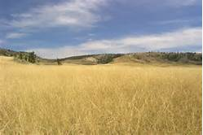
Grasslands
Grassland biomes are large, rolling terrains of grasses, flowers and herbsThere are two different types of grasslands; tall-grass, which are humid and very wet, and short-grass, which are dry, with hotter summers and colder winters than the tall-grass prairie.

Slide 14
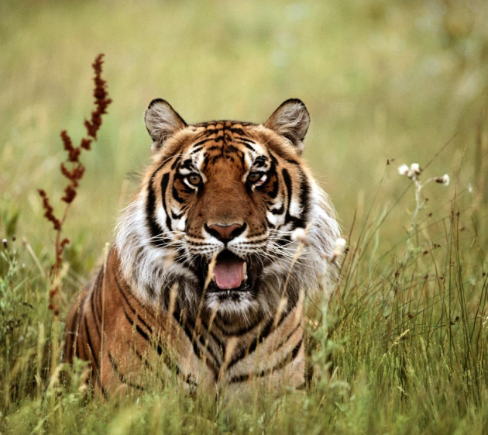
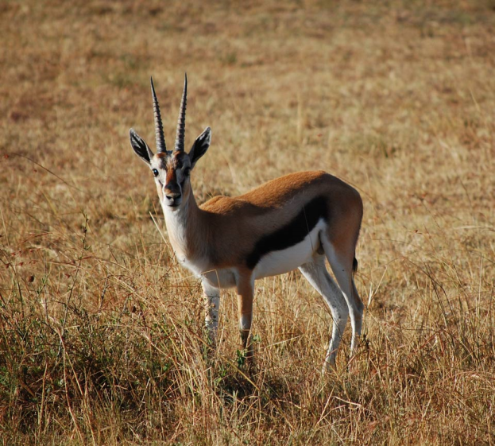
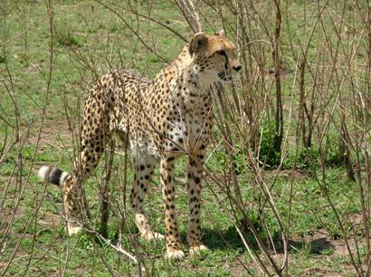
Animals of the Grassland!
?? ?? ??

Slide 15
https://www.youtube.com/watch?v=_4jqcw-1pYA

Slide 16
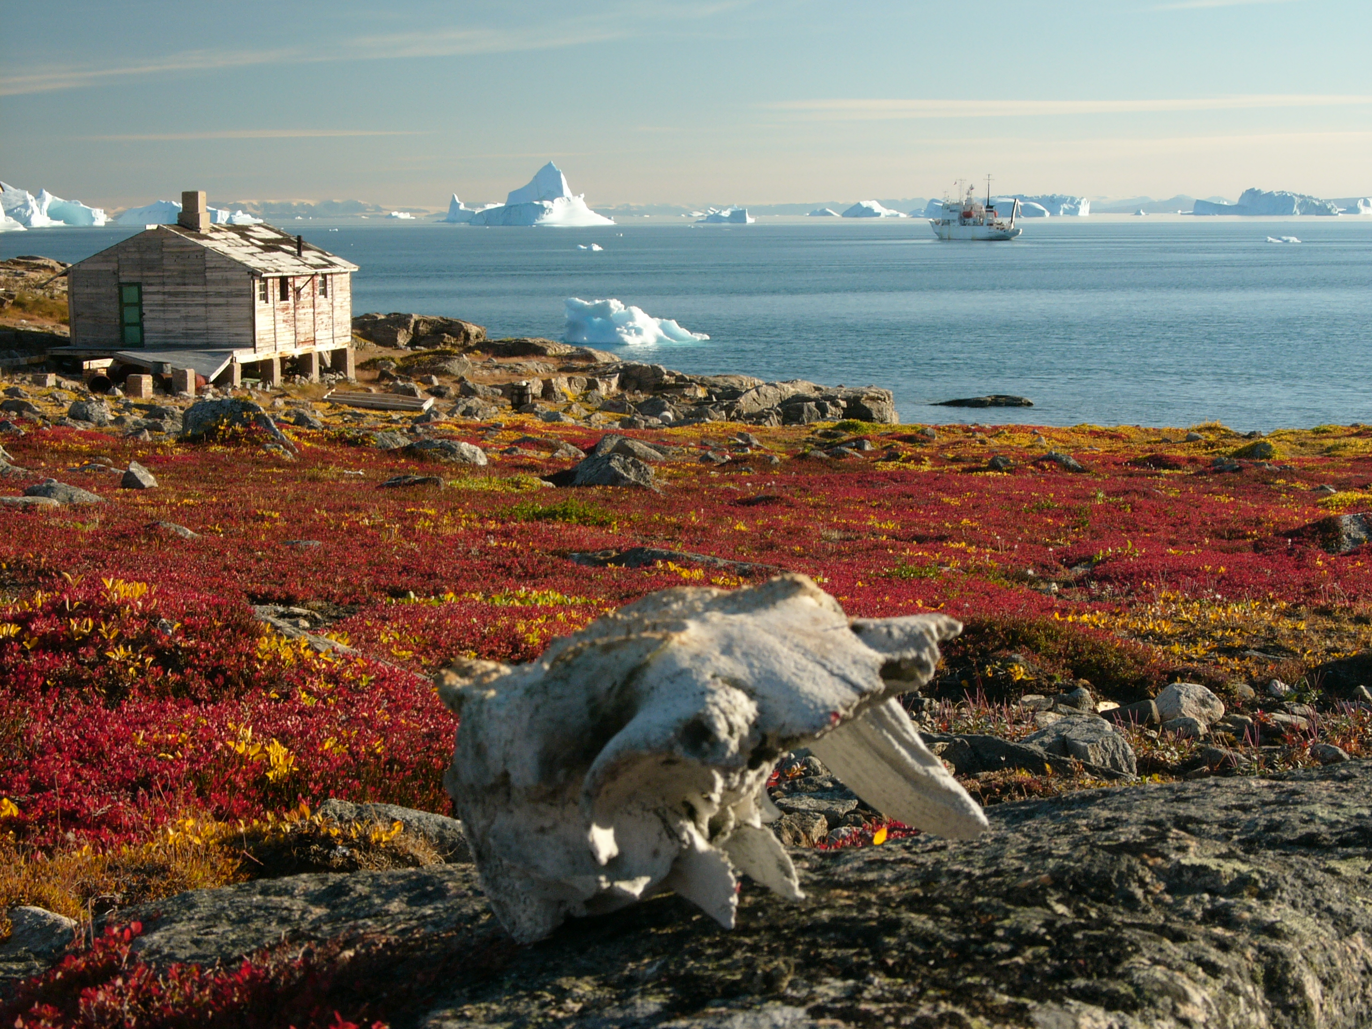
Tundra

Slide 17
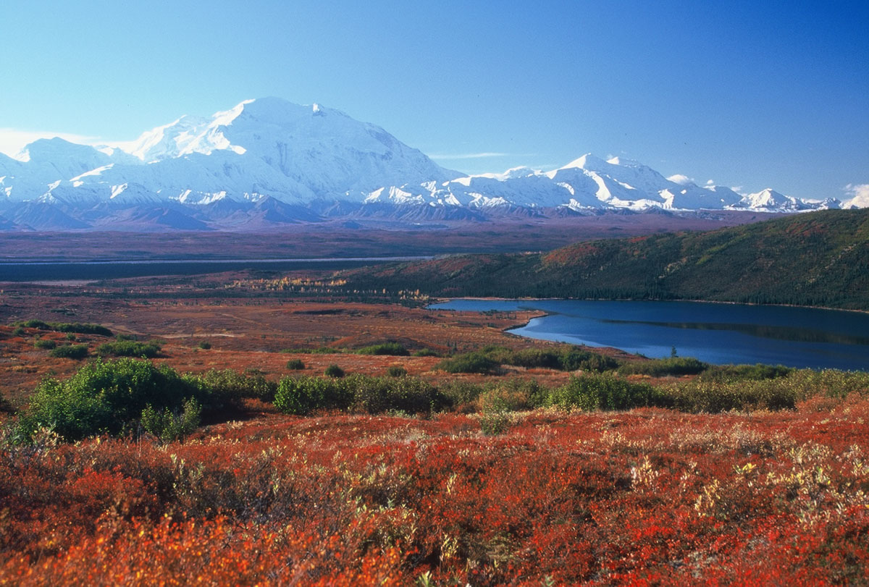
What is the Tundra
The tundra biome is the coldest of all biomes. It is also quite big. The tundra covers about one fifth of the land on earth. The word tundra comes from a Finnish word that means treeless plain, which is a good description of the biome. very few plants grow in the Tundra and there are almost no trees.

Slide 18
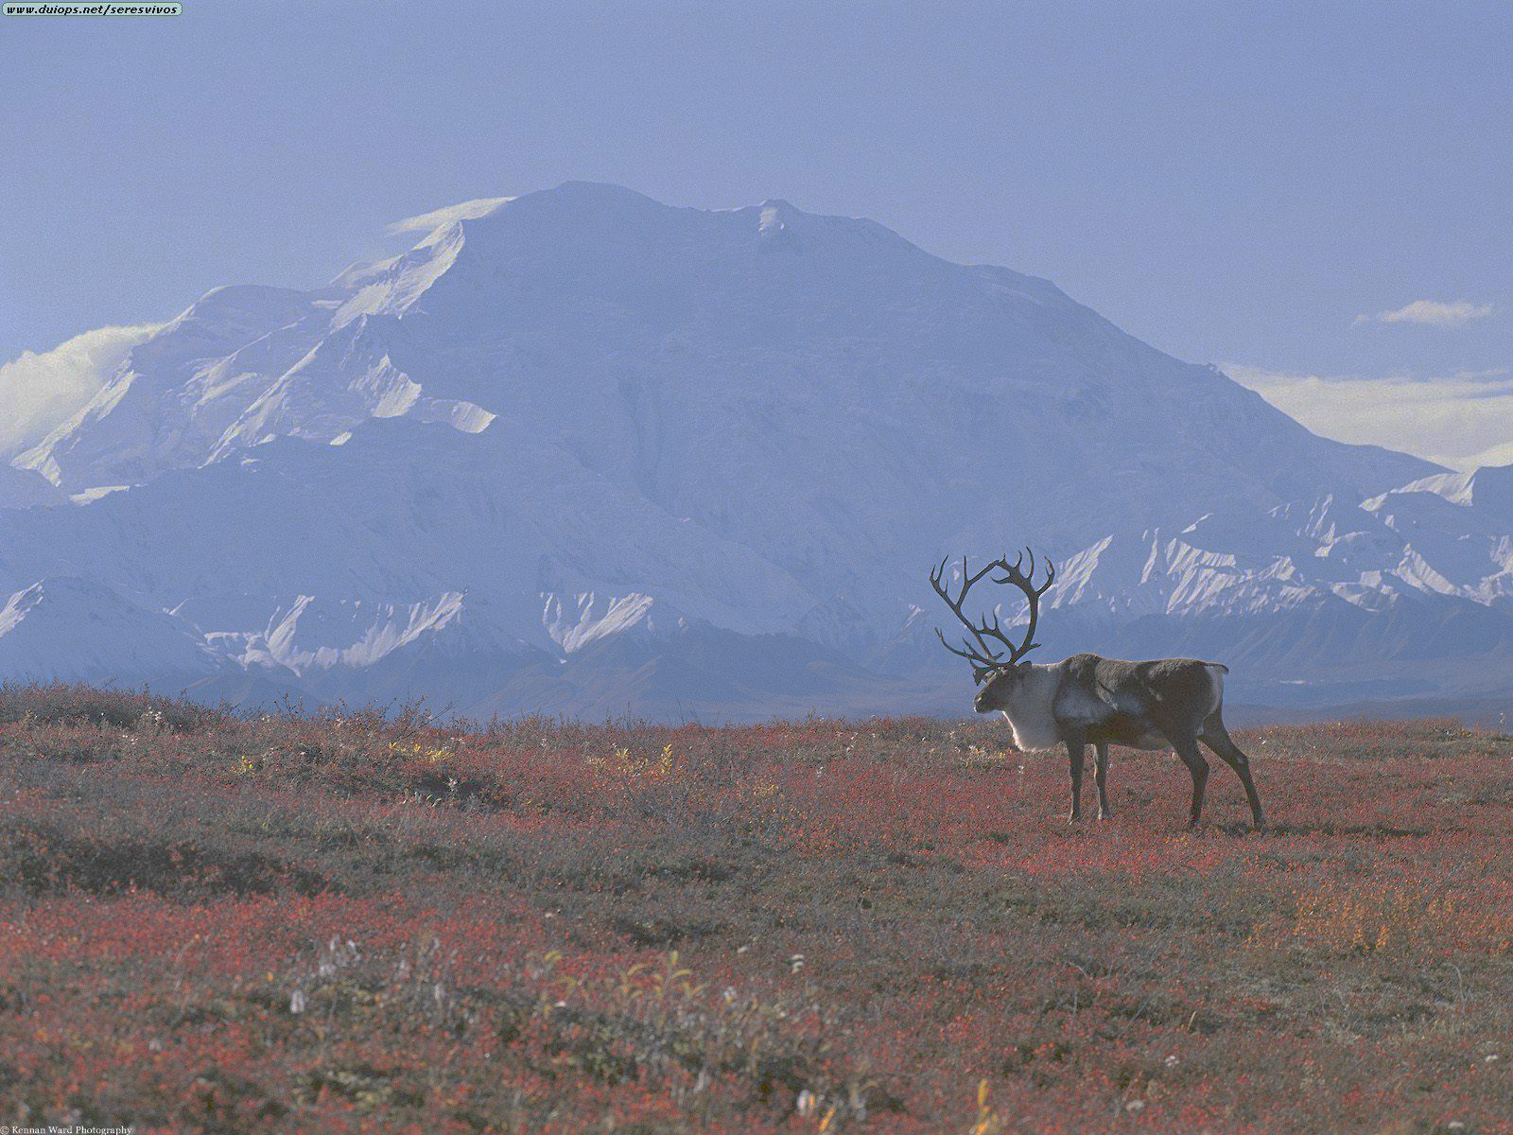
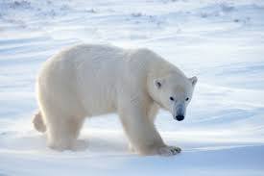
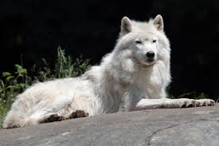
Animals of the Tundra
Animals of the tundra have to be tough to survive. If they live in the artic they usually adapt to their environment by getting a white coat of fur to blend in!

Slide 19
https://www.youtube.com/watch?v=4b91MGt-Bg4

Slide 20
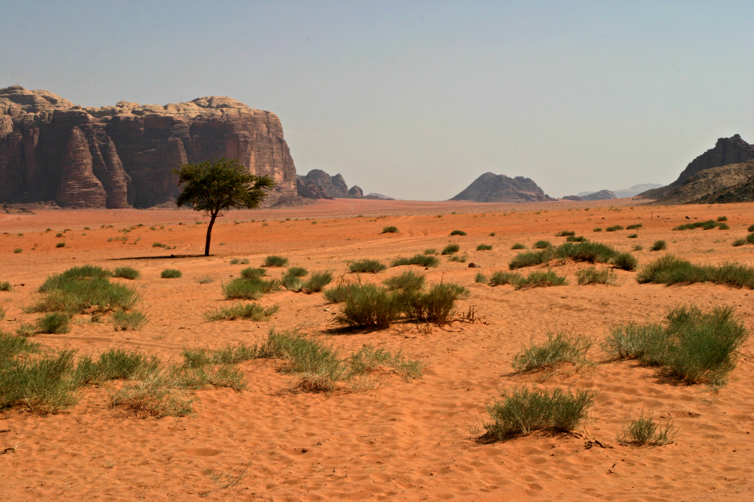
The Desert

Slide 21
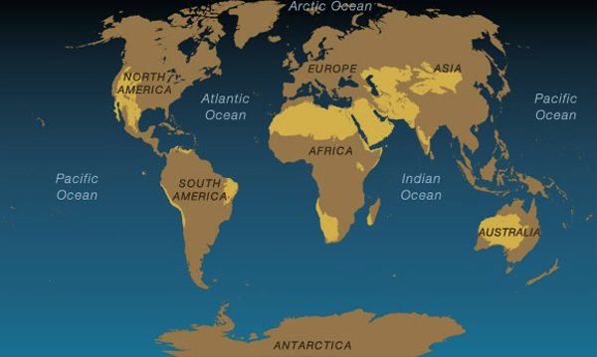
Where is the Desert
Deserts cover about one fifth of the Earth's surface and occur where rainfall is less than 50 cm/year. Although most deserts, such as the Sahara of North Africa and the deserts of the southwestern U.S., Mexico, and Australia, occur at low latitudes.

Slide 22
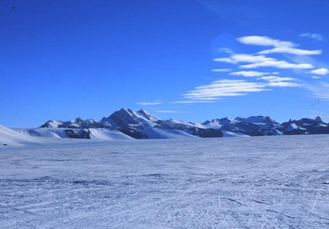
A Frozen Desert??
Did you know that a desert doesn’t always have t be this hot dry place that most of you think it is? It can actually be freezing up to -50 degrees! All desert means is that the land is very desolate which means no trees, very harsh, no plant life and very where very few animals can survive, an example of this would be the north pole or Antarctica!

Slide 23
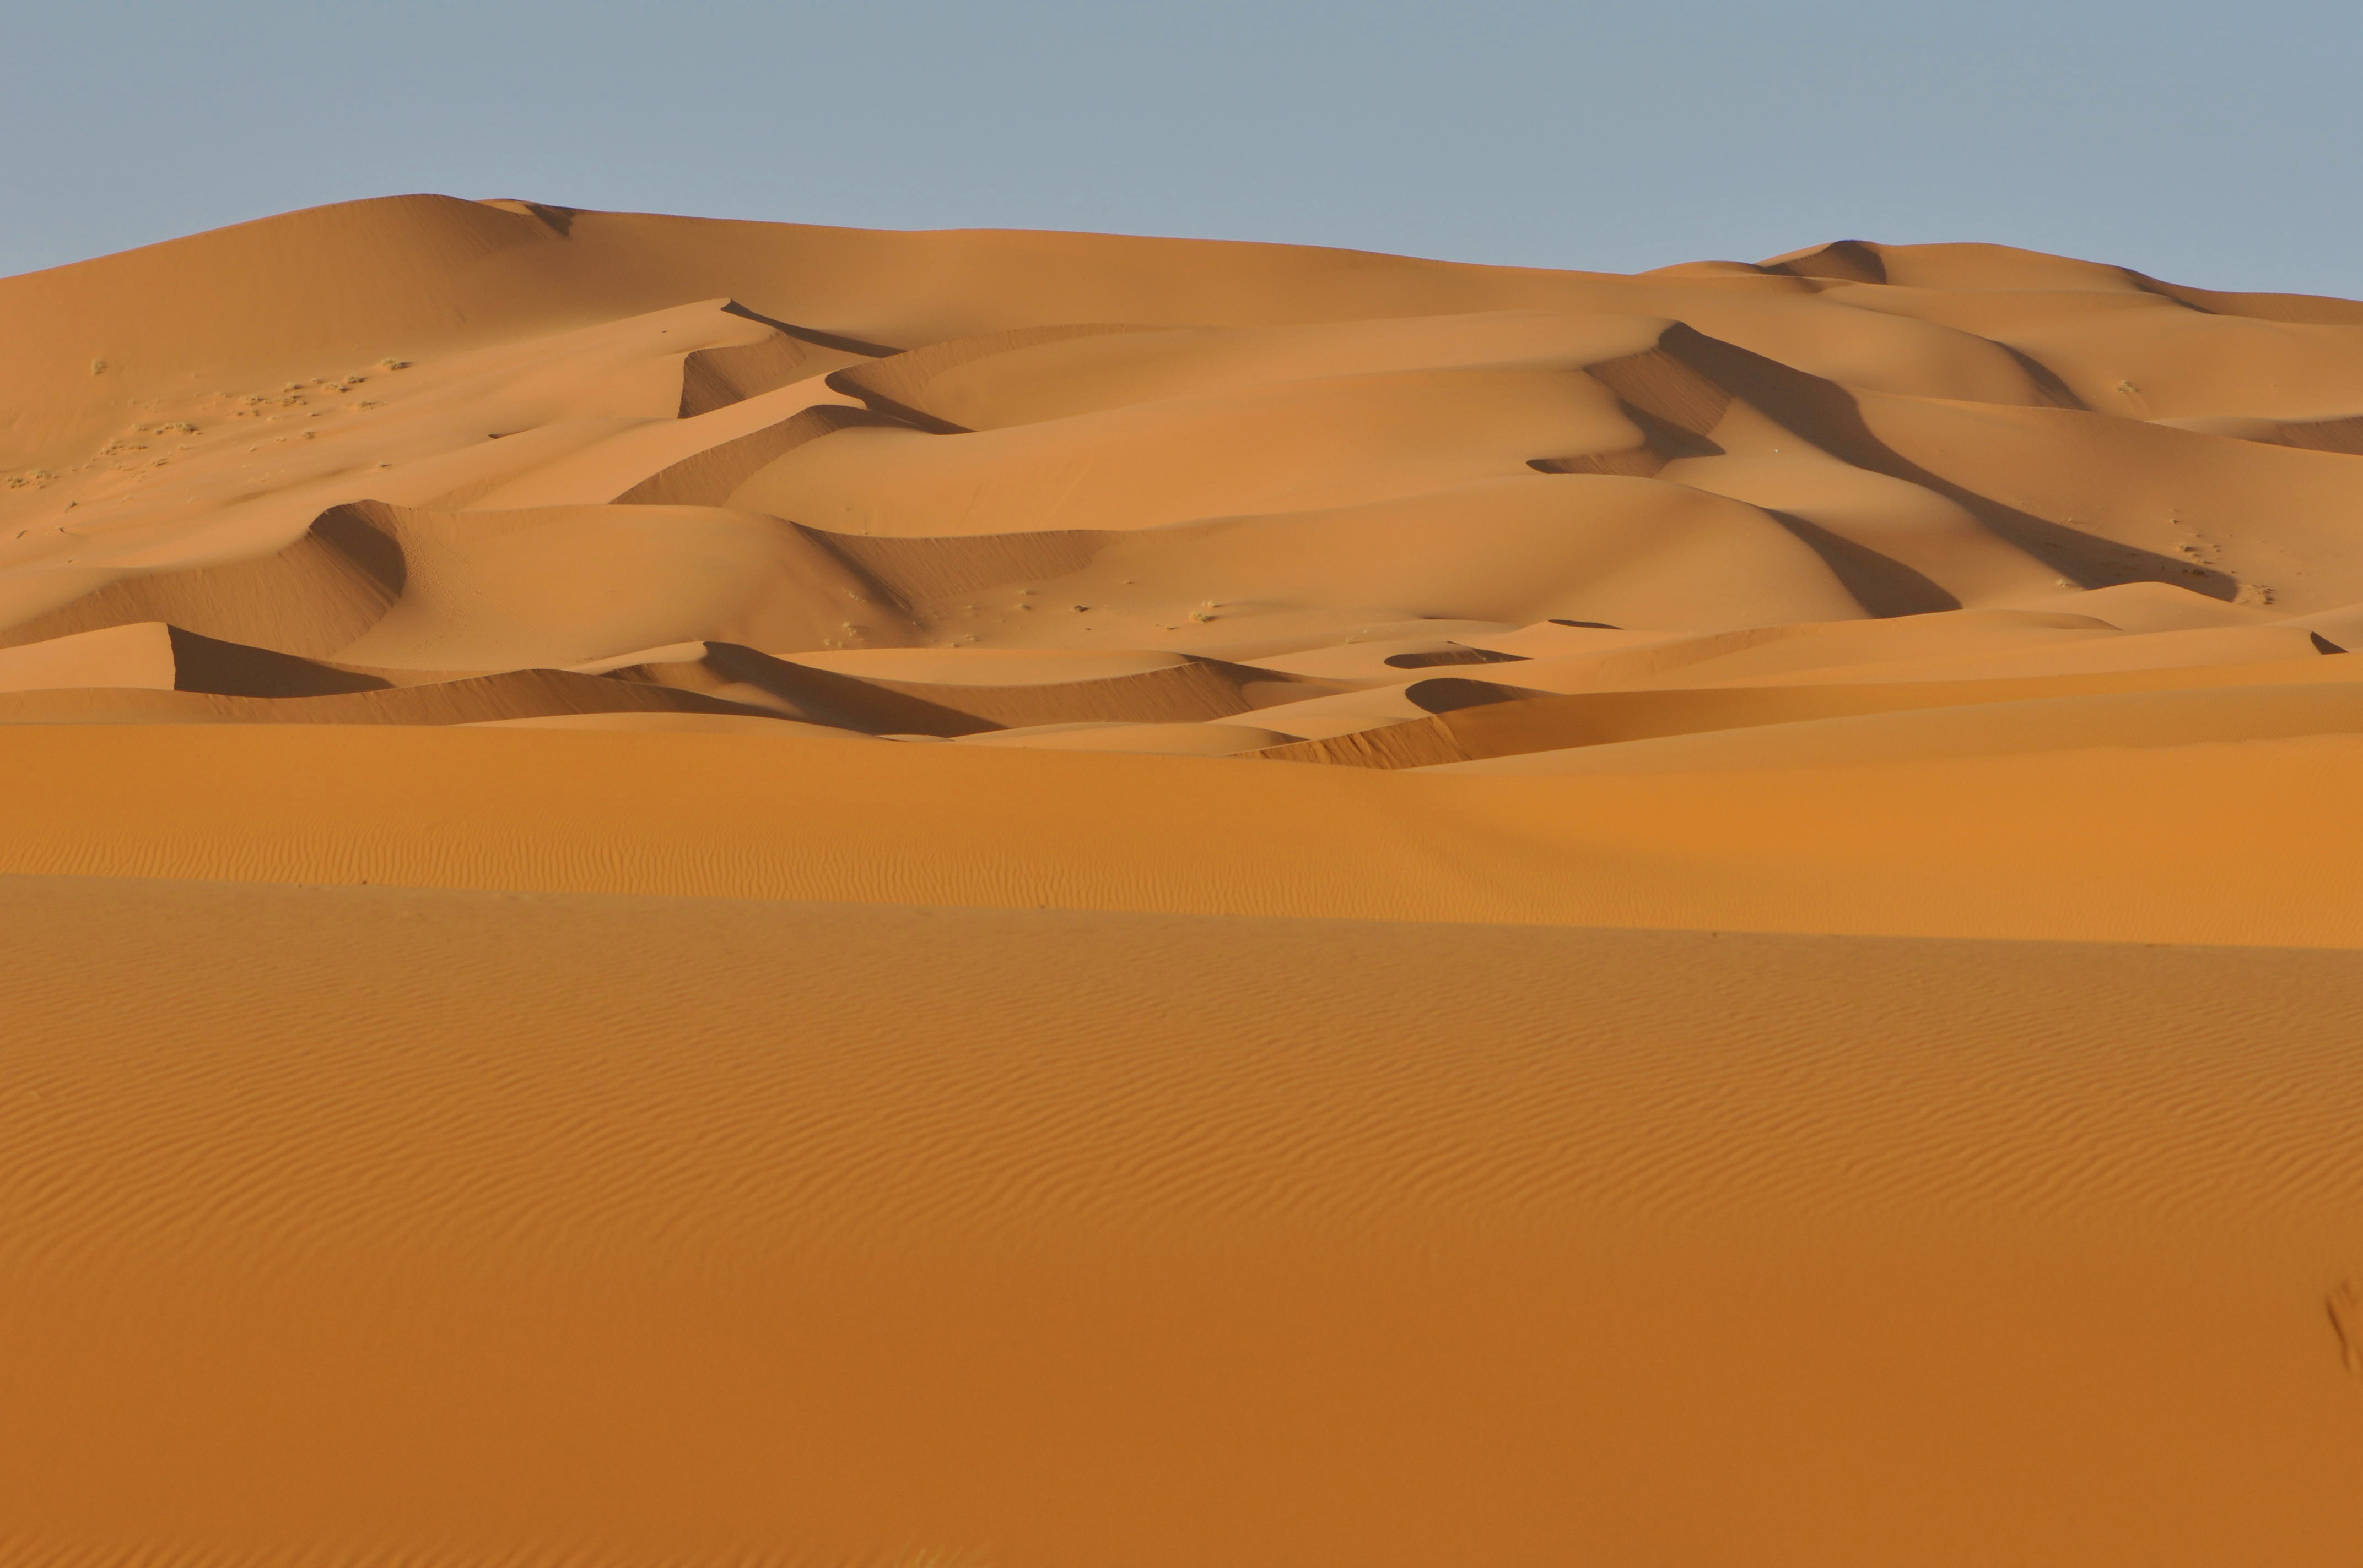
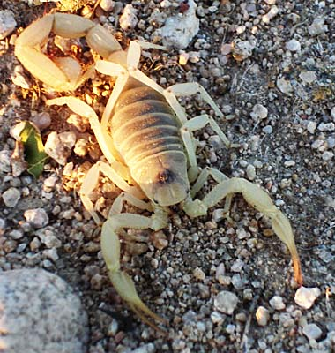
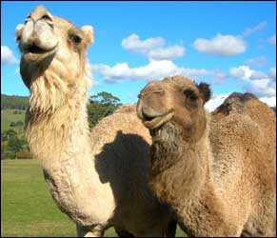
Animals of the Desert

Slide 24
https://www.youtube.com/watch?v=5scAt0hasIg

Slide 25
Thank you!
By:
Megan
&
Caleb

