Slide 1
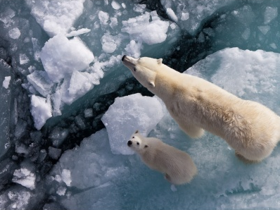
Global warming

Slide 2
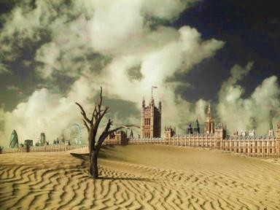
Global warming is the increase of the Earth’s average surface temperature due to greenhouse gases, such as carbon dioxide, which trap heat that would otherwise escape.

Slide 3
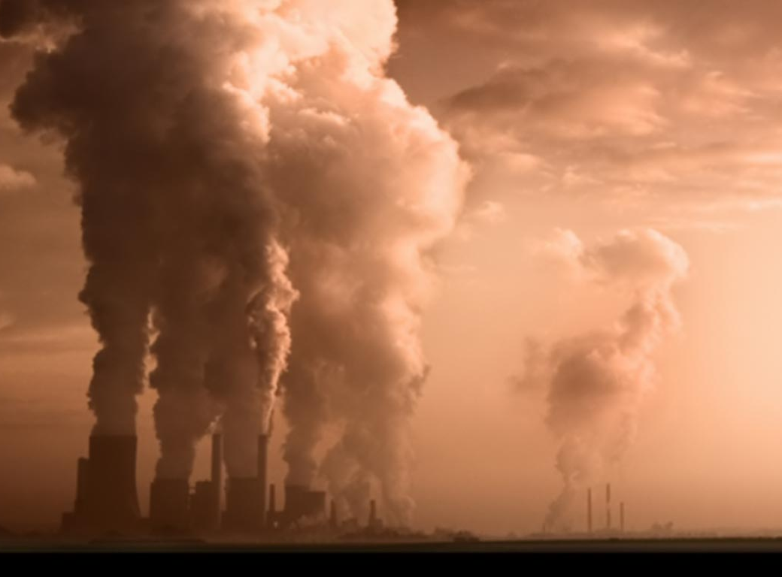
The burning of fossil fuels has been labeled the leading cause of global warming, due to the increased emission of carbon dioxide in the last 30 years.
A group of 1300 scientific experts from countries all over the world have concluded that there is a better than 90% probability that human activities over the last 250 years have warmed the planet.

Slide 4
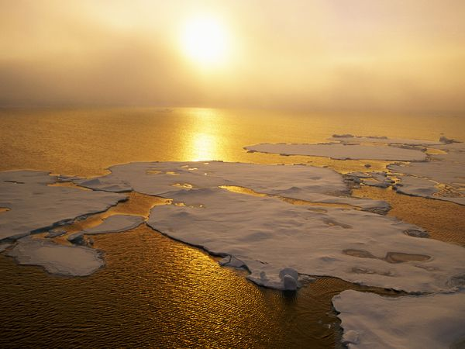
Greenhouse gas levels are higher now than they have been within the last 650 000 years.
Climate temperatures are changing at a pace so rapid that animals are unable to adapt, and are dying as a result.
Eleven of the twelve hottest years have occurred within 1995 and 2006.

Slide 5
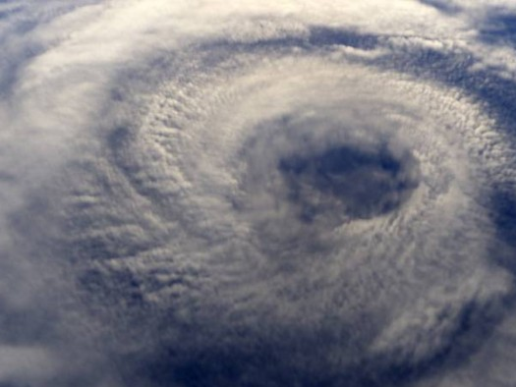
Research indicates that sea levels worldwide have been rising at a rate of 0.14 inches per year since the early 1990’s.
There is more carbon dioxide in the atmosphere today than at any point in the last 800,000 years.

Slide 6
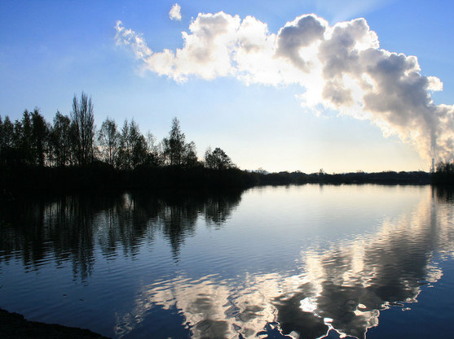
40% of the 6 billion tons of carbon dioxide emitted by the United States comes from power plants alone.
Emissions such as carbon dioxide, nitrous oxide and other greenhouse gases are unable to be removed for many decades.

Slide 7
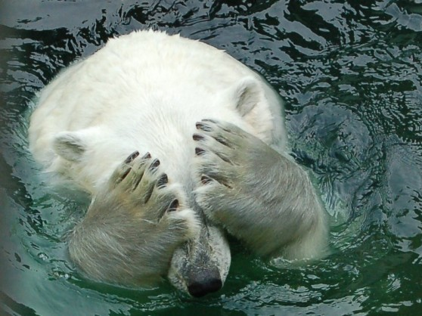
Since the early 20th century, the surface temperature of Earth has risen by 1.4 degrees Fahrenheit.
After samples were taken from the Antarctic core, it was revealed that levels of methane and carbon dioxide have increased by 38% and 148%, since the 1750s.

Slide 8
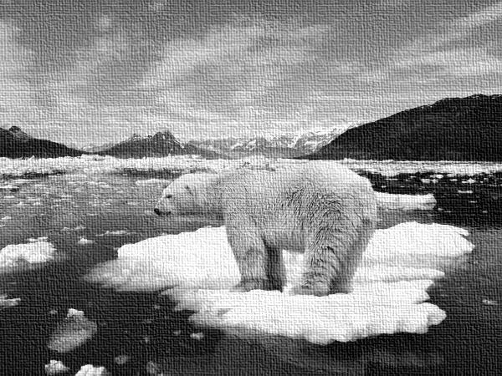
“Global warming is not a conqueror to kneel before – but a challenge to rise to. A challenge we must rise to.” – Joe Lieberman
“Global warming is not a conqueror to kneel before – but a challenge to rise to. A challenge we must rise to.” – Joe Leiberman

Slide 9
Bibliography
http://environment.nationalgeographic.com/environment/global-warming/gw-overview/
http://planetsave.com/2009/06/07/global-warming-effects-and-causes-a-top-10-list/
http://www.conserve-energy-future.com/various-global-warming-facts.php
http://guardianlv.com/2014/03/global-warming-top-evidence-that-it-is-real/

