Slide 1
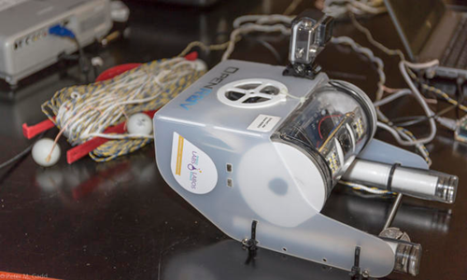
OpenROV
Computer Science 110
By: Julia Wierzchoslawska

Slide 2
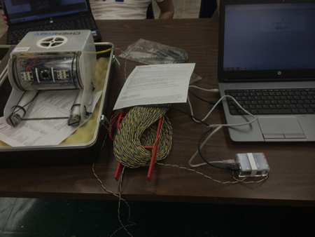
Robot
We started with the already assembled OpenROV. Our initial plan was to modify and use the already assembled one, then build our own. But The already assembled OpenROV had and still has little problems, so instead of building one from scratch we just stuck with the already assembled one.

Slide 3
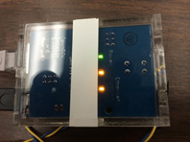
The Beginning
The first things we did was basically learn about the OpenROV, we kind of read some instruction, and talked about what we were going to do. Before we could really start playing around with it we had to get the robot to start. So batteries, we ordered them from Singapore, and they were quite expensive. To make the batteries fit properly in the battery tubes we had to do some soldering. Mr. Whalen came in during our indep and class to help and show us how to solder the parts . Check out the video by clicking on the link bellow!
http://mvhs.nbed.nb.ca/other/video/soldering-101-battery-update-mr-whalen

Slide 4
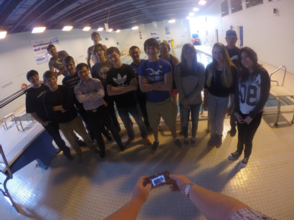
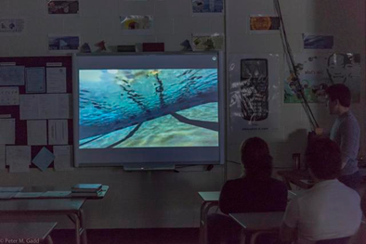
First Dive!(with the class)
After getting the OpenROV all hooked up to the computer, and getting a handle on the controls we were ready for our first dive! Its was somewhat successful, one of the problems was controlling the OpenRov. We tried hooking up a remote control but we couldn’t get it connected, so were stuck with using the keyboard. Another problem with the first dive was condensation in the camera tube. You can watch our dive on the link below.
http://mvhs.nbed.nb.ca/other/video/dive-2-testing-rov-students

Slide 5
OpenROV Community
The OpenRov website allows anybody who has any problems to put out a question about there OpenROV. So basically you just ask a question and wait for someone to give you advice on your problem. This website really has helped us get through a lot of our problems with the OpenROV.

Slide 6
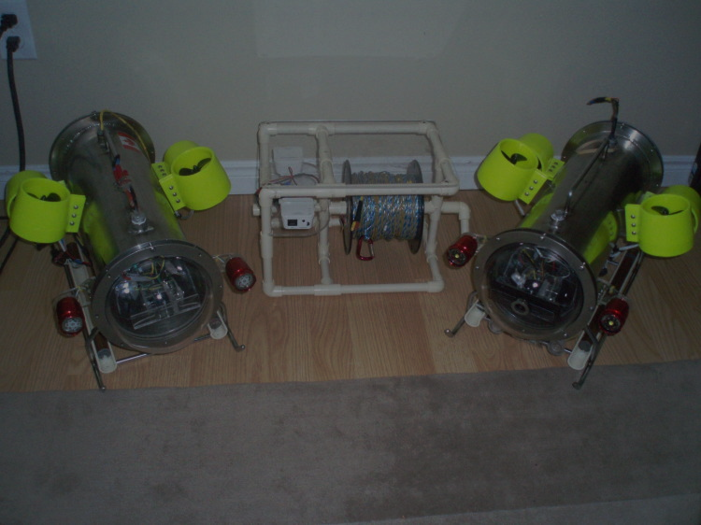
Skype with David Murphy!
David Murphy’s this guy from Nova scotia who built his own under water robots. We got in contact with him through the OpenROV website, after emailing him we decided to set up a skype session. We made up a list of questions to ask him about our problems with our OpenROV. The skype session was very useful and we learned a lot of things.

Slide 7
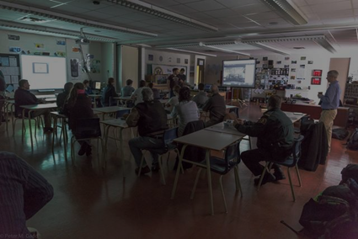
OpenROV Informative Presentation
Our class decided to give a presentation on our OpenROV to a selected group of people. Our original plan was to put the robot in the MVHS pool and have it navigate through an obstacle course, but since there were some technical difficulties we had to come up with a plan B. Plan B was to have a classroom presentation, that covered everything you needed to know about our robot. It turns out plan B was not only a better choice than we thought, but left a more lasting impression on our guests.

Slide 8
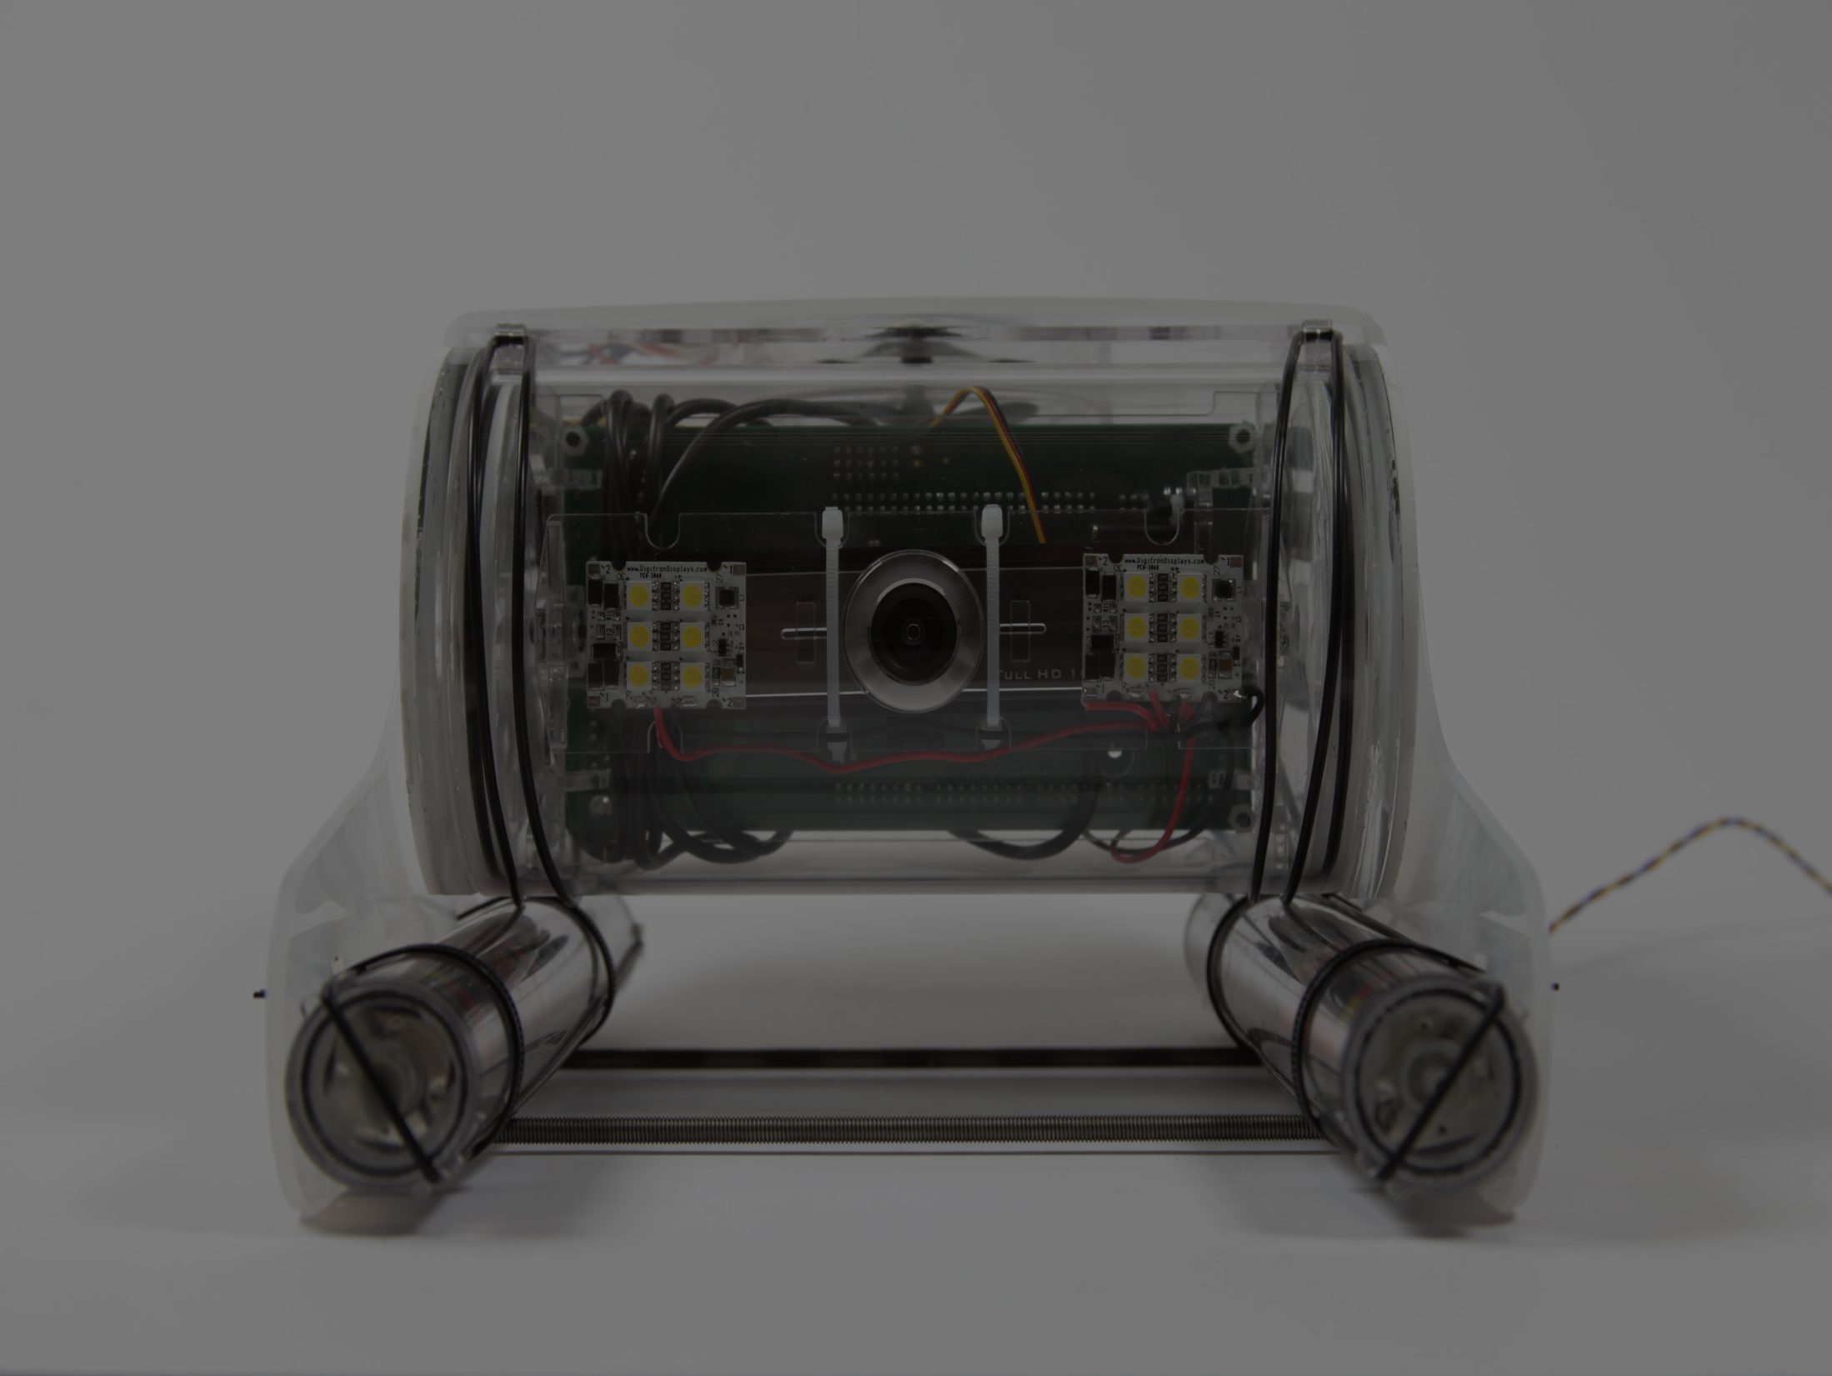
Skype session with David Lang!
Davide Lang is the creator of The OpenROV, and our class had the chance to skype with him. We made up a short list of questions to ask him, because we only had a limited amount of time. It was a little tricky to set this skype session up since David Lang lives in California, and the time difference is four hours. It was really cool to hear what he had to say about the OpenRov and all the difficulties that he had, just like we have difficulties with our OpenROV.

Slide 9
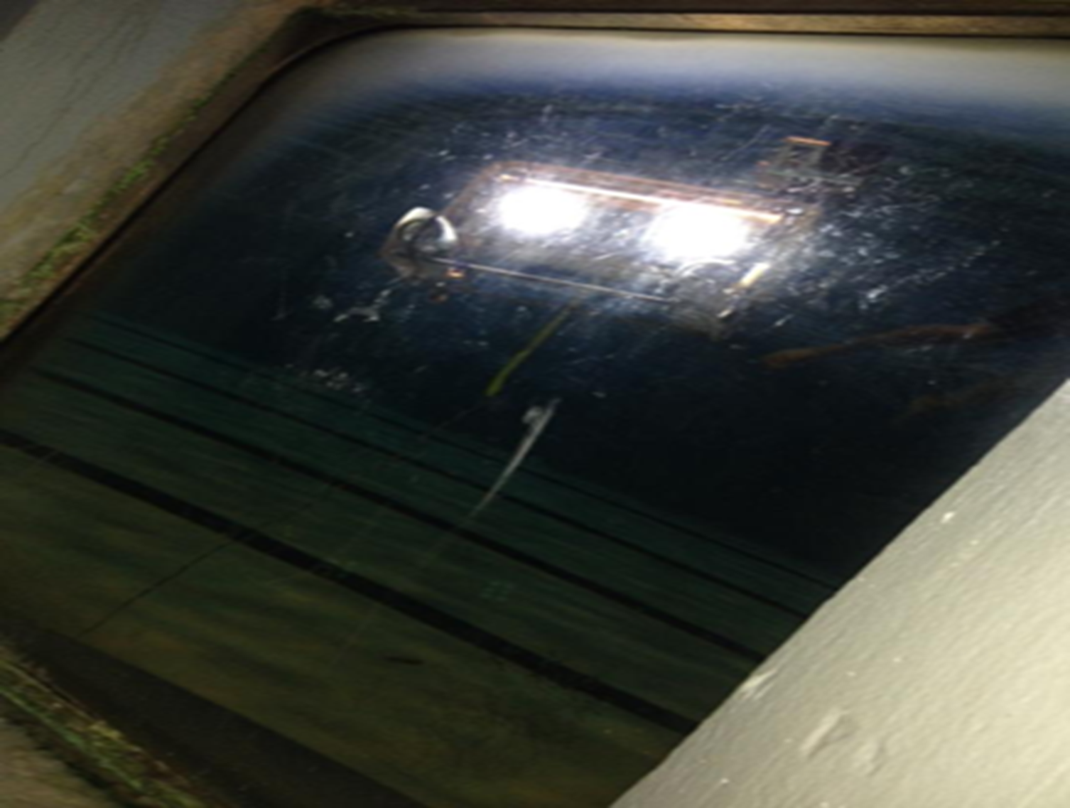
This whole experince with the OPenROV has been pretty great. I mean how many high school students get the chance to work with something like this. Yes there were and still are problems that we have to fix and I'm sure we will find a way to fix them. But the most important thing that I got out of this is the experience and seeing how teamwork really works.

