Slide 1
SALMON dissection
By : Meagan Holmes

Slide 2
Getting to know that Salmon

Slide 3
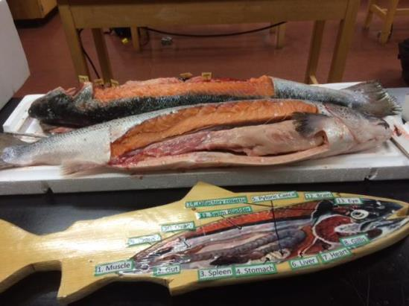
Getting to know the salmon *Photo by Mr. Hallihan

Slide 4
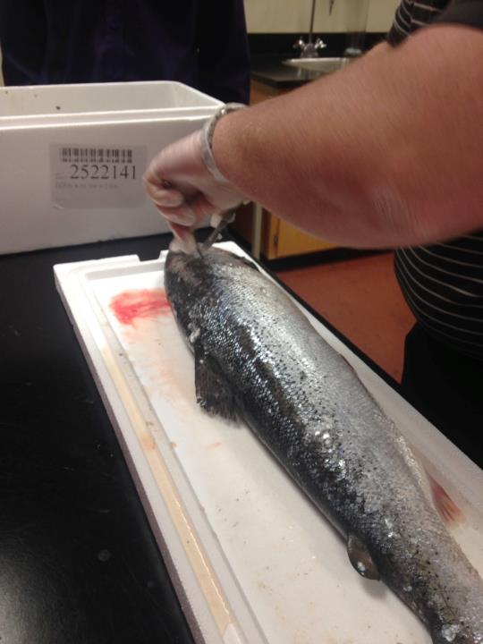

Slide 6
Beginning stages

Slide 7
Time to explore…
This it the time where we began to look for the different organs: heart, spleen, swim bladder…

Slide 8
MSA Biologist Holly Labadie

Slide 9
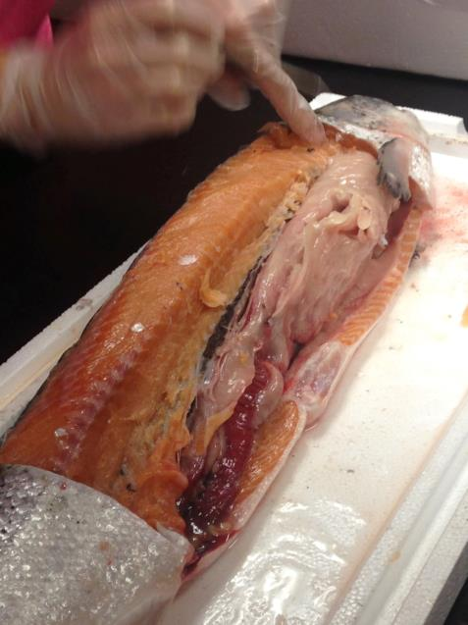

Slide 10
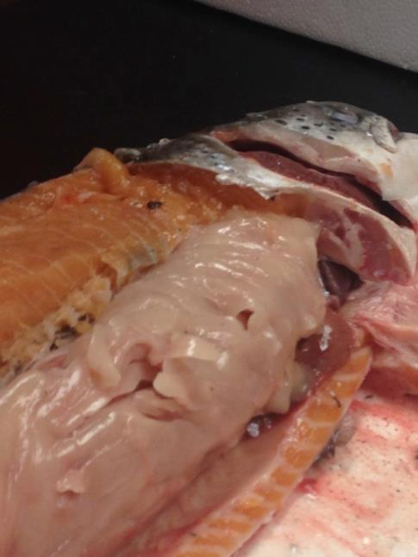

Slide 11
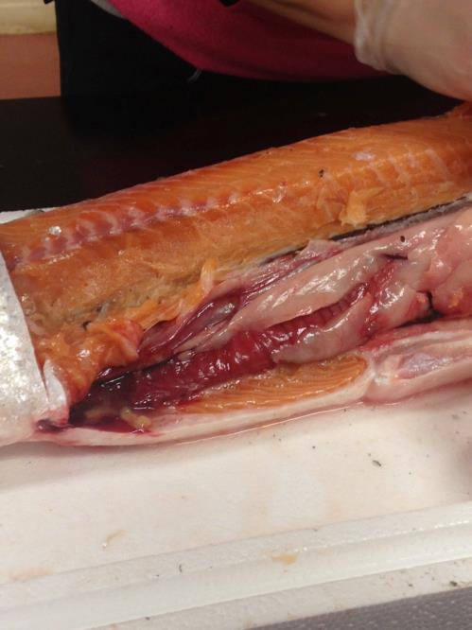

Slide 12
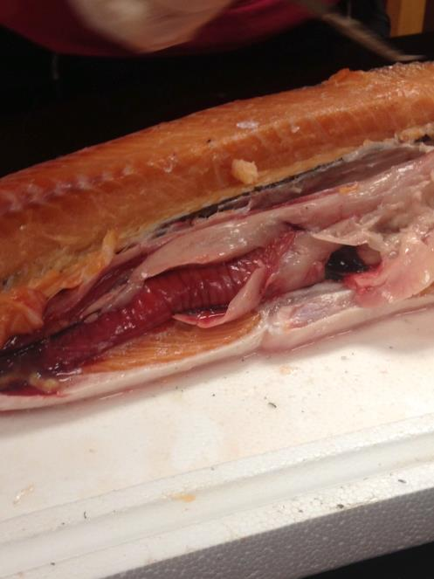

Slide 13
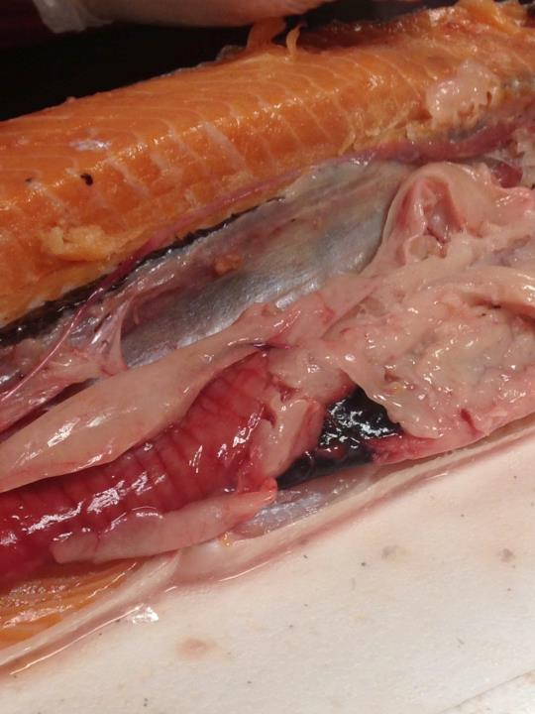
Kidney
Spleen
Gut

Slide 14
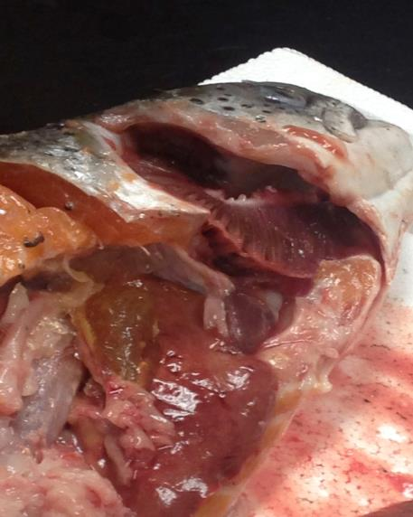

Slide 15
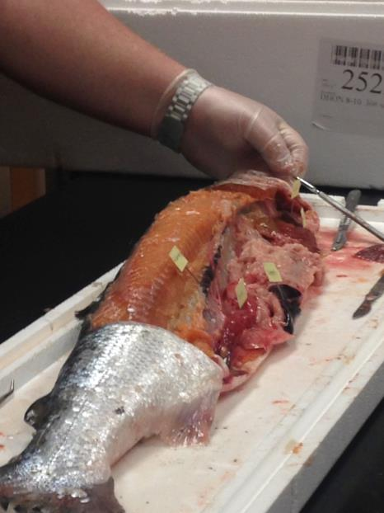

Slide 16
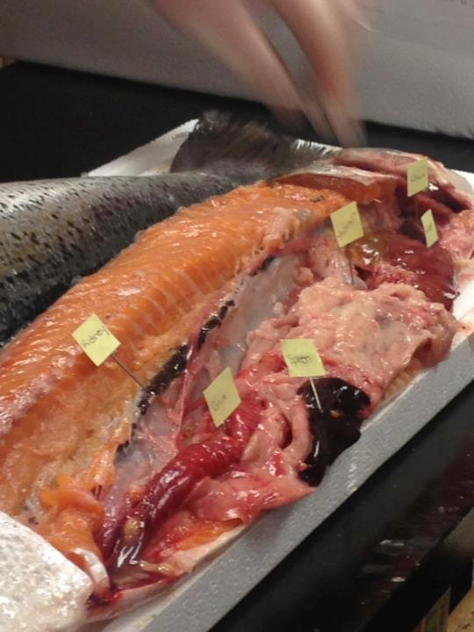

Slide 17
Now to dissect smolts

Slide 18
Swim bladder

Slide 19
Swim bladders
Once we started to dissect the smolts, some students we able to remove the swim bladders.
While dissecting the Salmon we were unable to find the swim bladder, most likely due to it being previously frozen.
Photo by Mr. Hallihan

Slide 20
Having some fun

