Slide 1
Life Cycle Of A Salmon

Slide 2
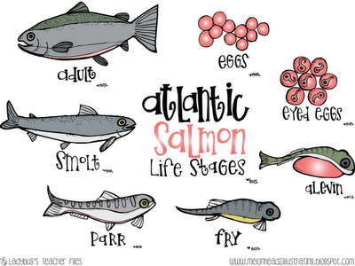
The Stages Of A Salmon

Slide 3
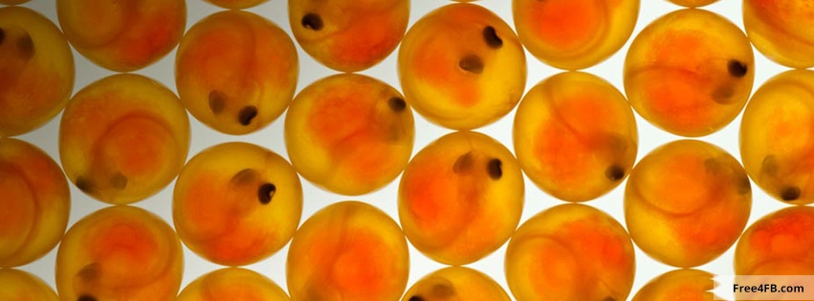
Eggs ( Stage 1 )
Adult salmon lay their eggs in special nests called redds in late fall at the bottom of the lake.
The salmon eggs hatch in the spring time into little fish called alevins.

Slide 4
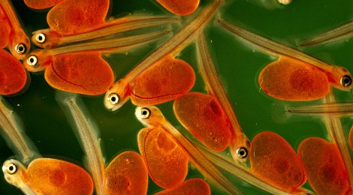
Alevins (Stage 2)
They come up from their nests about four to six weeks after hatching.

Slide 5
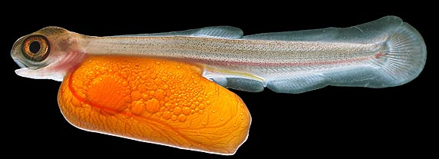
Fry (Stage 3)
After the yolk sacs have been used up, the alevins have to start to eat. At this point they are known as fry. They eat tiny water bugs and grow quickly during their first year.

Slide 6
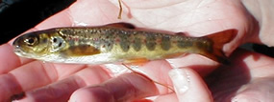
Parr (Stage 4)
Once the fry grow up to be 1 year old, we call them parr
They eat small bugs and grow larger.

Slide 7
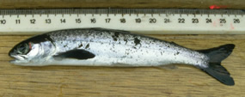
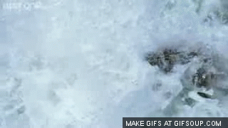
Smolts (Stage 5)
The parr grow into smolts when they turn three or four years old.
This change from parr into smolts is when the salmon are getting ready to head out to sea. Smolts head out to sea in groups, which are called shoals, during late spring. At this point they are a silver color.

Slide 8
Adult Salmon (Stage 6)
Adult salmon travel for a long time in the sea to feeding grounds in cold waters and eat sand eels, krill and herring. The salmon go back to the same rivers where they were born after being at sea for one to four years.
Adult salmon that return to lay their eggs after one year at sea are known as grilse.

Slide 9
Bingo!!

Slide 10
Work Sited Page
http://idahoptv.org/sciencetrek/topics/salmon/teachers.cfm
http://seymoursalmon.com/lifecycle.php

