Slide 1
The Life Cycle of The Salmon

Slide 2
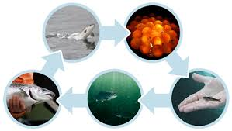
Life Cycle
Adult
Eyed Eggs
Parr
Alevin
Fry

Slide 3
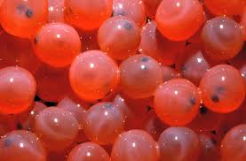
Eyed Eggs
The eyed eggs, get their name from their looks…
Once the eggs are ‘eyed’
they will take 3 months
(approximately) to hatch.
Then after hatching comes the Alevin.

Slide 4
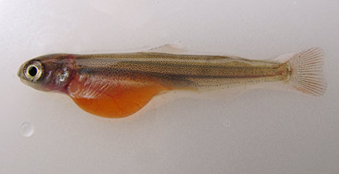
Alevin
Alevin is the second stage of the Salmon life cycle…
Alevin is a newly hatched salmon.
An Alevin still carries a
Yolk sack

Slide 5
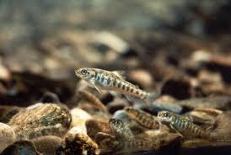
Fry
Fry is the third stage of the Salmon life.
They feed on microscopic
life, and grow fast in the
first year!
They reach between 5-8
cm before turning into a Parr.

Slide 6
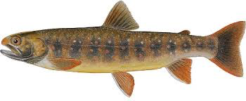
Parr
At this point the salmon are over one year in age.
Markings called “Parr Spots” appear and are used for camouflage.(Hide)
The spend 1-5 years in the river, feeding on small insects.

Slide 7
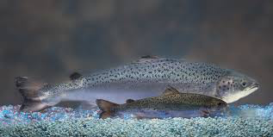
Smolt
Smolt is the fifth stage of the salmon’s life.
Salmon switch from a Parr to a Smolt when the start to move toward the sea.
They are longer, and shinier.
Smolt
Parr

Slide 8
Adult
Adult salmon are silvery in colour and head out to the sea!
There they build up body weight, and grow fast.
Eventually the salmon return to the river they were born in, to lay eggs.

Slide 9
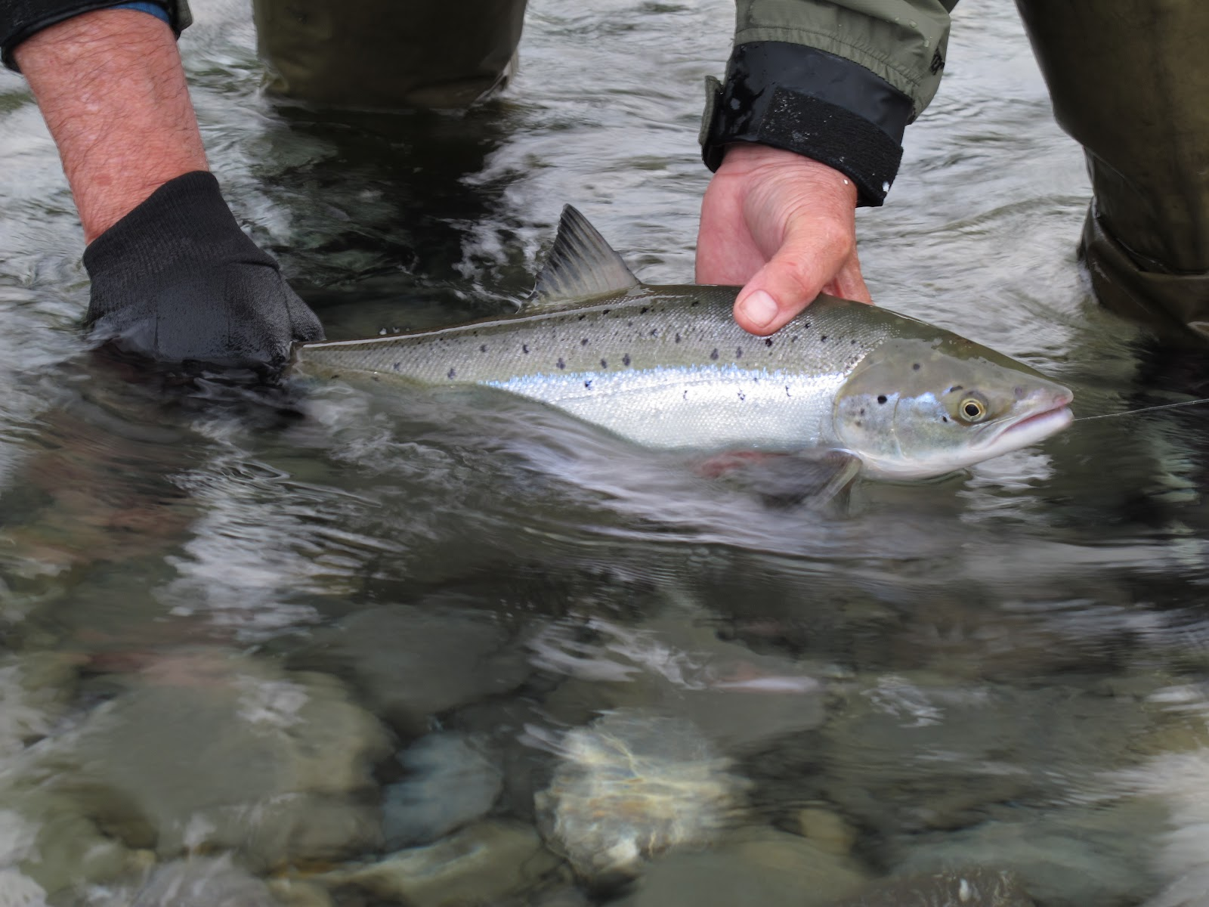
Grilse
If an adult spends only one year in the sea, it comes back as a Grilse.
It is smaller than a Salmon

Slide 10
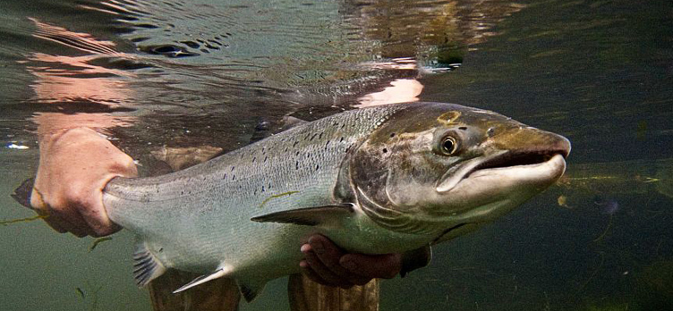
Salmon
If an adult spends two or more years in the sea, it comes back as a Salmon.
They are larger than a Grilse.

Slide 11
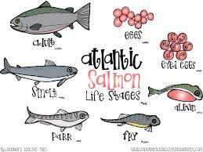

Slide 12
GAME TIME

Slide 13
What is the first stage of the Salmon’s life?
Eyed Eggs!

Slide 14
What is the Second stage of the Salmon’s life?
ALEVIN

Slide 15
What is the third stage of the Salmon’s life?
Fry!

Slide 16
What is the Fourth stage of the Salmons life?
Parr!

Slide 17
What is the 5th stage of the salmons life?
SMolt

