Slide 1
Global Warming
Jayden Jones

Slide 2
Global warming is the term used to describe a gradual increase in the average temperature of the Earth's atmosphere and its oceans, a change that is believed to be permanently changing the Earth's climate.

Slide 3
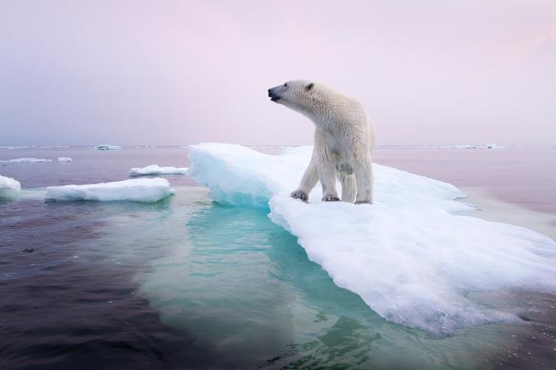
Species Affected
Polar Bears
Penguins
North Atlantic Cod
Quiver Tree
Orange Spotted Filefish
And so many more….

Slide 4
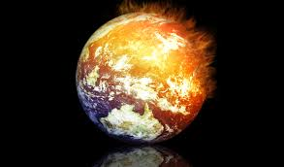
Scientific understanding of global warming has been increasing. In its fifth assessment in 2014 the Intergovernmental Panel on Climate Change (IPCC) reported that scientists were more than 95% certain that most of global warming is caused by increasing concentrations of Greenhouse Gases and other human activities.

Slide 5
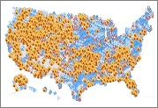
This map includes all of the places that will be affected by global warming in years to come.

Slide 6
Videos to explore:
https://www.youtube.com/watch?v=gWT-EWKIR3M
https://www.youtube.com/watch?v=__UgsLUxmos
https://www.youtube.com/watch?v=xVQnPytgwQ0

Slide 7
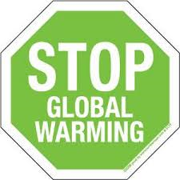
How We Can Help
Take steps to reduce your energy use, improve efficiency and help end global warming. The biggest cause of global warming is the carbon dioxide released when fossil fuels -- such as oil and coal -- are burned for energy. So when you save energy, you fight global warming and save money, too

Slide 8
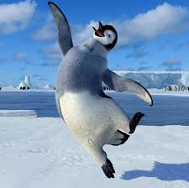
Together, we can help stop global warming!

