Slide 1
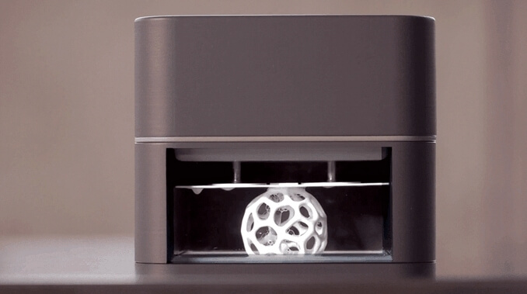
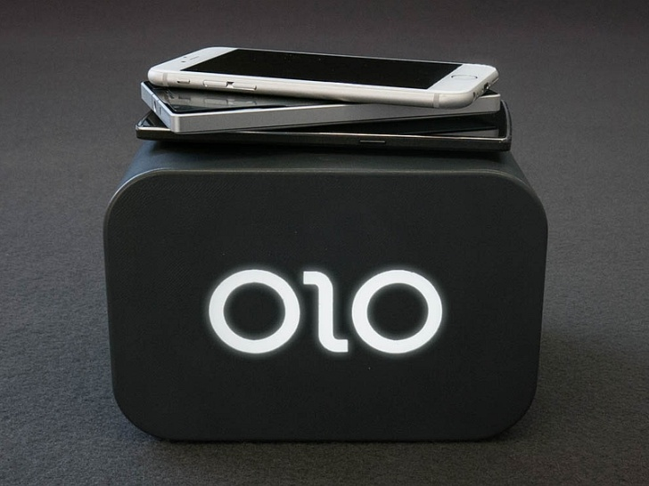
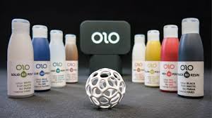
OLO: Turn your Smartphone into a 3D Printer

Slide 2
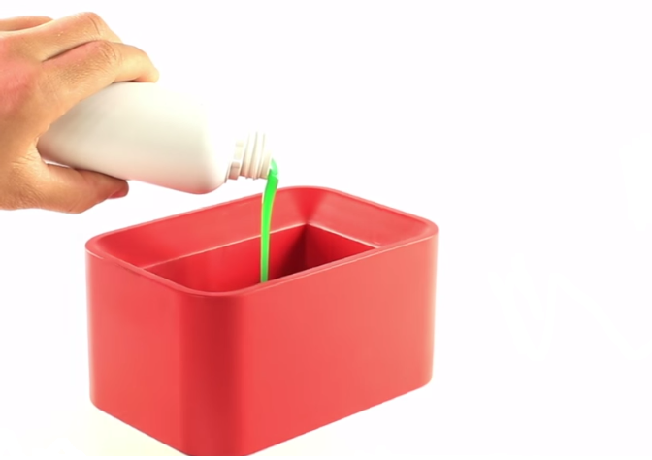
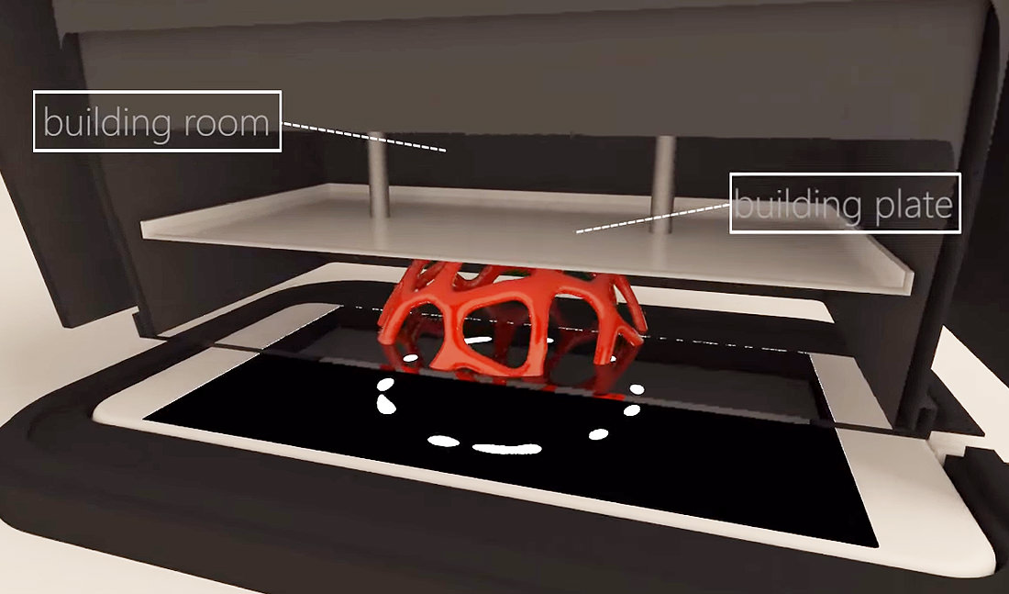
How it works
It uses a liquid called “daylight resin” then solidifies when exposed to the white light emitted from your cellphone screen
The liquid is poured into the chamber and the ceiling raises slowly while patterns of white light on your phone screen targets which areas to harden
OLO units cost $99 US, weigh 780 grams, have 400 cubic cm of printing space and work with most cell phone devices

Slide 3
Links
OLO Demonstration Video: https://www.youtube.com/watch?v=lRU6h46eAmg
Web Article: http://indianexpress.com/article/technology/gadgets/3d-printer-smartphone-olo-app-android-ios/
Kickstarter (goal - $80 000, reached – $2.1 Million): https://www.kickstarter.com/projects/olo3d/olo-the-first-ever-smartphone-3d-printer

