Slide 1
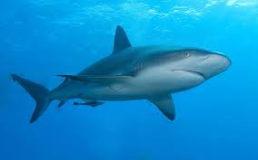
The Fantastic Sharks!
By Jordyn Sonier and Michaela MacCallum

Slide 2
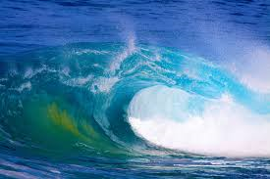
Fun facts about sharks!
Did you know that there is 400 different species of shark.
Until the 16th century they were known as sea dogs!
Sharks are closely related to sting rays.
Baby sharks are called pups.
When sharks get wounded they heal easily and quickly.
Sharks must not stop swimming or they will sink.
Sharks do not suffer from cavities.

Slide 3
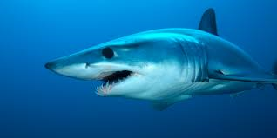
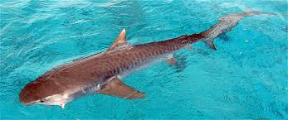
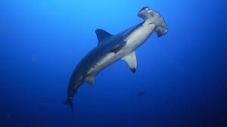
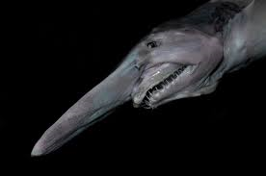
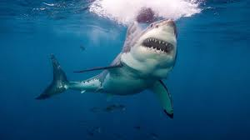
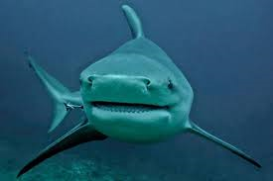
Types of shark
There is the hammerhead shark
The great white shark
The tiger shark
Bull shark
Goblin shark
Mako shark

Slide 4
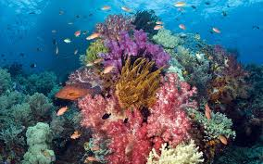
how they feed
They are one of the greediest eaters and killers of the sea animals.
They feed on small fish of all kinds, and do great damage to mans supply of food fish.
Certain harks are vicious and greedy, they only get this way if they’re suffering from Continual hunger.
Their stomachs will not let them rest.
As soon as they eat they need to feed again for more food, they are counsel hunger.

Slide 5
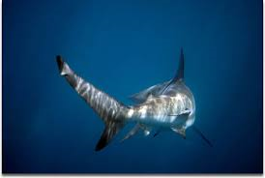
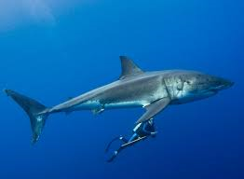
About their body
They are rounded and may be up to 40 feet long.
The tail is usually notched.
The upper part of the tail is longer than the lower part.

Slide 6
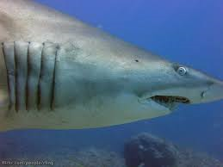
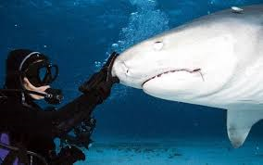
More body parts
They are covered in scales, which gives the skin a rough feeling.
The mouth is on the underside of its head.
Their gills are on the side of the head, and there are five t seven openings on the surface.

Slide 7
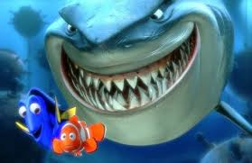
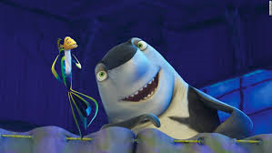
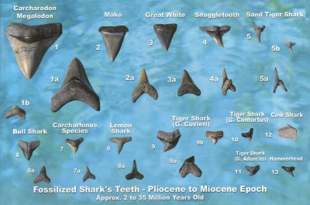
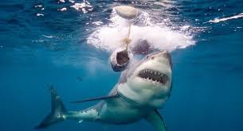
Their deadly teeth
Some kinds of sharks have about 15 rows of long sharp teeth, with all the rows except one or two folded back on the jaws.
They lose a tooth per week, then another one grows in its place.
Some other sharks have flat teeth or small teeth.
Their teeth are not attached to the root or gum like our teeth.
The tooth of the shark range from 31/2 – 7 inches long and can weigh more than a pound!

Slide 8
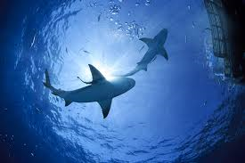
How they swim?
They swim very rapidly..
They offended follow ships for days at a time to get food and waste matter that is thrown overboard.
Sharks have been known to swim close to the beaches, where they wait for bathers.
Some sharks are fast-swimming (up to 40 mph or 64.4 mph) predators that live in the ocean.
Unlike other fish they cannot stop suddenly or swim backwards.

Slide 9
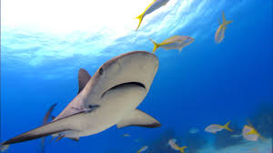
swimming
Their fins cannot bend upwards, limiting themselves to only swim forward.
If a shark needs to move backwards it uses the force of gravity.
Sharks have to swim to the side to invoke hitting something-they cannot simply stop.
They propel themselves with there tail, the fins are only used for balance.

Slide 10
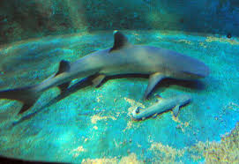
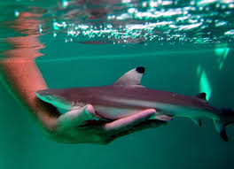
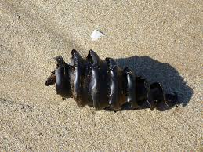
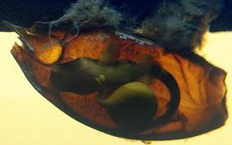
the birth of a shark
Some sharks have there young by laying eggs.
Which are protected by a shell.
Most sharks take care of there young, from 3 to 6 or more in a pack.
Some of the young are born quite large considering the size of their parents.

Slide 11
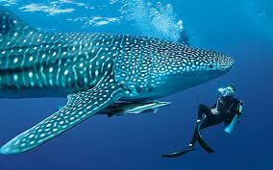
Whale shark
The largest shark is the harmless one, it’s the Whale Shark, which is often more than 50 feet long.
It’s a slow moving filter feeding shark.
Their live span is about 70 years.
They feed mainly on plankton and are generally considered harmless to humans.
It lives in all tropical and warm temperate seas.
They have a grey with white belly.

Slide 12
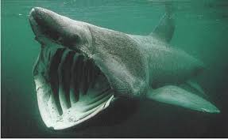
Basking shark
It is the second largest shark.
It is another harmless fish.
They are found in the Arctic Ocean.
It got its name because it like to come to the surface and basks in the sun.
The teeth of the basking shark are very small.
They arranged between 20 to 26 meters in length.

Slide 13
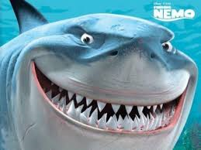
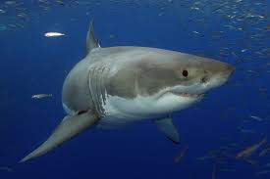
great white shark
It is one of the best known sharks that live in our oceans.
It feeds on humans “a man eater”
It lives in tropical seas, and sometimes along the southern coast of the United States..
They are 21 feet in length all though reports have been posted that they are measured at 26 feet.
They weigh 7328 lbs. in weight.
They can accelerate to speeds to 35 miles per hour or 56 kil per hour.

Slide 14
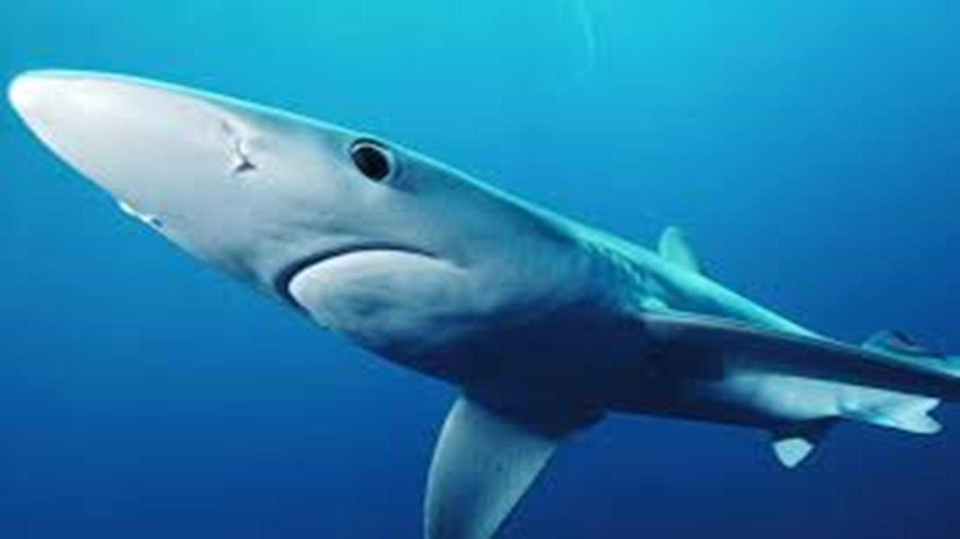
Blue Shark
Is another shark that preys n humans.
It also feeds on fish and squid.
It gets its name from its color.
These sharks live up to 20 years.
They have large letters of 25 to 100 pups.

Slide 15
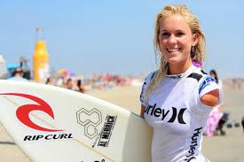
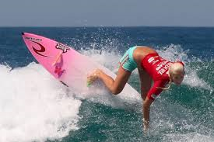
Bethany hamilton
Is the inspiration to millions through her story of determination, faith, and hope.
At the age of 13 she was attacked by a 14-foot Tiger Shark, during a Halloween surf session in 2003.
She was with her friend Alana Blanchard, and her friends brother Byron, and father Holt.
The shark had bite off her left arm and lost 60% of her blood, which she thought it would end her surf career.
This had happened in Hawaii.

Slide 16
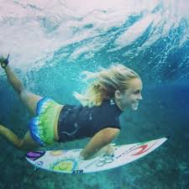
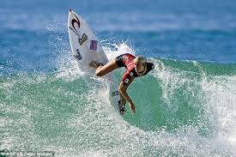
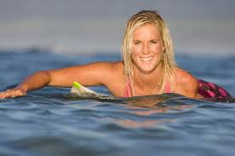
Bethany hamilton
Her father had seen her disappointment and built her a custom board so she could surf again, she ended up being one of the best female surfers of all time.
One month after the attack she returned to the water and just after a year later she won her first National title

Slide 17
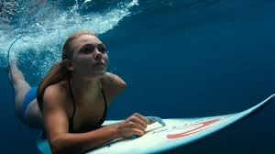
“Soul surfer”
Is a movie base on Bethany Hamilton.
https://www.youtube.com/watch?v=isjY34VD5jE

Slide 18
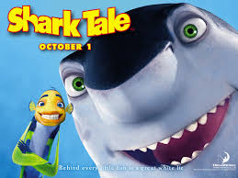
Is a kids movie about a shark who wouldn’t eat meat because he didn’t want to harm the other fish who lived in the sea.
https://www.youtube.com/watch?v=mp2SbaK8dDg

Slide 19
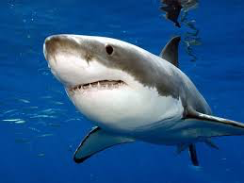
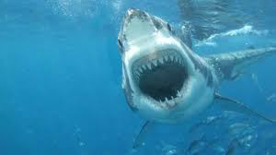
Activity
https://www.brainpop.com/science/diversityoflife/sharks/

Slide 20
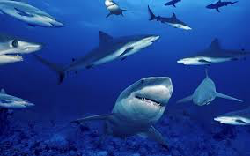
Work cited
Took all the information out of a book
http://bethanyhamilton.com

