Slide 1
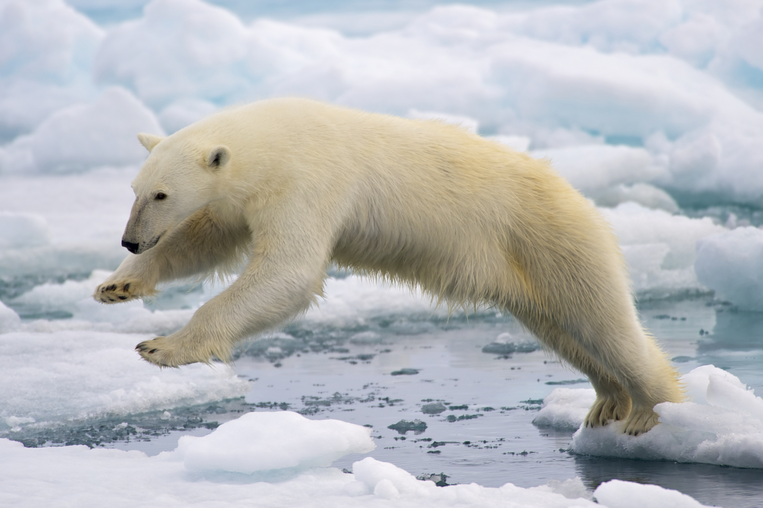
Polar Bear
By: Tanner Allison
and Ben Sobey

Slide 2
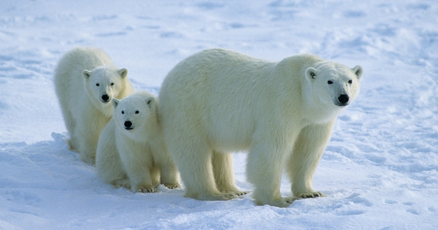
Habitat
The polar bear is a marine mammal because it spends many months of the year at sea. Its preferred habitat is the annual sea ice covering the waters over the continental shelf and the Arctic inter-island archipelagos. Polar bears are therefore found primarily along the perimeter of the polar ice pack, rather than in the Polar Basin close to the North Pole.

Slide 3
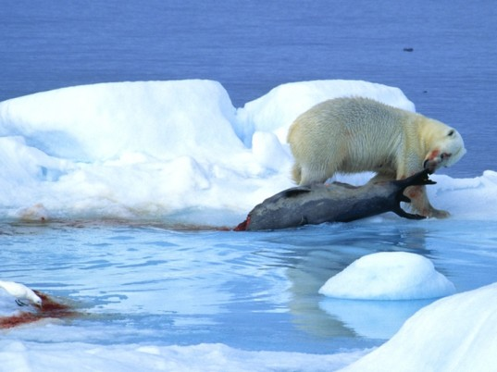
Hunting and Diet
The polar bear is the most carnivorous member of the bear family. The polar bear's most common hunting method is called still hunting. The bear uses its excellent sense of smell to locate a seal breathing hole, and crouches nearby in silence for a seal to appear. The bear may lay in wait for several hours. When the seal exhales, the bear smells its breath, reaches into the hole with a forepaw, and drags it out onto the ice. The polar bear kills the seal by biting its head to crush its skull.

Slide 4
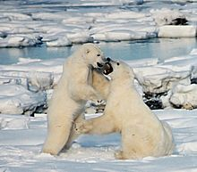
Behaviour
unlike grizzly bears, polar bears are not territorial. However, due to their lack of prior human interaction, hungry polar bears are extremely unpredictable, fearless towards people and are known to kill and sometimes eat humans. Many attacks by brown bears are the result of surprising the animal, which is not the case with the polar bear. Polar bears are stealth hunters, and the victim is often unaware of the bear's presence until the attack is underway. Whereas brown bears often maul a person and then leave, polar bear attacks are more likely to be predatory and are almost always fatal. However, due to the very small human population around the Arctic, such attacks are rare.

Slide 5
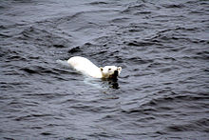
Long-distance swimming and diving
Researchers tracked 52 sows in the southern Beaufort Sea off Alaska with GPS system collars; no boars were involved in the study due to males' necks being too thick for the GPS-equipped collars. Fifty long-distance swims were recorded; the longest at 354 kilometres , with an average of 155 kilometres. The length of these swims ranged from most of a day to ten days. Ten of the sows had a cub swim with them and after a year, six cubs survived. The study did not determine if the others lost their cubs before, during, or some time after their long swims. Researchers do not know whether or not this is a new behaviour; before polar ice shrinkage, they opined that there was probably neither the need nor opportunity to swim such long distances. Polar bears may swim underwater for up to three minutes to approach seals on shore or on ice floes.

Slide 6
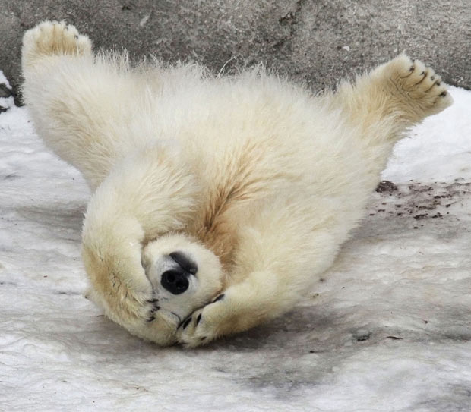
Life expectancy
Polar bears rarely live beyond 25 years. The oldest wild bears on record died at age 32, whereas the oldest captive was a female who died in 1991, age 43. In the wild, old polar bears eventually become too weak to catch food, and gradually starve to death. Polar bears injured in fights or accidents may either die from their injuries or become unable to hunt effectively, leading to starvation.

Slide 7
Ecological Role
The polar bear is the apex predator within its range, and is a keystone species for the Arctic. Several animal species, particularly Arctic foxes routinely scavenge polar bear kills. The relationship between ringed seals and polar bears is so close that the abundance of ringed seals in some areas appears to regulate the density of polar bears, while polar bear predation in turn regulates density and reproductive success of ringed seals

Slide 8
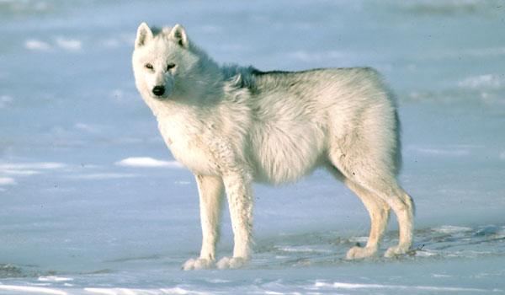
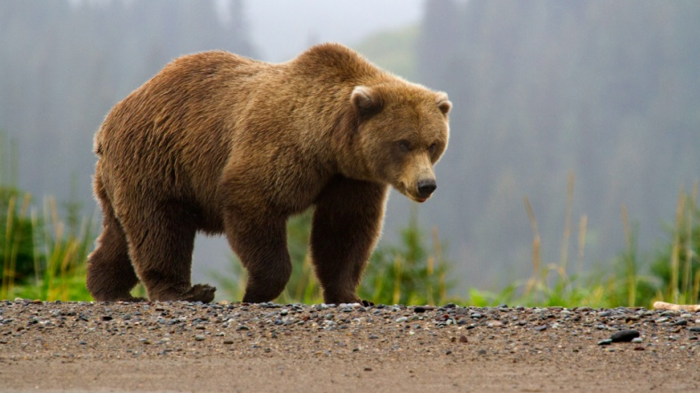
Predators of Polar Bears
Brown bears tend to dominate polar bears in disputes over carcasses, and dead polar bear cubs have been found in brown bear dens. Wolves are rarely encountered by polar bears, though there are two records of Arctic wolf packs killing polar bear cubs.

Slide 9
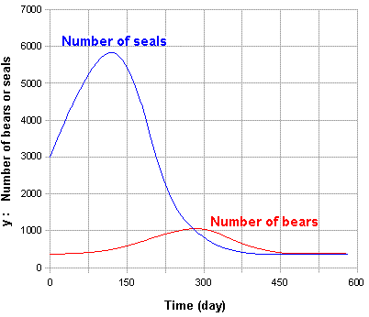
Population
Polar bear population sizes and trends are difficult to estimate accurately because the occupy remote home ranges and exist at low population densities. As of 2015, the International Union for Conservation of Nature reports that the global population of polar bears is 22,000 to 31,000, and the current population trend is unknown

Slide 10
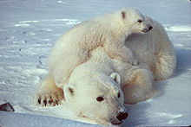
Climate Change
Polar bears hunt seals from a platform of sea ice. Rising temperatures cause the sea ice to melt earlier in the year, driving the bears to shore before they have built sufficient fat reserves to survive the period of scarce food in the late summer and early fall. Reduction in sea-ice cover also forces bears to swim longer distances, which further depletes their energy stores and occasionally leads to drowning. Thinner sea ice tends to deform more easily, which appears to make it more difficult for polar bears to access seals. Insufficient nourishment leads to lower reproductive rates in adult females and lower survival rates in cubs and juvenile bears, in addition to poorer body condition in bears of all ages. Mothers and cubs have high nutritional requirements, which are not met if the seal-hunting season is too short

