Slide 1
Soap Nuts
By: Katelyn Ryan

Slide 2
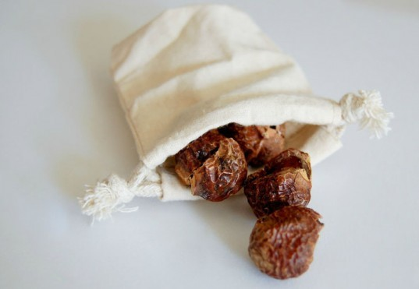
What are They?
Soap nuts are an organic, biodegradable form of laundry detergent.
They contain a natural soap that can be used to clean clothes.

Slide 3
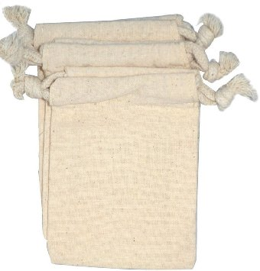
How to Use?
Usually when you purchase Soap Nuts, they come with 2 or 3 small cloth bags, like this.

Slide 4
How to Use?
For the washing machine you can put 5 whole soap nuts into the bag or 10 half nuts.
Tie off the bag and put in a container with warm water.
Put a cover on & shake the container to get soap suds.

Slide 5
How to Use?
Pour now soapy water & bag into your washer.
Set to preferred wash cycle on washer & you’re done!
Do this process each time you start a new load.

Slide 6
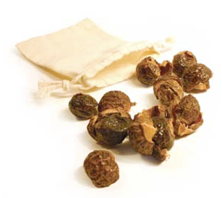
How long do they Last?
A bag of 5 soap nuts/10 halves usually last quite a few washes. (More than 10)
They can last longer, as long as they still make suds in the warm water, they can still be used.

Slide 7
Where to get Them?
Wellness Fairs
Internet
Organic Stores & online sellers
Search internet for other options.

Slide 8
Thanks for Listening!

