Slide 1
Coop 120… #MVHSMake
‘Project based independent learning where students are given an opportunity
to be creative, innovative and take ownership of their learning!’
STEM
orth

Slide 2
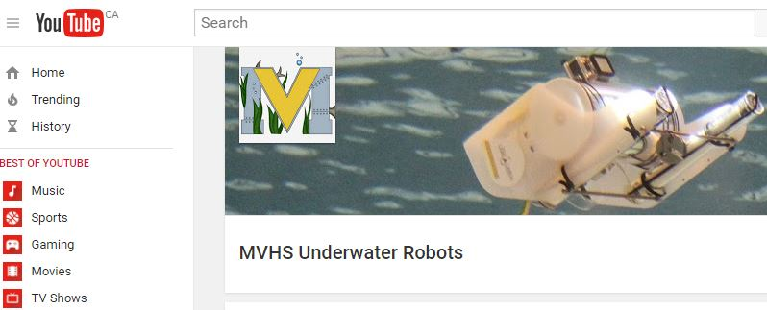
COMMUNICATION & COLLABORATION
School Website & Online Journals…MVHS MakerSpace
http://mvhs.nbed.nb.ca/other/mvhs-make
ASD-North…STEMNorth
http://stemnorth.nbed.nb.ca/
Twitter…@MVHS_ROV
https://twitter.com/MVHS_ROV
YouTube…Search MVHSMake for our channel
https://www.youtube.com/channel/UC-hZtA0UUEzndBMm1wlme4Q

Slide 3
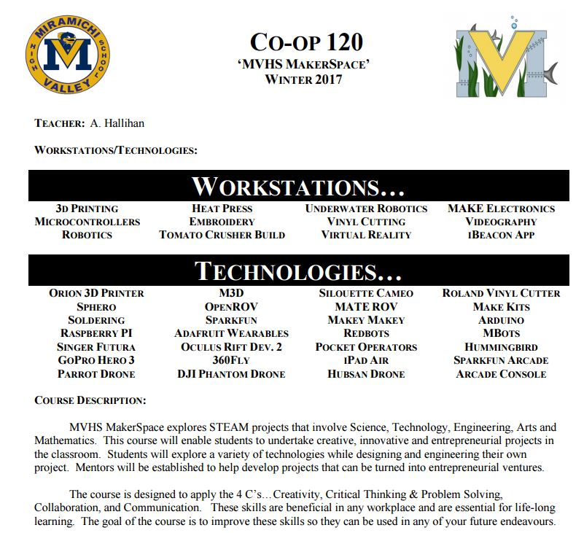
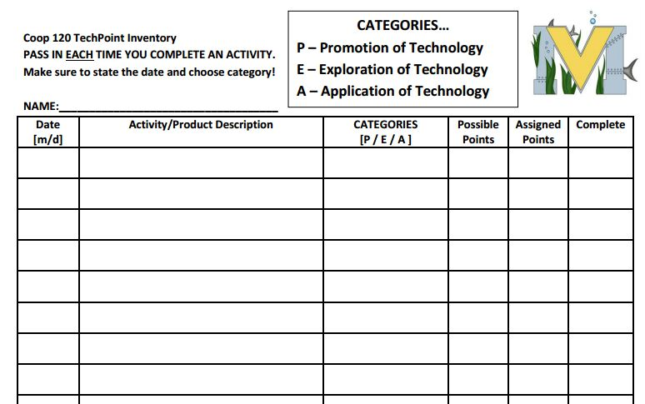
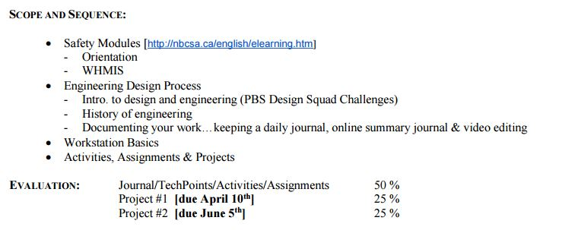
COURSE OUTLINE… TechPoints ☺

Slide 4
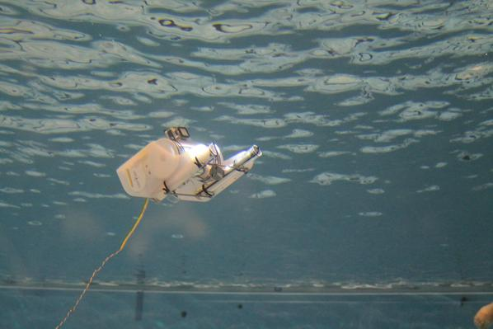
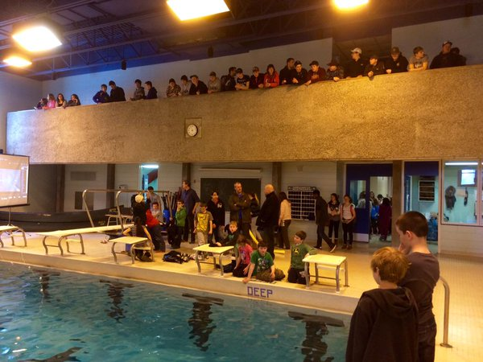
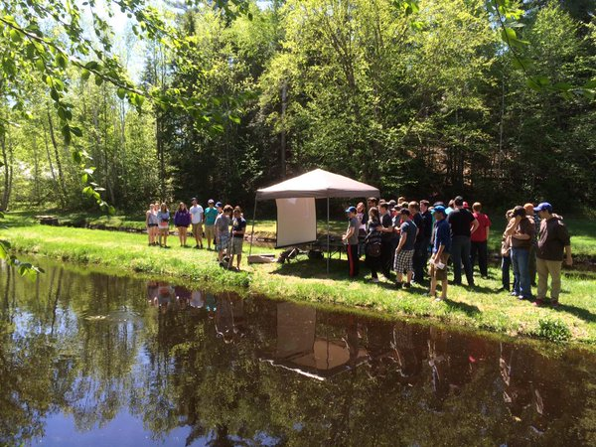
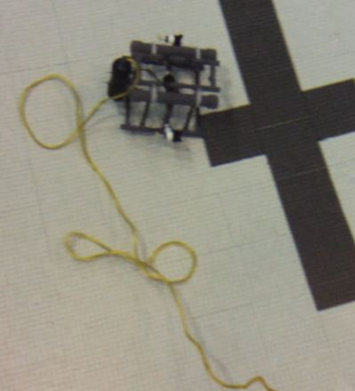
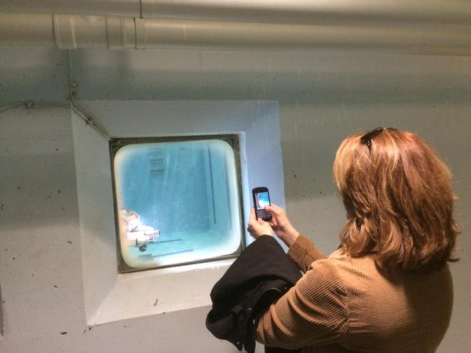
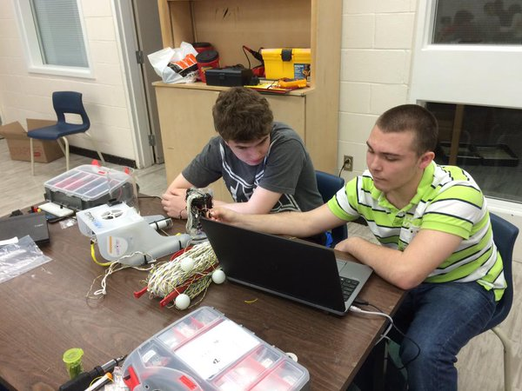
Underwater Robotics… - OpenROV & MATE ROV * This Semester: MATE ROV Camera Mount & OpenROV Updates

Slide 5
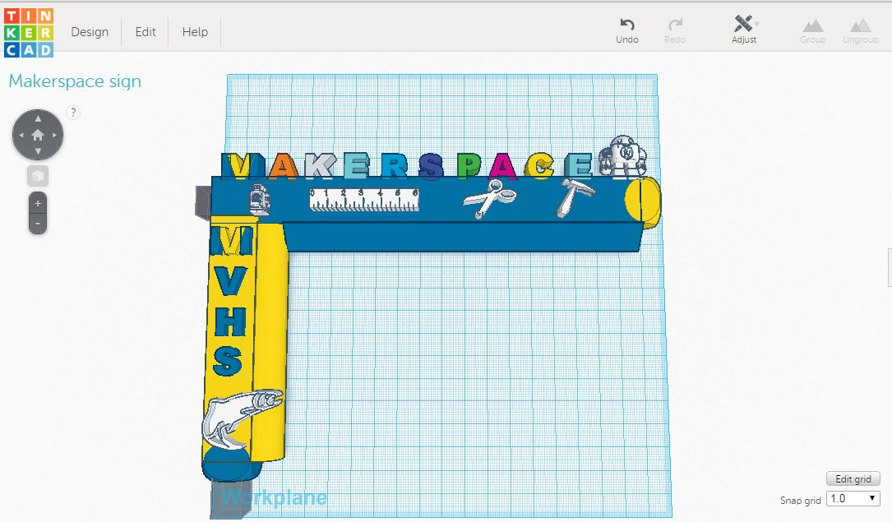
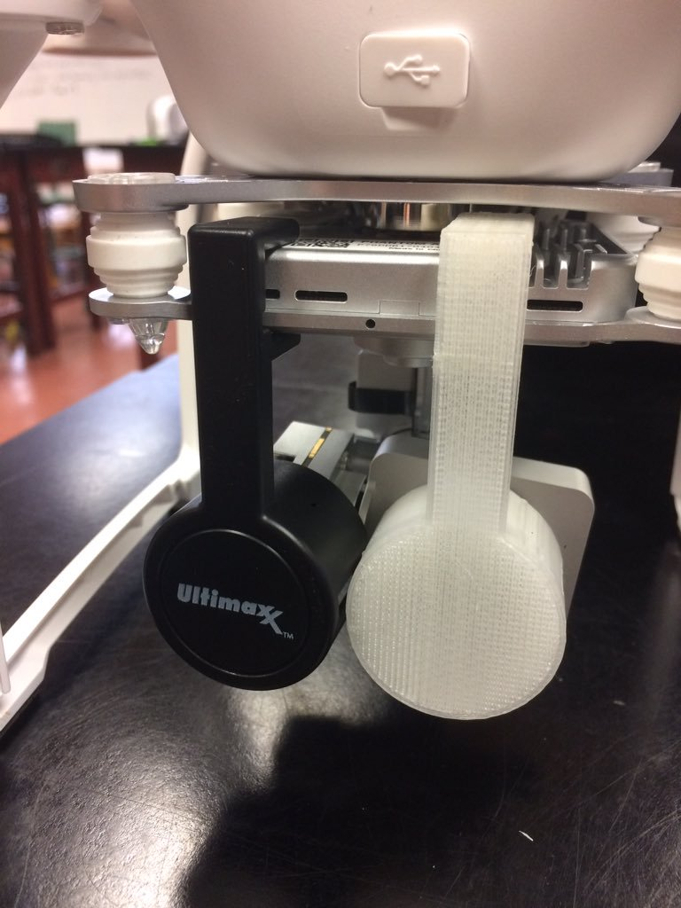
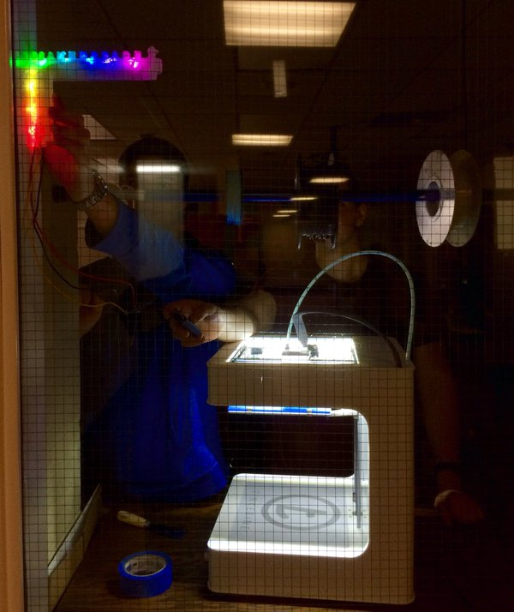
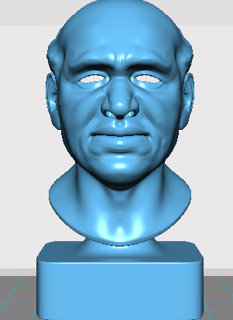
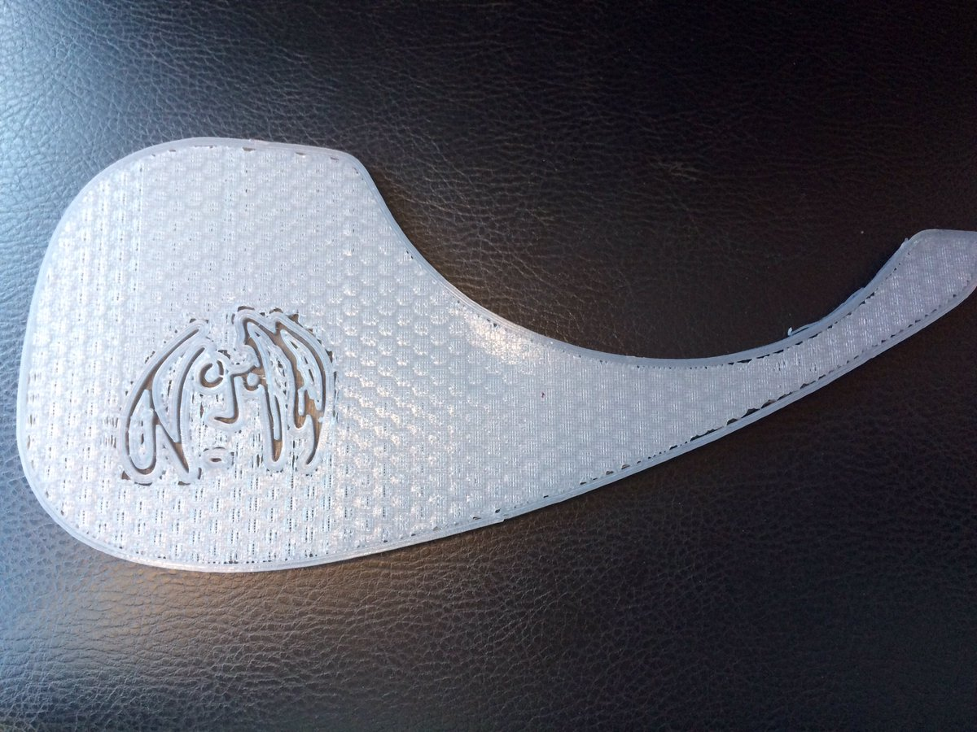
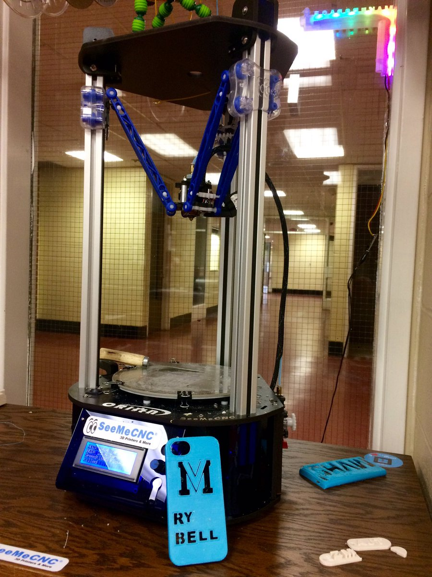
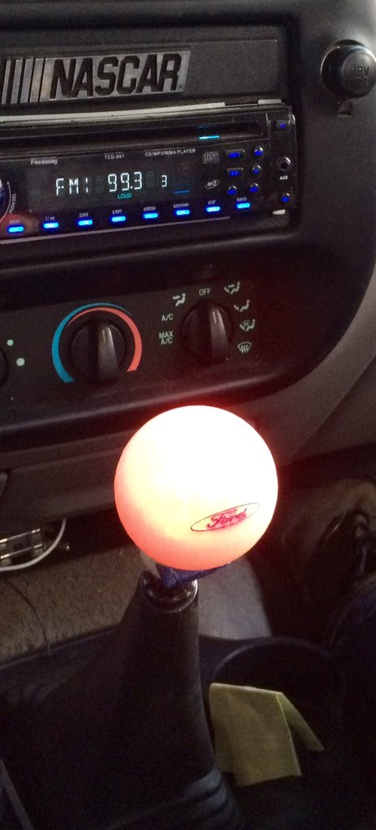
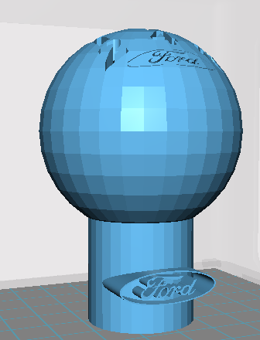
3D Printing… - SeeMeCNC & Tinkercad - Hard & Soft PLA/ABS *This Semester: Custom Cellphone Case & Figits

Slide 6
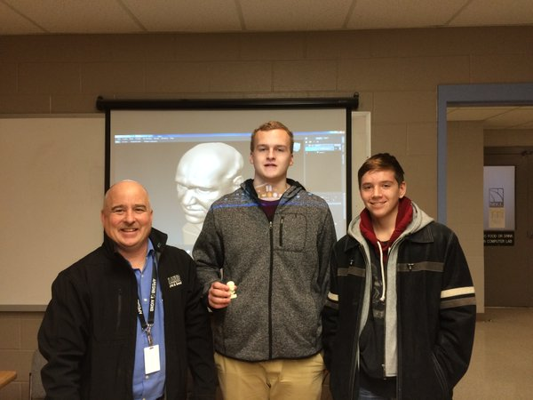
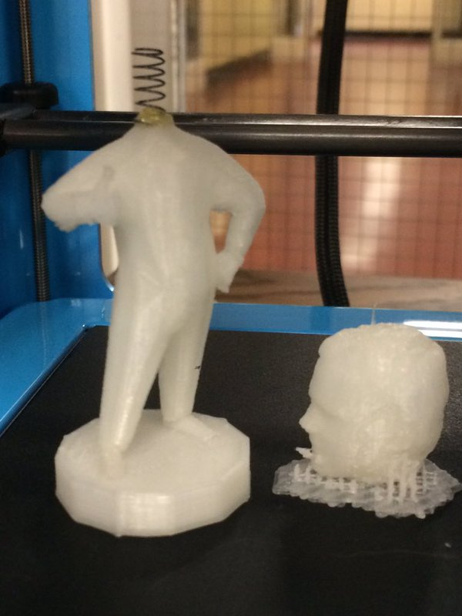
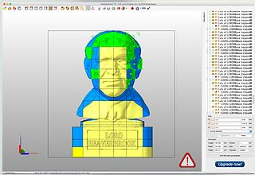
3D Scanning… - Started the Brilliant Labs Lord Beaverbrook Collaborative Print Project

Slide 7
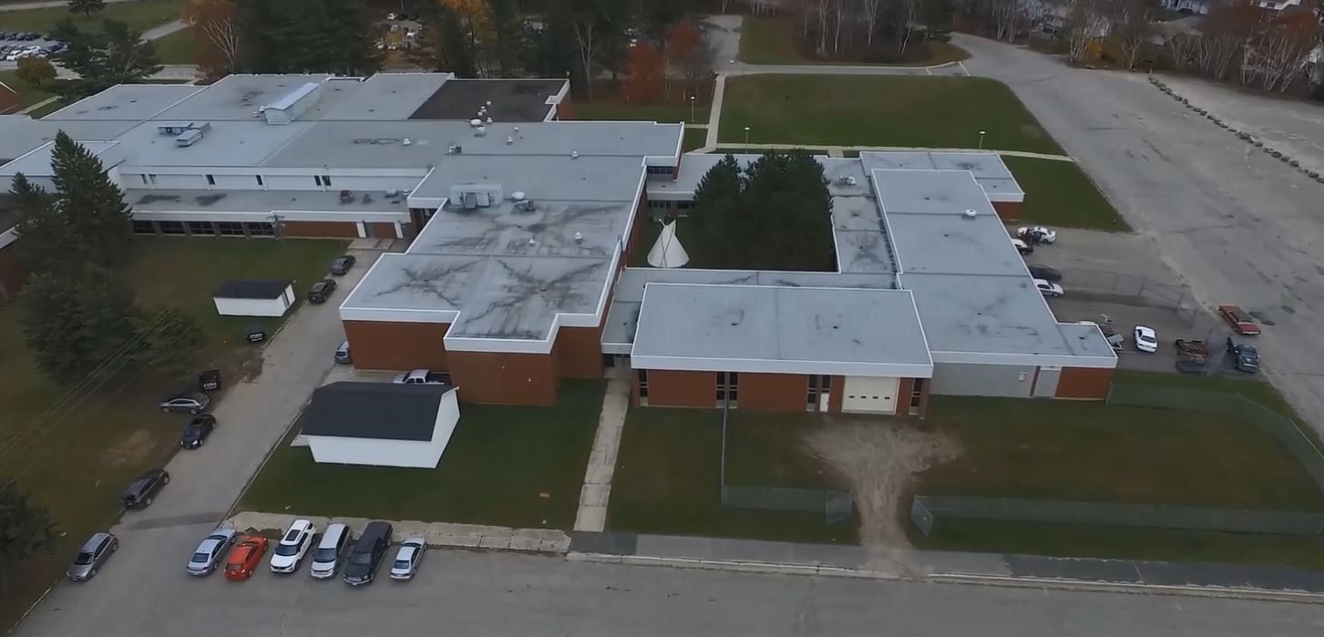
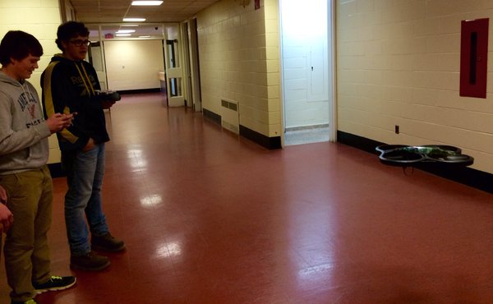
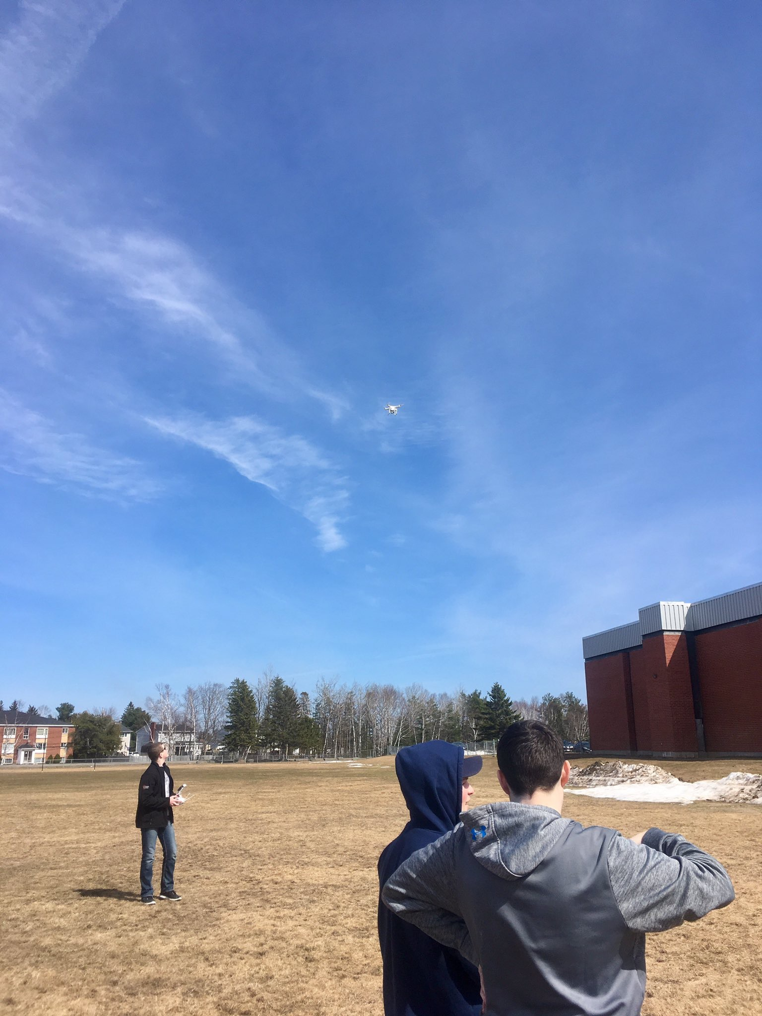
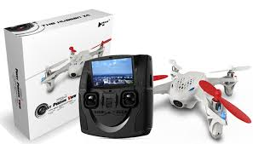
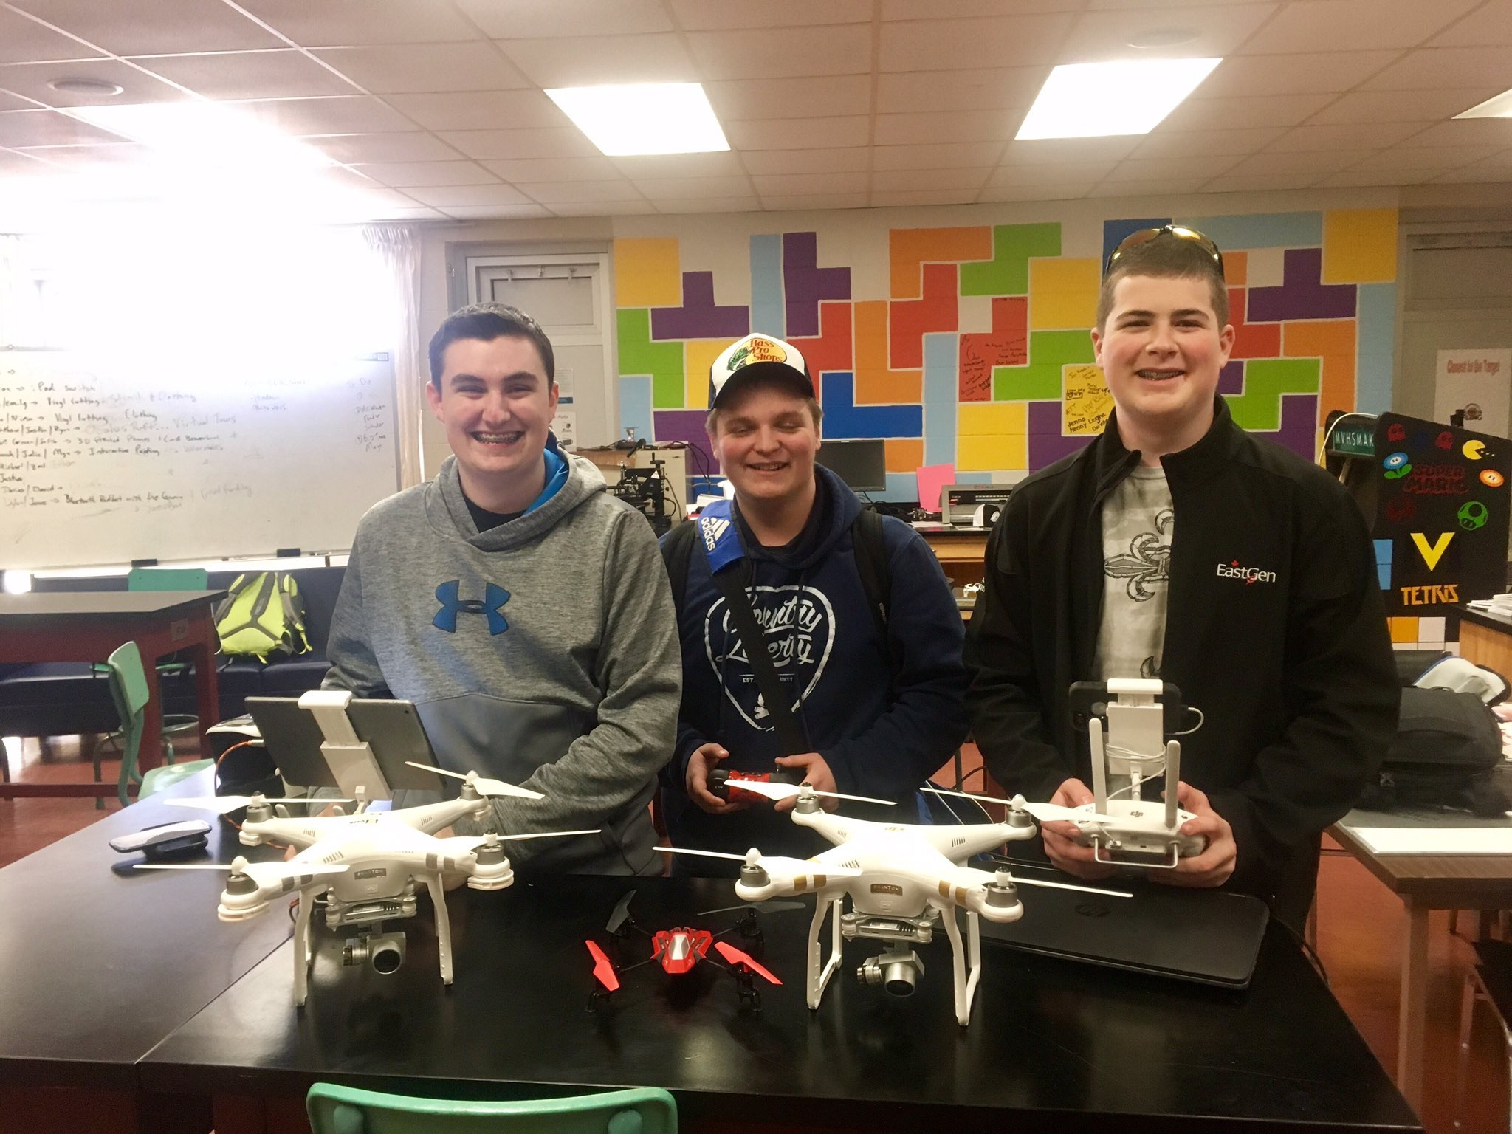
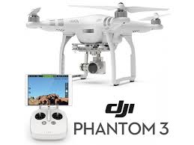
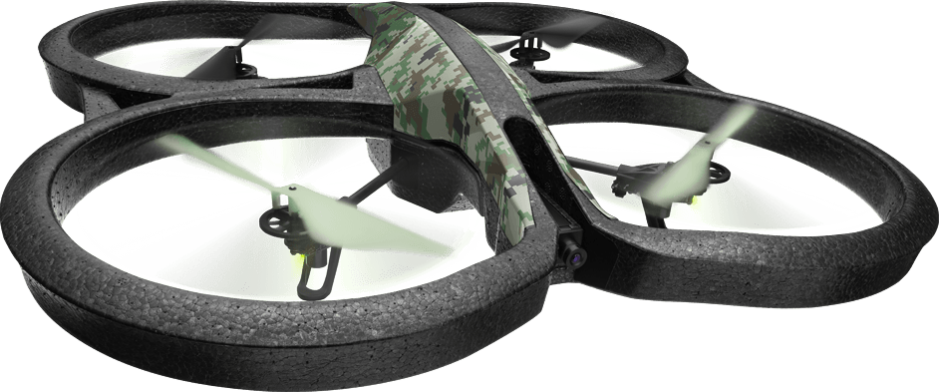
Drones… - DJI Phantom 3 Standard/Hubsan/Parrot Drones
* This Semester: NBCC/APEGNB Drone Races & MVHS Fly Fishing Club Striped Bass Fishing Trips

Slide 8
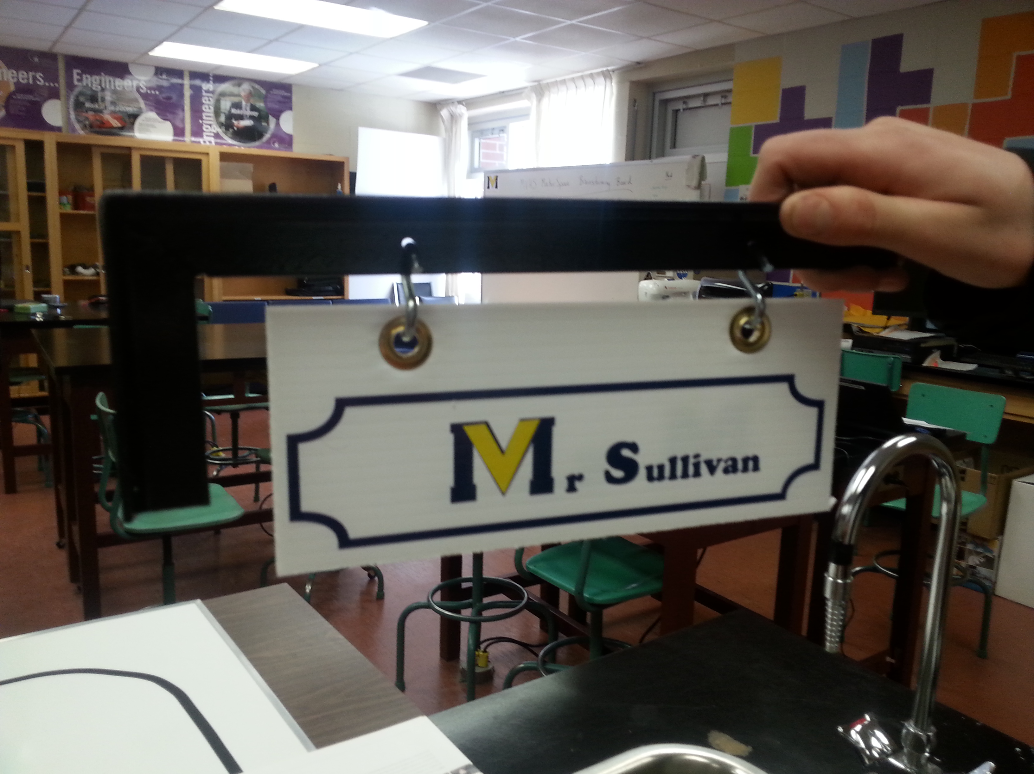
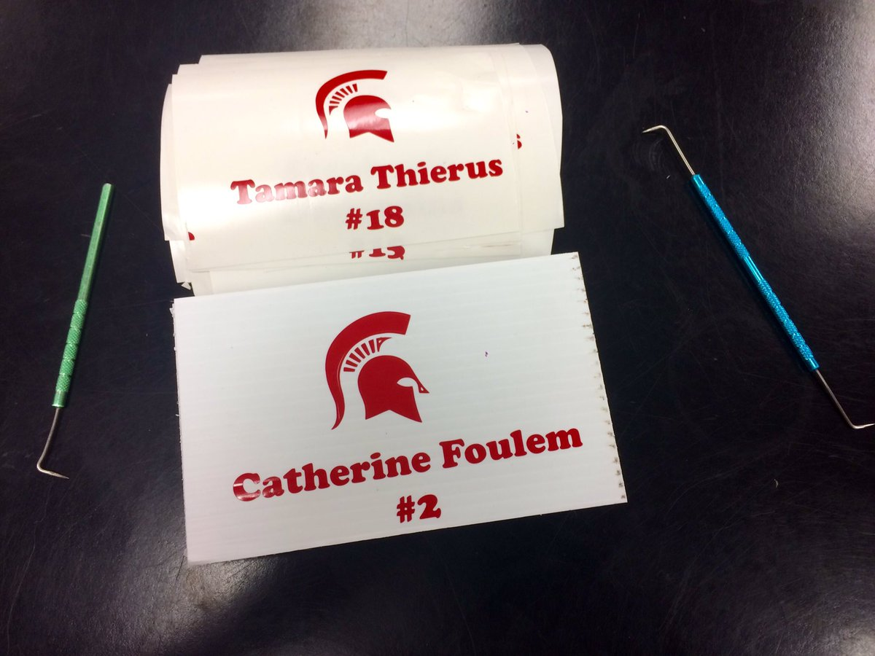
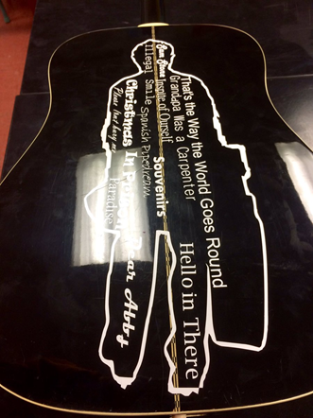
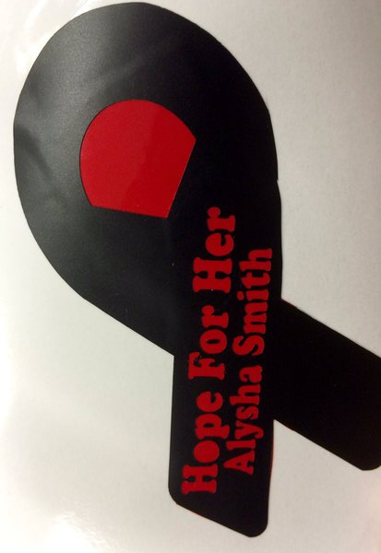
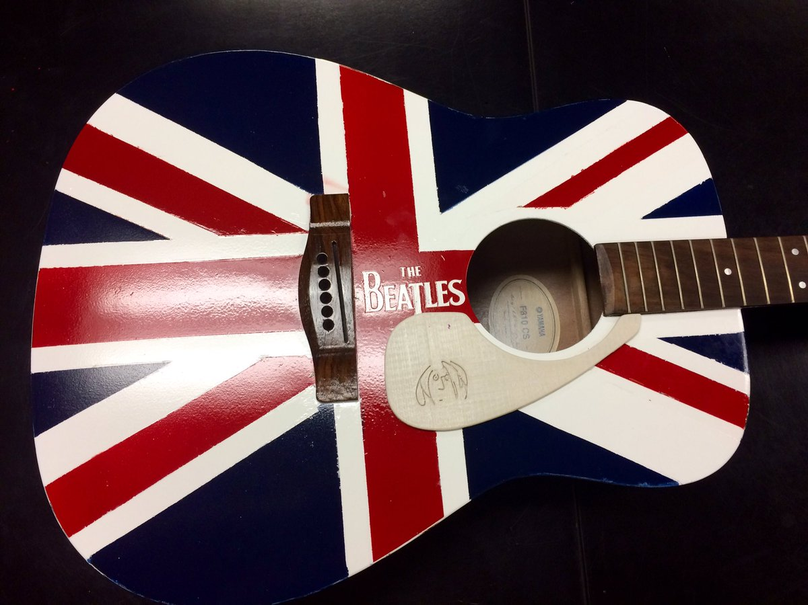
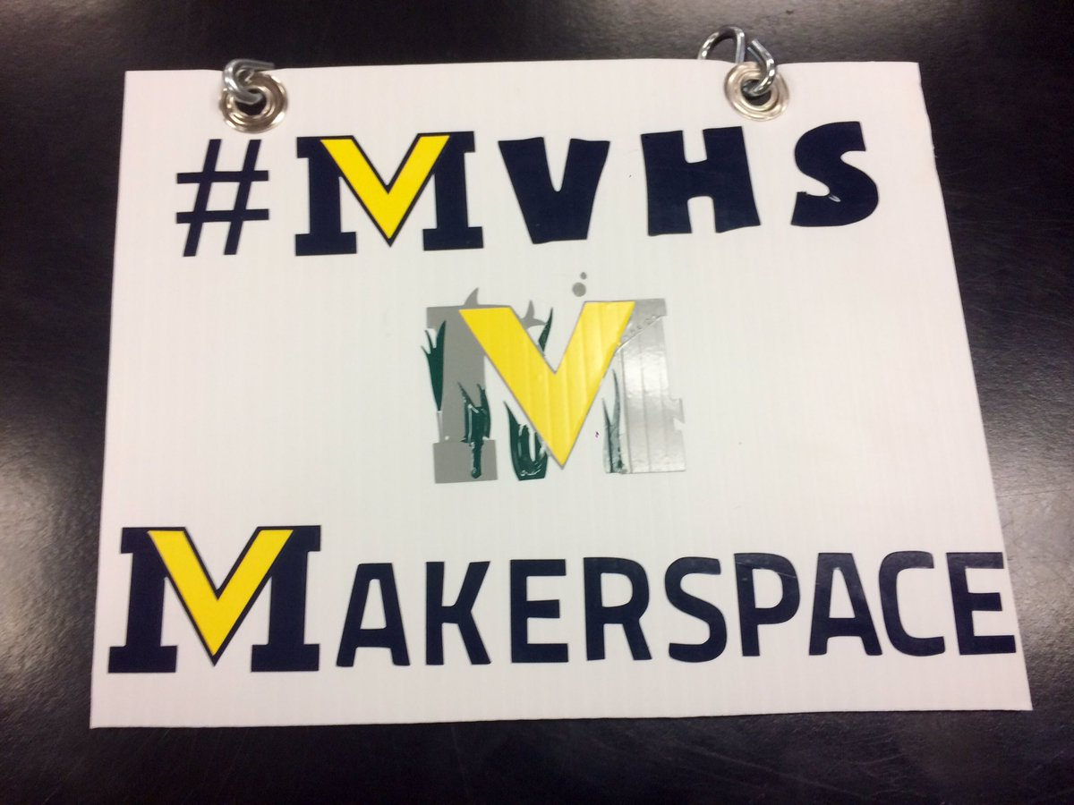
Vinyl Cutting… - Silhouette Cameo 1 & 3 - Sign/Heat Transfer/Stencil Vinyl
*This Semester: Millerton and Nelson School Signs, Stencil Crafts

Slide 9
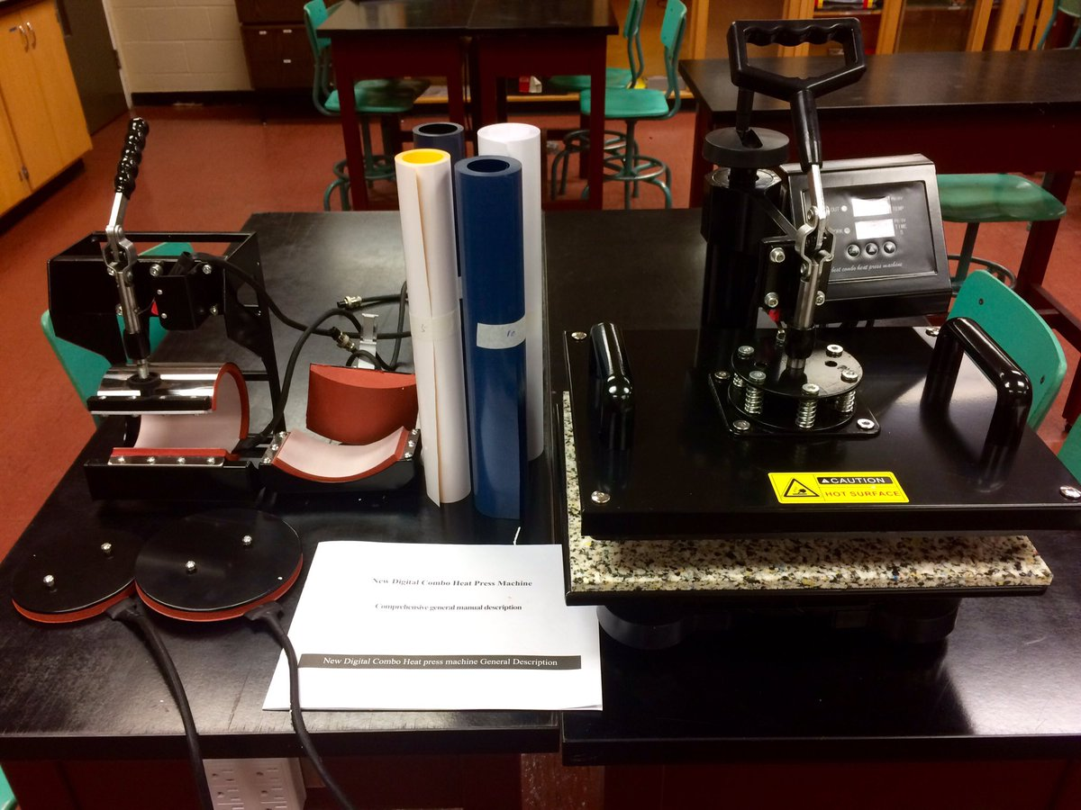
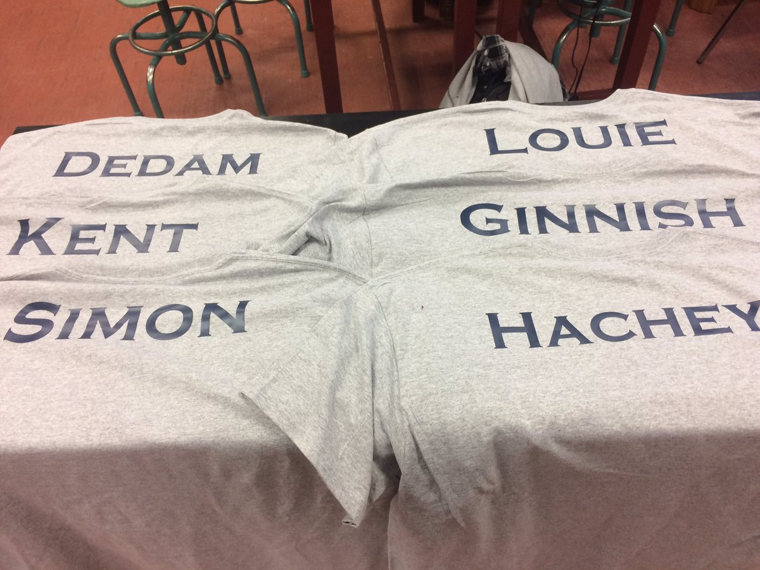
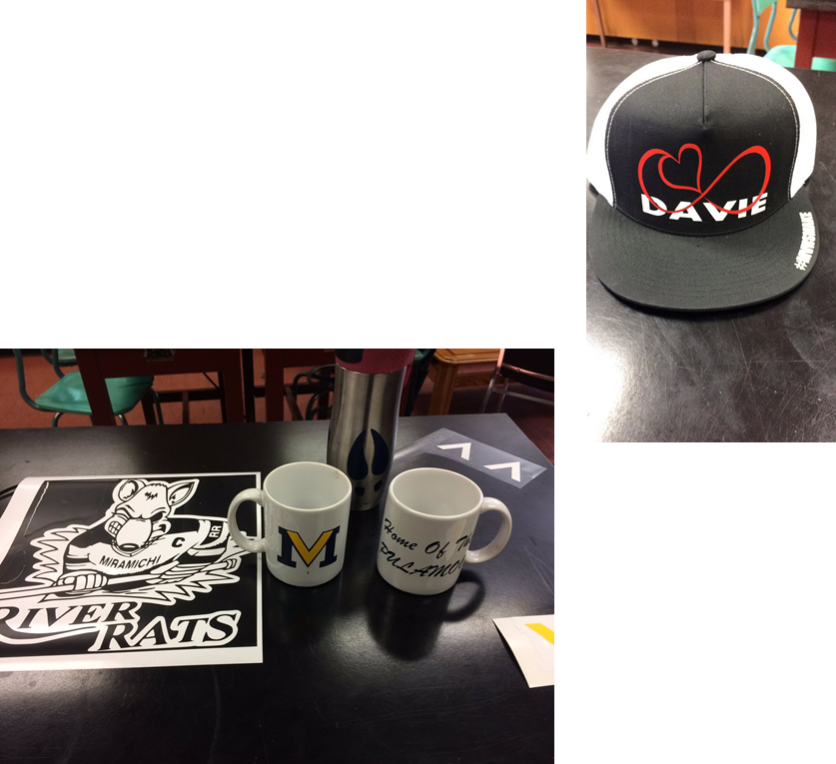
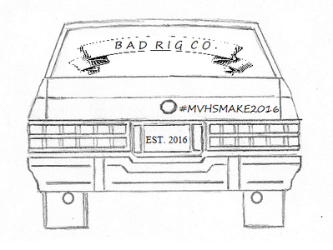
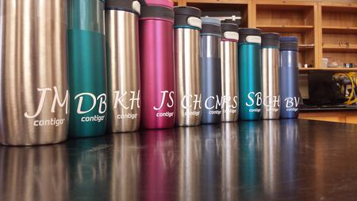
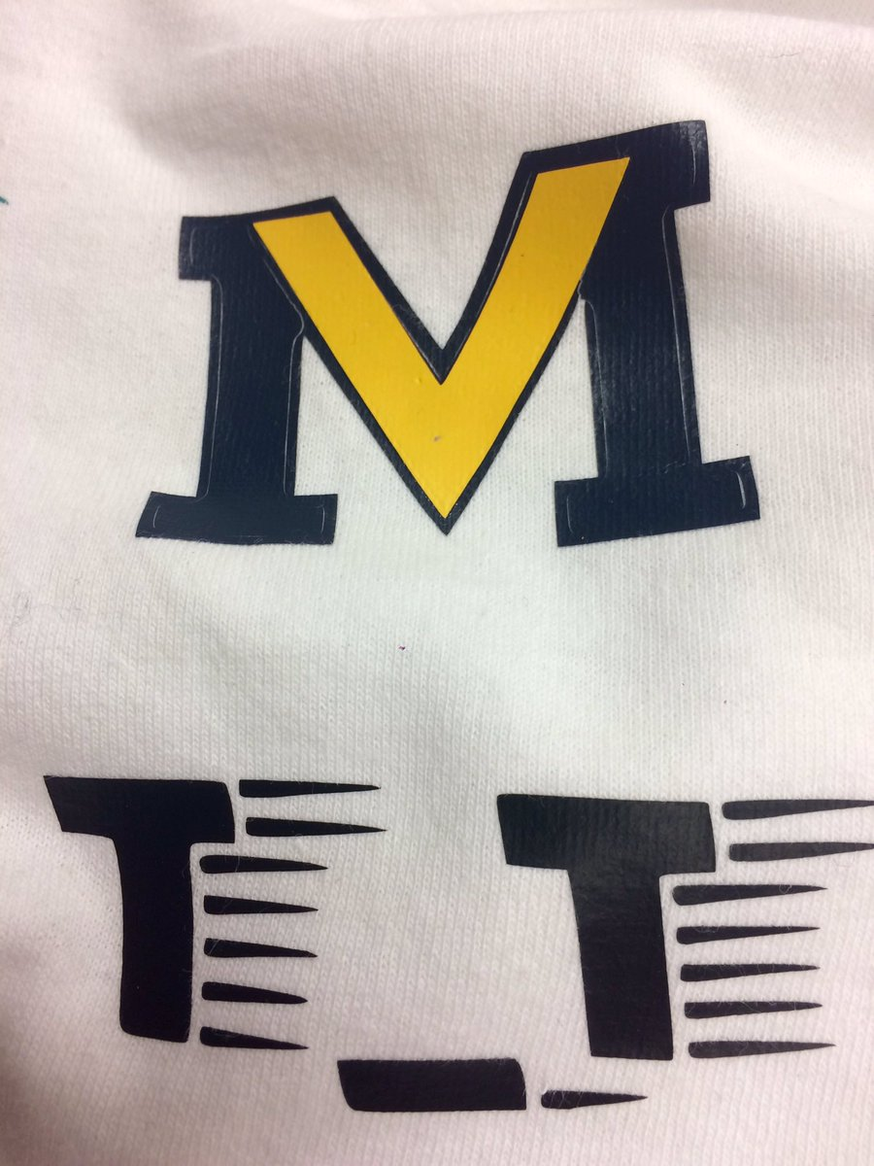
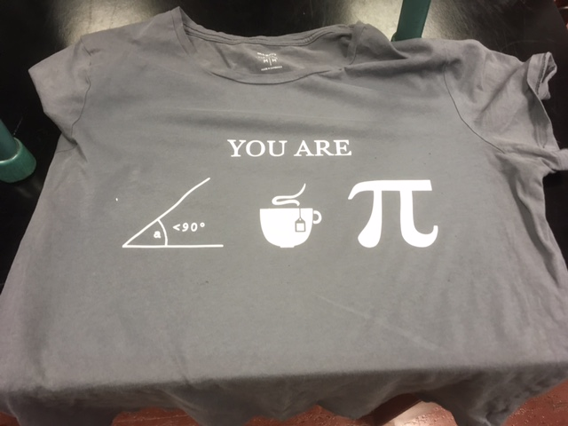
Heat Press… - Custom t-shirts/mugs/hats/logos
*This Semester: Custom clothing…Pi Day Shirts, Drag Team T-Shirts, #tightlines hats, DAVIE Aprons

Slide 10
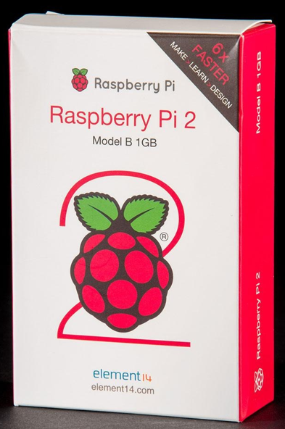
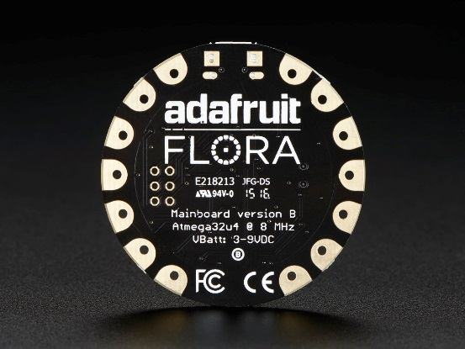
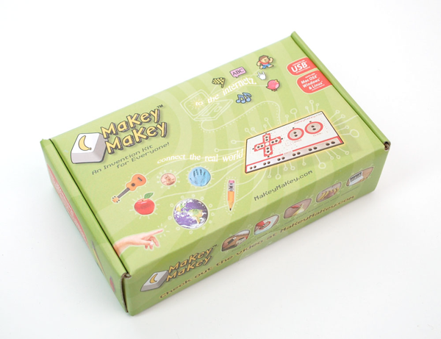
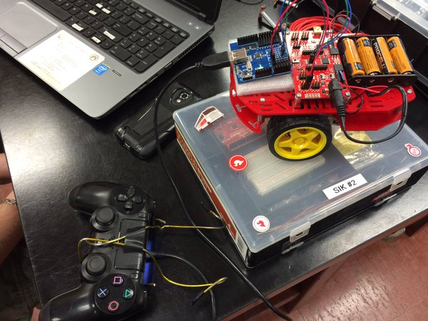
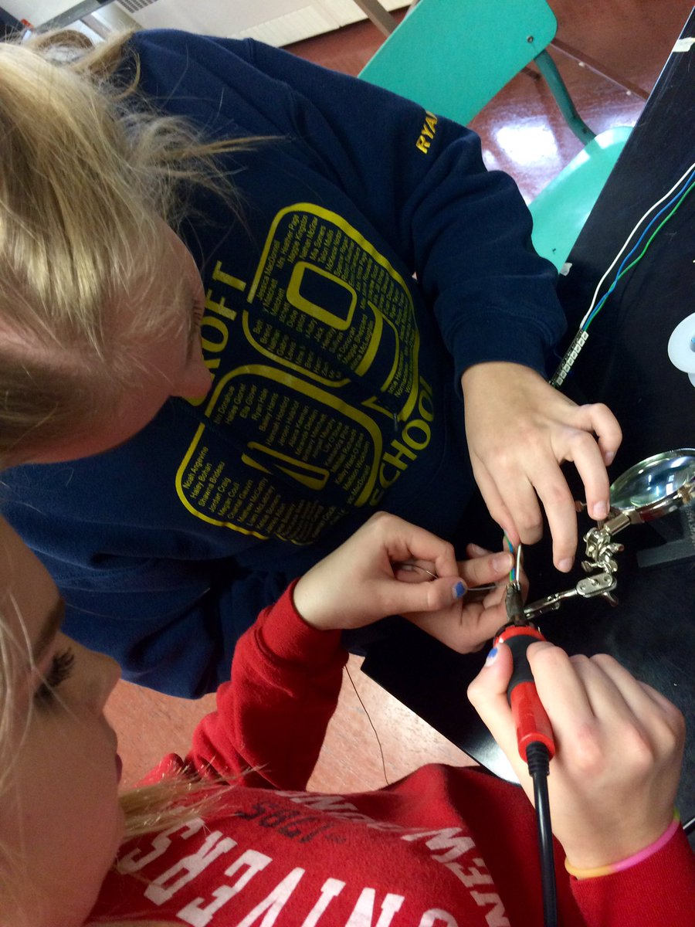
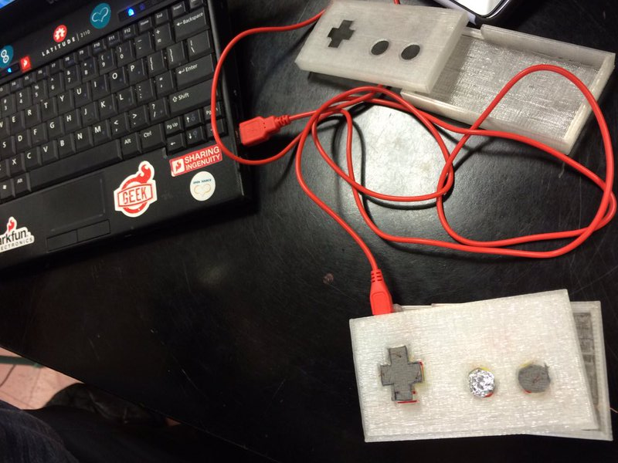
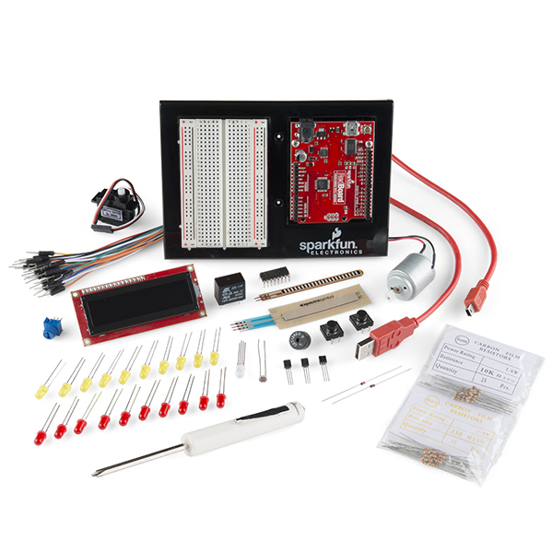
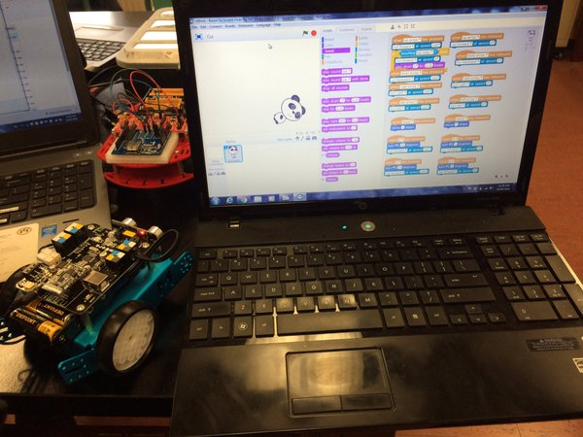
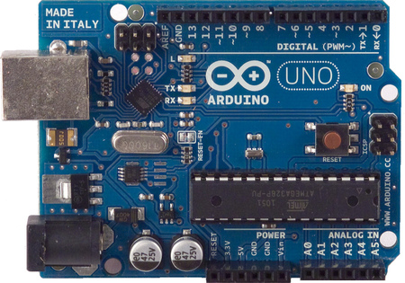
Microcontrollers… - Raspberry Pi, Flora, Circuit Playground, Uno, Makey Makey
* This Semester: Bluetooth Redbot, Retro Arcade, Interactive Painting with Flora & BLE ipad Switch with Feather MO

Slide 11
Robotics… - Arduino & Scratch programming - Redbots/Mbots/Sumobots, RetroArcade, Sphero * This Semester: Bluetooth RedBot, Mbot Soccer, Sphero Obstacle Course, RetroArcades, SumoBots

Slide 12
Dylan Howe & James MacMillan Coop 120 → Advanced Technology 120 students

Slide 13
BEAM… ‘Johnny 5’

Slide 14
MAKE Electronics… - Soldering & Circuits
* This Semester: Pulse Motor & Electric Pick with 3D Printed Case, Wearables, MATE ROV

Slide 15
Virtual Reality Video… - Oculus Rift, 360Fly, Dual GoPro Hero 3’s

Slide 16
Embroidery… - Singer Futura to do custom logos

Slide 17
APEGNB Trebuchet Challenge… #MVHSMake won 1st place in ASDNorth
* 2017 Challenge…Tomato Crusher with Trebuchet Launch

Slide 18
SuperPowerChallenge… - 2016 Finalist: Beacons for the Community
* This Semester: Submit several projects with hopes of placing in the top 10 again!

Slide 19
#MVHSMake
Thanks for your interest in the MVHS MakerSpace!
Next year we will be offering Advanced Technology 120 for
students who were successful in Coop 120 and want back
back into the MakerSpace for the second time
I have posted this PowerPoint along with a
link to the video playlist on our website…
My email is hallihana@nbed.nb.ca if you want to
further discuss the projects. Be great to have you
follow us on Twitter and subscribe to our YouTube
channel. Hope you can add some STEAM into your
lesson planning and course framework!

