Slide 1
Global Debt

Slide 2
Global Debt
Most of the countries in the world are in debt, this is known as global debt. The U.S. and the countries in Europe are the main lenders to third world countries.

Slide 3
Third World Debt
Poor countries often incur debt to provide for the basic necessities in life such as safe water, adequate shelter, sanitation, medicine, protection against warring factions, etc. With struggling economies, problems are often compounded when massive interest payments are unmet. The result is a negative credit rating which often restricts their ability to borrow on the open market.

Slide 4
Affects of Changing Existing Loan Size
By changing the loans sizes we found out that because of the interest the money is used quickly meaning needing another loan.
Out of Money and deeper in debt
Loan
Running of Country
Re-Paying Loans
and Extra Interest
Money Country Makes

Slide 5
What is HIPC
“HIPC” stands for heavily indebted poor countries. The scheme was set up in 1996 by the World Bank and IMF(International Monetary Fund). It was set up to cancel some of the poor country’s debt and to reduce the dept to a level that is manageable for payback.

Slide 6
Introduction
https://www.youtube.com/watch?v=zwIEZDMDBo4

Slide 7
Who controls HIPC
HIPC is monitored and put into action by the World Bank and IMF. But the rich countries, private creditors and regional banks who supply the money, are encouraged to get involved and decide where the money should go.

Slide 8
How Countries Claim HIPC
Countries qualify for HIPC if there are poor countries. By definition, poor countries are those with an annual income of $825 or less per person a year.
https://www.youtube.com/watch?v=9-4V3HR696k

Slide 9
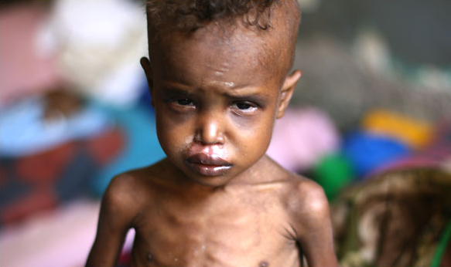
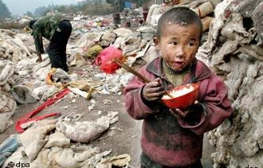
http://www.youtube.com/watch?v=daOAeB-zIIA&feature=related

Slide 10
Non Eligible for HIPC
Bangladesh: In 2005, Bangladesh paid $791 million to the rich world in debt payments. However, the World Bank does not even consider it moderately in debt. It instead describes Bangladesh as ‘less indebted’. Because of this Bangladesh’s debt is considered sustainable and instead of being rewarded for prompt debt servicing they are not eligible for debt relief. However some things have been done. Canada cancelled Bangladesh’s bilateral debt of $600,000 in 1999 due to devastating floods and extreme poverty levels. Also, in return for an $8.5 million the United Sates agreed to relieve $10 million in 2000. Bangladesh was one of the original countries highlighted as being in immediate need of debt cancellation.

Slide 11
Completed HIPC
Malawi: In 2005 Malawi paid $95 million to rich countries as debt repayments from a total debt of $3.2 billion. In 2006 this was reduced to $5 million. There are many conditions that Malawi must conform to for this cancellation. These include:
Strengthening of land and credit markets
Certain financial and economic policies being put into action.
Specific actions regarding health, education and safety.
Proper management of spending through

Slide 12
Global Debt
The Debt Simulation

Slide 13
Poorest Countries
The very poorest countries in the world are still paying over 4 million dollars every hour to the rich, repaying debts which in many cases arose from irresponsible lending. Rich country lenders have often done very well out of the loans they gave to poor countries, winning support or contracts. The poor people in countries with debt often did not benefit at all. But it is them who suffer from the demand that these debts be quick.

Slide 14
Interest Rates
Fluctuation of Interest Rates

Slide 15
What Debts Should We Drop?
Debts that a country can't afford to repay without meeting its people's basic needs.
Debts on loans that the lender knew was going to be stolen through corruption.
Debts in payment for projects that failed because of bad advice or incompetence by the lenders.
Debt on unfair terms, such as very high interest rates.

Slide 16
Where did the debt come from?
In the 1960s and 1970s, poor countries were lent large amounts of money. Many banks in rich countries had huge sums of money deposited with them. They had to make money on this by lending it, and rushed to lend to poor countries. Meanwhile, many rich country governments were keen to support countries that they saw as potential allies in the cold war, so they lent them money.

Slide 17
What are the Major Types of Sovereign Debt Defaults?
External and Internal Debt Defaults
External debt default: Here a country defaults on its payments to foreign debt holders. When a country runs into a sovereign debt crisis interest rates rise, capital flows stop and the country is thrown into a severe period of economic contraction and fall in living standards.
When this happens, the country has a choice of debt repudiation which means it renegs on its debt to foreign debt holders entirely as Argentina did recently, as the Soviet Union did with Czarist bonds and Mexico in the 19th century or
debt restructuring and debt rescheduling which means that it sits down with its foreign creditors and negotiates a settlement. Usually, the creditors are forced to take a loss on some portion of the debt, known as a “haircut”, interest rates are renegotiated towards more favourable terms and external lending resumes
The IMF was created in 1945 to assist countries when they run into this type of crisis by extending emergency lending at concessionary rates based on conditionality, that the government undertakes a specific set of reforms to balance its budget and return the country to financial solvency

Slide 18
What are the Major Types of Sovereign Debt Defaults?
External and Internal Debt Defaults
Internal debt default: Here a country runs into an inability to service its debts to its citizens but is not forced to default, because the government has the power to print money to service its debts. This results in a rise in unexpected inflation and results in economic stagnation -stagflation
The inflation unleashed by the printing of money reduces the real value of the bonds held by debt holders who are its own citizens and thus the government lessens the burden of its debts. Inflation shifts the burden of debt from the state to its citizens and represents the ultimate form of taxation.
The process of unwinding the sovereign debt burden results in a period of moderate inflation (10% - 20%) and moderate contraction. The Developed world went through such an episode during the 1970s. Today, with central bank independence, it is questionable to what extent central banks will allow this to happen without breaching their inflation control mandates. If they resist, interest rates will rise.

Slide 19
First World Debt
Debt is not only a Third World problem! Most of the First World have also consistently ran deficit budgets on an annual basis and borrowed billions/trillions to pay for expected services to maintain lifestyles.
https://learn.stashinvest.com/10-countries-with-largest-national-debt-to-gdp
http://www.businessinsider.com/countries-by-debt-2011-07?op=1
http://en.wikipedia.org/wiki/List_of_countries_by_external_debt

Slide 20
Government Budget Deficits, Percent of GDP, 2009
Budget deficits have exploded all over with the worst affected being in the advanced
industrial world
https://www.youtube.com/watch?v=BIdD-31otWQ
Iceland
Greece
UK
Spain
Ireland
USA
Portugal
France
Japan
Czeck
Belgium
Russia
Turkey
Italy
Netherlands
Canada
0
2
4
6
8
10
12
14
16
18
https://www.youtube.com/watch?v=Njp8bKpi-vg

Slide 21
Advanced Economies: Gross Debt-to-GDP Ratios, 2010 IMF Projections
Debt-GDP ratios have been rumped up dramatically in many countries
250
Percent (%) of GDP
225
200
Japan
Iceland
Greece
Italy
175
Belgium
USA
150
France
Canada
125
Portugal
Israel
100
UK
Germany
75
Ireland
Austria
50
Netherl
Spain
25
0
https://www.youtube.com/watch?v=3PZDLG-rtGs

Slide 22
http://www.youtube.com/watch?v=xx5nsIL1c0M
http://www.youtube.com/watch?v=wr8kZu4zbLQ
http://www.youtube.com/watch?v=h8TiFx56pxU&feature=fvwrel
https://www.youtube.com/watch?v=Ln6VGCB8f_c

