Slide 1
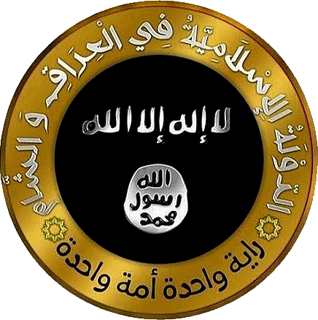
ISIS/ISIL/Daʿesh/IS
By: Andrew & Connor

Slide 2
Who Are they?
ISIL originated as the strongest, most unruly branch of the al Qaeda terrorist group, known as Al Qaeda in Iraq (AQI)
In February 2014 Al Qaeda and AQI split as the frayed relationship could no longer continue, and ISIL was formed.
https://www.youtube.com/watch?v=vOGLesXQ4Tc

Slide 3
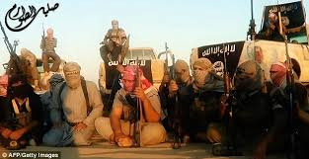

Slide 4
What are their goals?
ISIS is attempting to form a Hardline Sunni caliphate ( Islamic Government )
ISIS at one point controled an area approximately equal in size to Belgium
Their ambitions don’t stop there, they wish to take over much of the Middle East and parts of northern Africa

Slide 5
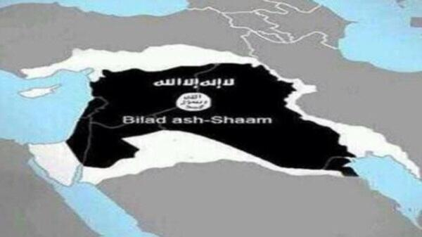

Slide 6
ISIS VS ISIL
In English, the group's name was translated variously
as the Islamic State of Iraq and al-Sham (ISIS), the
Islamic State of Iraq and Syria (also ISIS), or the
Islamic State of Iraq and the Levant (ISIL), the term
usually used by the U.S. government
and various U.N. agencies.
Levant- a vaguely defined territory that includes
what is now Syria, Lebanon, Israel, the Palestinian
territories and Jordan.
http://www.cbc.ca/player/play/1157279299982

Slide 7
Where did they come from?
The age-old conflict between the Sunni and Shia faiths provides the fuel and crusade-like belief that corrupted the minds of the ISIS fighters and allows them to commit horrid acts with the ideals of religion to justify them
The withdrawal of US militants without first stabilizing the region they destabilized created a power vacuum and when the minority Sunni people where being poorly represented the seeds of hate and terror where planted

Slide 8
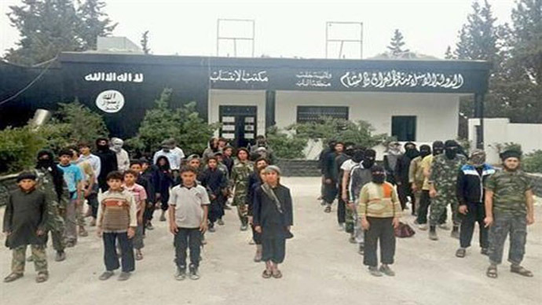

Slide 9
Sunni and Shia?
https://www.youtube.com/watch?v=5KLvjs7Yrtw
The Sunni and Shia conflict has been ongoing since 661 CE
The only time a Sunni and Shia cooperative government has ever been in control was in 950
With Saddam Hussein leadership the Sunni minority oppressed the Shia Majority
When the US left Iraq the Shia Majority oppressed the Sunni minority
Completely unexpectedly the Sunni minority lashed out in violent bursts and terrorist and rebel groups came into Iraq to fuel the fire

Slide 10
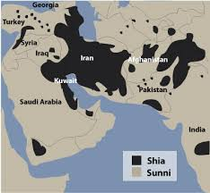

Slide 11
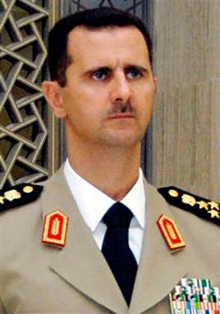

Slide 12
Syrian Rebellion
In 2012 the Syrian people began to protest the oppressive government of Bashar Hafez al-Assad and soon a police state began with nearly all freedom denied to the people of Syria
Thousands died while protesting, militants frequently opened fire on protesters
Small armed rebel groups began appearing and fighting back the Syrian army and police
When ISIL, being so highly disciplined and experienced invaded Syria they had little trouble with rebel groups and where much more fearsome than the Syrian military and easily defeated them off

Slide 13
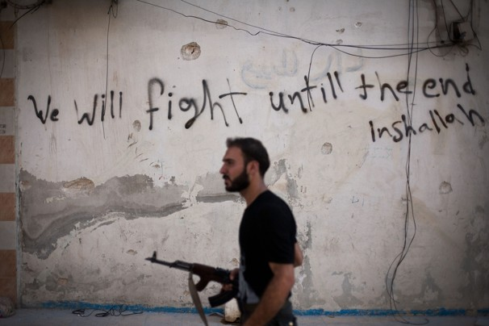

Slide 14
ISIS in Syria
ISIS has a critical foothold in Syria and over many very profitable oil fields, currently producing 4% of the entire world supply of oil
With the chaos in Syria unable to provide a solid leader or a disciplined militia ISIS forces have had little problem holding onto their territory and becoming increasingly more wealthy and powerful
They also looted the Iraqi and Syrian military weapons caches and are extremely well armed

Slide 15
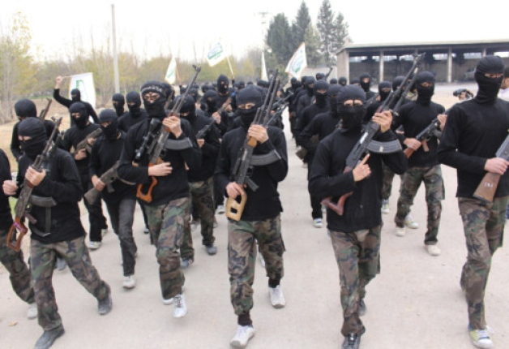

Slide 16
Follow the Money
ISIS is almost exclusively funded through oil and extortion
They hold control over many oil fields in Syria and a few in Iraq
They’re also known for kidnapping and holding people of interest for ransom to fund their organization
This has made them the most wealthy and well armed terrorist organization in the world

Slide 17
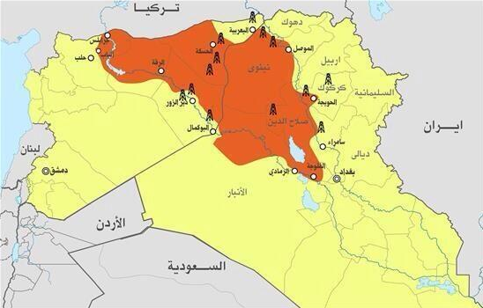

Slide 18
Iraqi Forces
The Iraqi army is made up of 250,000 members and are very poorly trained and display little discipline or will to fight
ISIS fighters where originally about 2,500 in numbers, but have grown to 15,000 actual combatants
Clearly the Iraqi army could have easily destroyed the ISIS fighters by numbers, however their will to fight and belief in their cause is much less powerful than that of the ISIS combatants
There are reports of over 45,000 Iraqi militants fleeing from less than 900 ISIS fighters due to their sheer power, weaponry, and ruthlessness

Slide 19
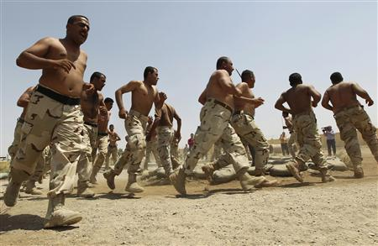

Slide 20
Iran and Syria
Iran has begun to fight against the ISIS combatants, but purely for religious reasons and they support the al-Assad regime
Although the UN, US, and Coalition forces appreciate the support, one must contemplate the agenda of Iran once ISIS fighters are defeated
With the coalition dead set against the Assad regime and Iran supporting them, this can easily breed ground for new conflicts in the near future

Slide 21
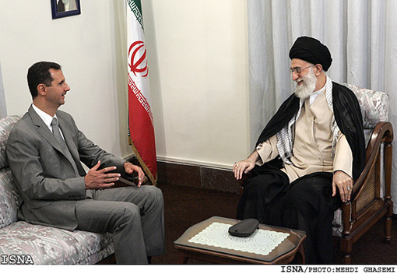

Slide 22
ISIS Control
ISIS now controls large swathes of territory including Mosul (Iraq’s second largest city) and are currently launching offensives on Baghdad Iraq’s capital and largest city
Along with the oil fields and other illicit sources of funding ISIS has stolen hundreds of millions from captured banks, financial institutions, and other precious items
As of September 25th ISIS has an estimated bankroll at about 2.3 Billion US dollars

Slide 23
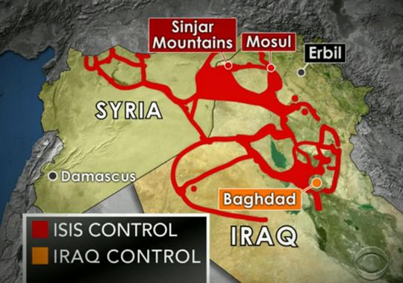

Slide 24
New-Age Terror
https://www.youtube.com/watch?v=2B9yEL_R4MY
Another critical contributor to ISIS’s success is their rapid modernization
You tube videos, websites, forums, and social media are all being used to distribute propaganda and show terrorist acts such as beheadings and the slaughter of innocents by the thousands
This is what created such an infamous reputation for the relatively new group and has begun to start pockets of ISIS supporters in countries all around the world, including Canada

Slide 25
