Slide 1
Airborne Operations
Normandy 1944

Slide 2
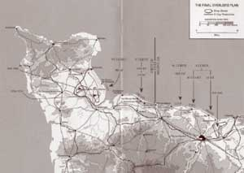
The First Wave
On the night of June 5th 1944, the allies sent paratroopers into a number of sites in Normandy
Their aims were:
Take or destroy bridges
Open roadways to center
Secure the flanks of the upcoming beachhead

Slide 3
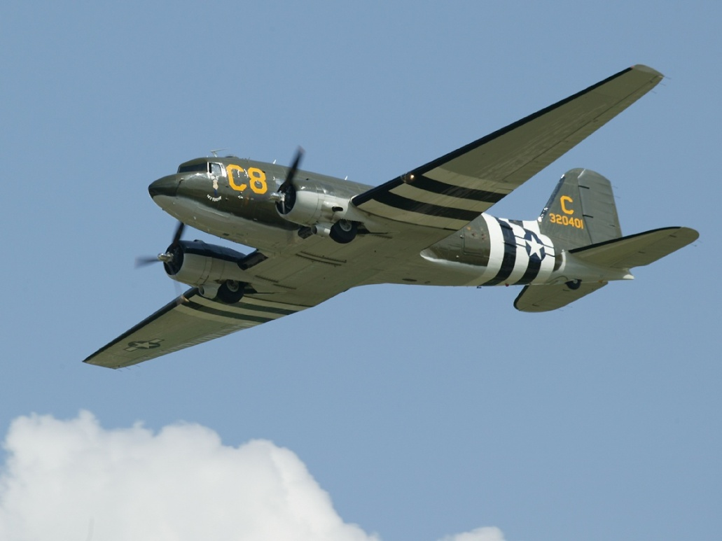
This will be the largest use of airborne units up to that time
More than 13,000 men
925 C-47 transport planes
4,000 reinforcements will arrive later in 500 gliders

Slide 4
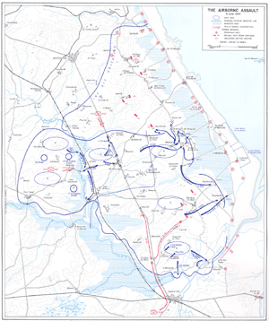
The Units
There were four main units involved:
US 82nd Airborne
US 101st Airborne
British 6th Airborne
1st Canadian Parachute Battalion

Slide 5
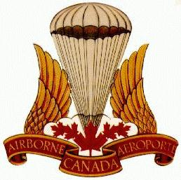
Unit symbols
82nd Airborne
101st Airborne
British 6th Airborne
1st Canadian Parachute Battalion

Slide 6
Results
The Canadians, despite taking high casualties, achieve all of their objectives
The British have similar success
The US drops were badly scattered with many of their men in the wrong places
Many US troops were killed or injured
Those who landed fought well and kept the Germans occupied

