Slide 1
D-Day
Operation Overlord
June 6, 1944

Slide 2
General Dwight D. Eisenhower
"You are about to embark upon the great crusade, toward which we have striven these many months.”

Slide 3
Naval Activity
There were ships from 8 different navies involved
Transport ships delivered the allied forces and supplies
Warships protected the fleet and provided the opening bombardment

Slide 4
Landing Operations
Five beaches were code-named for the Normandy landings (E to W)
Sword
Juno
Gold
Omaha
Utah
The guns at Point-du-Hoc were also targeted

Slide 5
Sword Beach
Bombardment from air and sea
Tanks went ashore at 7:30, followed closely by the infantry
Casualties were light
They advance about 8 km by day’s end
They do not take all of their objectives

Slide 6
Juno Beach
Canadians faced many obstacles during the landing:
Heavy artillery
Machine gun nests
Pillboxes and other concrete fortifications
High seawall
First wave suffered 50% casualties

Slide 7
Juno Beach
Within a few hours they have moved off the beach, assisted by the specialized tank units
15,000 Canadians are successfully landed by day’s end
Despite their success, they do not link up with the British at Sword Beach by the end of the day

Slide 8
Juno Beach
Canadian 3rd Division advanced further into France than any other allied unit on D-Day
In the next two days they will hold their ground against attacks from units of the 12th SS Hitler Jugend (Hitler Youth) and 21st Panzer Divisions

Slide 9
Gold Beach
British took heavy casualties
Tanks were delayed
Germans had a fortified village on the beach
British moved inland before day’s end

Slide 10
Omaha Beach
Attacked by two US Infantry divisions
Heavily fortified defenses:
Mortars
Machine guns
Artillery
Experienced defenders
Many landings drifted off course

Slide 11
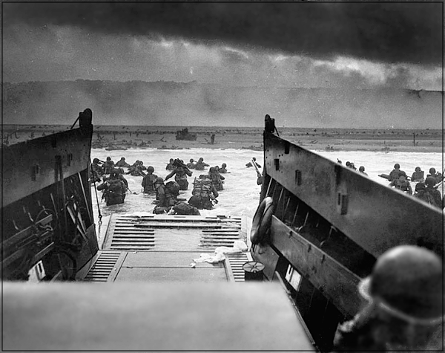
Omaha Beach
The official record stated that "within 10 minutes of the ramps being lowered, [the leading] company had become inert, leaderless and almost incapable of action. Every officer and sergeant had been killed or wounded [...] It had become a struggle for survival and rescue".

Slide 12
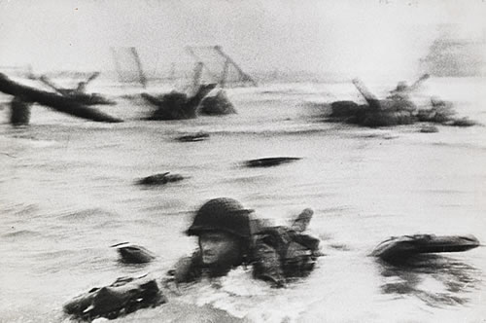
Omaha Beach
Numerous beach obstacles
Vehicles became trapped on the shores
Commanders considered abandoning the beach
Eventually small groups get through by scaling the cliffs
Two footholds established by day’s end

Slide 13
Omaha Beach
American casualties numbered about 5,000 out of a force of 50,000 men
Omaha beach is remembered as “Bloody Omaha”
The landings are re-enacted in the movie “Saving Private Ryan”

Slide 14
Pointe-Du-Hoc
US Rangers climbed the 30 meter cliffs under enemy fire to destroy the coastal defense guns
When they reached the top, the guns had been removed
The Rangers found them inland and destroyed them with special grenades
They later take 60% casualties holding their position

Slide 15
Utah Beach
Compared to other landings, Utah was the least deadly
197 casualties out of 23,000 men
Landing crafts went off course and landed where there was little opposition
Landed US soldiers linked up with the 101st Airborne by mid-afternoon

Slide 16
Mulberry Harbors
There is no port where the allies can land in Normandy, so they bring their own
These temporary structures are to serve as landing docks until a port is captured
A storm will later destroy them

