Slide 1
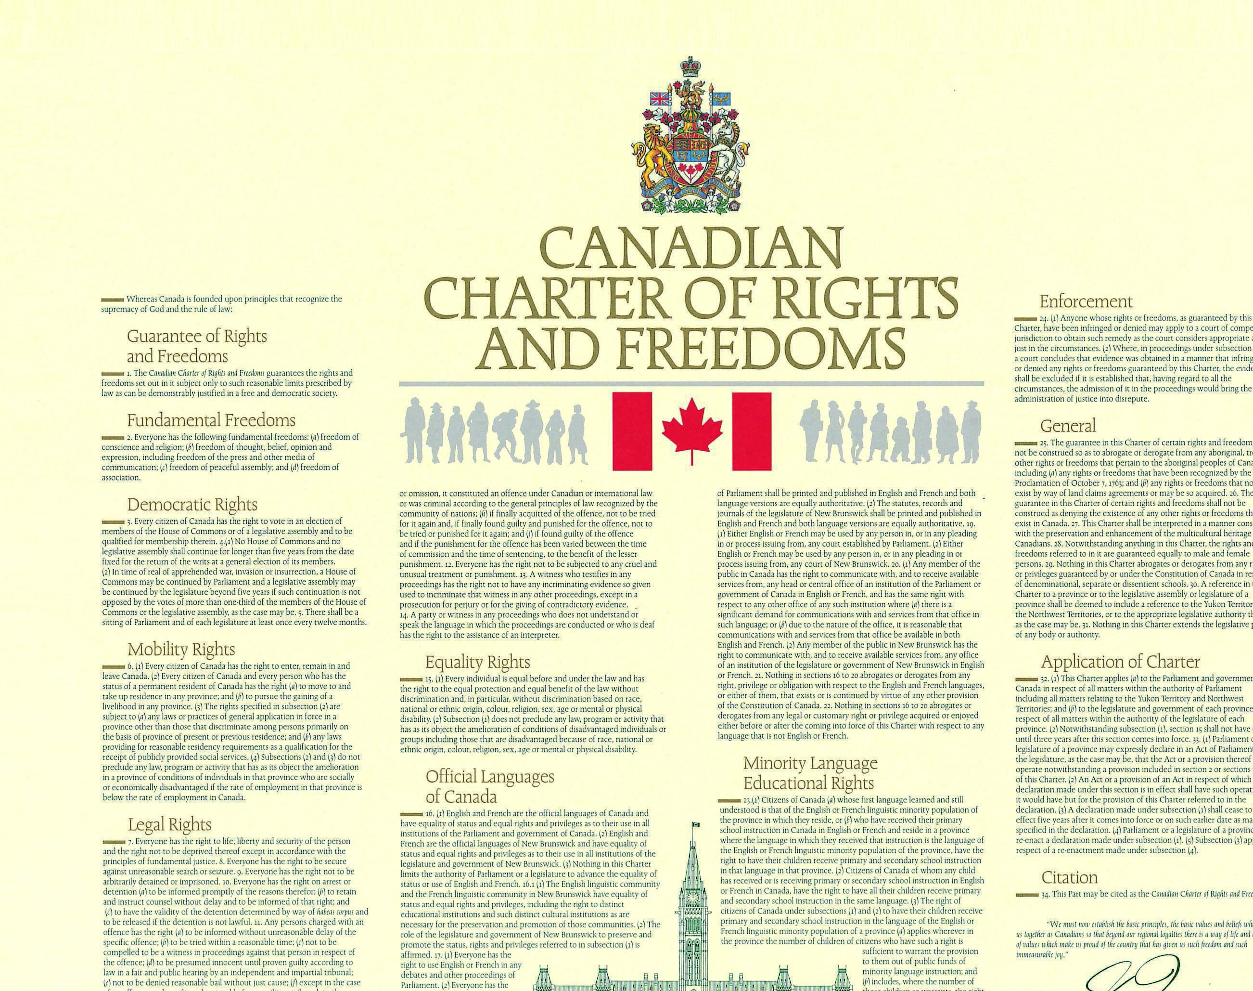
Democracy in Action!
How to be a responsible citizen

Slide 2
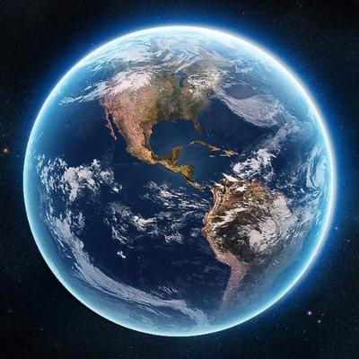
We will look at citizenship from a local, national and a global perspective.

Slide 3
Citizenship is defined as being a member of a particular country and having rights because of it.

Slide 4
We are citizens of our local community and in the global community. To define citizenship for yourself, you need to think about the role you play in society and in the world. You are a citizen of many groups- your family, your school, sports team, ethic or cultural groups. What are some other examples of places in our daily lives where you are a citizen?

Slide 5
What other examples of being a citizen of a group can you think of??
School
Cadets
Choir
Miramichi
Drama Club

Slide 6
How people become Canadian citizens if you are not born in Canada.
Be at least 18 years old.
Be a permanent resident who came to Canada legally (immigrant or refugee.
Been living in Canada 3-4 years before you apply to become a citizen
Speak English or French.
Know about Canadian history and geography.
Understand how our government works and what being a responsible citizen means.

Slide 7
Are you a responsible citizen? What are some current issues you are aware of? What areas need to be addressed at a local/national and global level?
War in Ukraine Poverty Drugs/addiction
Homelessness inflation LGBTQ+
Deforestation Pollution
Global warming
Climate change
Mental health

Slide 8
What can you do? Democracy in action!!
There are many things happening that have an impact on our daily lives and these events may be also be ongoing.
Locally we have an issue with very little for youth in our area. Do you agree?
Do you think it is a problem in other urban areas?
What do you think is the reason for this? Provide 3 reasons:
What types of leisure activities/facilities do we currently have?
Do you think that this problem is something you can help to solve in our community (municipality)?
What are some things we can do to as responsible citizens to create awareness of this issue ?

