Slide 1
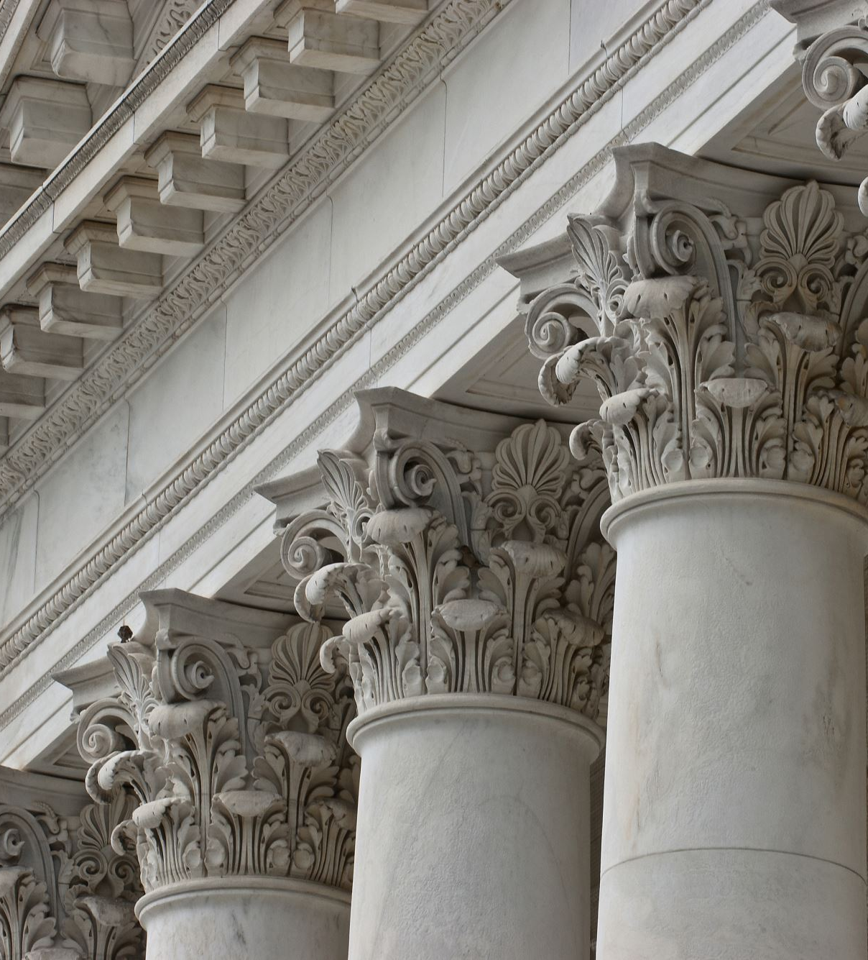
Municipal Government
Learning about our municipal government, services provided and elected representatives .

Slide 2
What is municipal government?
Municipal government is one of the three levels of government within Canada. It is local government.
The local government(s) are controlled by the provincial government.
Cities and towns have elected mayors and councils.
These representatives are chosen by eligible voters.

Slide 3
Roles of Municipal Government
Garbage collection/recycling.
Street plowing and repairs.
Building and maintaining parks and recreation facilities.
City transit (busses).
City Bi-laws.
Some responsibilities of municipal government are:

Slide 4
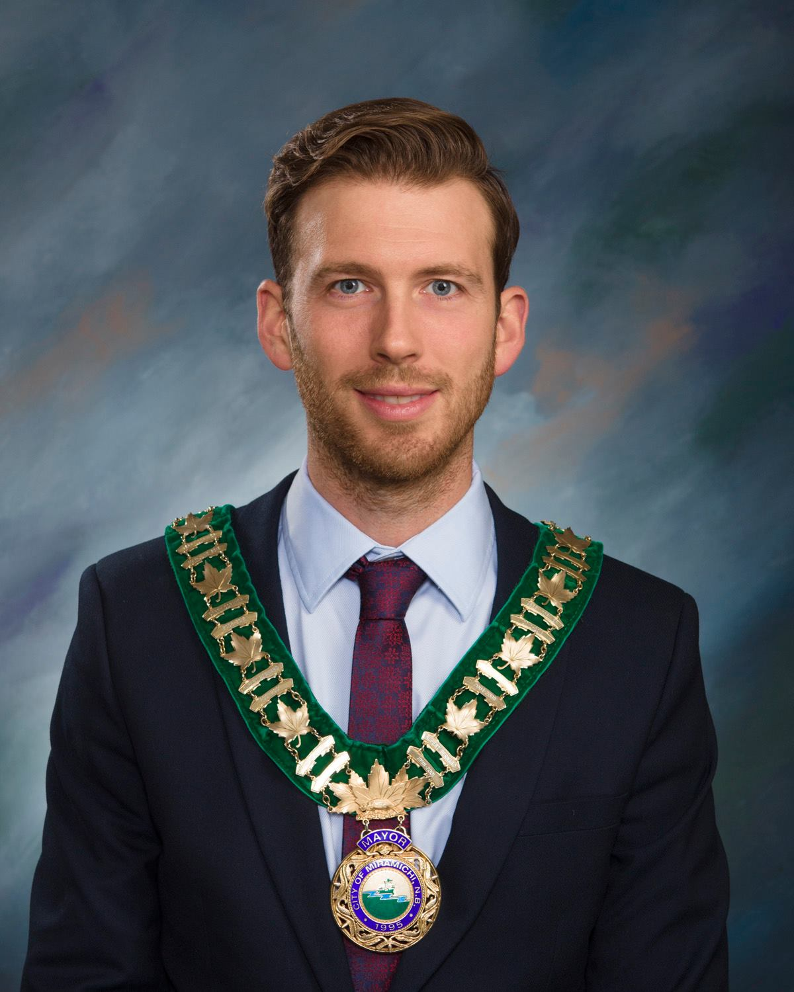
Our Mayor: Mr. Adam Lordon
This area has all the amenities offered in a larger urban center, yet the cost of living is much lower and makes Miramichi a great choice for a person to settle and establish their roots.
Mr. Lordon is a young and energetic individual who is helping to promote our regional identity and attract new individuals/businesses to our city.

Slide 5
Miramichi City Council:
PADDY QUINN (DEPUTY MAYOR)
CITY COUNCILLORS:
VERONIQUE ARSENAULT RYAN SOMERS
JASON HARRIS TARA ROSS-ROBINSON
SAM JOHNSTON CHAD DUPLESSIE
BRIAN KING

Slide 6
What grinds your gears???
Municipal government is responsible for the day-to-day operations and regular council meetings are held to deal with any issues relating to the successful functioning of the city.
As we discussed earlier-in order to initiate change or to bring a concern to the attention of our council, we have many options:
Do you remember some ways we had discussed before?

Slide 7
Showing your concerns:
Write a letter/send an email
Peaceful protests
Petitions
Social Media campaigns
Posters
Billboards
Etc.

Slide 8
Politics in Action!
The next two classes we are going to work in the computer lab to write a persuasive letter about a concern relating to events/situations in Miramichi (something you think is a problem) prior to our class visit from Mayor Lordon:
Each student will write a letter to the Mayor and Council stating your concerns about one of the following:
the lack of leisure/recreation activities for youth aged 13-18 in our city, drug use, homelessness, bus stops, dangerous intersections, etc.
We will present our letters to Mr. Lordon when he visits on April 25th.

