Slide 1
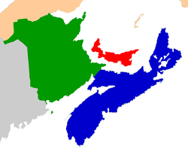
On behalf of our host teams and
Welcome to the 2017 Miramichi Hoop Classic!
We would like to extend a sincere “thank you” to all our tournament sponsors!
Also, thanks to all the dedicated coaches, student athletes, school administrators, referees, parents and fans for participating in our 25th annual GIANT TIGER
Miramichi Hoop Classic basketball tournament.
Carleton North High School Florenceville - Bristol, NB
Moncton High School
Moncton, NB
Miramichi
Woodstock High School
Woodstock, NB
Leo Hayes High School
Fredericton, NB
Fredericton High School
Fredericton , NB
Saint John High School Saint John, NB
John Caldwell High School
Grand Falls, NB
Central Kings Rural High School
Cambridge, NS
Amherst Regional High School
Amherst, NS
Charlottetown Rural High School
Charlottetown , PEI
Rothesay High School
Rothesay, NB
Welcome sheet provided by:

