Slide 1
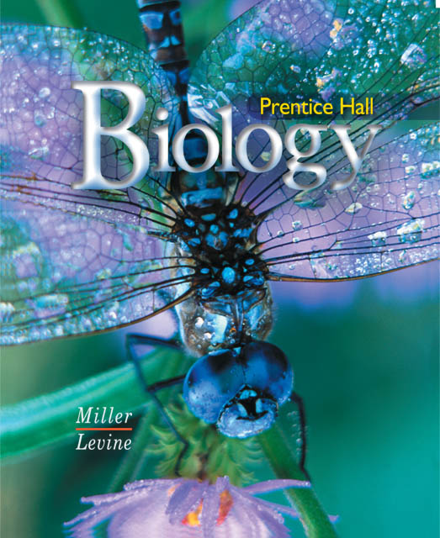
Biology

Slide 2
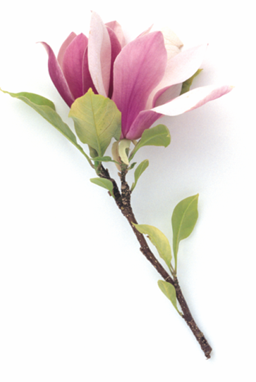
22–5 Angiosperms—Flowering Plants
Notes:
Photo credit: ©Dorling Kindersley

Slide 3
Flowers and Fruits
The majority of living plant species are flowering plants, or angiosperms.

Slide 4
Flowers and Fruits
What are the characteristics of angiosperms?

Slide 5
Flowers and Fruits
Flowers and Fruits
Angiosperms develop unique reproductive organs known as flowers.

Slide 6
Flowers and Fruits
Flowers are an evolutionary advantage because they attract animals, which then transport pollen from flower to flower.
Flowers contain ovaries, which surround and protect the seeds.
After pollination, the ovary develops into a fruit.
A fruit is a wall of tissue that surrounds a seed. A fruit protects the seed and aids in its dispersal.

Slide 7
Diversity of Angiosperms
Diversity of Angiosperms
Angiosperms are categorized in many ways:
monocots and dicots
woody and herbaceous plants
annuals, biennials, and perennials
An angiosperm can belong to more than one category.

Slide 8
Diversity of Angiosperms
Monocots and Dicots
There are two classes within the angiosperms—monocots and dicots.

Slide 9
Diversity of Angiosperms
What are monocots and dicots?

Slide 10
Diversity of Angiosperms
Monocots and dicots are named for the number of seed leaves, or cotyledons, in the plant embryo. Monocots have one seed leaf, and dicots have two.
A cotyledon is the first leaf or the first pair of leaves produced by the embryo of a seed plant.

Slide 11
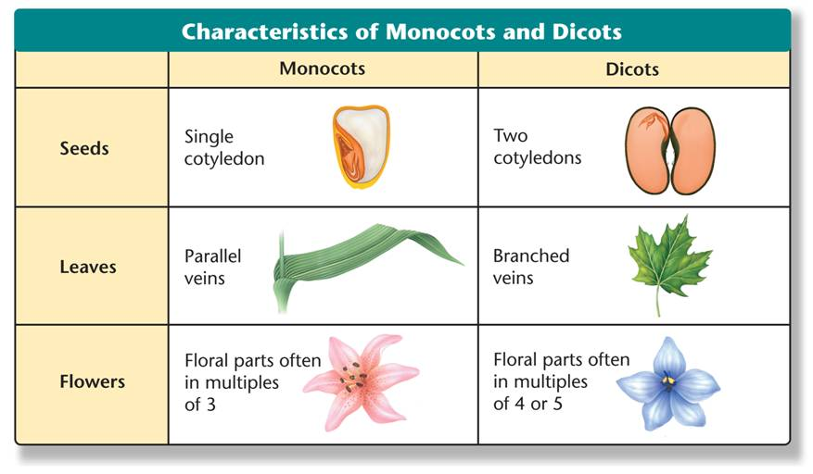
Diversity of Angiosperms
Notes:
Monocots and dicots are named for the number of seed leaves, or cotyledons, in the plant embryo. The table compares the characteristics of monocots and dicots.

Slide 12
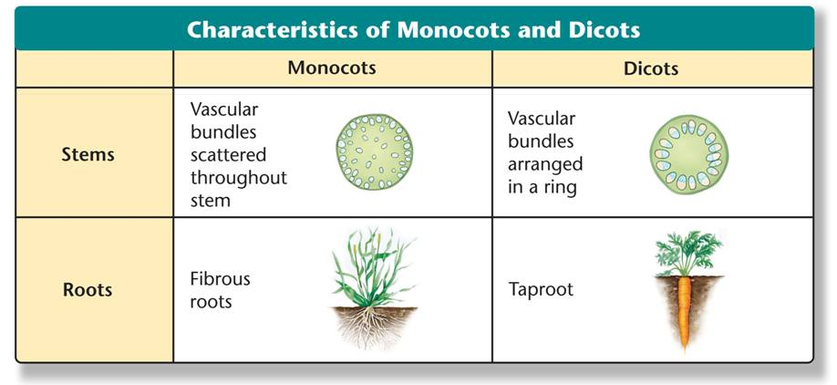
Diversity of Angiosperms
Notes:
Monocots and dicots are named for the number of seed leaves, or cotyledons, in the plant embryo. The table compares the characteristics of monocots and dicots.

Slide 13
Diversity of Angiosperms
Monocots include corn, wheat, lilies, orchids, and palms.
Dicots include roses, clover, tomatoes, oaks, and daisies.

Slide 14
Diversity of Angiosperms
Woody and Herbaceous Plants
Flowering plants are also categorized by the woodiness of the stem.
Woody plants are made primarily of cells with thick cell walls that support the plant body.
Woody plants include trees, shrubs, and vines.

Slide 15
Diversity of Angiosperms
Plant stems that are smooth and nonwoody are characteristic of herbaceous plants.
Herbaceous plants do not produce wood as they grow.
Herbaceous plants include dandelions, zinnias, and petunias.

Slide 16
Diversity of Angiosperms
Plant life span is determined by genetic and environmental factors.
What are the three categories of plant life spans?

Slide 17
Diversity of Angiosperms
Annuals, Biennials, and Perennials
There are three categories of plant life spans: annual, biennial, and perennial.

Slide 18
Diversity of Angiosperms
Annuals are plants that complete a life cycle in one growing season.
Biennials complete their life cycle in two years. In the first year, they germinate and grow roots, short stems, and sometimes leaves. In the second year, they grow new stems and leaves, produce flowers and seeds, and die.
Perennials live for more than two years.

Slide 19
22–5

Slide 20
22–5
One function of angiosperm fruit is to
distract animals from eating the rest of the plant.
provide extra food for the seeds.
attract animals to eat the fruit and spread seeds.
store food for use by the plant.

Slide 21
22–5
Flowers are specialized structures in angiosperms that
have ovaries that surround and protect the seeds.
attract animals to eat the flowers instead of the plant.
are the site of asexual reproduction for the plant.
make toxins to protect seeds developing inside the flower.

Slide 22
22–5
Angiosperms that have one seed leaf are classified as
biennials.
monocots.
dicots.
annuals.

Slide 23
22–5
Which of the following is a characteristic of monocots?
branched veins
parallel veins
taproots
seed with two cotyledons

Slide 24
22–5
Flowering plants that live for more than two years are called
biennials.
annuals.
perennials.
shrubs.

Slide 25
END OF SECTION

