Slide 1
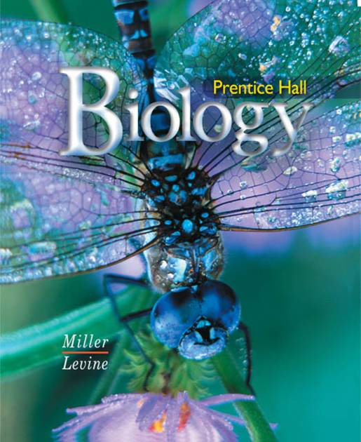
Biology

Slide 2
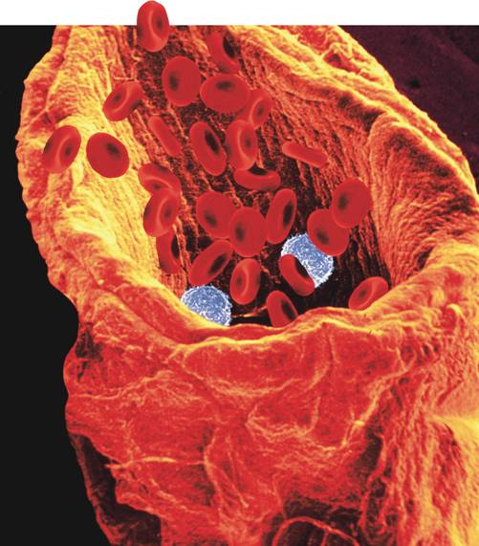
37–1 The Circulatory System
Notes:
Photo Credit: © Image Shop/Phototake

Slide 3
37–1 The Circulatory System
The circulatory system and respiratory system work together to supply cells with the nutrients and oxygen they need to stay alive.

Slide 4
Functions of the Circulatory System
Functions of the Circulatory System
Humans and other vertebrates have closed circulatory systems, meaning that the blood is contained within a system of vessels.

Slide 5
Functions of the Circulatory System
What are the structures of the circulatory system?

Slide 6
Functions of the Circulatory System
The human circulatory system consists of:
the heart
blood vessels
blood

Slide 7
The Heart
The Heart
The heart is enclosed in a protective sac of tissue called the pericardium.
In the walls of the heart, two layers of epithelial and connective tissue form around a thick layer of muscle called the myocardium.
Contractions of the myocardium pump blood.

Slide 8
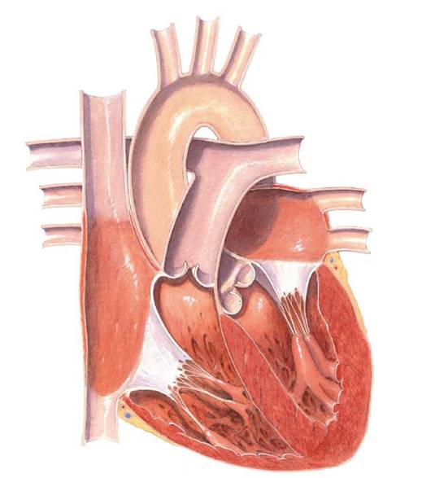
The Heart
Structures of the Heart

Slide 9
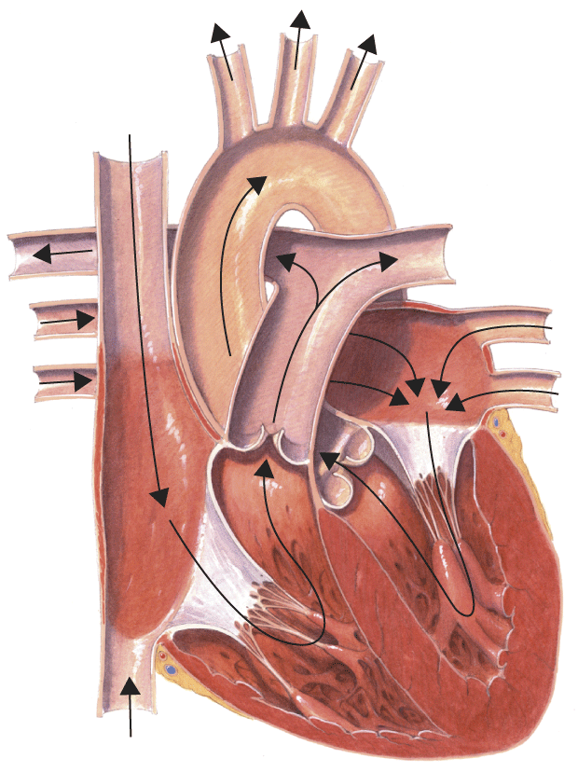
The Heart
Superior Vena Cava:
Large vein that brings oxygen-poor blood from the upper part of the body to the right atrium
Right Atrium

Slide 10
The Heart
Left Atrium
Pulmonary Veins:
Bring oxygen-poor blood from each of the lungs to the left atrium

Slide 11
The Heart
Pulmonary Arteries
Pulmonary Valve:
Prevents blood from flowing back into the right ventricle after it has entered the pulmonary artery.
Right Atrium

Slide 12
The Heart
Right Atrium
Tricuspid Valve:
Prevents blood from flowing back into the right atrium after it has entered the right ventricle

Slide 13
The Heart
Right Atrium
Inferior Vena Cava:
Vein that brings oxygen-poor blood from the lower part of the body to the right atrium.

Slide 14
The Heart
Left Atrium
Mitral Valve: Prevents blood from flowing back into the left atrium after it has entered the left ventricle
Left Ventricle

Slide 15
The Heart
Aorta
Left Atrium
Aortic Valve: Prevents blood from flowing back into the left ventricle after it has entered the aorta
Left Ventricle

Slide 16
The Heart
Pulmonary Arteries:
Bring oxygen-poor blood to the right or left lung

Slide 17
The Heart
Aorta:
Brings oxygen-rich blood from the left ventricle to the body

Slide 18
The Heart
The septum divides the right side of the heart from the left.
It prevents the mixing of oxygen-poor and oxygen-rich blood.

Slide 19
The Heart
The heart has four chambers—two atria and two ventricles.
There are two chambers on each side of the septum.
The upper chamber, which receives the blood, is the atrium.
The lower chamber, which pumps blood out of the heart, is the ventricle.

Slide 20
The Heart
Circulation Through the Heart
Blood enters the heart through the right and left atria.
As the heart contracts, blood flows into the ventricles and then out from the ventricles to either the body or the lungs.

Slide 21
The Heart
There are flaps of connective tissue called valves between the atria and the ventricles.
When the ventricles contract, the valves close, which prevents blood from flowing back into the atria.

Slide 22
The Heart
At the exits from the right and left ventricles, valves prevent blood that flows out of the heart from flowing back in.
Blood leaves the left ventricle, and enters the aorta.
The aorta is one of the blood vessels that carry the blood through the body and back to the heart.

Slide 23
The Heart
Circulation Through the Body
The heart functions as two separate pumps.

Slide 24
The Heart
Pulmonary Circulation
One pathway circulates blood between the heart and the lungs.
This pathway is known as pulmonary circulation.
In the lungs, carbon dioxide leaves the blood and oxygen is absorbed. The oxygen-rich blood returns to the heart.

Slide 25
The Heart
Systemic Circulation
The second pathway circulates blood between the heart and the rest of the body.
This pathway is called systemic circulation.
After returning from the lungs, the oxygen-rich blood is pumped to the rest of the body.

Slide 26
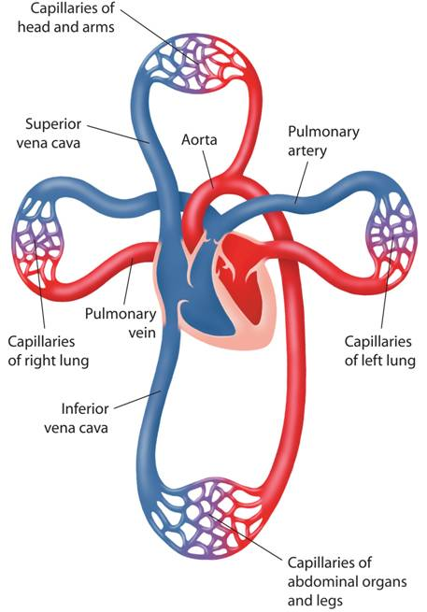
The Heart
Capillaries of head and arms
Circulation of Blood through the Body
Superior vena cava
Pulmonary artery
Aorta
Pulmonary vein
Capillaries of right lungs
Capillaries of left lung
Inferior vena cava
Capillaries of abdominal organs and legs
Notes:
The circulatory system is divided into two pathways. Pulmonary circulation carries blood between the heart and the lungs. Systemic circulation carries blood between the heart and the rest of the body.

Slide 27
The Heart
Heartbeat
Each contraction begins in the sinoatrial (SA) node in the right atrium.
Because these cells start the wave of muscle contraction through the heart, they are called the pacemaker.

Slide 28
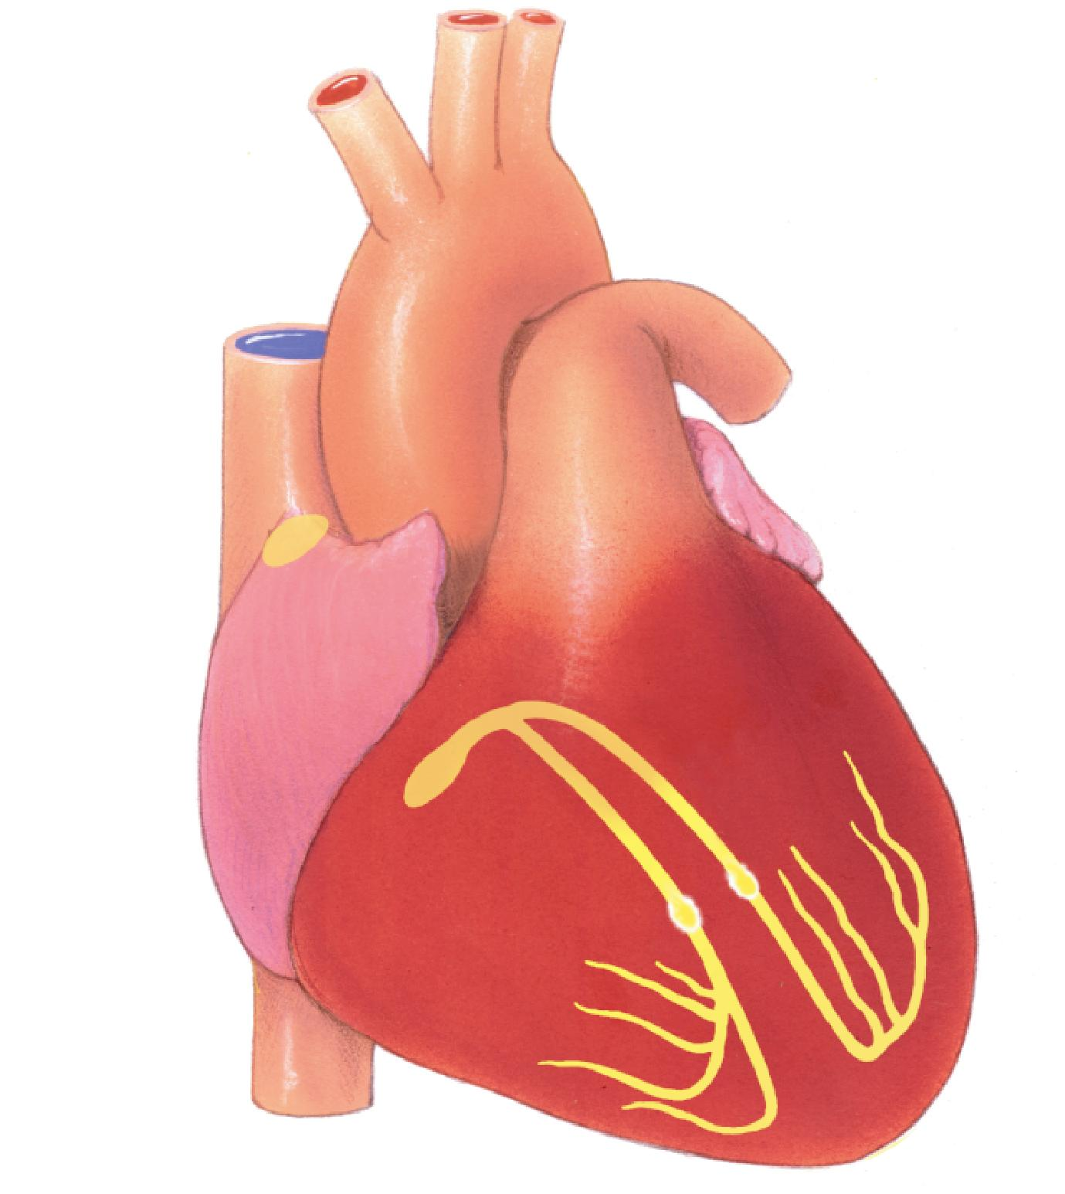
The Heart
The impulse spreads from the pacemaker (SA node) to a network of fibers in the atria.
Sinoatrial (SA) node
Conducting fibers
Notes:
The signal to contract spreads from the sinoatrial node to the cardiac muscle cells of the atria, causing the atria to contract. The impulse is picked up by the atrioventricular node, which transmits the impulse to muscle fibers in the ventricles, causing the ventricles to contract.

Slide 29
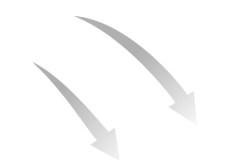
The Heart
The impulse is picked up by a bundle of fibers called the atrioventricular (AV) node and carried to the network of fibers in the ventricles.
Conducting fibers
Atrioventricular (AV) node
Notes:
The signal to contract spreads from the sinoatrial node to the cardiac muscle cells of the atria, causing the atria to contract. The impulse is picked up by the atrioventricular node, which transmits the impulse to muscle fibers in the ventricles, causing the ventricles to contract.

Slide 30
The Heart
When the network in the atria contracts, blood in the atria flows into the ventricles.
When the ventricles contract, blood flows out of the heart.

Slide 31
Blood Vessels
Blood Vessels
What are the three types of blood vessels in the circulatory system?

Slide 32
Blood Vessels
As blood flows through the circulatory system, it moves through three types of blood vessels:
arteries
capillaries
veins

Slide 33
Blood Vessels
Arteries
Large vessels that carry blood from the heart to the tissues of the body are called arteries.
Except for the pulmonary arteries, all arteries carry oxygen-rich blood.
Arteries have thick walls.
They contain connective tissue, smooth muscle, and endothelium.

Slide 34
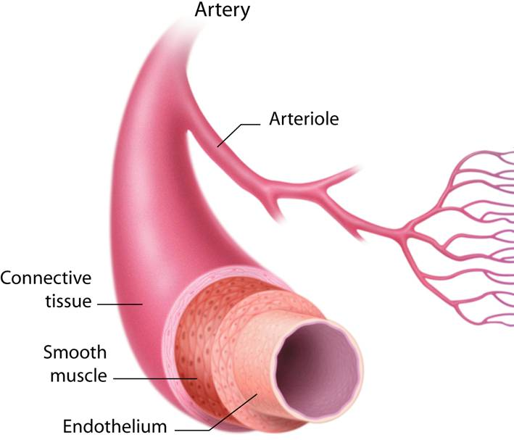
Blood Vessels
Notes:
In the circulatory system, there are three types of blood vessels—arteries, capillaries, and veins. The walls of these vessels contain connective tissue, smooth muscle, and endothelium.

Slide 35
Blood Vessels
Capillaries
The smallest of the blood vessels are the capillaries.
Their walls are only one cell thick, and most are narrow.
The capillaries bring nutrients and oxygen to the tissues and absorb carbon dioxide and other waste products from them.

Slide 36
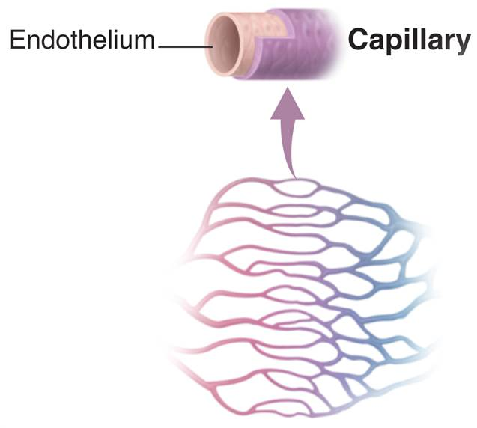
Blood Vessels
Notes:
In the circulatory system, there are three types of blood vessels—arteries, capillaries, and veins. The walls of these vessels contain connective tissue, smooth muscle, and endothelium.

Slide 37
Blood Vessels
Veins
Blood vessels that carry blood back to the heart are veins.
Veins have thinner walls than arteries.
The walls of veins contain connective tissue and smooth muscle.

Slide 38
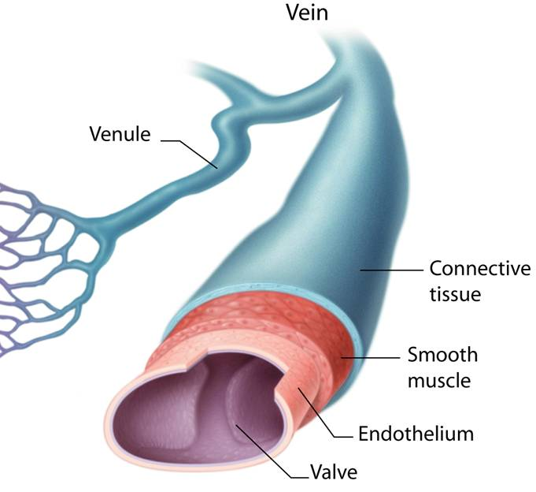
Blood Vessels
Notes:
In the circulatory system, there are three types of blood vessels—arteries, capillaries, and veins. The walls of these vessels contain connective tissue, smooth muscle, and endothelium.

Slide 39
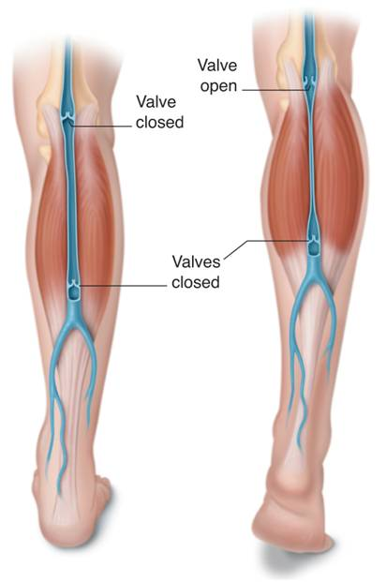
Blood Vessels
Valve open
Large veins contain valves that keep blood moving toward the heart.
Many veins are located near and between skeletal muscles.
Valve closed
Valves closed
Notes:
Contraction of skeletal muscles helps move blood in veins toward the heart.

Slide 40
Blood Pressure
Blood Pressure
When the heart contracts, it produces a wave of fluid pressure in the arteries.
The force of the blood on the arteries’ walls is blood pressure.
Blood pressure keeps blood flowing through the body.

Slide 41
Blood Pressure
Blood pressure is measured with a sphygmomanometer.
A typical blood pressure for a healthy person is 120/80.

Slide 42
Diseases of the Circulatory System
Diseases of the Circulatory System
Cardiovascular diseases are among the leading causes of death and disability in the U.S.
Atherosclerosis is a condition in which fatty deposits called plaque build up on the inner walls of the arteries.
High blood pressure is defined as a sustained elevated blood pressure of 140/90 or higher.

Slide 43
Diseases of the Circulatory System
Heart Attack and Stroke
If one of the coronary arteries becomes blocked, part of the heart muscle may begin to die from a lack of oxygen.
If enough heart muscle is damaged, a heart attack occurs.

Slide 44
Diseases of the Circulatory System
If a blood clot gets stuck in a blood vessel leading to the brain, a stroke occurs.
Brain cells die and brain function in that region may be lost.

Slide 45
Diseases of the Circulatory System
Circulatory System Health
Ways of avoiding cardiovascular disease include:
getting regular exercise.
eating a balanced diet.
avoiding smoking.

Slide 46
37–1

Slide 47
37–1
The layer of muscle in the heart that pumps blood through the circulatory system is called the
myocardium.
atrium.
ventricle.
vena cava.

Slide 48
37–1
Oxygen-poor blood from the body enters the heart through the
left atrium.
left ventricle.
right atrium.
right ventricle.

Slide 49
37–1
Atherosclerosis is a condition in which
blood cells die from a lack of oxygen.
plaque builds up along the walls of the arteries.
blood pressure is too high.
the heart stops pumping blood.

Slide 50
37–1
The inner wall of all blood vessels is lined with
endothelium.
connective tissue.
smooth muscle.
myocardium.

Slide 51
37–1
The vein that brings oxygen-poor blood from the upper part of the body to the right atrium is the
pulmonary vein.
inferior vena cava.
aorta.
superior vena cava.

Slide 52
END OF SECTION

