Slide 1
Adaptations
By Ethan Green

Slide 2
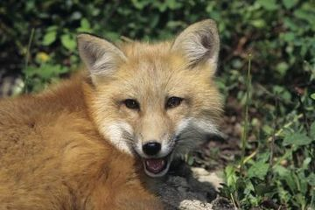
Red Fox
Structural =Their tails are long, bushy and thick, sometimes with a white tip. The eyes of mature animals are yellow. The fox, like other canids have molar structures emphasizes crushing.
Behavioral =Caching is a method red foxes use to store food for later. During this process, a shallow hole 5-10 cm deep is dug, a food item relatively small in size is deposited, and then the hole is covered and camouflaged
Physiological= They can hear very low sounds

Slide 3
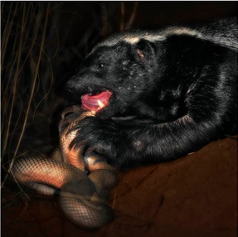
Honey Badger
Structural = It has very lose skin which allows it to
slips around and out of danger.
Behavioral= It usually lives by its self unless it has a family so it is easier for to find food and survive. It will also not back down from any fight no matter how big or strong the other animal is.
Physiological =The front claws average around 38mm and grow throughout its life. Its wide palms and long claws specialize in running along the loose sand.

