Slide 1
ASCSN… #SalmonSchoolScotland
Conservation Efforts in Miramichi

Slide 2
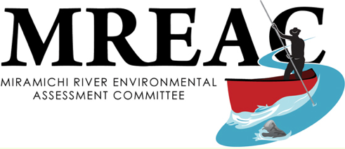
MREAC
A presentation by: Doug, Patrick, Jerry and Patrick

Slide 3
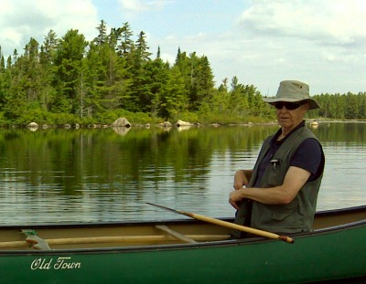
About MREAC
MREAC or (The Miramichi River Environmental Assessment Committee) Is an organization that was formed in 1989 as a multi-shareholder environmental non-governmental organization that focuses on watershed based issues.
MREAC’s executive director Harry Collins

Slide 4
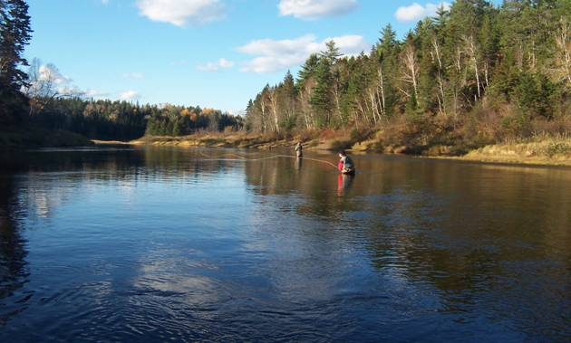
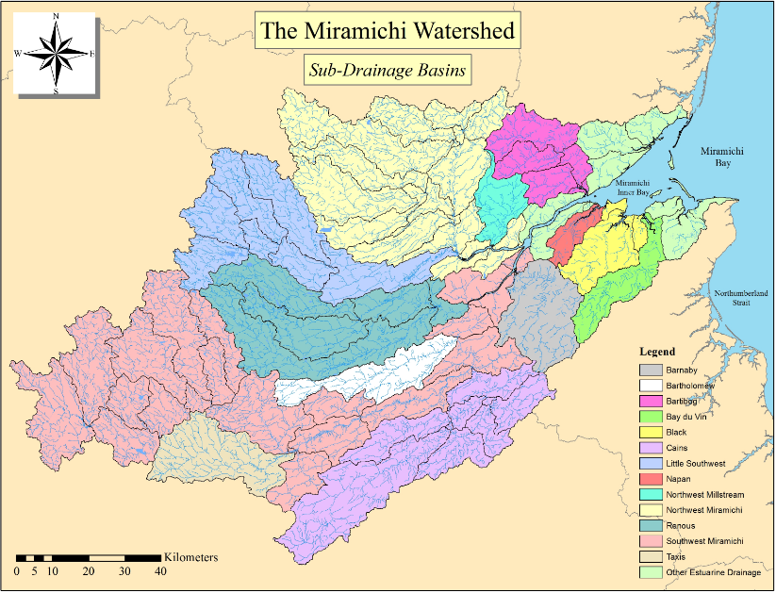
Their Goal
MREAC’s mail goal is dedicated the continual improvement of the environmental quality of the Miramichi River ecosystem with emphasis on the Miramichi watershed
The Miramichi River
Map of the Miramichi watershed

Slide 5
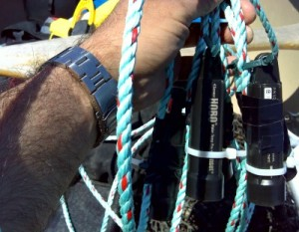
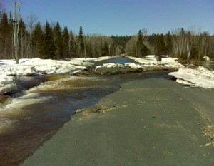
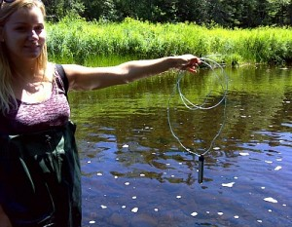
Core Programs
Some of MREAC’s core programs are as followed
Species at Risk
Atlantic Salmon Habitat Assessment
Ice Observation
Real-Time Monitoring
A picture from their Ice observation as a part of their “1river Watch
MREAC assessing habitats
MREAC lake monitoring a lake

Slide 6
Facts
The inner channel of the Miramichi river averages 4m in depth.
The combined length of the Miramichi river is 440km.
The size of Miramichi’s watershed is almost 23% of our provinces land mass.
Miramichi river tides range from 0.2 – 1.2 meters.

Slide 7
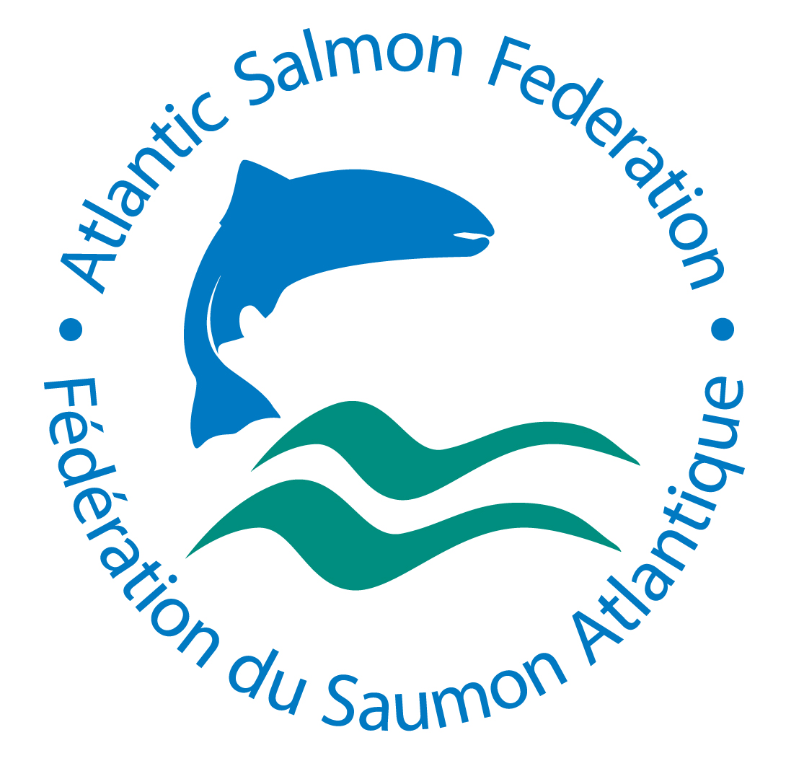
Atlantic Salmon federation
https://www.asf.ca/main.html

Slide 8
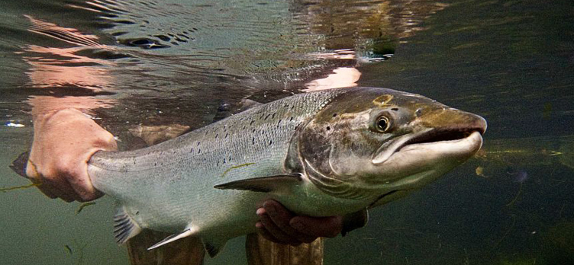
Who does asf serve and where are they located?
The Atlantic Salmon Federation works to help conserve, protect, and restore wild Atlantic salmon populations and ecosystems throughout Atlantic Canada.
They originate from St. Andrews, New Brunswick.

Slide 9
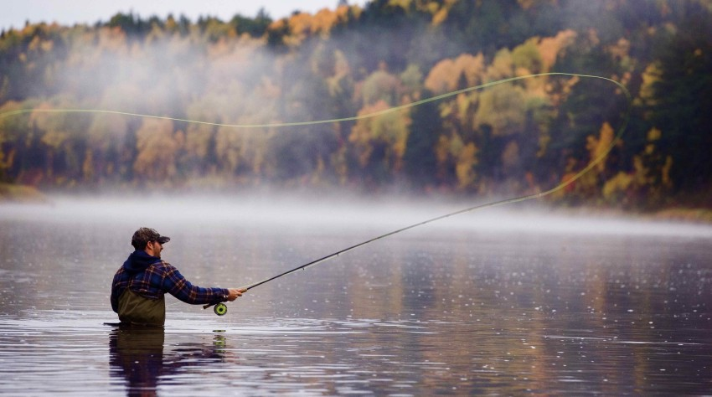
How important is Ecotourism and Atlantic Salmon Fishing in NB? in Miramichi?
Ecotourism and Atlantic salmon fishing are a huge part of the economy in New Brunswick. In 2010 the Atlantic salmon industry generated $54,716,000 of spending in New Brunswick, with Miramichi generating over $20 Million and 637 jobs alone.

Slide 10
ASF Projects
ASF Is the leader in Atlantic Canada in removing unnecessary hydro dams.
ASF help to restore critically endangered populations of Atlantic Salmon where possible.

Slide 11
Additional Information
http://www.inter.dfo-mpo.gc.ca/Gulf/asir/map
http://www.inter.dfo-mpo.gc.ca/Gulf/asir/count?period=1031&group=1
https://www.asf.ca/endangered-populations.html

Slide 12
Department of Fisheries and Oceans (DFO)
By: Jackson, Sarah M, Hannah L

Slide 13
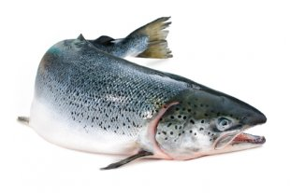
Current Atlantic Salmon Stock Status
Estimated small salmon returns in 2015: 26,000
Estimated large salmon returns in 2015: 16,000
Current estimate of salmon at sea: 600,000

Slide 14
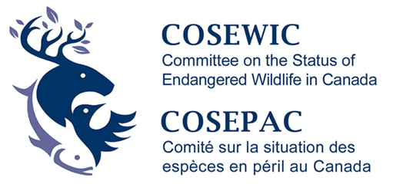
History of conservation practices
1984: Commercial fisheries closed
1998: Aboriginal and recreational fisheries closed
2010: COSEWIC assessment of southern Gulf of St. Lawrence Atlantic Salmon populations as “Special Concern”
2014: Reduction of number of fish allowed to be caught
2015/2016: Expansion of the catch and release measures for the salmon recreational fishery in all Gulf Region salmon fishery areas

Slide 15
Relevant Data Links
http://www.glf.dfo-mpo.gc.ca/Gulf/FAM/Recreational-Fisheries/2016-atlantic-salmon-survey

Slide 16
Miramichi Salmon Association (MSA) http://www.miramichisalmon.ca/
By: Zack, Logan and Justin

Slide 17
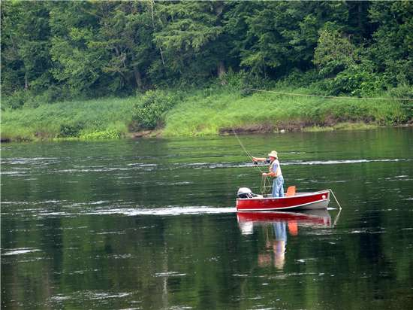
Since 1953 the Miramichi Salmon Association (MSA) has worked toward the preservation and enhancement of the wild Atlantic salmon, and for the protection of its habitat in the Miramichi watershed.

Slide 18
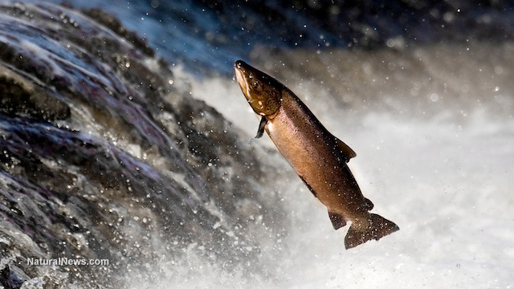
Mark Hambrook said the number of salmon returns has been gradually declining. Some years have been better than others, but essentially, it’s not getting any better.

Slide 19
The rapidly declining salmon counts being recorded along the Miramichi have coincided with the sharp rise in the bass population. Roughly 255 000 striped bass spawners were recorded on the northwest Miramichi in 2014,The highest estimated total since monitoring began back in 1993, where the numbers ranged from only 3 000 to 5 000.

Slide 20
The MSA and ASF have completed the tagging for the 2016 smolt tracking study. The team tagged 180 smolts from May 17th – 20th on both the NW and SW branches, on top of the 60 wild fish that were tagged at the hatchery in early March of 2016.

Slide 21
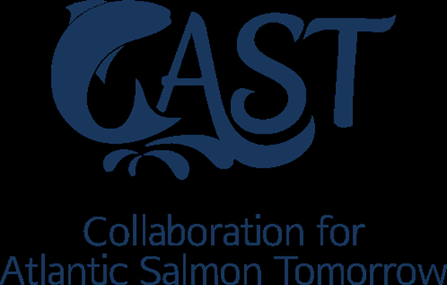
Cast
Collaboration for Atlantic Salmon Tomorrow

Slide 22
Who is involved with this group and what is their goal?
Goal:
A joint project to stop the decline of wild Atlantic salmon.
Involved:
UNB, Irving, Cooke Aquaculture, International Paper, ASF, MSA, RRWMC CGBVRR, Rocky Brook Salmon Club, Canadian Rivers Institute.

Slide 23
What projects are being planned and what projects are already happening?
Cast projects:
Thermal imaging/Water based LiDAR, ARIS Sonar Population Assessment, Aquatic Data Warehouse- Stock Recruitment Model, adult salmon release project, Atlantic salmon predator study, salmon migration tracking program
Cast funding and future:
Multi party effort, widespread socio-economic benefits, program supposed to last 5 years with monitoring extended to 7 years, program could b a model for other Eastern Canadian Rivers.

Slide 24
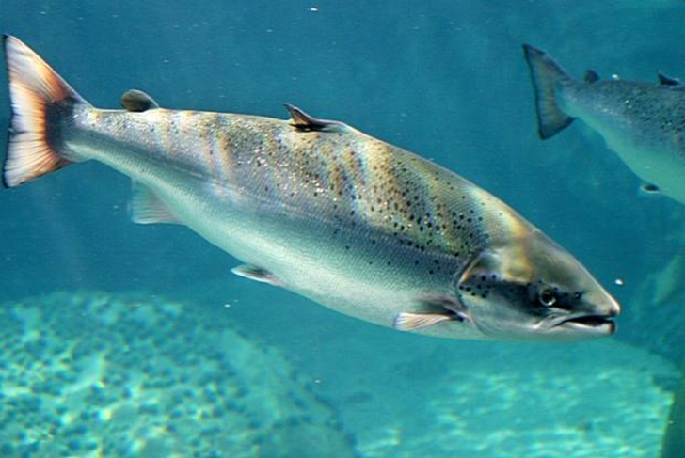
Links
https://www.youtube.com/watch?v=Kp8UF9F3uZQ(link is external)
https://www.youtube.com/watch?v=Xv1XZsnTMsE&feature=youtu.be(link is external)
http://ipcamlive.com/5616a40cabd65

