Slide 1
Backyard Composting Basics
Greater Miramichi Regional Service Commission – Solid Waste Services

Slide 2
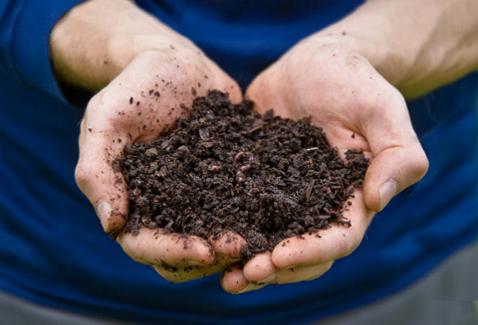
What is Compost?
Compost is when organic matter
breaks down into a dark, soil-like
material called humus.
Humus is decayed organic matter
Organic matter is anything that
is or was once alive
Source: Backyard Magic The Composting Handbook, NB DELG

Slide 3
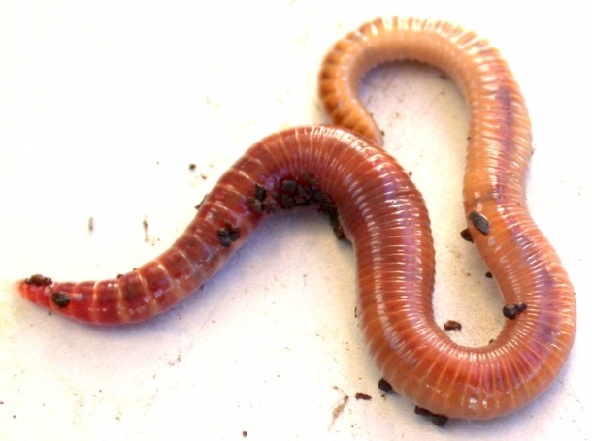
How does composting happen?
Microorganisms such as bacteria, fungi, and yeasts, as well as invertebrates such as worms and insects, decompose organic materials as natural part of their life cycles.
A healthy compost pile or bin is full of these microorganisms!

Slide 4
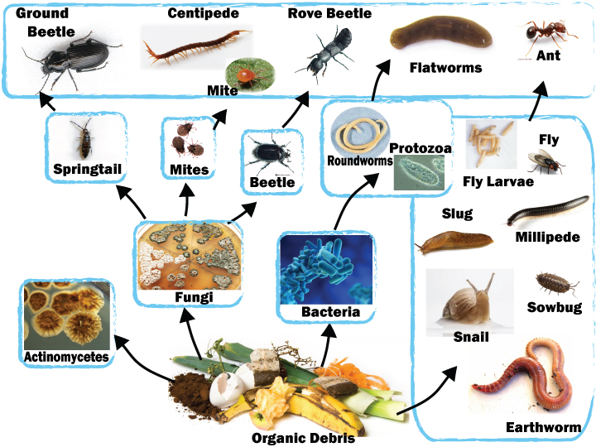

Slide 5
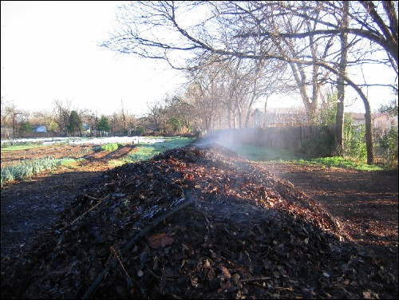
Composting Benefits
Compost provides a natural and slow release source of plant nutrition.
It adds moisture retention capacity to soil.
Source: Backyard Magic The Composting Handbook, NB DELG
Notes:
Compost will act like a sponge and help keep the water there so you don’t need to water your plants as much

Slide 6
Composting Benefits
Dark compost draws the sun’s rays to warm the soil, extending the growing season.
It improves the structure of both sand and clay soils, protecting them against drought and erosion.
Insects and diseases do not do as much damage where soil is enriched with compost.
Source: Backyard Magic The Composting Handbook, NB DELG

Slide 7
Why Take Up Backyard Composting
Not all Regional Service Commissions operate a Centralized Facility for processing household organics.
It’s much cheaper to implement home composting than to operate a centralized facility.
It reduces the volume of waste going to the landfill.

Slide 8
Why Take Up Backyard Composting
Improve your lawn by top dressing spreading compost evenly on top of the grass surface.
Your efforts will be rewarded with stronger plants; improved root growth and seed production; and disease resistant plants.
Reducing waste by up to 40% is vital to protecting our environment.

Slide 9
The Compost Recipe
Composting is like cooking. It follows a basic recipe. Here are the three basic ingredients:
Air: Without air, a compost pile can get quite smelly. Adding air is done by turning the pile.

Slide 10
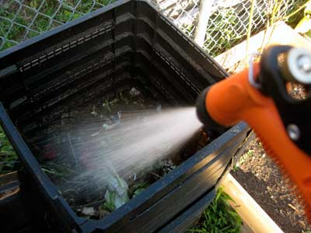
The Compost Recipe
Water: Without water, a compost pile will stop decomposing. Water should be added so that none comes out when a handful of compost is squeezed.

Slide 11
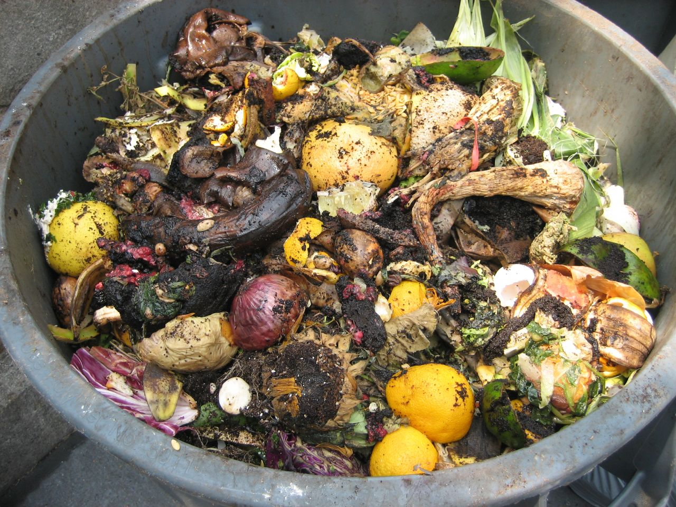
The Compost Recipe
Food: Without food, in the form of organic matter, the microorganisms in a compost pile will stop working.
A compost pile will need approximately equal amounts by weight of “brown” and “green” food.

Slide 12
Compost Ingredients
Green Compost Food
(Nitrogen Rich)
Bone Meal
Fruit and Vegetable Peels
Hair
Fresh Grass Clippings
Coffee Grounds
Manure
Eggshells
Brown Compost Food
(Carbon Rich)
Coffee Filters
Dried Grass Clippings
Hay
Dead Leaves
Corn Cobs, Stalks
Dryer Lint
Wood Chips or Sawdust
Tea Bags

Slide 13
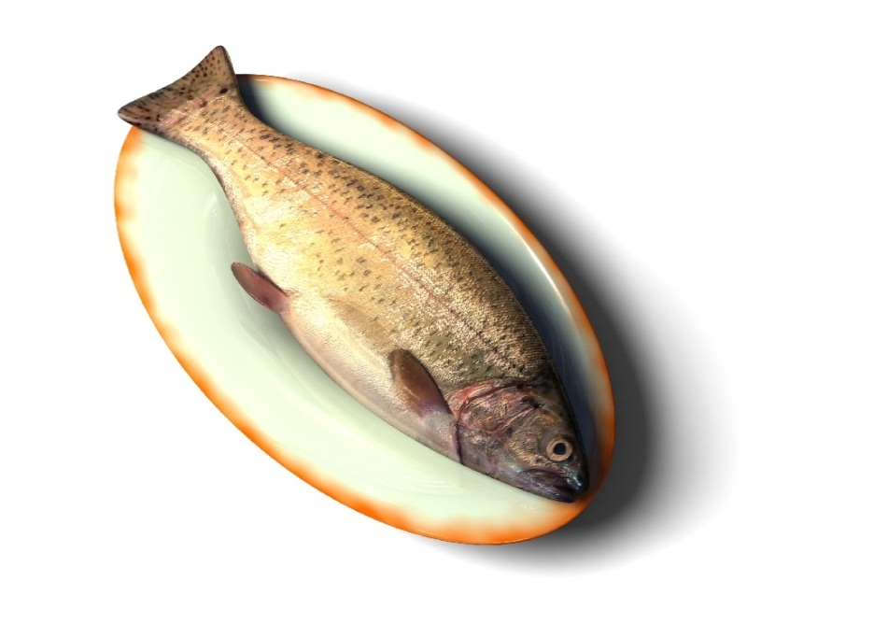
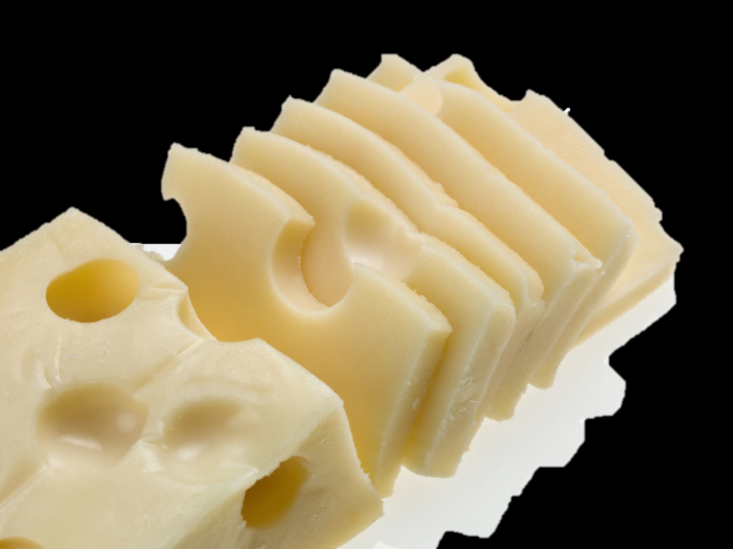
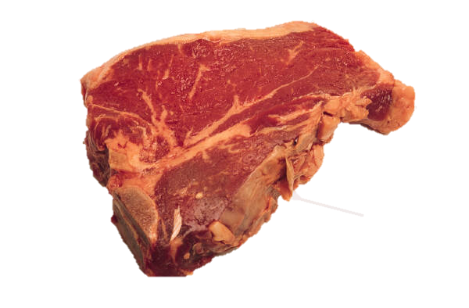
Things that should not be put in a compost pile
Pet waste: It might contain diseases
Meat, fish and bones: It will draw unwanted animals such as raccoons to your composter.
Dairy product, salad dressings and oils: It will make the compost smell.
Notes:
Insect-infested or diseased plants may persist in the compost
Weeds with mature seeds and plants with a persistent root system may not be killed by the heat of the compost.
Rhubarb and walnut leaves contain toxins to insects or other plants so many choose not to compost them.

Slide 14
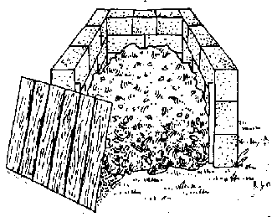
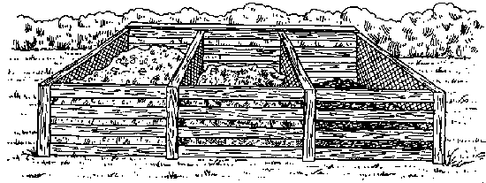
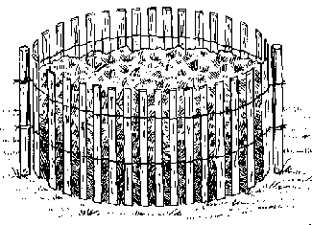
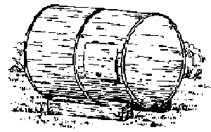
Types of Composters
Source: Backyard Magic
The Composting Handbook, NB DOELG

Slide 15
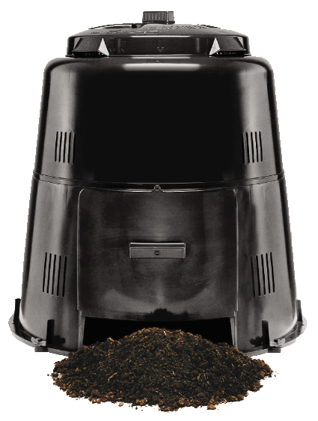
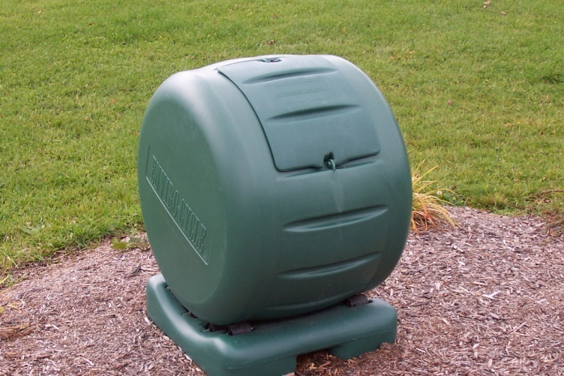
Types of Composters (cont’d)

Slide 16
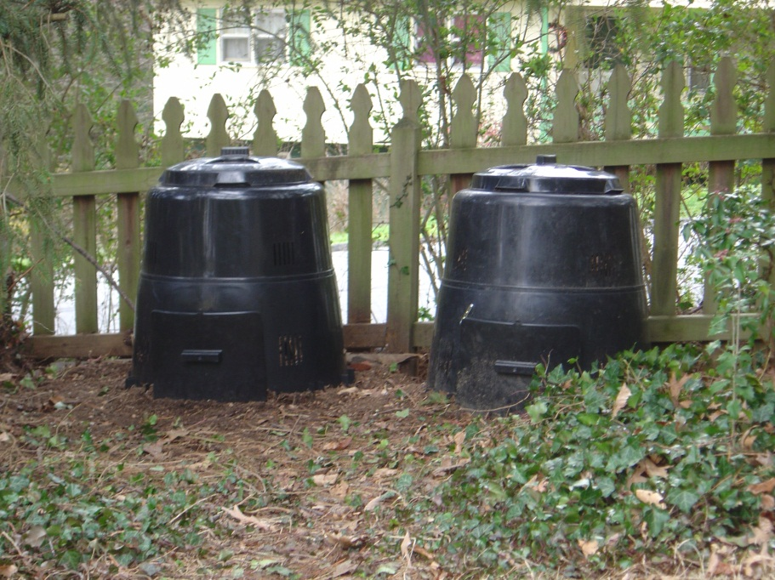
Cold Composting Recipe
Find a place in your yard for a pile or a bin.

Slide 17
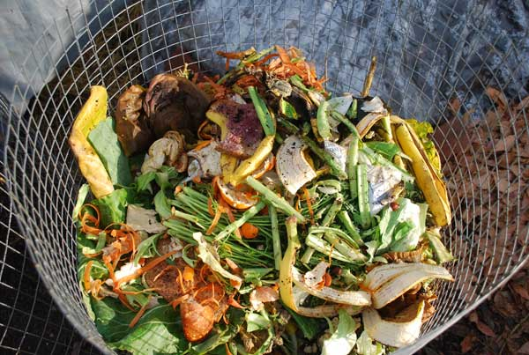
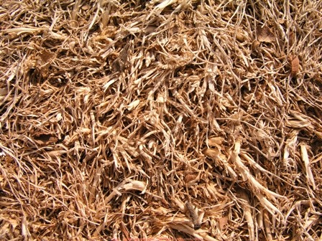
Cold Composting Recipe
Add green compost food whenever it becomes available.
Cover the green food with a layer of brown food such as dried leaves, dried grass clippings or straw. These can be stored near the composting area.

Slide 18
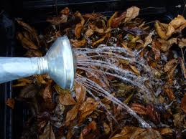
Cold Composting Recipe
Add water if the mix appears to be too dry and sprinkle in a bit of garden soil every now and then.

Slide 19
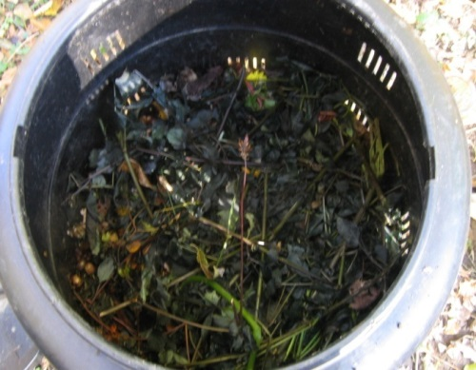
Cold Composting Recipe
Continue to add materials to the top of the pile when they become available.

Slide 20
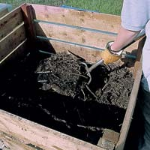
Cold Composting Recipe
Turn the pile if you want to but this step isn’t absolutely essential.

Slide 21
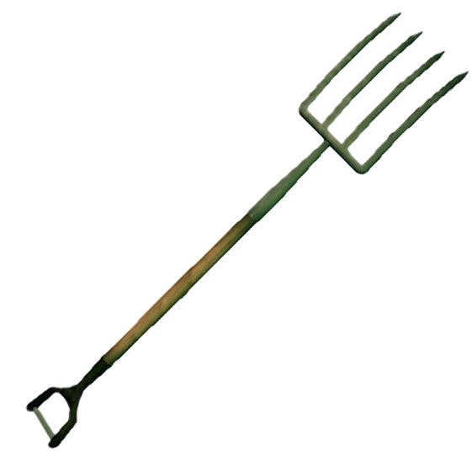
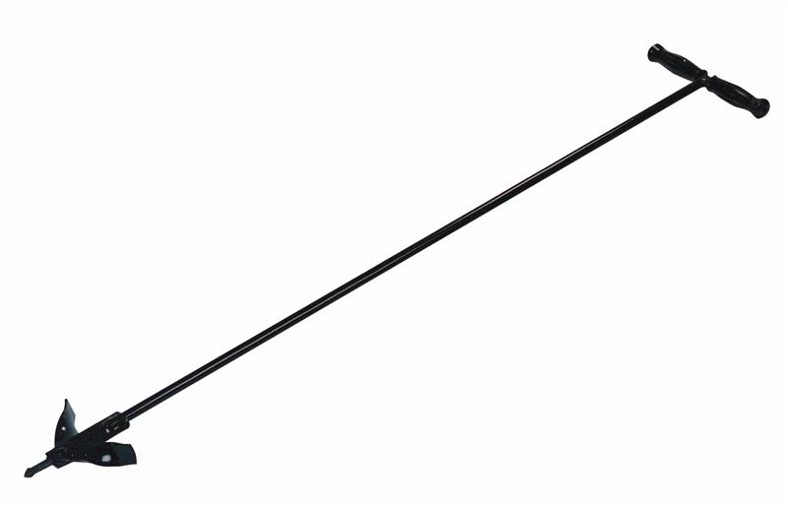
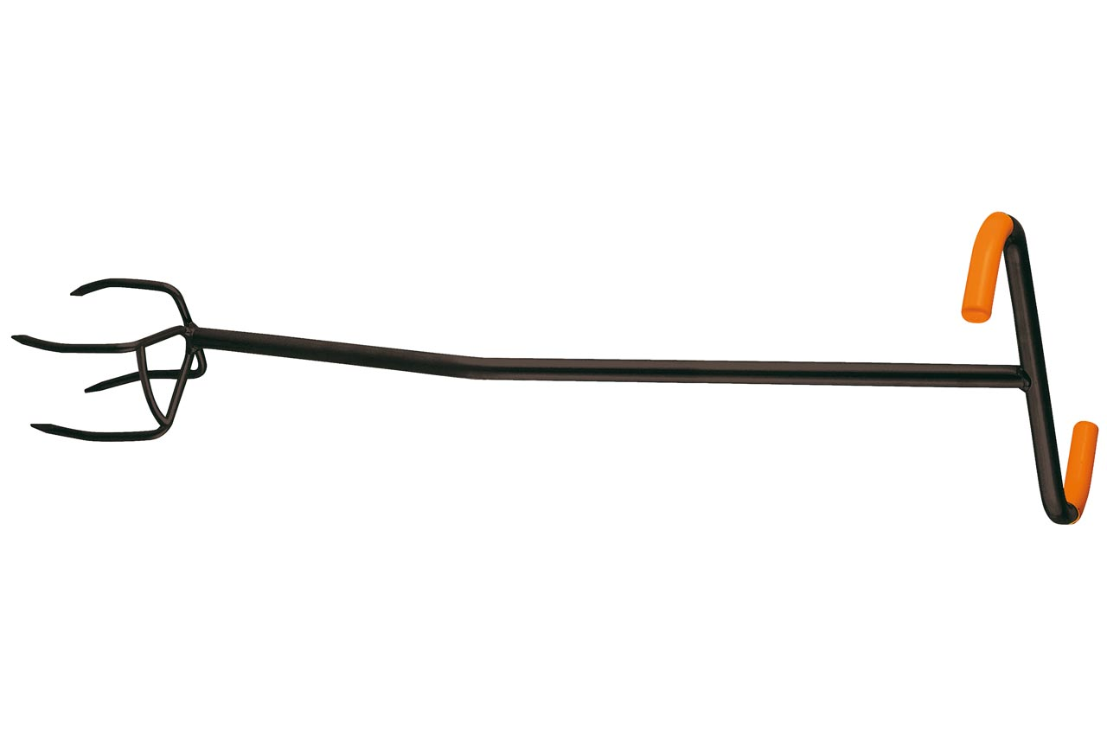
Cold Composting Recipe

Slide 22
Cold Composting Recipe
The lower layers of the pile will decompose first and can be harvested at the end of the growing season.

Slide 23
Common Compost Problems and Solutions
Smell
An earthy scent is normal and inoffensive, but a well-built compost shouldn’t produce unpleasant odours. If it does, your problem is either too much “green” stuff (ammonia smell) or too little air (rotten-egg smell). Turning the pile will help. If the odour persists, turn and rebuild the pile with more “brown” materials.
Remember to not put any bones, fish, dairy, or meat scraps in the composter
Source: Backyard Magic The Composting Handbook, NB DELG

Slide 24
Common Compost Problems and Solutions
Dryness
Add water or leave the cover off when it rains.
Too Wet
Add some dry leaves or some peat moss to soak up excess water.
Keep cover on when it rains.

Slide 25
Common Compost Problems and Solutions
Pests
If mice or hornets invade the composter, either empty it and start fresh with another location or saturate it with water from a hose.
If fruit flies are troublesome, bury the top layer with soil or brown materials.
If raccoons, skunks or groundhogs are a problem, sink a wire mesh around the base of the composter.

Slide 26
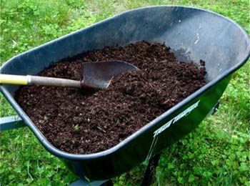
This is what unfinished and finished compost looks like

Slide 27
How can I compost in the winter?
Move bin(s) closer to the house for easier access
Add greens and browns as usual
Move the bin(s) back to summer location when contents thaw in the spring (turning the contents in the process).

Slide 28
Or…
Collect kitchen scraps in large plastic tubs, stored outdoors in a convenient place, where the contents will freeze and add it to your composter in the spring!

Slide 29
Worm Composting (Vermicomposting)
Vermicomposting is the process by which worms are used to convert organic materials into a humus-like material known as vermicompost
Uses red wigglers
Useful for apartment dwellers
Can be set up in an easy to maintain plastic container
Unique approach that appeals to classroom environments
Source: Backyard Magic The Composting Handbook, NB DELG

Slide 30
Green Cone Digester
The Green Cone is a Food Waste Digester. The sun heats an insulated chamber reaching optimal temperatures and internally circulates air, accelerates aerobic digestion and decreases organic volume through a natural process.
Reduces household waste up to 50%
Accepts ALL food waste including meat, bones, dairy, cooking oil, pet waste and seafood scraps
Optimally digests 1+ kg every 1-2 days in summer
Does not attract vermin, is raccoon-proof and bear resistant

Slide 31
Questions?

Slide 32
Credits
Marion McIntyre, Master Composter
Backyard Magic The Composting Handbook, NB DELG

