Slide 1
Chemistry 112
Percent composition and chemical formulas

Slide 2
Percent Composition of a Compound
The relative amounts of elements in a compound can be expressed as a percent composition.
It is the percent, by mass, of each of the elements.
As with every percent, the composition must add up to 100.
% mass of element = mass of element x100%
mass of compound

Slide 3
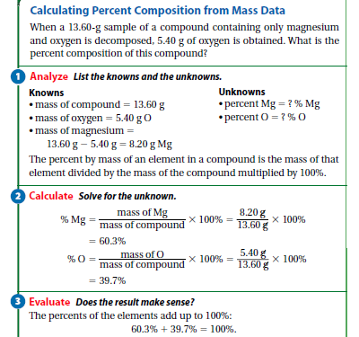

Slide 4
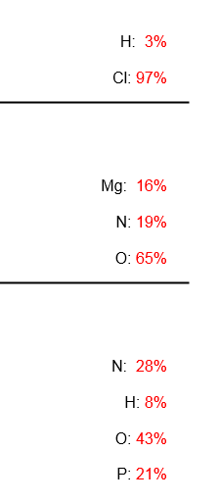
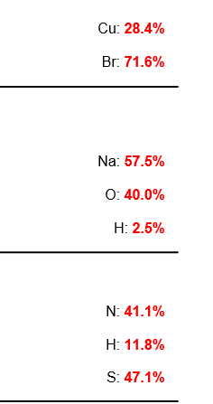
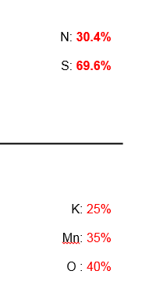
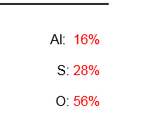

Slide 5
Example
Calculate the percent composition when 13.3g of Fe combine completely with 5.7g O?
Questions 32, 33 – page 306

Slide 6
Percent Composition from a Chemical Formula
If you know the formula, you can calculate the molar mass of the compound to help determine the percent composition of the individual elements.
% mass = mass of element of 1 mol compound x 100%
molar mass of compound

Slide 7
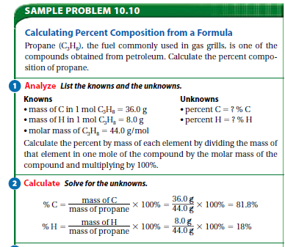

Slide 8
Example
Calculate the mass of oxygen in 90.0g of Cl₂O?
Questions 34, 35, page 307

Slide 9
Percent Composition as a Conversion Factor
Ex. Propane is 81.8% carbon and 18.2% hydrogen. How many grams of each would be found in 1kg of propane?

Slide 10
Empirical Formulas
If you want to write the basic ratio of a compound, it is otherwise known as its empirical formula.
It is the lowest whole-number ratio of the compound.
Ex. CH can be found in a series of formulas using the 1:1 ratio
CH, C₂H₂, C₈H₈
When we want to determine the empirical formula of a compound based on percent composition, assume 100g of material and use the lowest value to build your ratio…

Slide 11
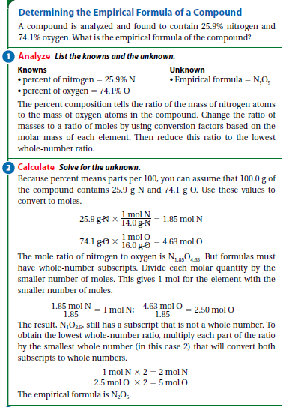

Slide 12
Example
What is the empirical formula of this compound based on its percent composition of 36.1% Ca and 63.9% Cl?
36.1 g Ca x 1 mol Ca =
63.9 g Cl x___1 mol Cl_=
Question 36, 37, page 310

Slide 13
Molecular Formula
Molecular formula for a compound is either the same as its experimentally determined empirical formula or it is a simple whole number multiple of its empirical formula
Hydrogen peroxide empirical formula is HO
Empirical formula mass (efm) is 17.0 g/mol
Molar mass of hydrogen peroxide is 34.0g/mol
34.0g/mol = 2
17.0 g/mol (efm)
Multiply the subscripts in the empirical formula by 2
HO x 2 = H₂O₂

Slide 14
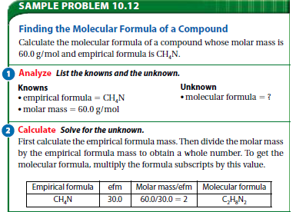

Slide 15
Assignment/homework
P 310 #36 & 37
P 312 #38 & 39
Section assessment
#40-46
Test Wednesday

