Slide 1
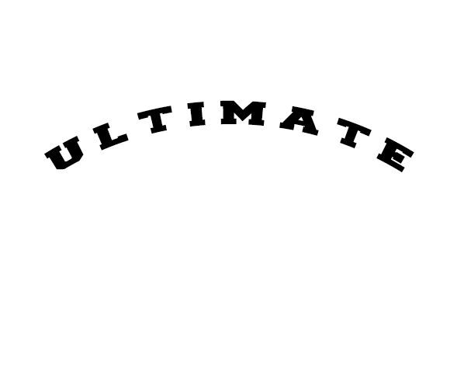
Clothing Project
By Oakley and Justin

Slide 2
Why we chose this
Wanted to use the Vinyl cutter
Always wanted to make clothes

Slide 3
Starting out
Thinking of a name brand
Creating a logo
Stickers
Heat Vinyl

Slide 4
Problems we faced
Very difficult time deciding on a Name
Wanted to create 2 brands, but ran out of time
Had trouble creating a logo
Couldn’t use most of our designs since we were unable to print more than one color at once.

Slide 5
Technology used
Photoshop
Silhouette
Vinyl Cutter
Heat Press

Slide 6
The End

