Slide 1
Heat Press
By: Leigha & Jenna

Slide 2
Our Idea
Newly introduced technology
Knew it was what we wanted to work with.
We didn’t exactly have a specific idea.

Slide 3
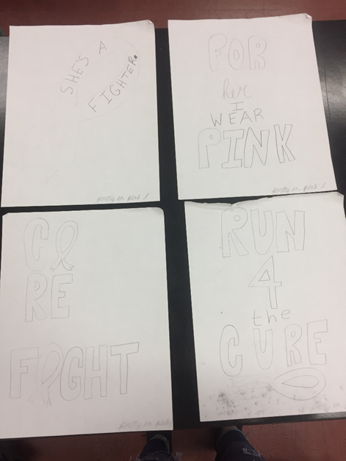
Our Design
Knew we wanted to make t-shirts to help raise awareness for a cause.
We decided to go with a Breast Cancer Awareness T-shirt
Made up four designs
Then continued to create it on silhouette
Pictures on google
Vinyl cutting them

Slide 4
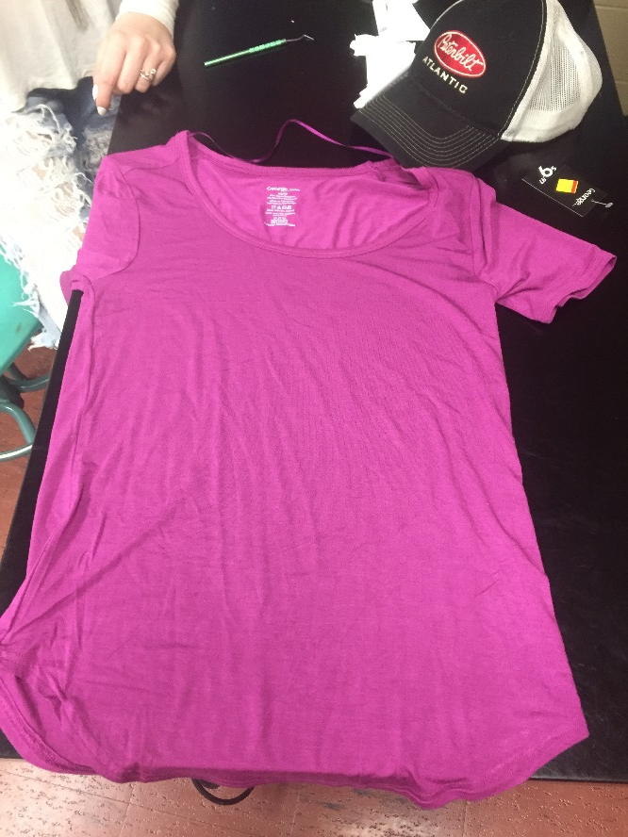
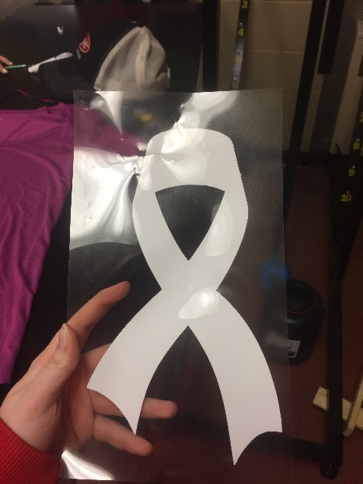
Things we need
Heat Vinyl
Pink t-shirt
Vinyl cutter
Heat press

Slide 5
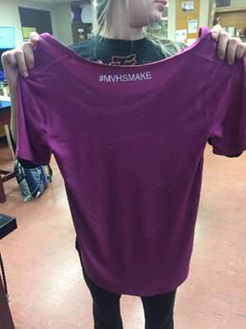
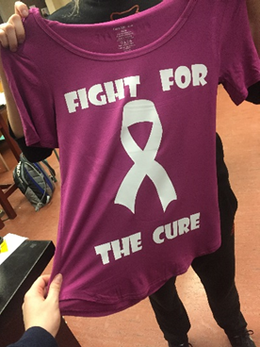
Final Look
Thick enough font
Heat press set to the right settings
Vinyl cut and picked all the letters and pictures we needed
Heat pressed onto the t-shirt
Added #mvhsmake to the back for a special touch

Slide 6
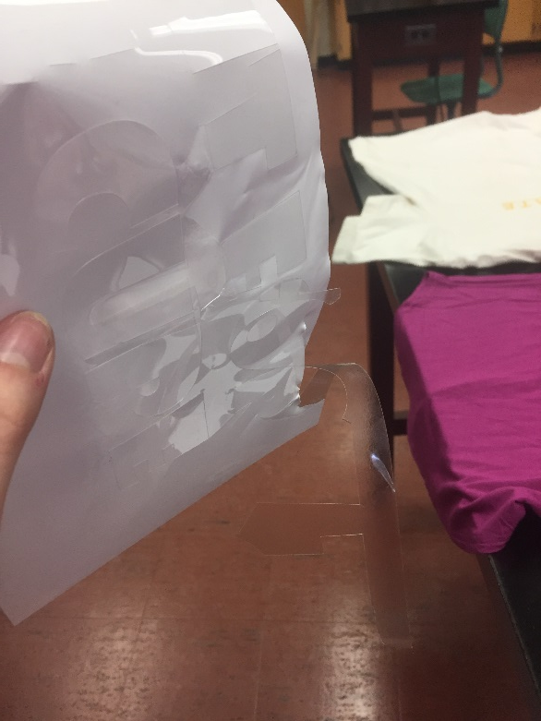
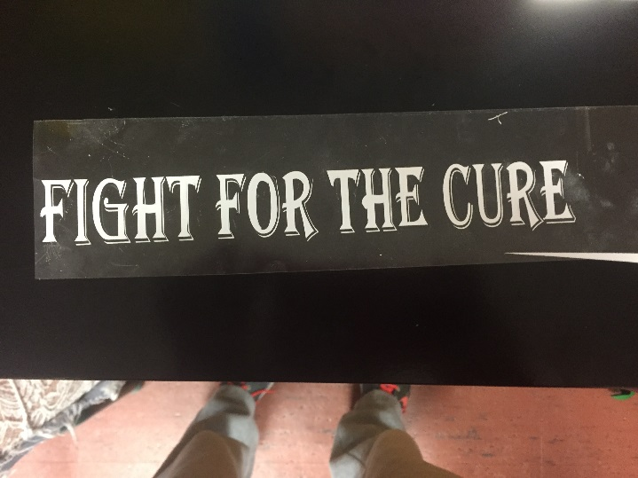
Issues
1. The original font we liked and wanted to use, too thin
2. Blade was on the wrong setting and cut through the heat vinyl
3. Forgot to flip it horizontally
4. Put a wrinkle in the shirt when we heat pressed it
5. Tough time figuring out the settings

Slide 7
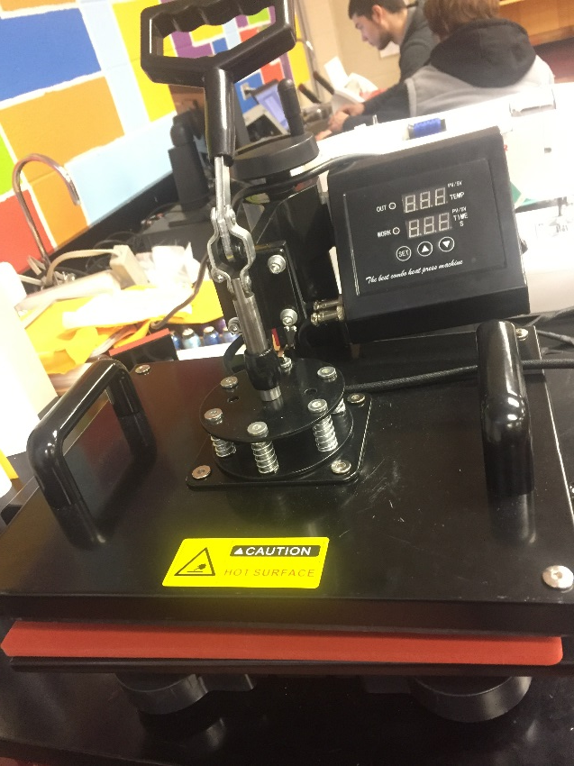
Side Projects
Before we started our projects
Gave us some practice with the heat press
Devon and Tim were using it too, made things easier
Helped us build our skill set before starting our actual project

Slide 8
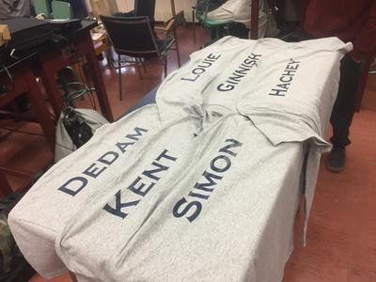
Side Projects
T-shirts for teachers and students in resource.
Vinyl cut all of the names.
Make sure the names went with the right size tshirt

Slide 9
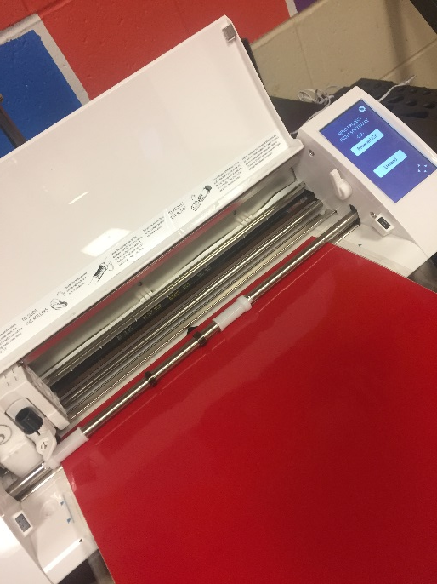
Side Projects
Name tags for Mr. Hallihan’s nieces Hockey teams bags.
Looked up the names on their school website
After the names were vinyl cut we picked and transferred them to card stock.
http://www.stansteadcollege.com/

Slide 10
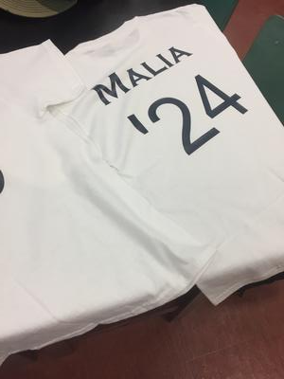
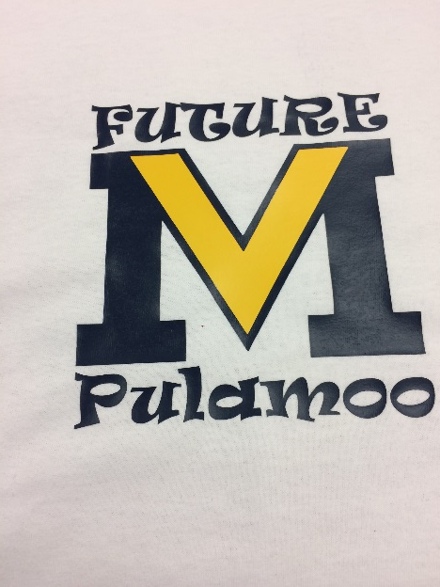
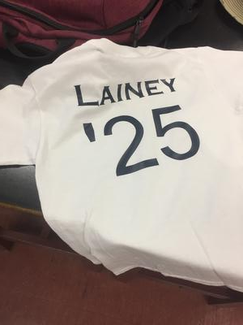
Side Projects
T-shirts for Mr. Hallihan’s two daughters
Wanted them to have shirts with the year they would come to MVHS on the back
Their names on the back too

