Slide 1
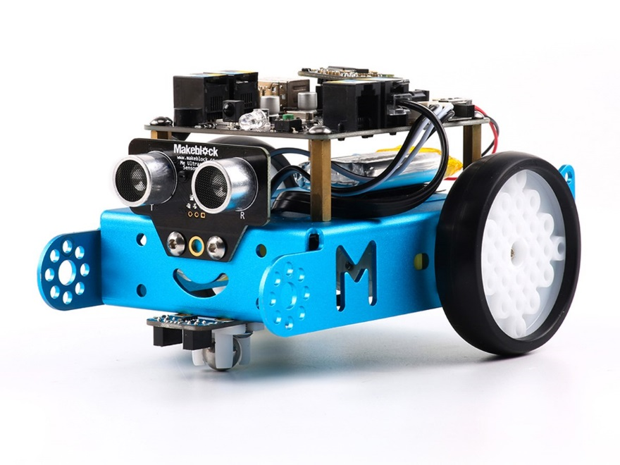
Mbot
Zac(k) Squared

Slide 2
Idea
To learn to code and program using scratch and Arduino.
To make cool things happen using the Mbot.

Slide 3
Problems
Some of the major key problems we had were trouble shooting.
Coding and figuring out the codes to each different sensor to make it work.

Slide 4
Highs
Some of the highs we had was that fact that we were very interested in learning the new piece of technology.
Knowing the possibilities of exactly what we could do with the Mbot.

Slide 5
Lows
Some of the main lows we had was the lack of motivation.
Another main low we had was lack of experience creating programs which set us back a lot.

Slide 6
Examples of Some of Our Work
https://www.youtube.com/watch?v=FtipUFqqwm8
https://www.youtube.com/watch?v=ykYhdJLsljc
https://www.youtube.com/watch?v=I4fX6H8MilI

Slide 7
