Slide 1
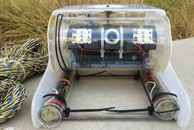
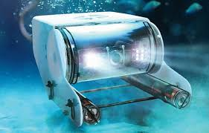
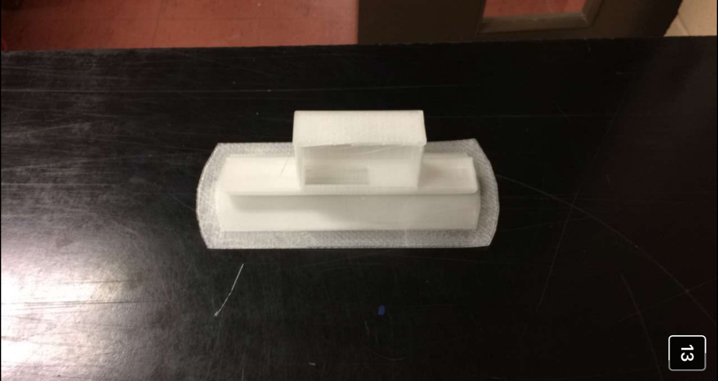
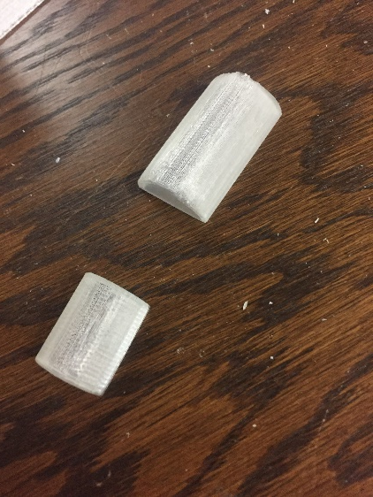
OpenROV Light Bar
Cole Augustine

Slide 2
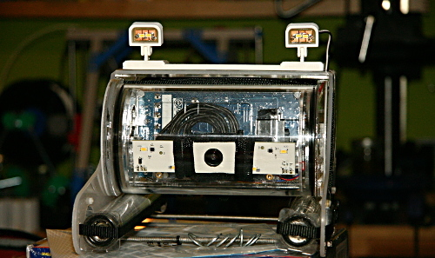
Project Ideas
I wanted to build an external source of light for the openROV for better lighting during darker dives.
This is the original design type I found online and wanted to create something similar. It is 3d printed.

Slide 3
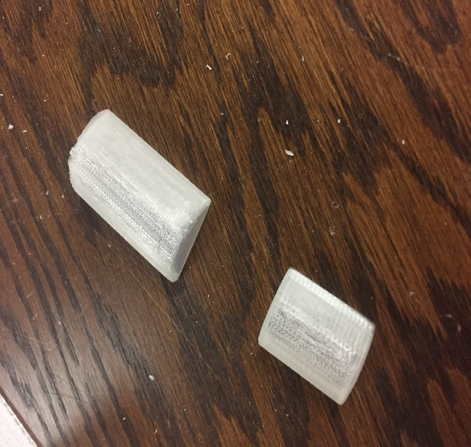
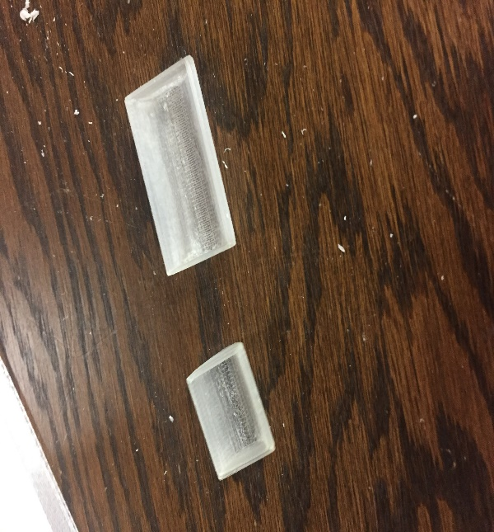
Designing The Prototype
I decided to use a string of lights instead of two separate ones.
This made making it easier as it is all one piece and easier to power.
I printed smaller half tubes with the clear filament to see how light will project through and how big it needed to be to fit the lights in.

Slide 4
Trying New Filaments
New ABS filament came in for the Makerspace to use so I researched printing that as we always used PLA before and everyone using the printer went through many prints trying to find a setting that will print well.
The best settings I used for printing this product was: Nozzle: 230
Bed: 100

Slide 5
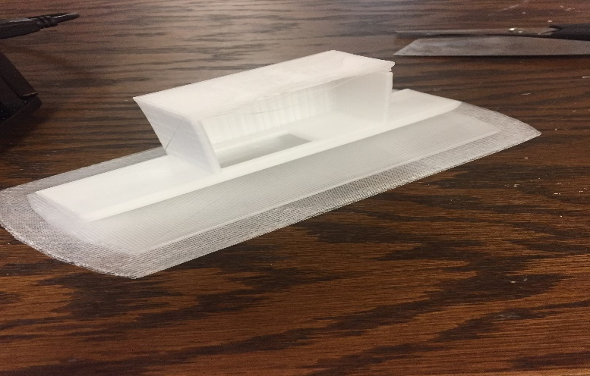
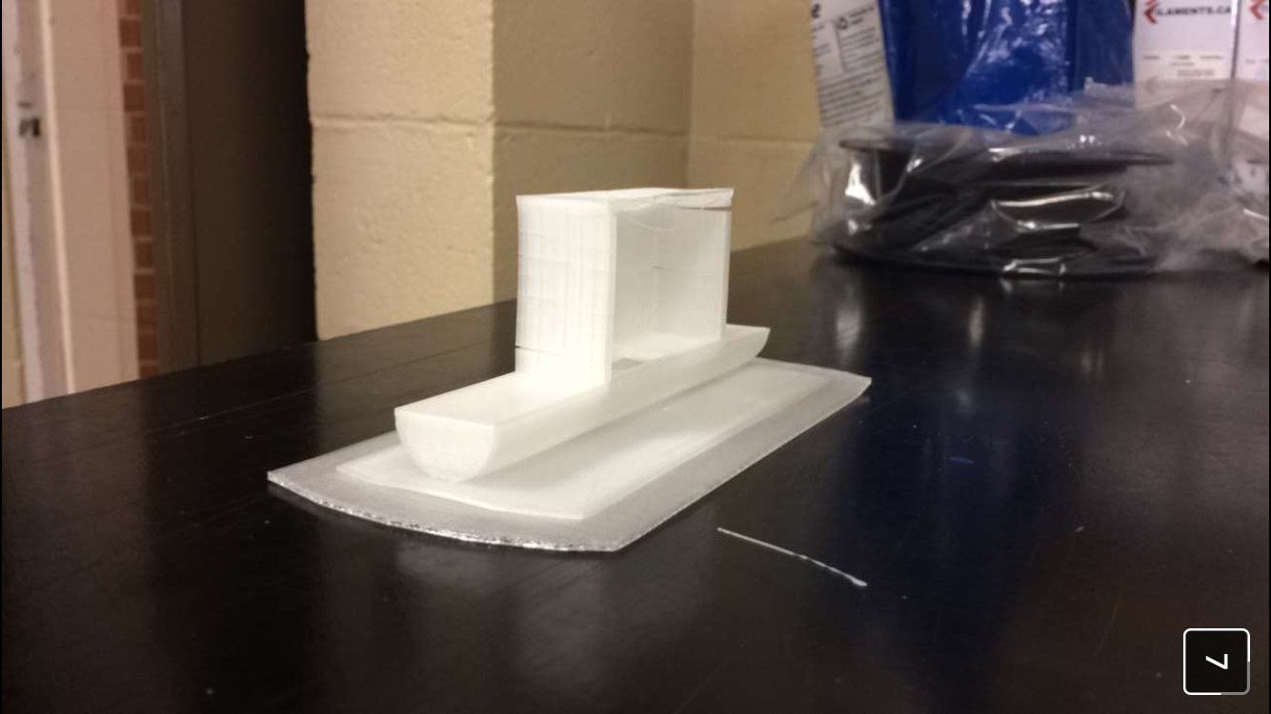
Full Sized Prints
After a few misprints of the light bar I made my own raft on tinker cad and did a final print which turned out very well for the most part except for a minor issue with the layers not sticking, a common problem with ABS.

Slide 6
The Light Bar Today
As this is the last week of the semester I could not complete the entire design as there was a lot of time dedicated to researching and learning how to print with new filaments and then basic troubleshooting with the design itself.
Although I did get to design a cover for the battery pack I did wire up one light to two AA batteries that illuminates the bar fairly well.

