Slide 1
Retro Arcade In a Cardboard Box
By: Logan Savoy

Slide 2
Planning Stage
• Guides didn’t explain much.
• Very few tutorials.
• No step by step instructions.

Slide 3
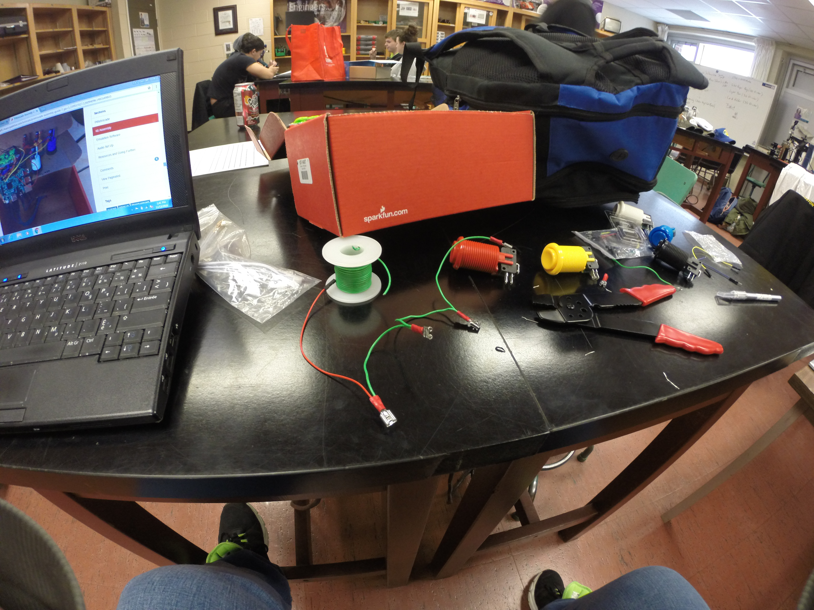
Initial Building
• Very few replacement parts.
• Crimping was a pain
• No clear instructions on the guide

Slide 4
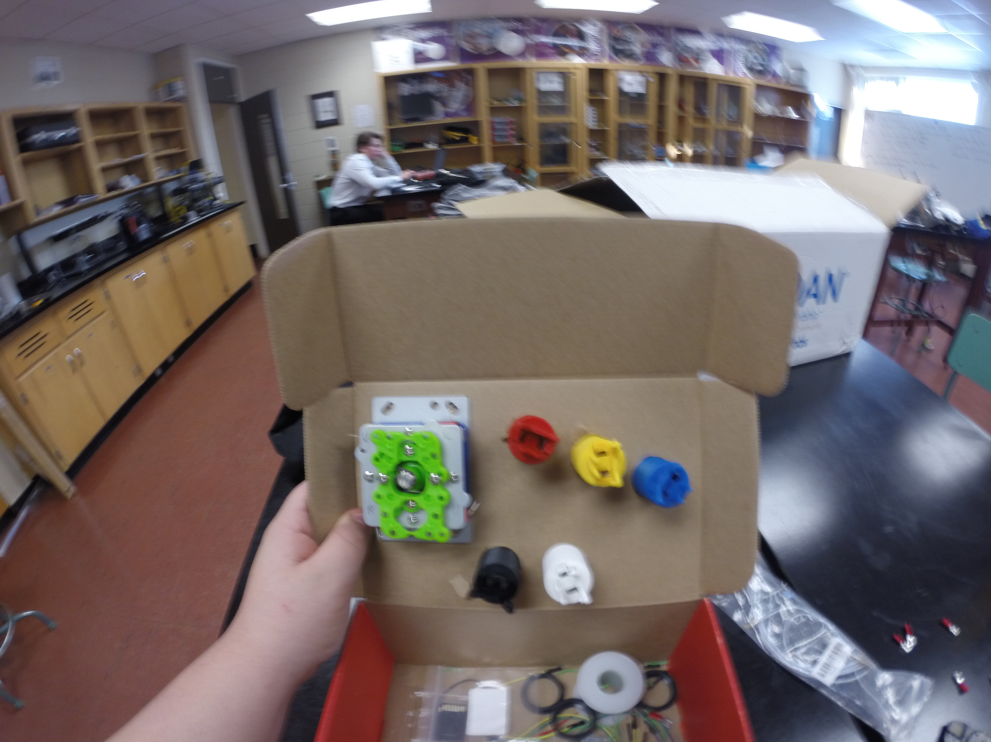
Mid Project
• Starting to take shape
• Commonly snipped wires by accident

Slide 5
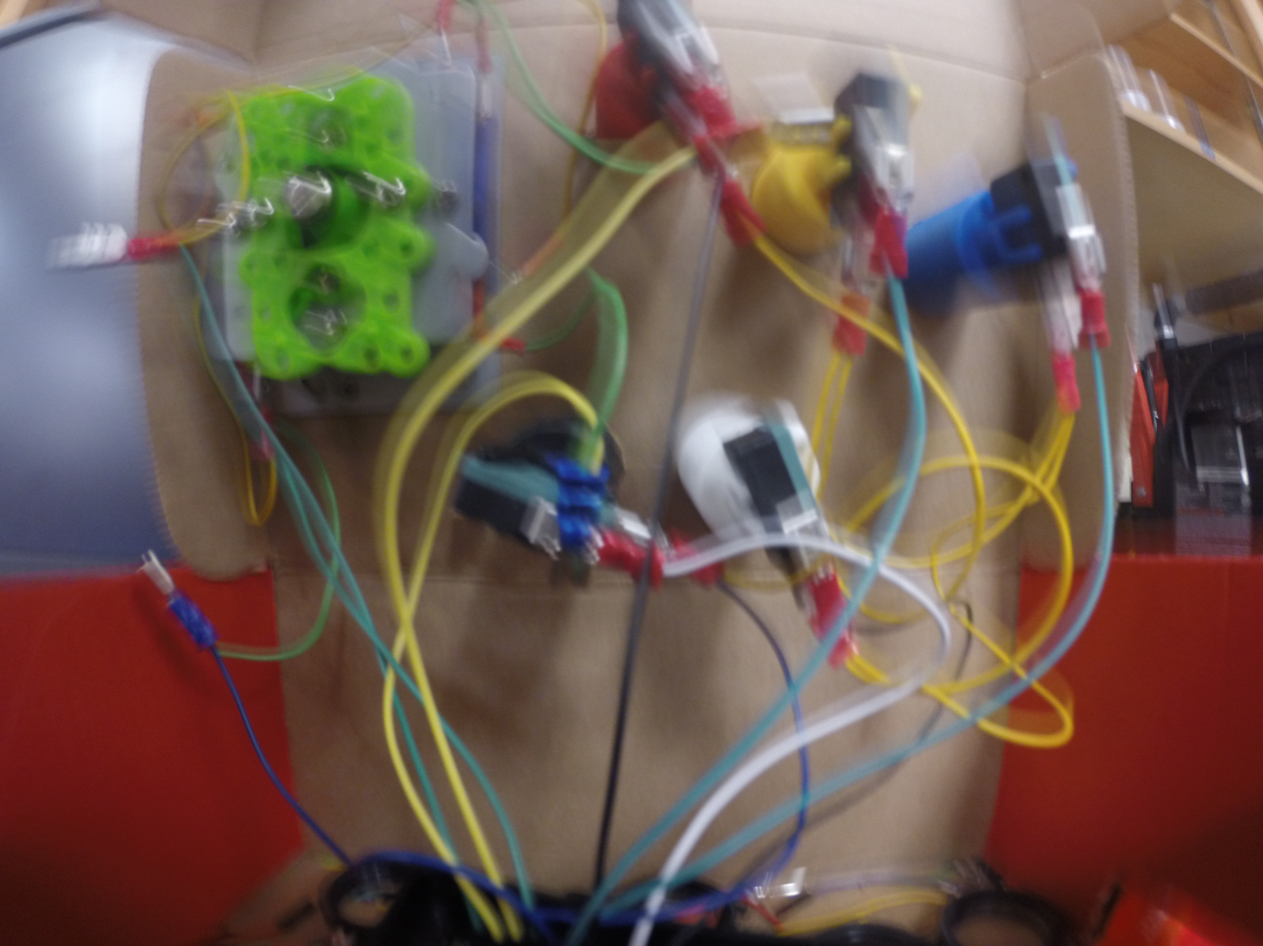
Final Build
• Wiring was messy
• The box was messy
• Controls didn’t work

Slide 6
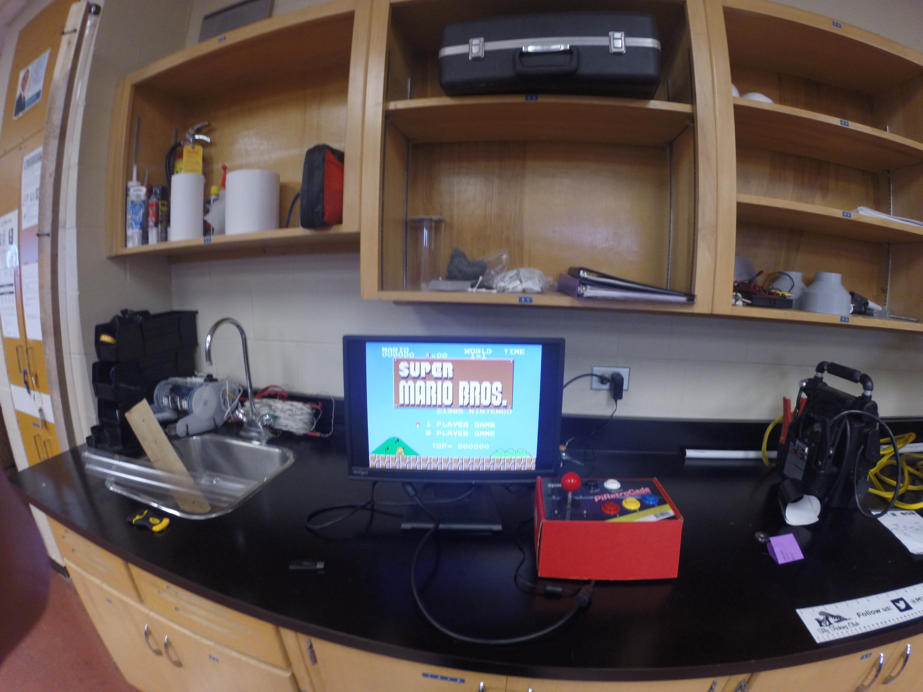
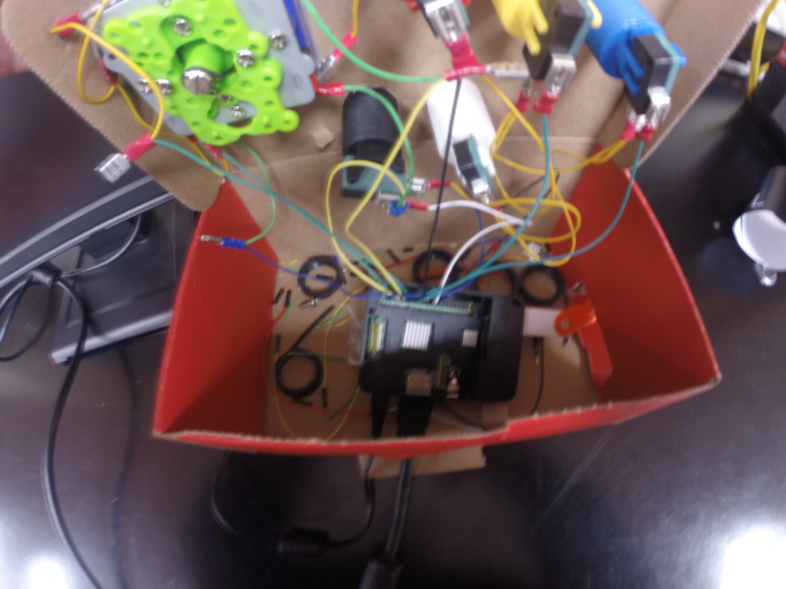
Rebuild
• Controls Worked
• Much cleaner box

Slide 7
Highs and Lows
Highs
• Getting the controls to work
• Operating the system without a keyboard
Lows
• Having to work incredibly slowly due to not having a guide
• Having the controls not work after following the guide as closely as possible

