Slide 1
Where Did All the Water Go?
Dylan Howe

Slide 2
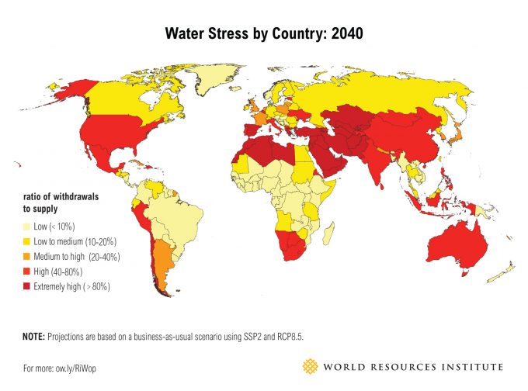
1 in 5 nations are expected to have acute water shortages by 2040
Disrupted rainfall patterns and climate change causing shortages
Agriculture accounts for between 70-90% of a country’s rain water consumption

Slide 3
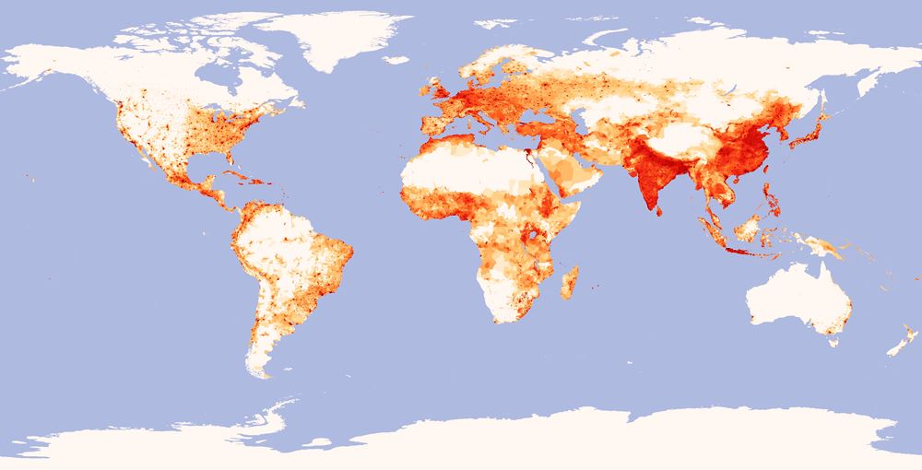
Population Density
More people moving to urban centers during drought
Increased stress on municipal water supplies
Agriculture consuming too much water, better technology is needed

Slide 4
Water Scarcity in Volatile Regions
Many countries with high levels of geopolitical tension are also the same countries that ranked very high in the future water stress index

Slide 5
Agriculture
Agriculture consumes the majority of a nation’s water resources
Many areas today are draining underground aquifers that take thousands of years to refill
Better irrigation technology can help take stress off of the local water supply

Slide 6
California Water Crisis
California is currently pumping water from its underground aquifers at a rate that doesn’t allow the resource to renew itself

Slide 7
Wells dug in the Central Valley were once able to reach water at 500 feet, but now have to be drilled 1000 feet or more
These wells are expensive, costing over
$300 000 US
The water at these depths cannot be replenished as fast as it is being pumped
Depletion of these deep ground aquifers will only worsen California’s drought

Slide 8
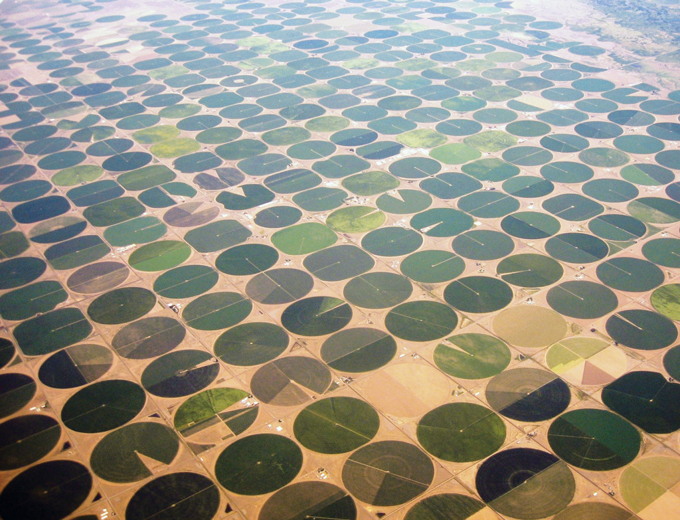
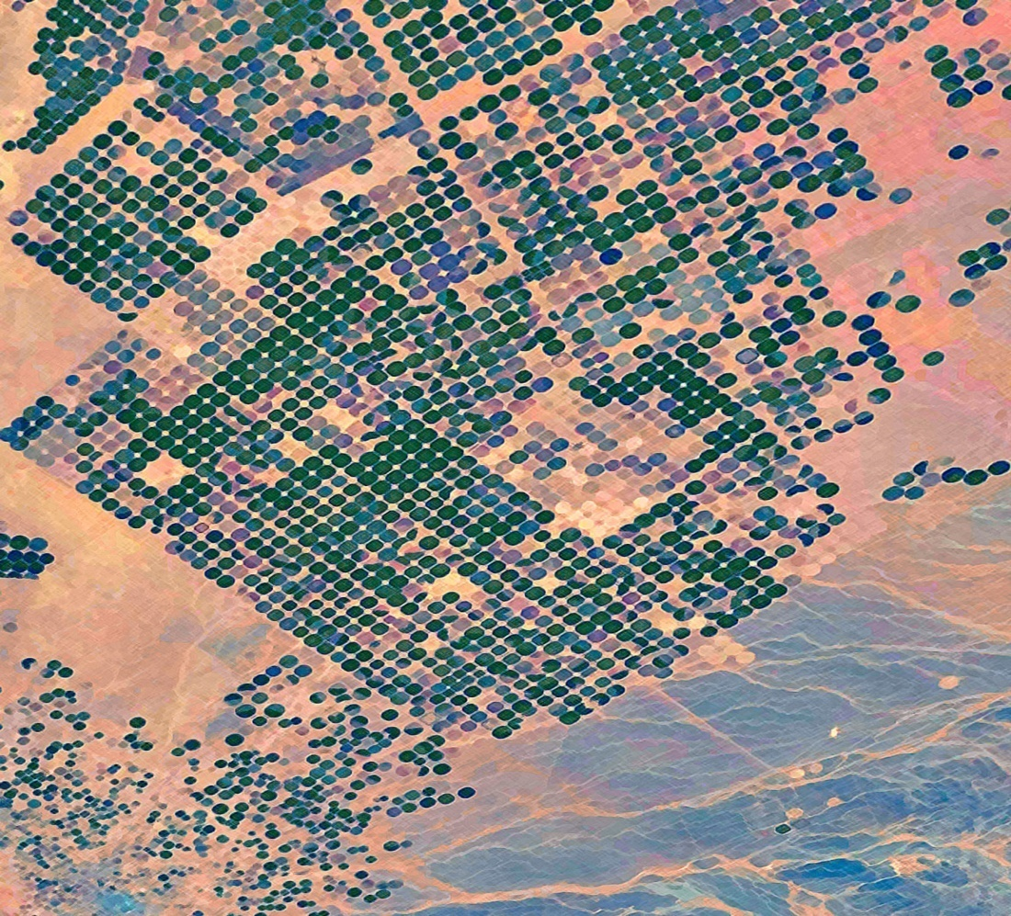
Saudi Arabia’s Farmland
Saudi Arabia was at one point the world’s sixth-largest exporter of wheat

Slide 9
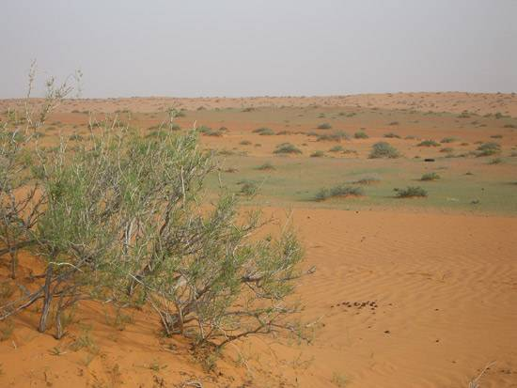
Saudi Arabia pumped over 5 trillion gallons of water per year from its aquifers to fuel its agricultural industry
At this rate, Lake Erie would be drained in 25 years
2016 was Saudi Arabia’s
last harvest, the
country now depends
on desalination
for potable water

Slide 10
Desalination
Desalination draws on water from the ocean to be processed into clean drinking water
It is expensive, requiring large amounts of energy
Energy from the grid and fossil fuels aren’t very sustainable, production of oil and gas consumes water itself

Slide 11
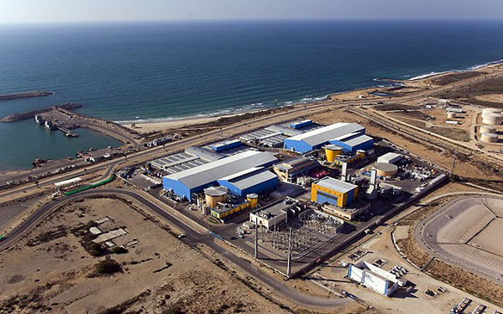
Solar Desalination
Some regions such as Chile, Saudi Arabia, and Abu Dhabi have turned to off-grid energy for desalination
Solar power has proven to be a sufficient source, especially for Low Temperature Distillation

Slide 12
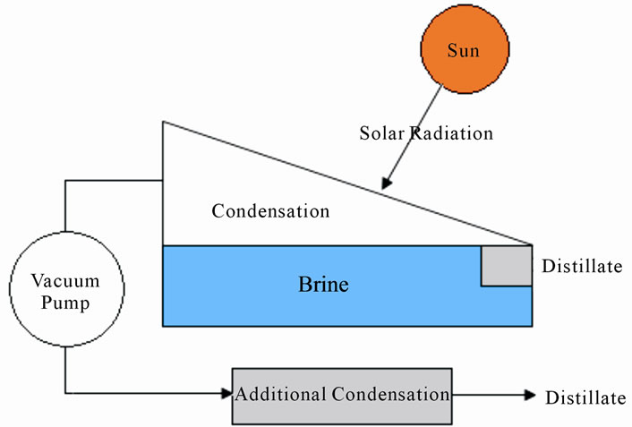
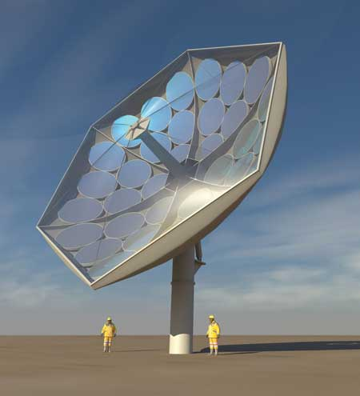
Low Temperature Desalination
This process creates a vacuum environment
It allows water to evaporate at near ambient temperatures
Lowers energy demand makes solar a viable option

Slide 13
Trivia
Questions involving hydrologic facts from around the world.

Slide 14
Question 1
What country contains the most of the worlds fresh surface water?
Norway
Russia
Canada
Brazil
Answer: Brazil

Slide 15
Question 2
Water that contains ___________ and ___________ is consider ”hard water”
Iron and sulfur
Magnesium and calcium
Phosphorus and carbon
Aluminum and tin
Answer: Magnesium and calcium

Slide 16
Question 3
___________ gallons of water are used to produce one gallon of gasoline.
12
20
10
16
Answer: 10

Slide 17
Question 4
Hydro power accounts for ___________ of Canada’s energy production.
24%
40%
31%
63%
Answer: 63%

