Slide 1
BLE 2
BLE device part 2

Slide 2
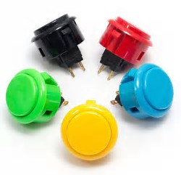
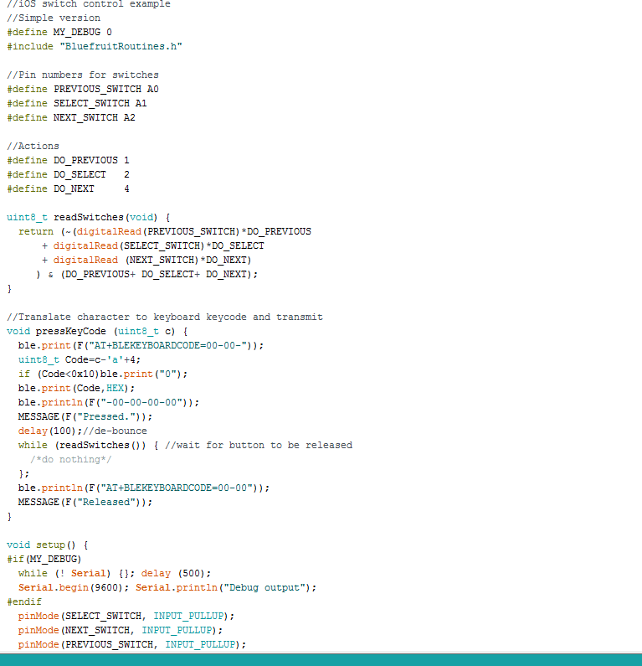
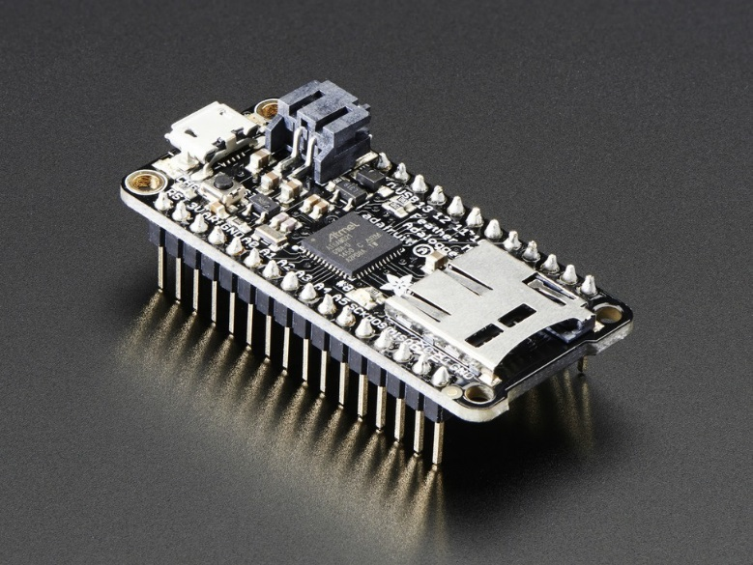
How it is built
Buttons
Feather M0
Code

Slide 3
Errors
What are errors?
Ways to fix errors

Slide 4
No such file or directory

Slide 5
Was not declared in this scope

Slide 6
Expected primary-expression before ‘.’ token

Slide 7
Sam-ba operation failed

Slide 8
Couldn't find a board on the selected path

Slide 9
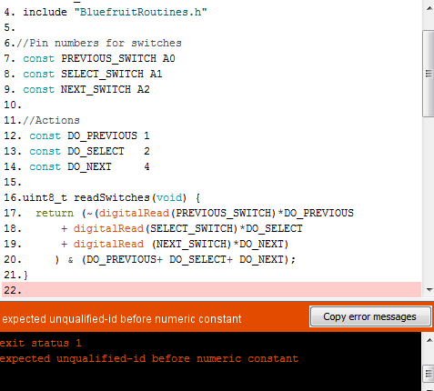
Unqualified-id before numeric constant

