Slide 1
High altitude balloon
Zachary, Mikey and Ethan

Slide 2
Table of contents
What is the high altitude balloon
What are they used for
Materials we used
Process of making the balloon
Extra Assistance

Slide 3
What is the high altitude balloon
High-altitude balloons are unmanned balloons
Most common type: weather balloon
usually filled with: helium/hydrogen, sometimes methane
They are released into the stratosphere
attaining between 18,000 to 37,000m
Collects data from the stratosphere; Temperature, Humidity, Altitude, Acceleration, pressure ect...

Slide 4
What are they used for
They are used as research balloons
also widely used to collect data and imagery from near space
High-altitude ballooning is used for scientific applications such as submillimetre astronomy
Enterprises are developing both manned and unmanned high-altitude balloons for scientific research

Slide 5
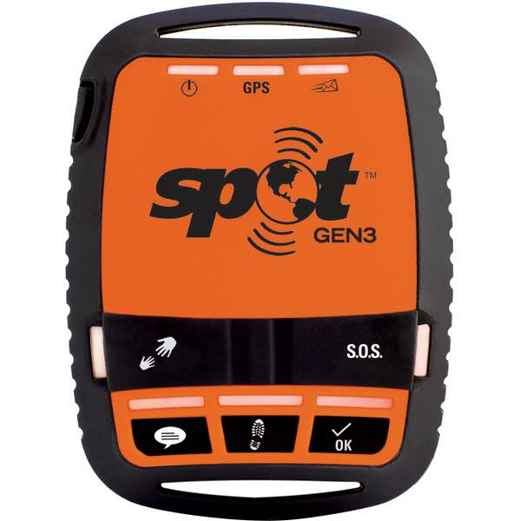
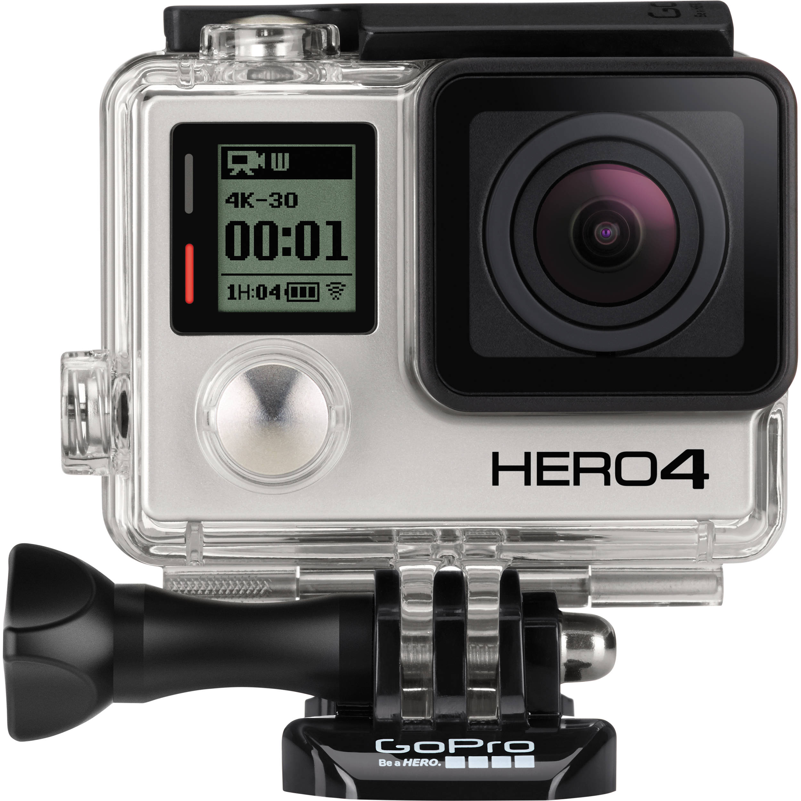
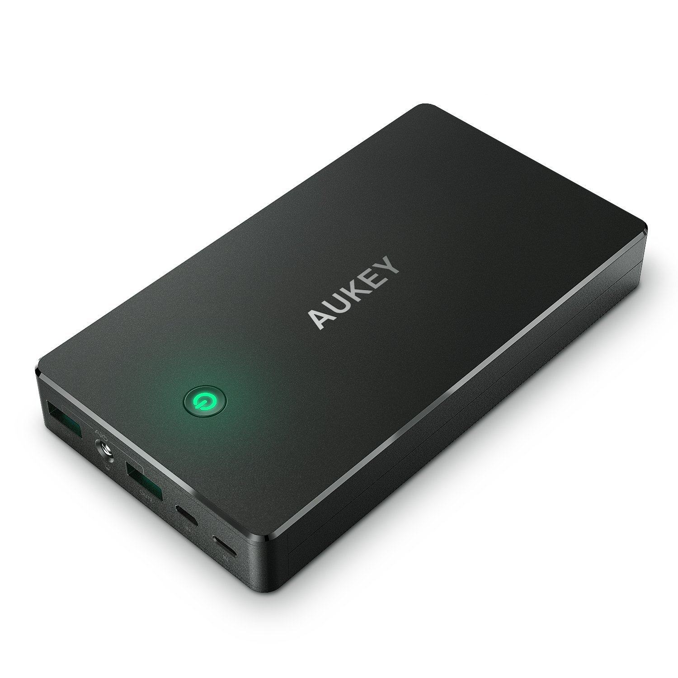
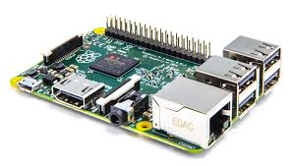
Materials we used to make this
1500g Weather Balloon
Raspberry pi
Spot Gen3 (tracking)
20 000mAh Power Bank
GoPro
Parachute
Styrofoam Cooler

Slide 6
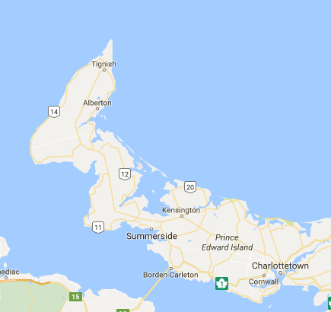
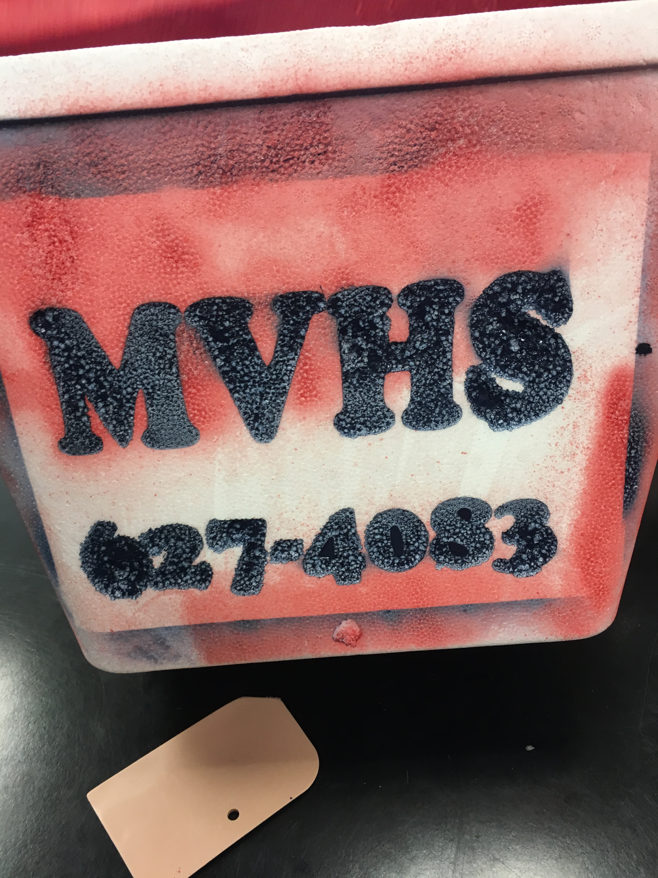
Making the Balloon
Cooler layout
Parachute tie off
Battery life
Spot Gen3 registration
Paracord
Landing destination

Slide 7
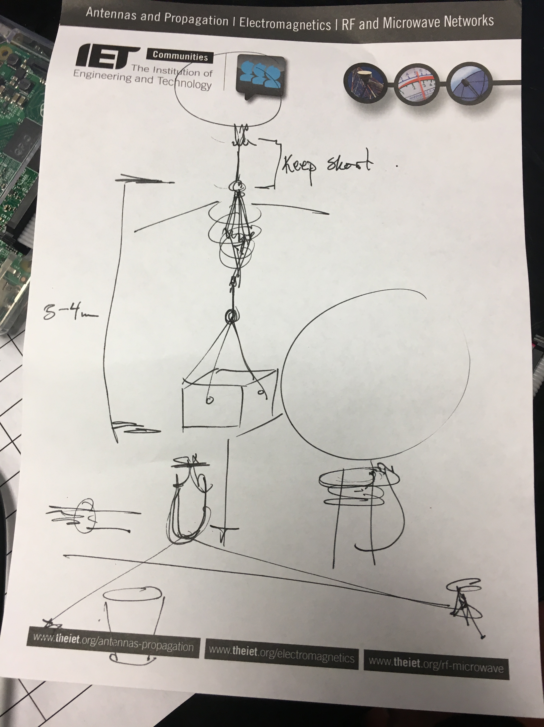
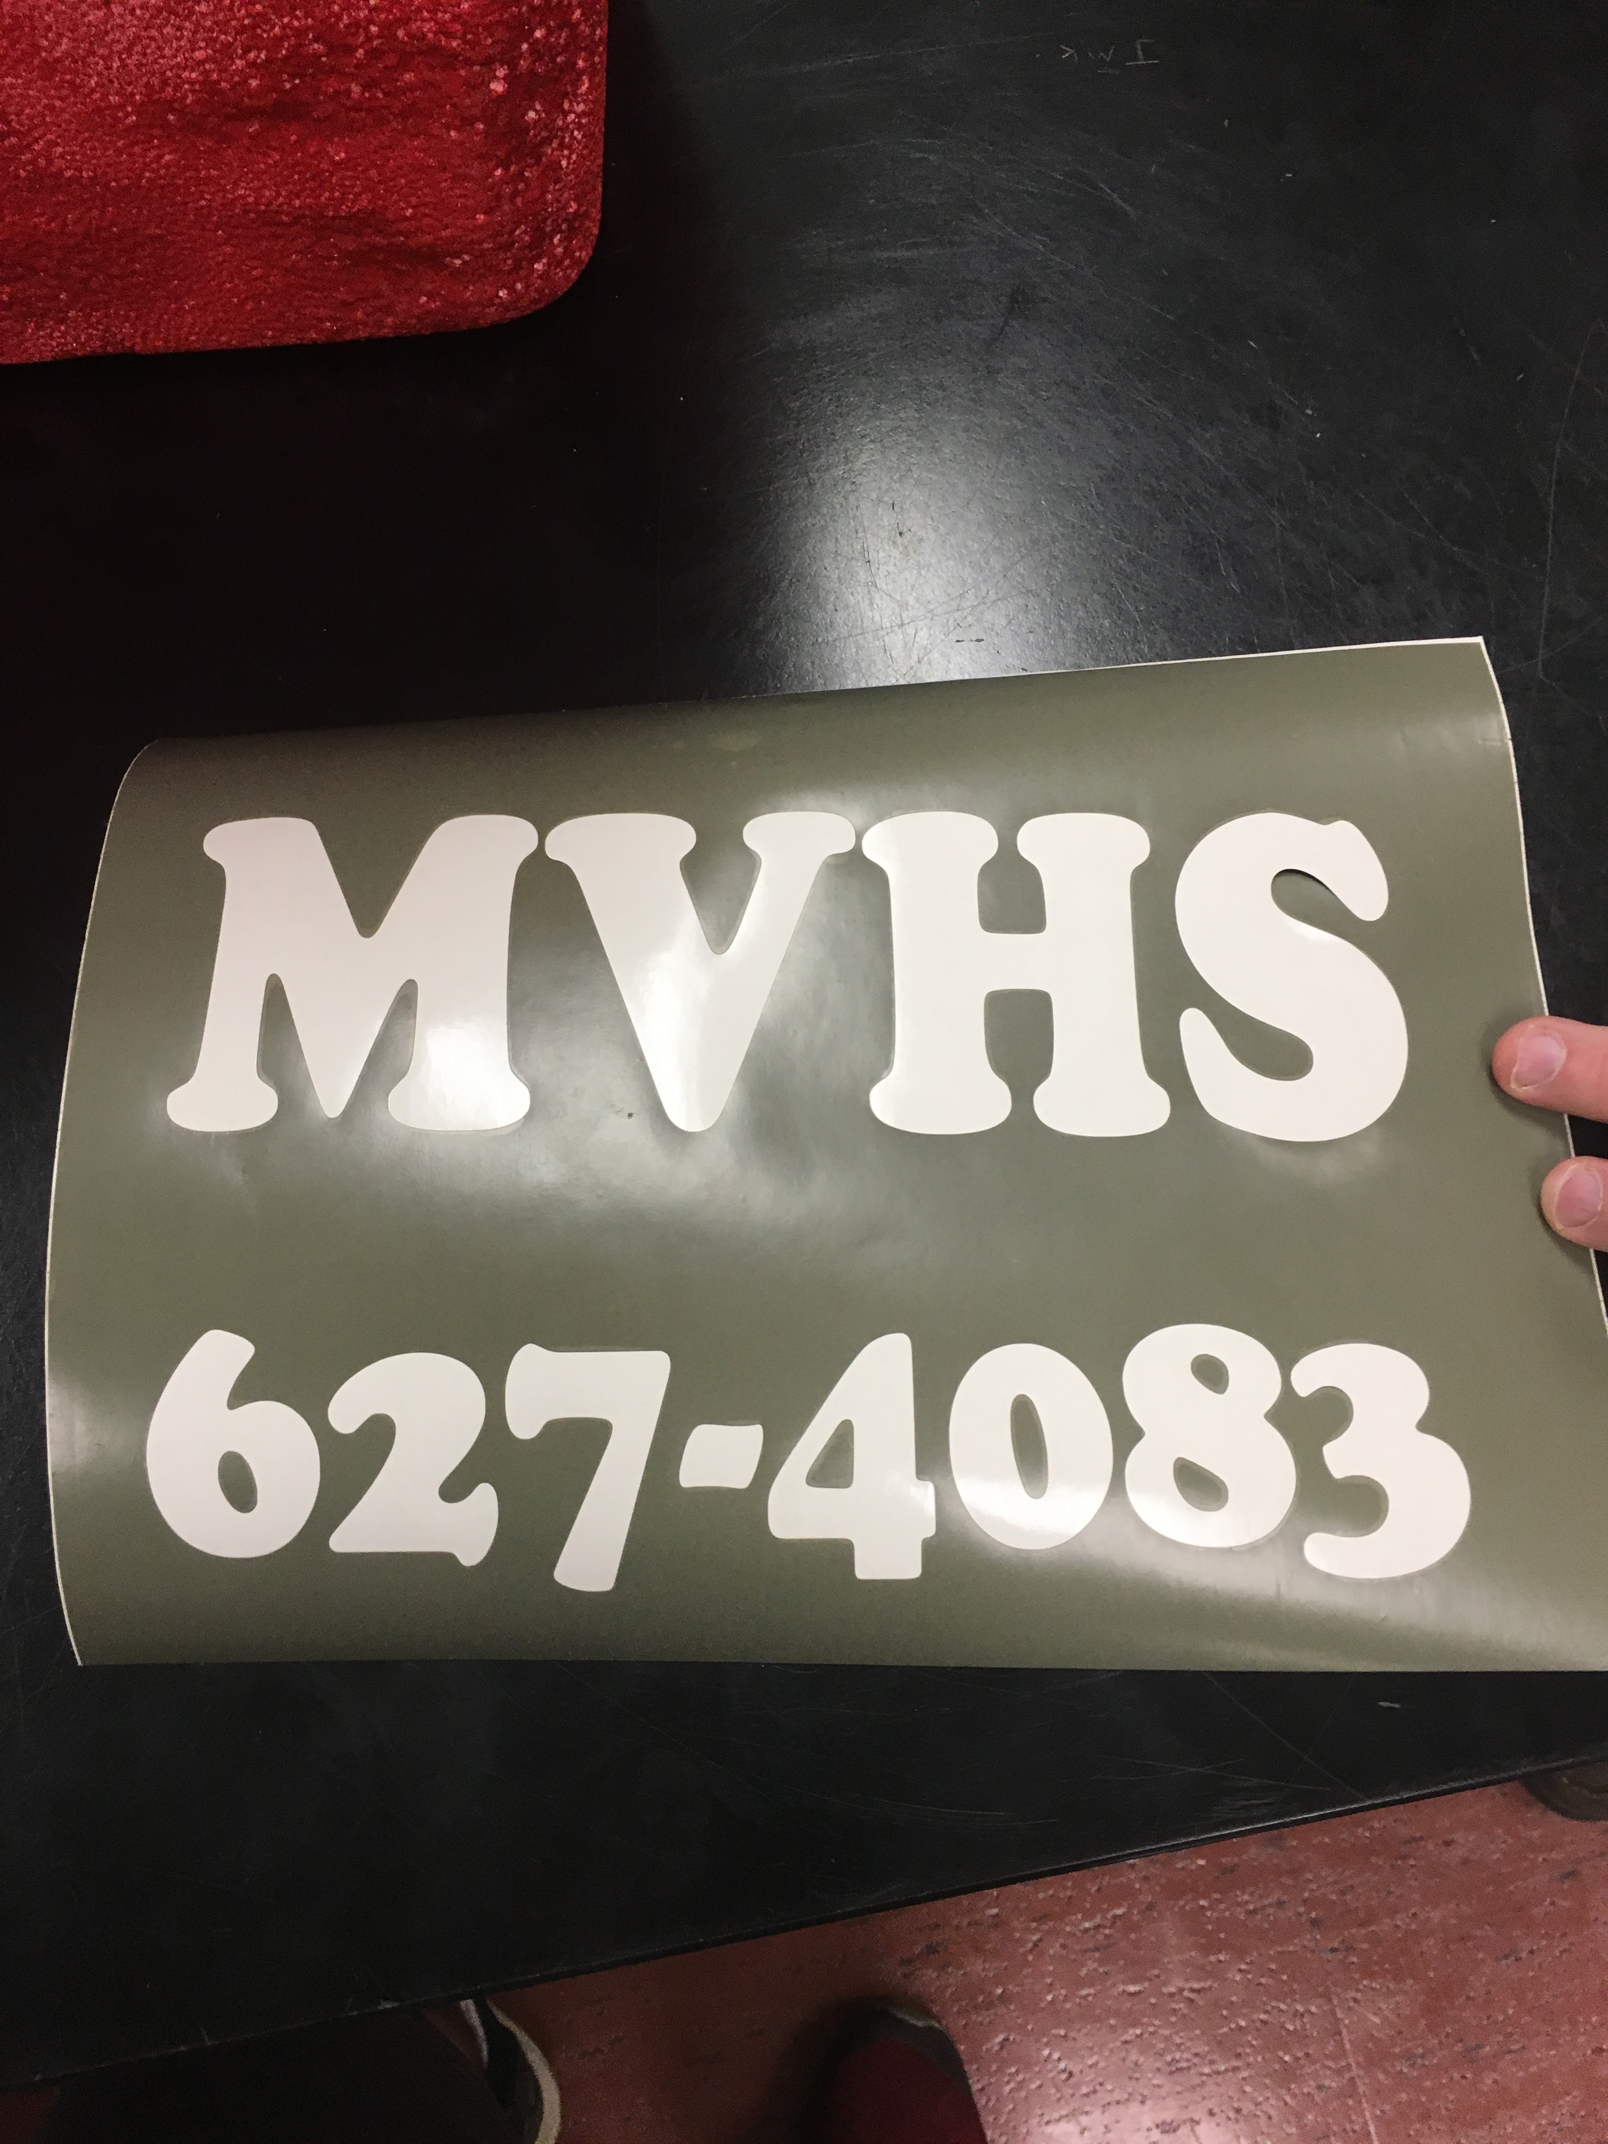
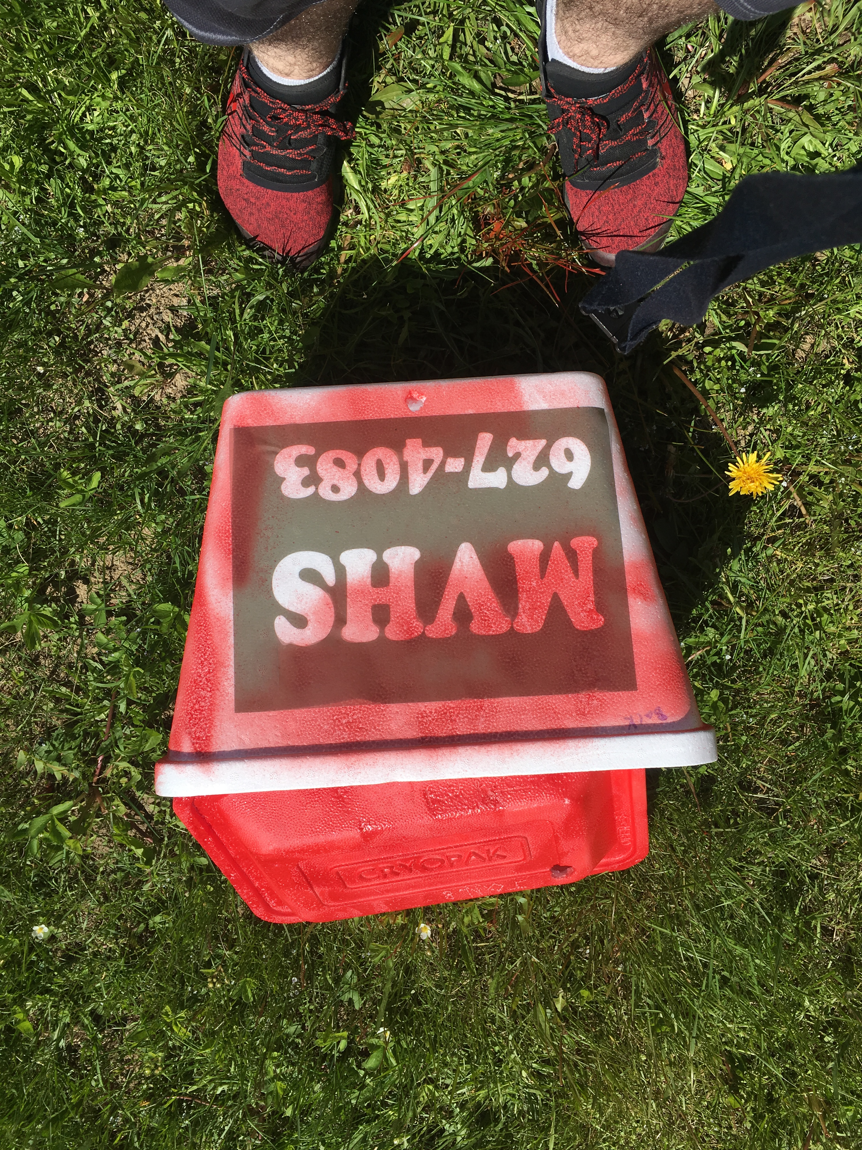
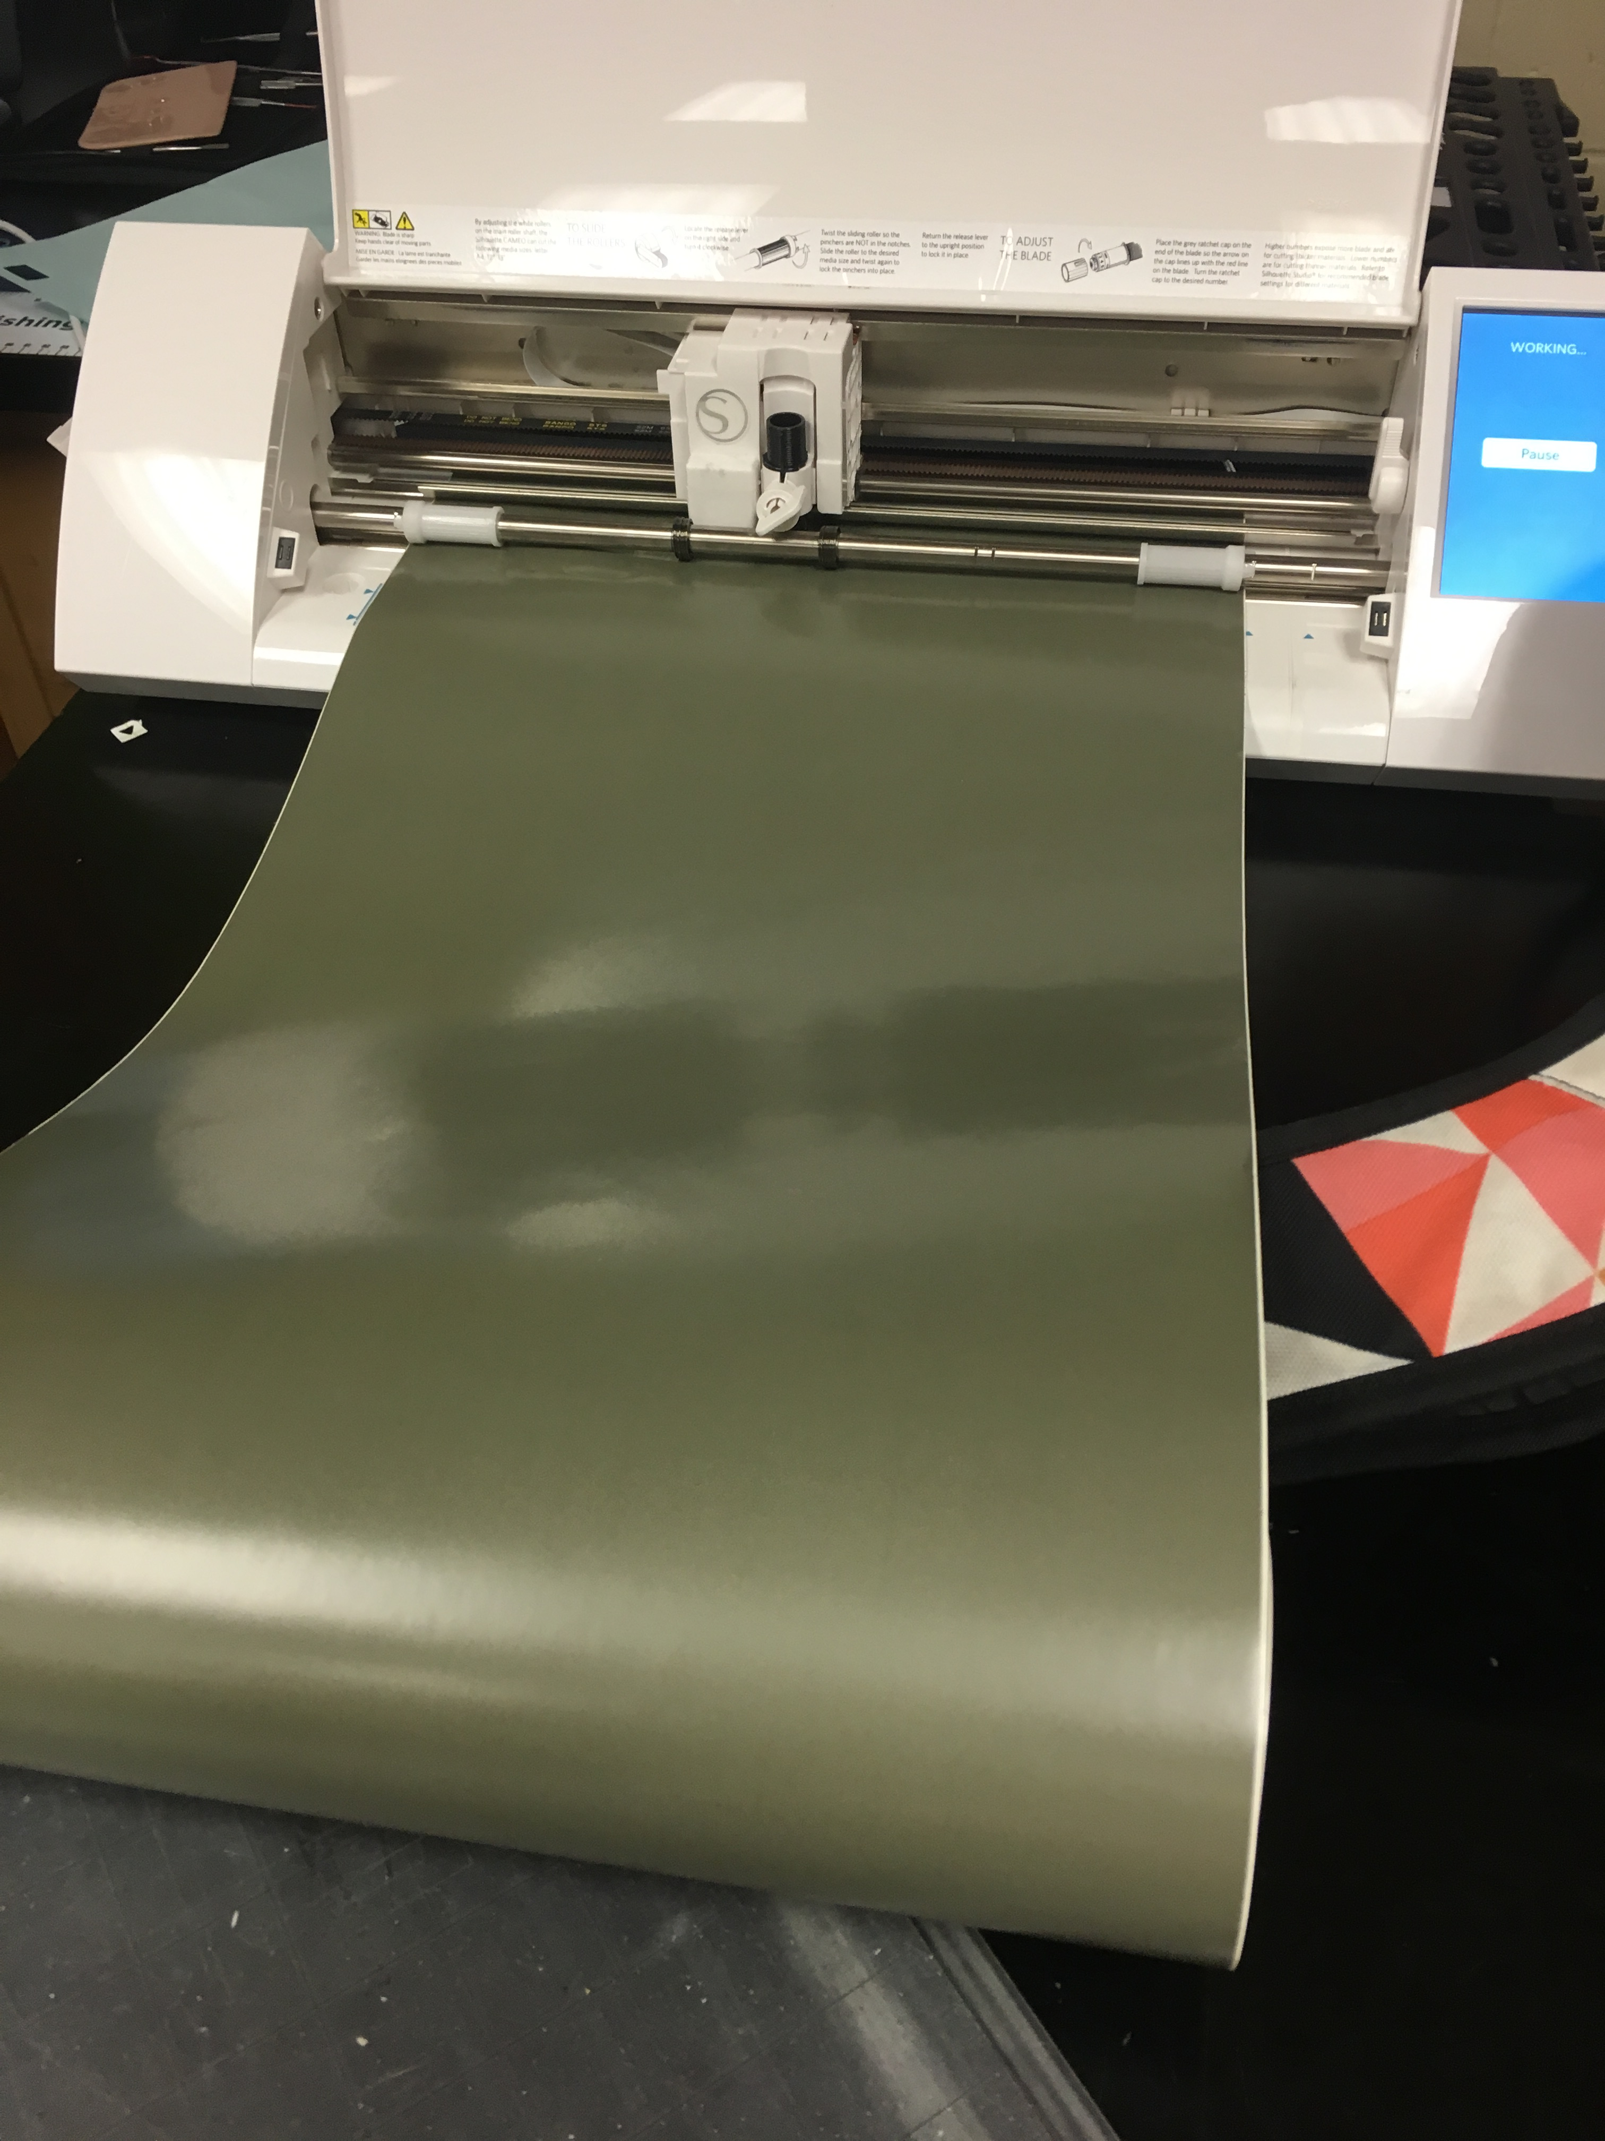
Extras
Help from the vinyl friends!
Raspberry Pi guys...
Mr Hallihan himself...
Jeff's help...

