Slide 1
High-altitude air balloon
By James and Dylan

Slide 2
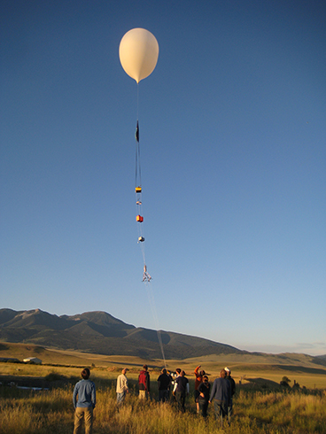
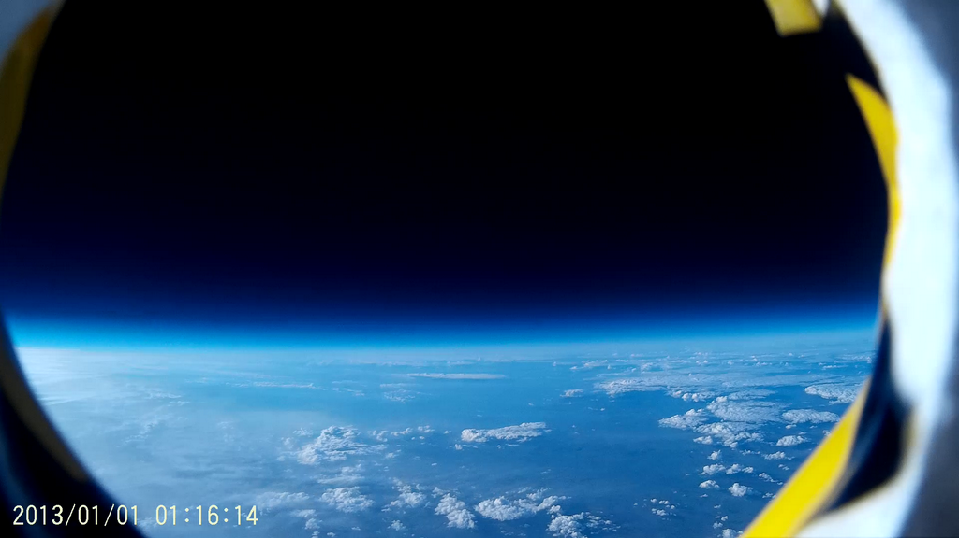
Assignment
Develop a sensor and GPS system for the hot air balloon team
The hot air balloon will embark on a 2-3 hour ascent into the upper atmosphere some time in June.
A Raspberry Pi 3 board will be used to collect sensory data.

Slide 3
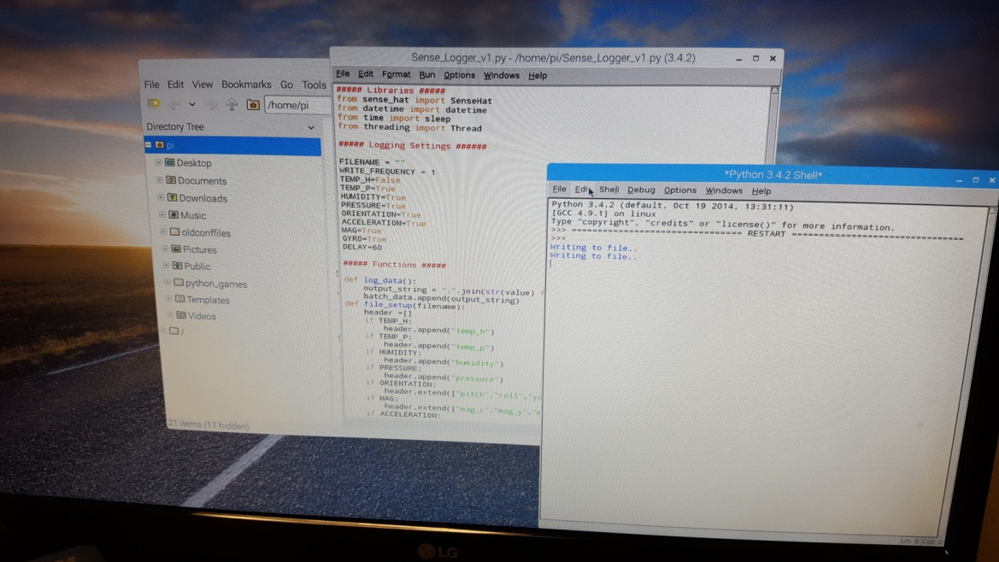
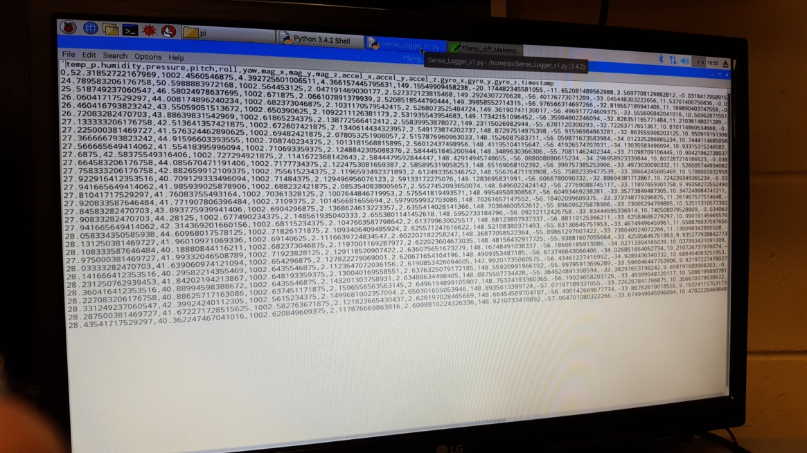
Programming the pi
We were able to find open-source code used to program the Raspberry Pi 3 to record data from the Sense HAT.
The program spits out a table that has a series of time stamped data from the sensors.

Slide 4
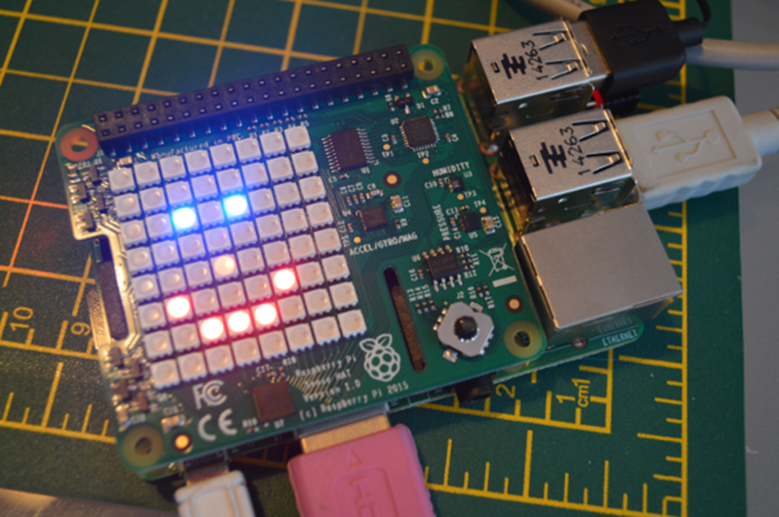
Sense hat testing
We tested the Sense HAT so far by operating it in three environments
We hypothesized the following:
Walk-In Cooler
Lower temperatures
Pool Area
Higher temperatures and humidity
CPU temperature closer to ambient
Maker Space
Normal room temperature
CPU temperature differential expected to be the most pronounced in this setting
May cool down CPU while operating

Slide 5
Average readings over HALF AN hour

Slide 6
Analysis
The portable charger used for the Raspberry Pi was able to power it for all 3 tests
Still had power even after being in the cooler
The Raspberry Pi seemed to stop recording data after ~ 10 minutes
Temperatures, except for the cooler, were within expected ranges
Cold isn’t picked up by the sensor, only heat or the absence of it. Low temperatures emphasize the heat given off by the CPU
Humidity was lower than expected in the pool area
We should find a away to distance the HAT Sensor from the CPU

Slide 7
Are we ready to launch?
The Raspberry Pi and Sense HAT are almost ready!
We just need to finish the balloon and solve the residual heat issue!

