Slide 1
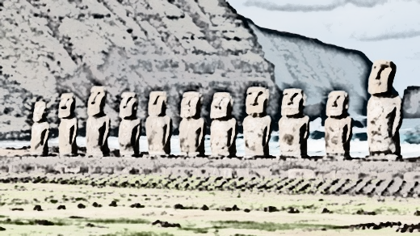
Easter Island
Nick surette

Slide 2
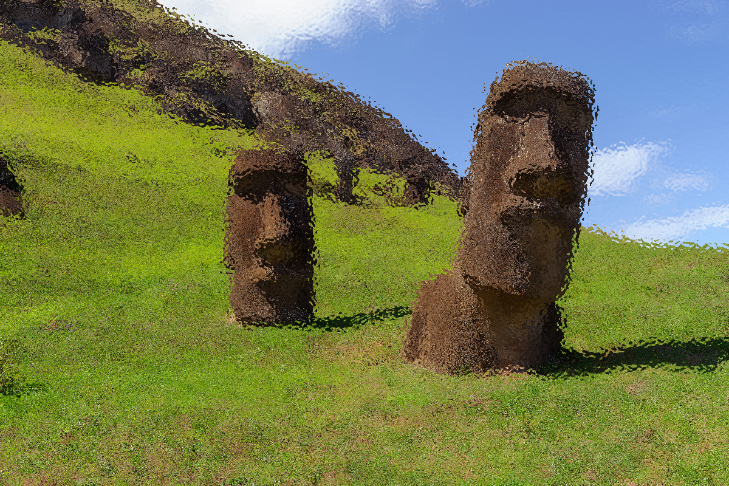
Who Lived There?
Native to Polynesia
Sailed from Polynesia
Called “Rapa Nui”

Slide 3
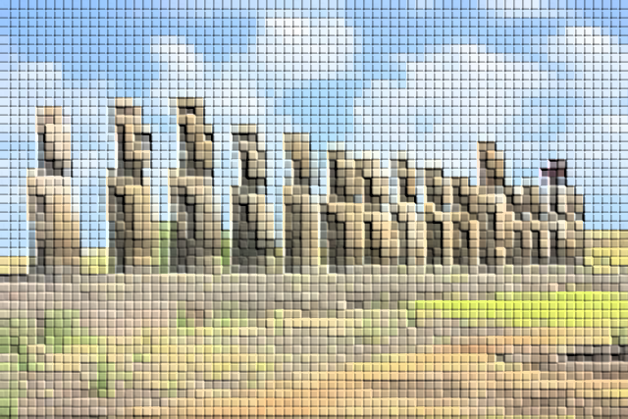
Resources
Once filled with trees and birds
Many birds were killed
All trees cut down

Slide 4
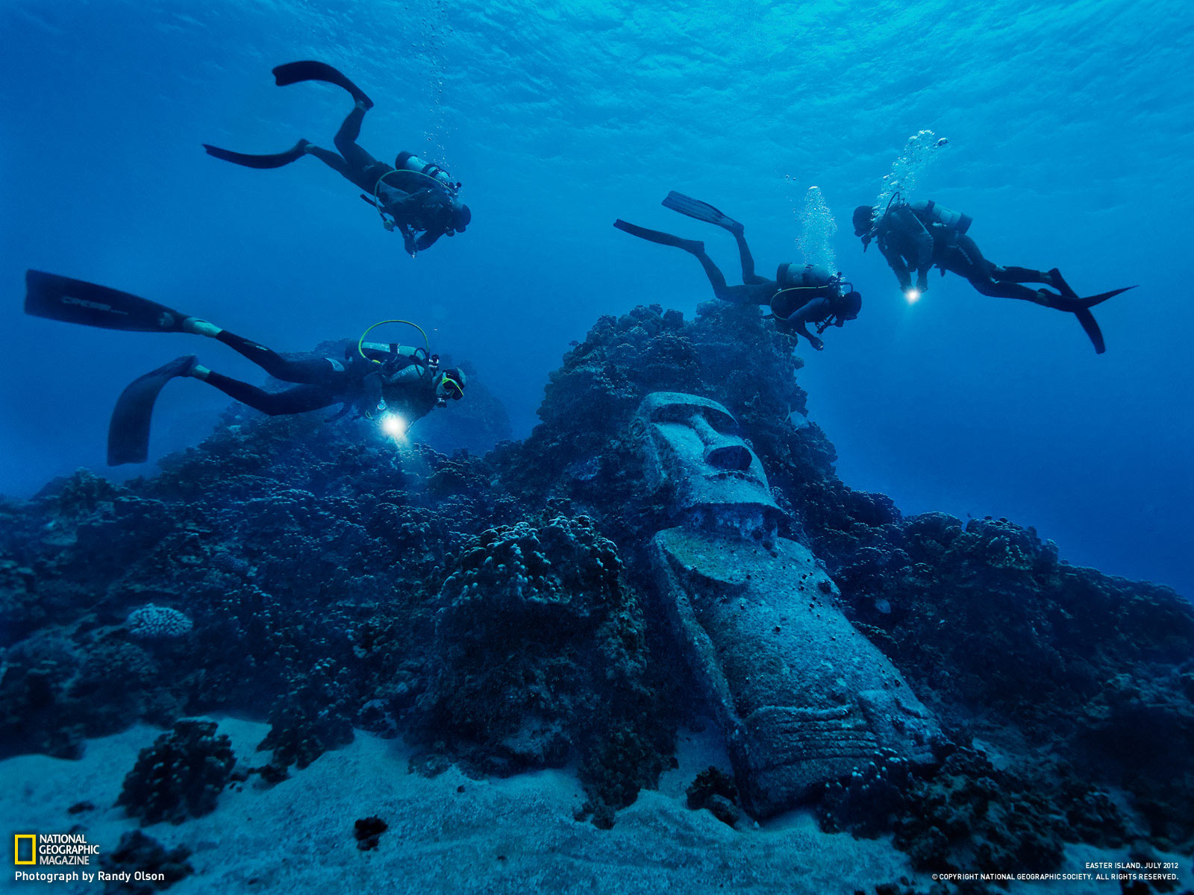
The heads
Some weighed up to 60 tonnes
Made to remember chiefs that died

Slide 5
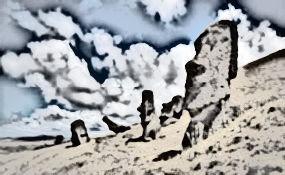
What made them die out
The population grew to much for the island to handle
The islands trees were chopped down to move the statues
in the end disease and slavery was the final blow

Slide 6
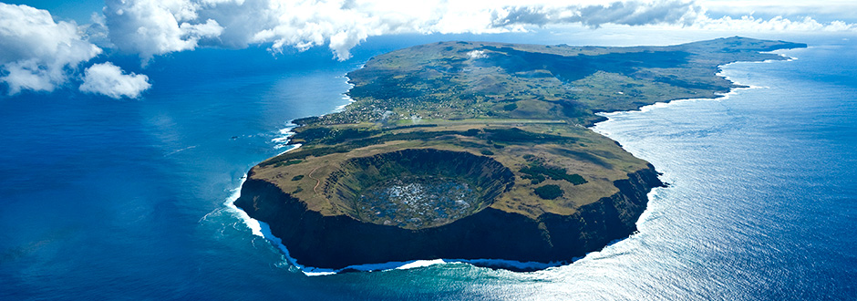
Do people live there now?
In 2016 the approximate population was 6600
People that live there come from all over the world

Slide 7
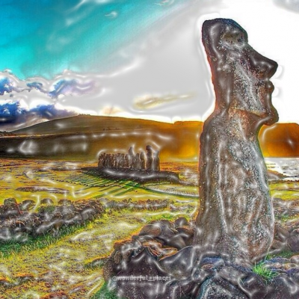
Thank you

