Slide 1
Bluetooth Redbot 2.0 & Sumobot
By James MacMillan and Dylan Howe

Slide 2
Objectives
Redbot:
Establish Bluetooth connection between Arduino board and Dualshock 4 controller
Communicate with Arduino using Dualshock 4
Provide live video feed to Android device from Raspberry Pi via Bluetooth
Sumobot:
Design cutting edge robots to fight to the death in provincial competition
Kick butt
Complete
In Progress
Incomplete
Complete
Incomplete

Slide 3
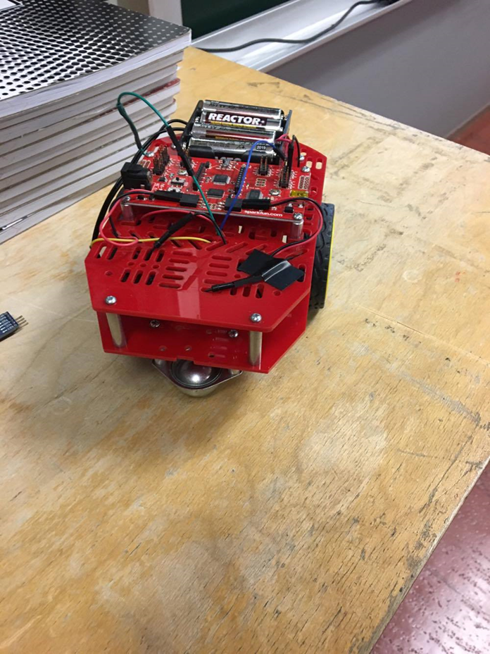
Bluetooth Redbot 2.0
Flagship Project

Slide 4
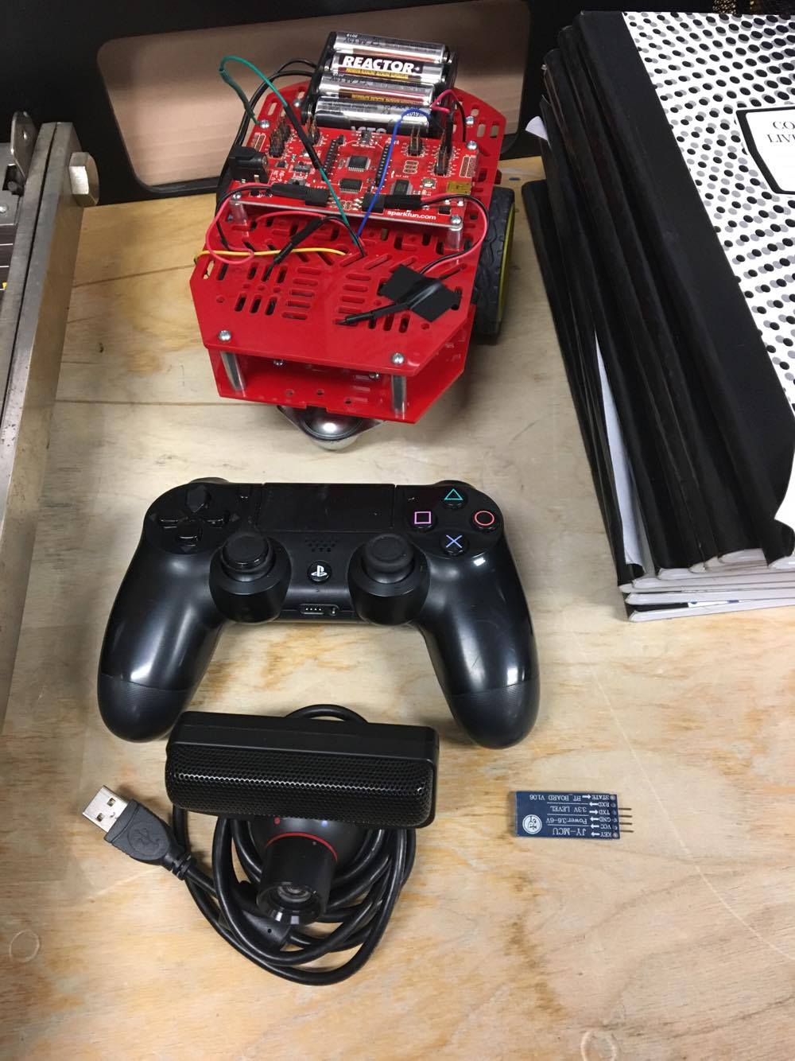
Bluetooth Redbot 2.0
This semester we decided to build on our previous Bluetooth Redbot design.
Our previous build involved transmitting input information from a Android Terminal Emulator wireless to an Arduino board.
Since we used a terminal emulator rather than developing our own dedicated app, video feed functionality could not be accessed on the mobile device while controlling the Redbot.

Slide 5
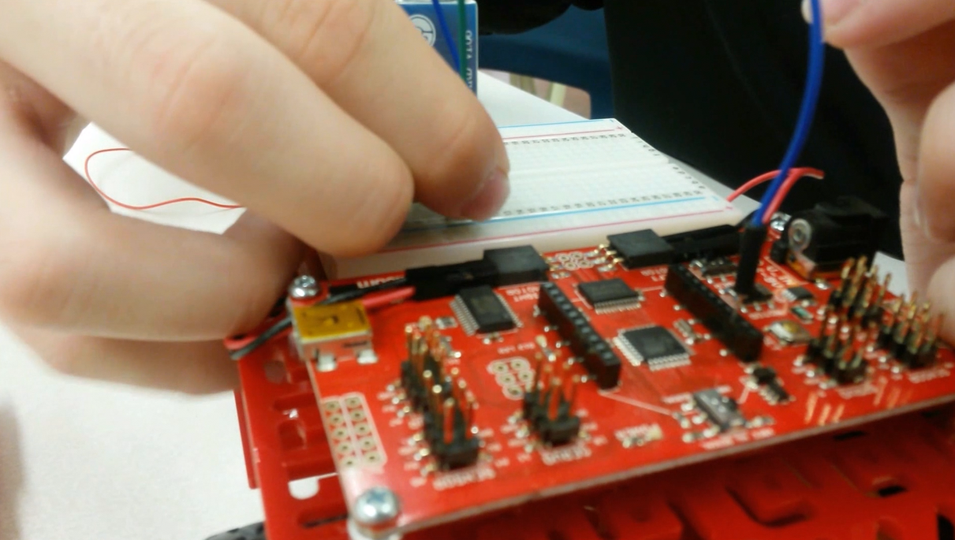
Constructing the Redbot
Built the Redbot from the ground up, started with basic Redbot chassis and Arduino board. Added breadboard, Bluetooth dongle, and rewired it.
Made room for webcam and Raspberry Pi.
Began to play around with code to see if we could control the Redbot via Dualshock 4 controller and Raspberry Pi.

Slide 6
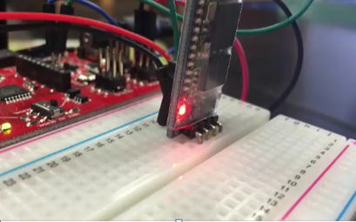
Problems/Lows
This semester we faced many problems with our Bluetooth Redbot design.
We were unable to use our old Bluetooth dongle to connect to the Dualshock 4 controller.
Unable to connect to our camera via Raspberry Pi 2.
Unable to send/receive signals to/from Arduino board.

Slide 7
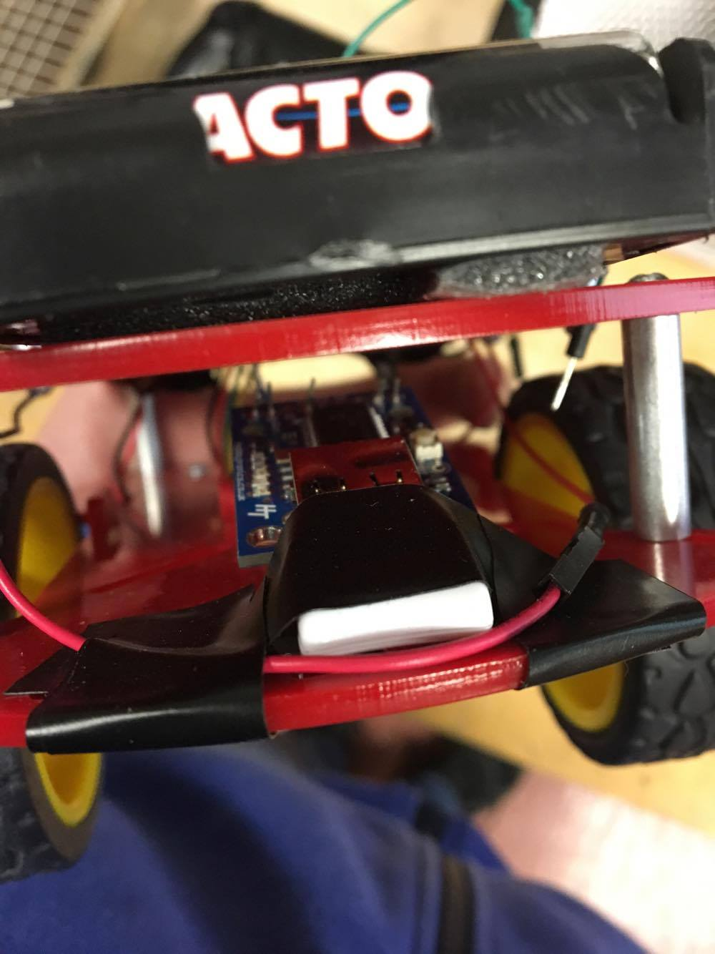
Successes/Highs
Received new Bluetooth dongle specifically made for Dualshock 4 connection.
Able to connect to Bluetooth dongle with Dualshock 4 controller.
Rearranged Redbot to allow space for camera and new dongle.
Still able to drive Redbot via terminal emulator on cellphone.
Discovered how to install programs on Raspberry Pi.

Slide 8
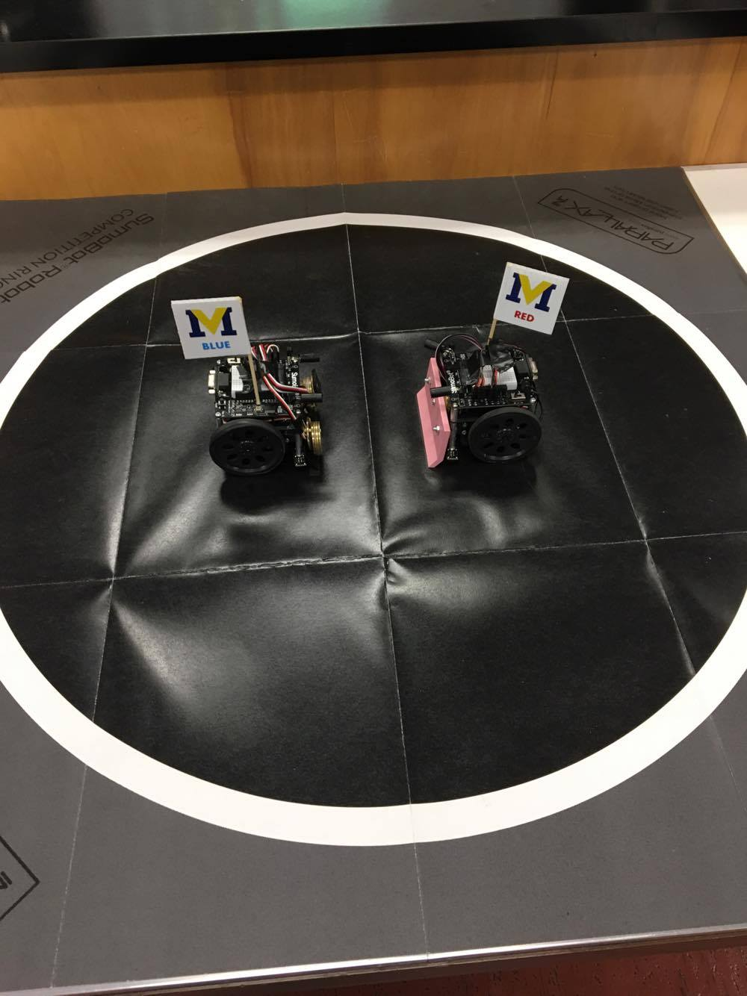
Sumobots
Robot Rumble

Slide 9
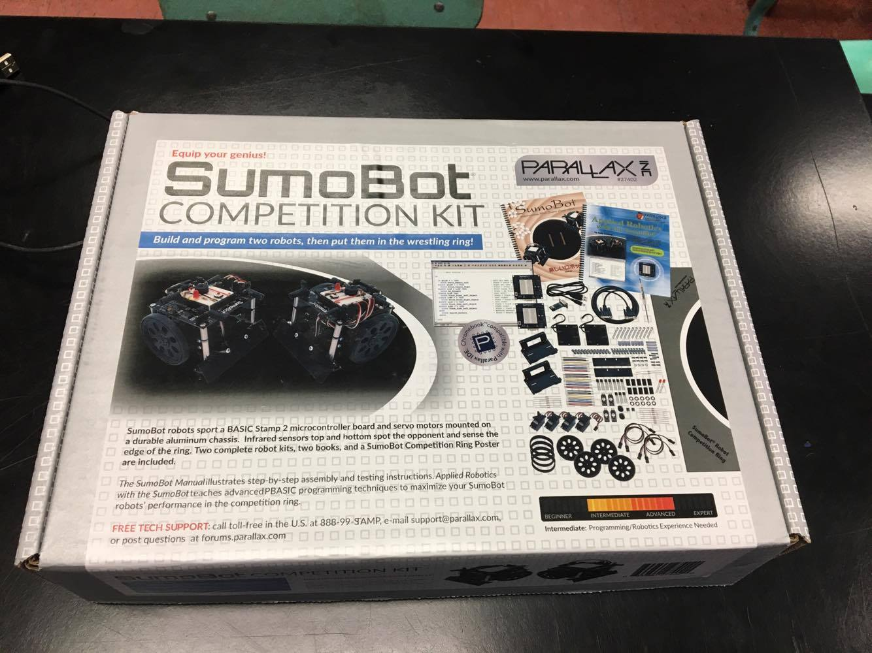
Sumobots
We were chosen to participate in the provincial Sumobot competition in Saint John.
Brilliant Labs supplied us with a $300 Sumobot competition kit.
We had no idea how the Sumobots worked and were given around 2 weeks to build and code them.
Sumobots had to function autonomously (without us controlling them).

Slide 10
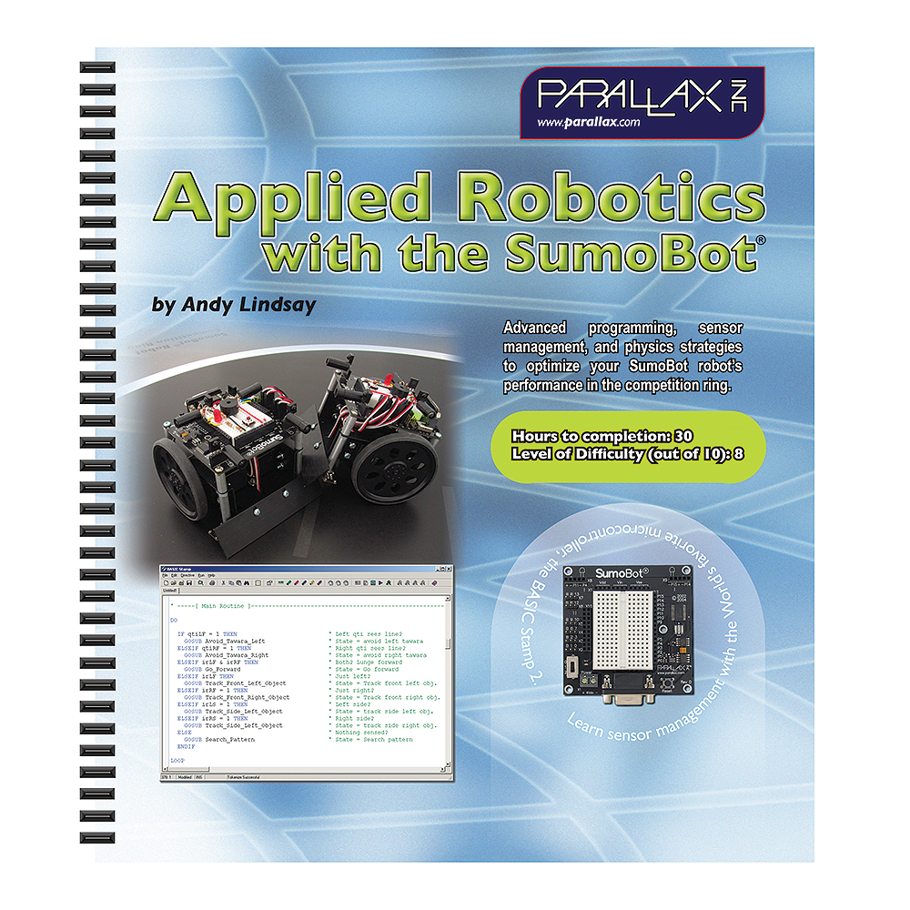
Problems/Lows
Thought we had to read 30 hours worth of material on applied robotics.
Received the Sumobots quite late, were pressed for time.
Sumobots would originally drive outside of the ring or come to a complete stop if they hit the edge of the ring.

Slide 11
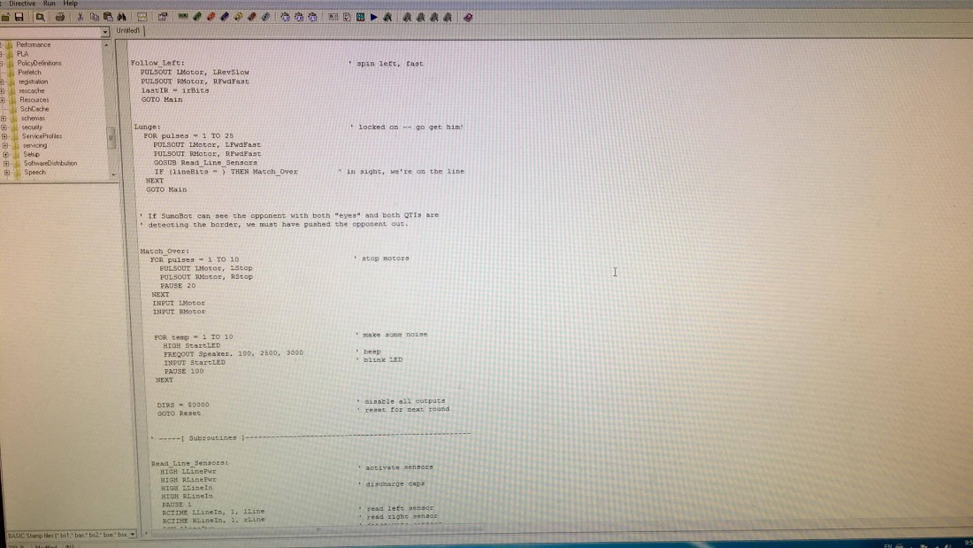
Successes/Highs
Found basic coding for the Sumobots online.
Figured out how to change the code by skim reading Applied Robotics book.
Changed the code to allow the Sumobots to turn around each time they hit the white line, thus allowing them to stay in the ring on their own.
Grade 10 students 3D printed a new blade and installed it for us.
We were able to add weights to the Sumobots while still staying under the 10cm x 10cm and 500g limits.

