Slide 1
Vinyl cutting + heat press
Nina Schaefer and Vera Santamaria

Slide 2
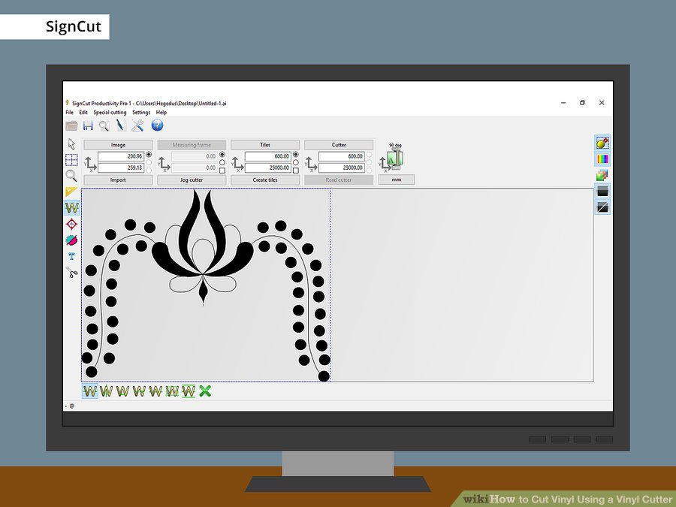
HOW TO USE A VINYL CUTTER (STEPS):
Choose the logo you want to print.

Slide 3
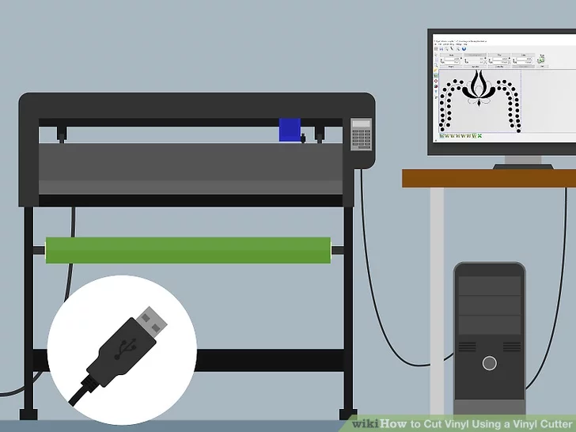
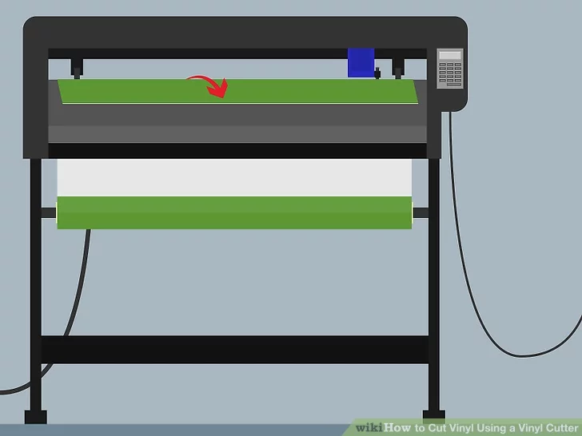
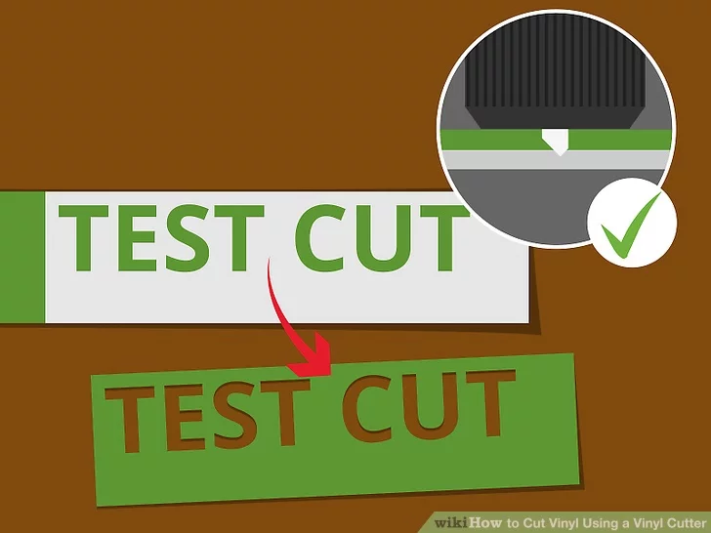
Connect up your vinyl cutter.
Load your material.
Make a test cut, to see if you can peel it off.

Slide 4
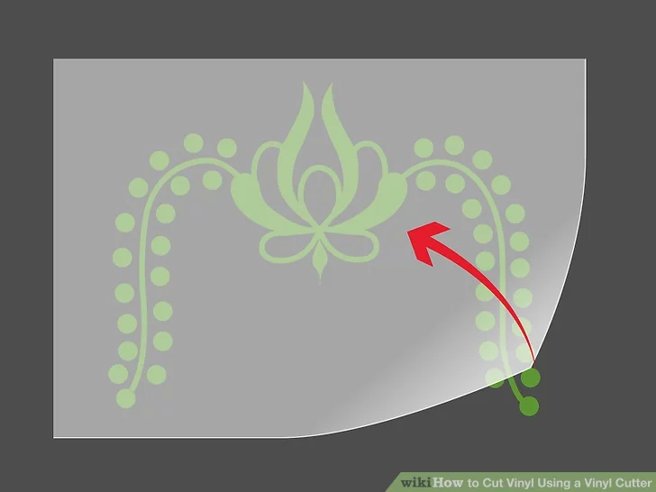
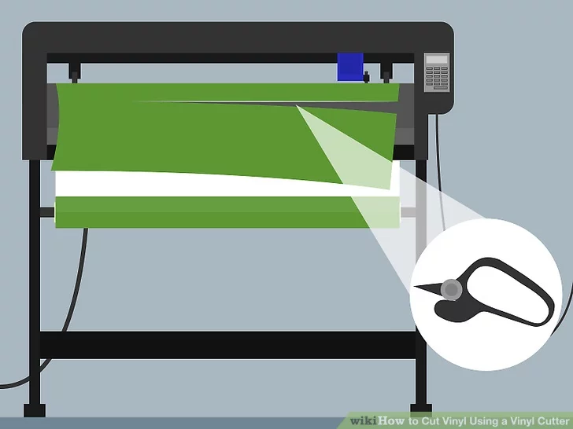
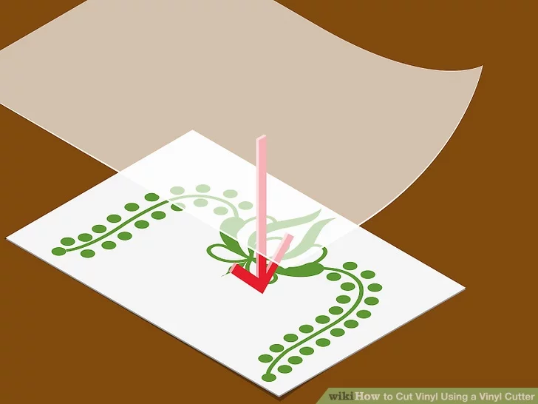
Print your sticker and cut it.
Apply transfer tape.
Put it whenever you want.

Slide 5
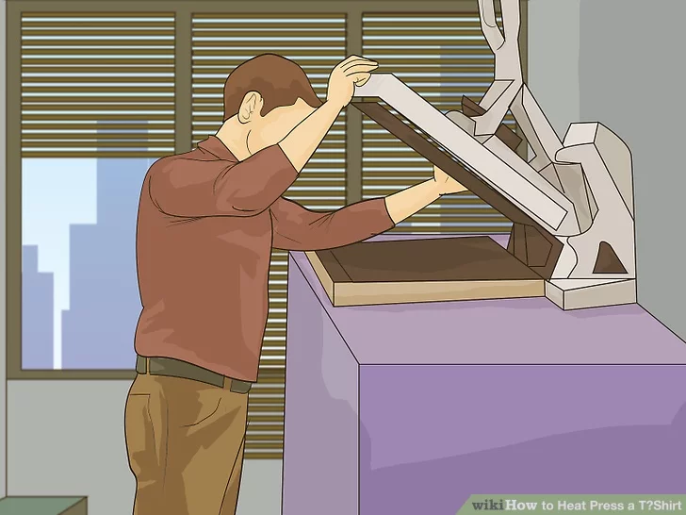
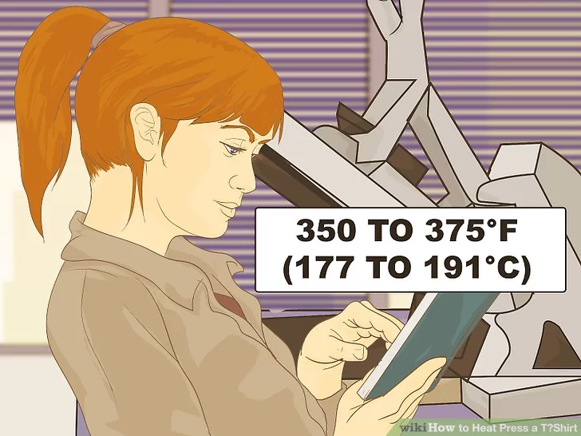
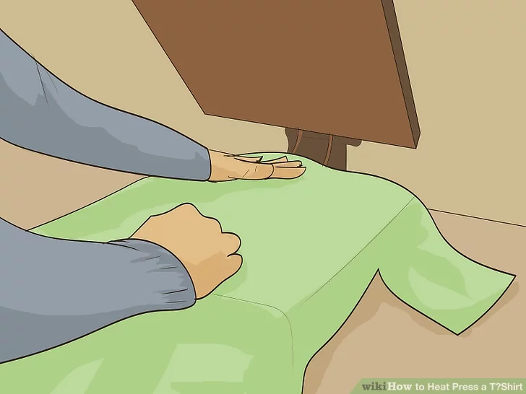
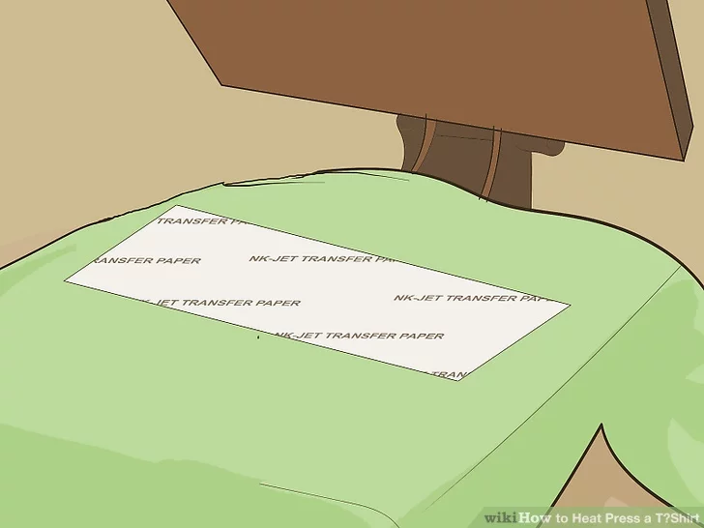
HOW TO USE THE HEAT PRESS
(STEPS):
Set up heat press
Wait until it gets to the temperature you want
Put your shirt with the vinyl under the heat press, make sure that you put your Teflon sheet on the vinyl to protect it

Slide 6
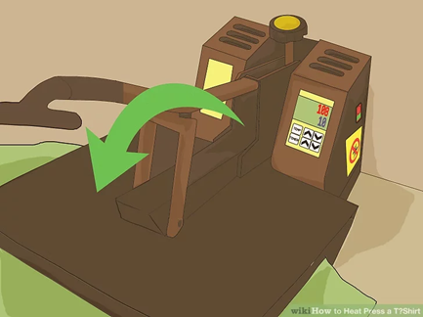
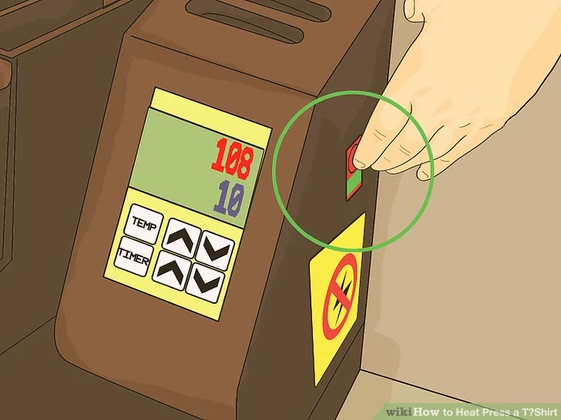
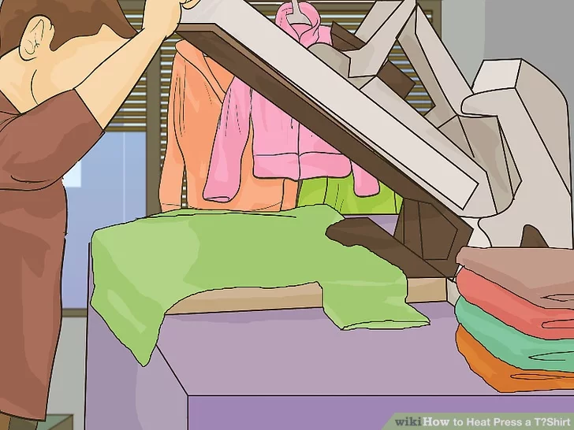
Bring the handle down. The handle should lock firmly in place
Set the timer and wait until it is done
Lift the handle to open the press
Peel the Transfer Paper from the shirt

Slide 7
OUR PROJECT: IDEA
We chose vinyl cutting and heat press because it seemed to be easier than the other technologies.
Our main idea was to make our own clothes with our own logo.

Slide 8
OUR PROJECT: PROBLEMS/LOWS
Cut the protective sheet thinking that it was a different type of vinyl.
Sometimes the vinyl didn’t lift up very good.
The vinyl didn’t stick to some of the mugs(lifted up).
Tried to put the MV sticker on the door and it didn’t stick to the transfer tape.

Slide 9
OUR PROJECT: HIGHS
Finishing the different projects and seeing the result.

Slide 10
OUR PROJECT: THE END(FINAL PROJECT)
Our final project is the same as at the beginning because we haven´t had the opportunity to do it yet >>>make our own clothing with our own logo.

Slide 11
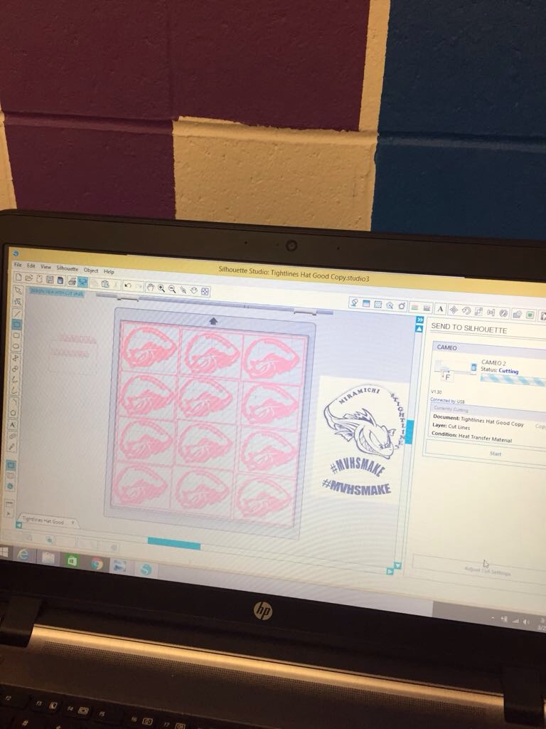
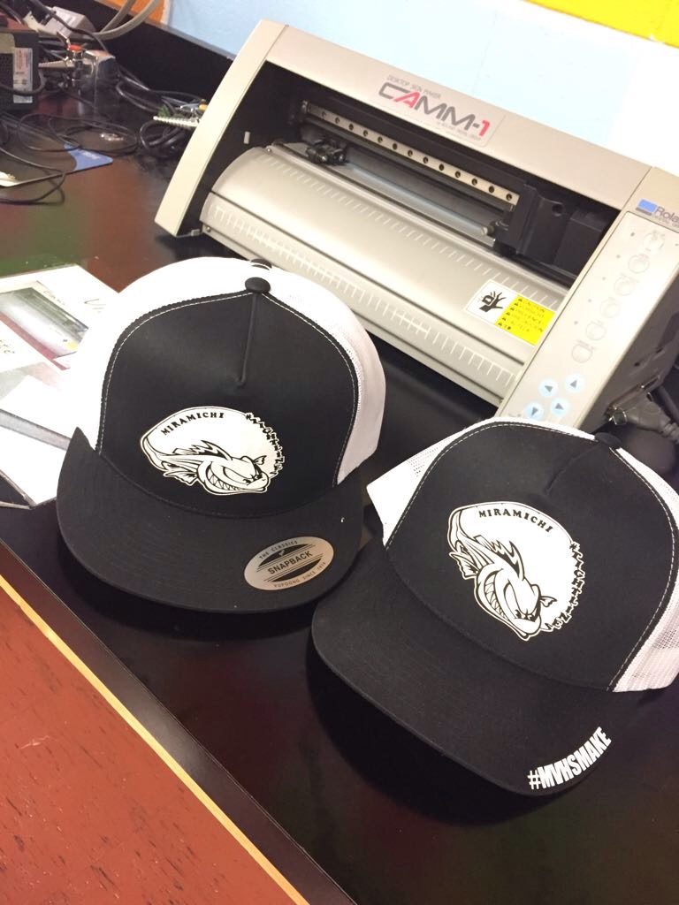
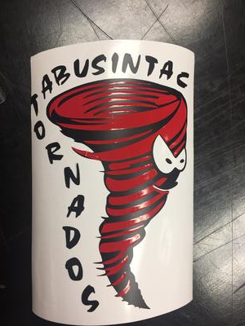
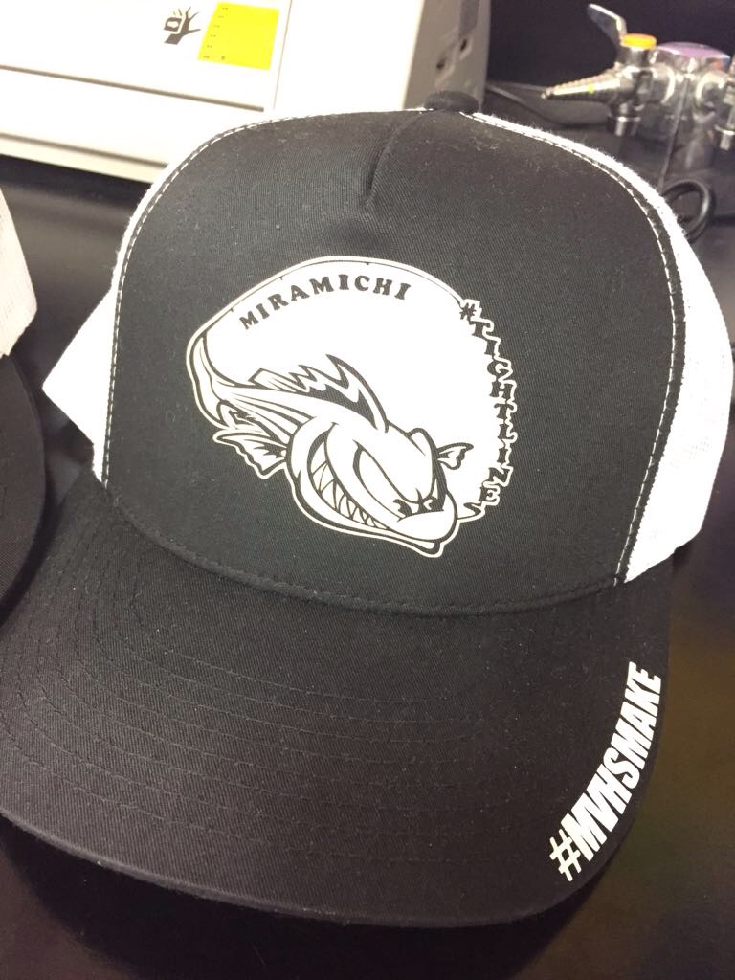
OUR WORK!

