Slide 1
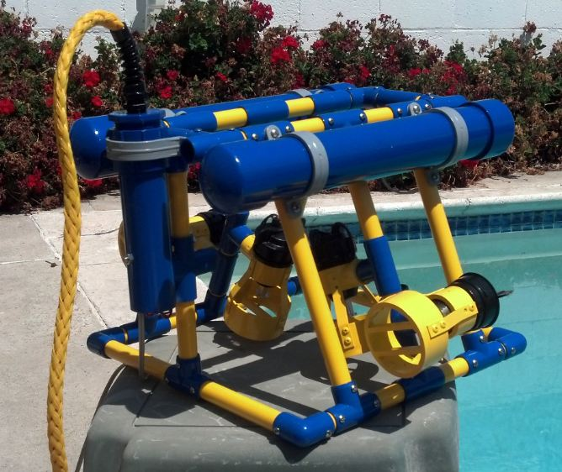
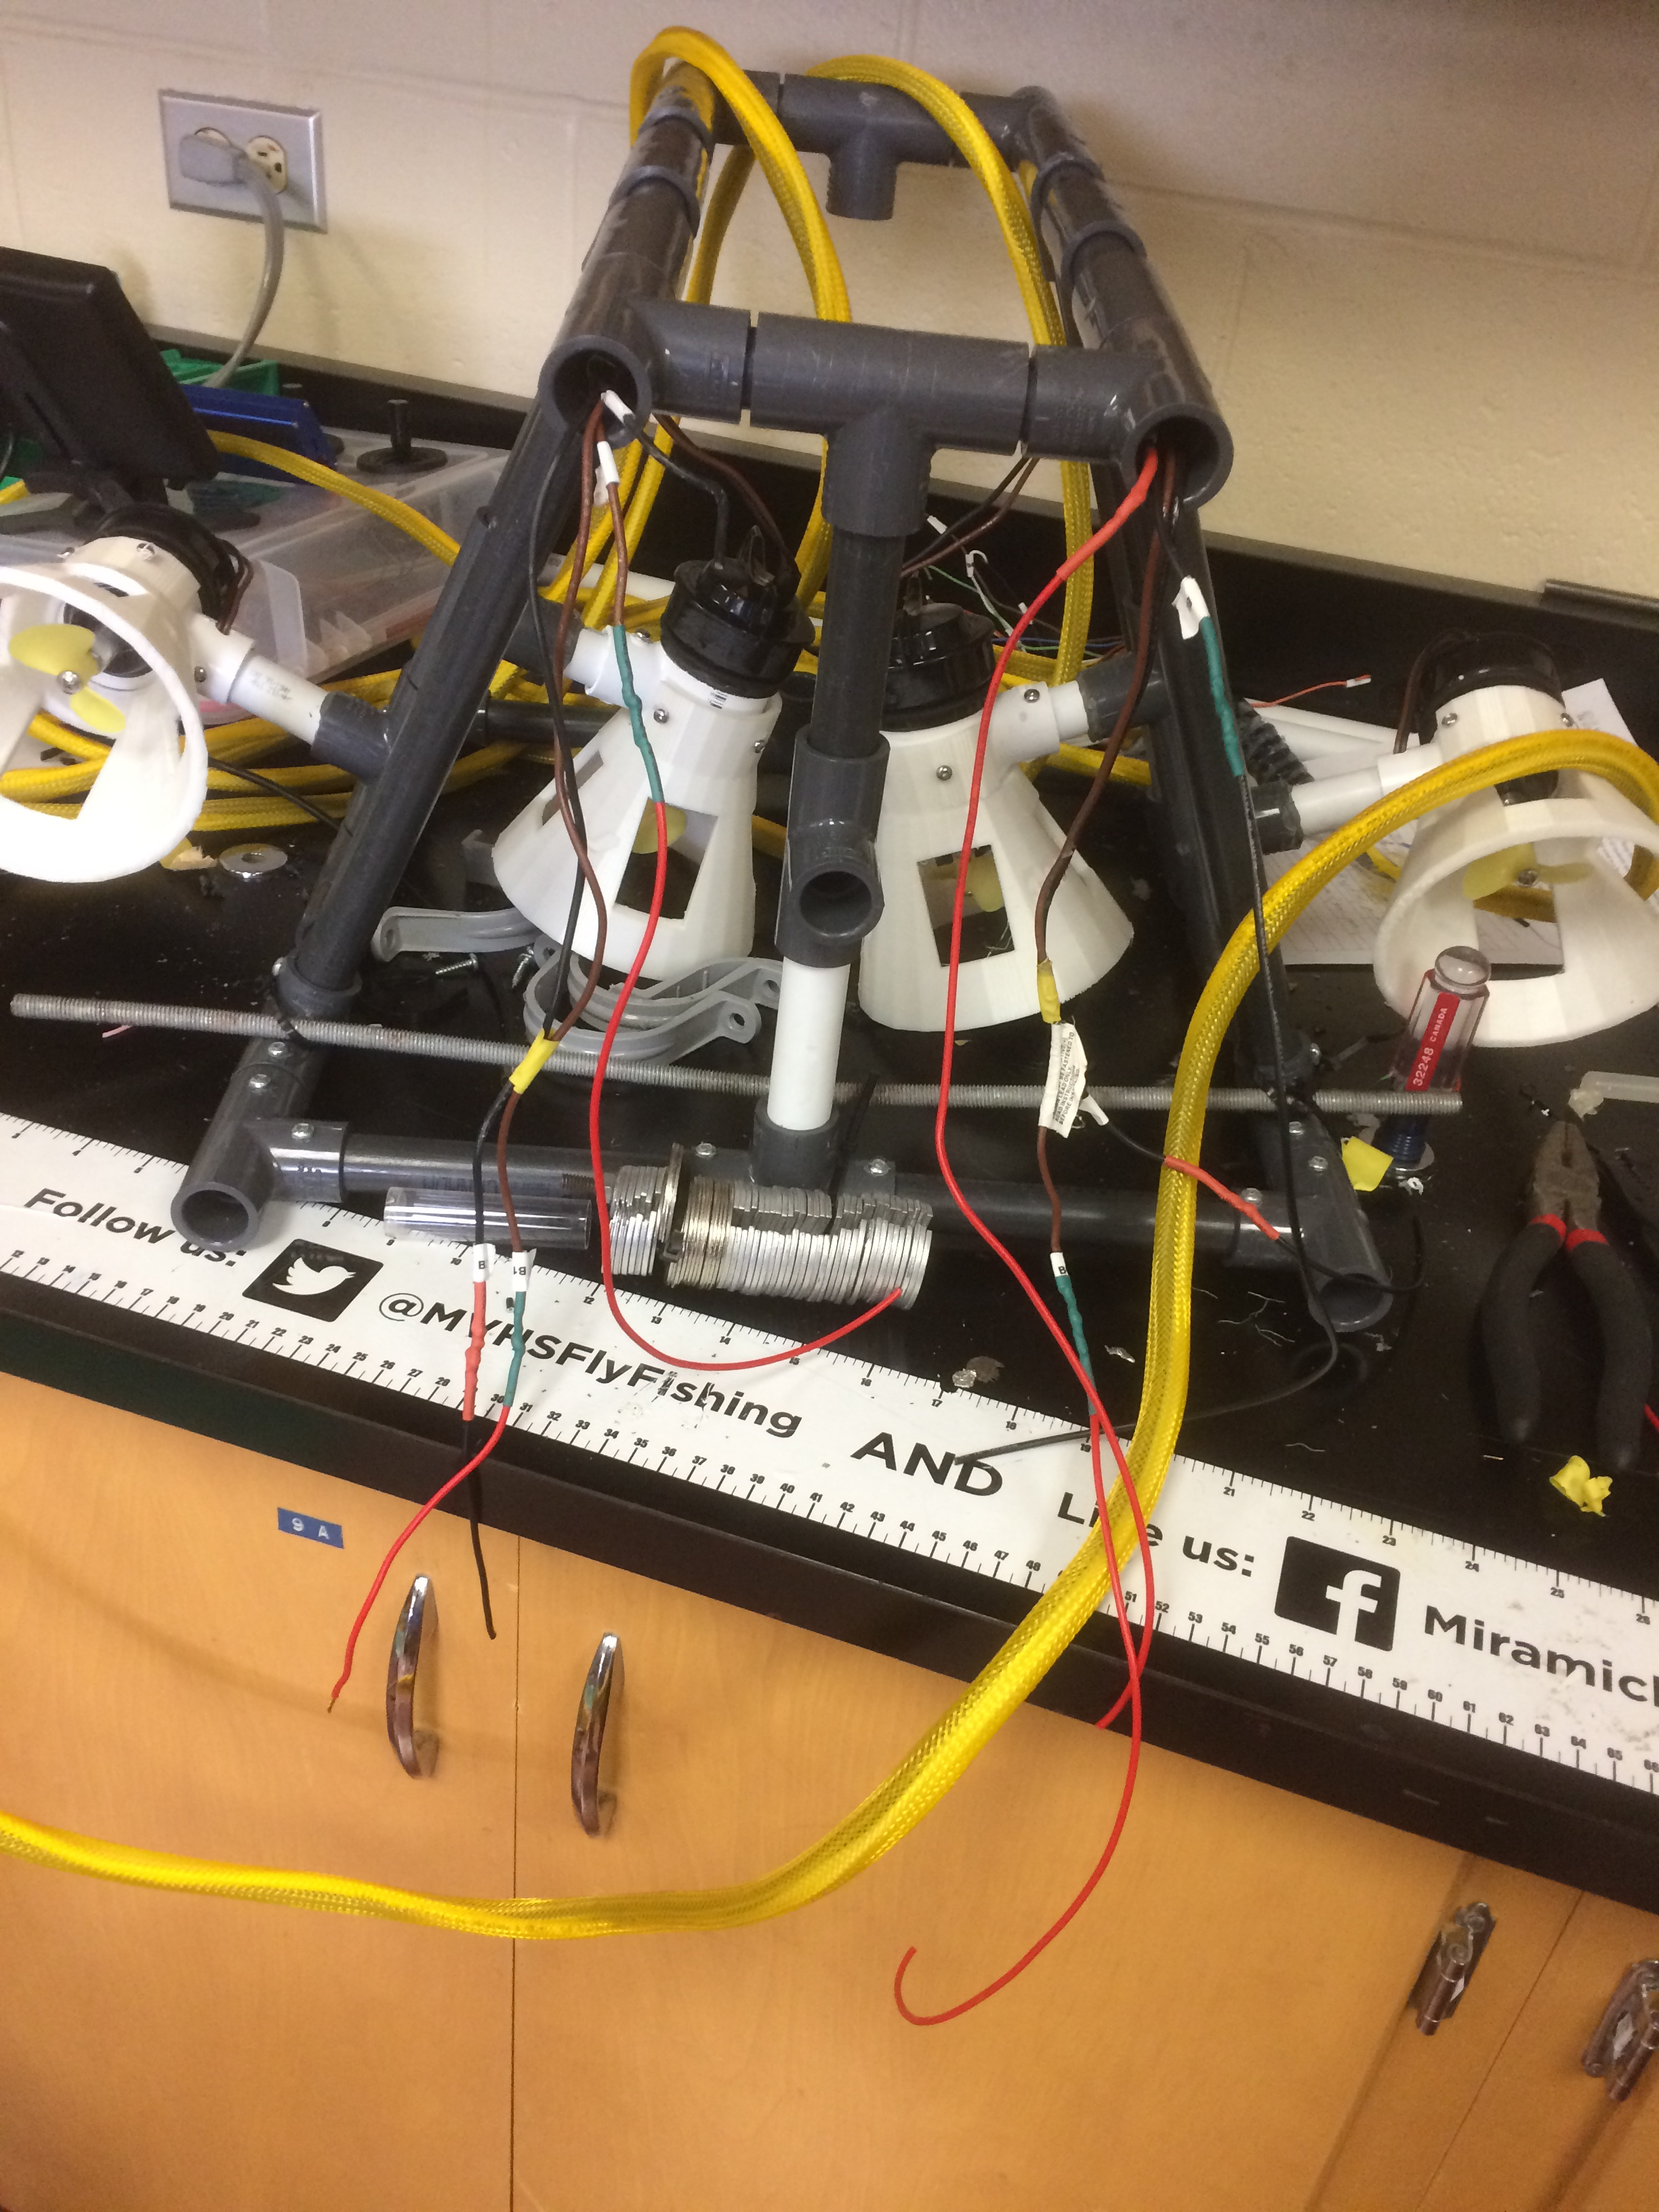
MATE ROV (Triggerfish)
By Zach and Mikey

Slide 2
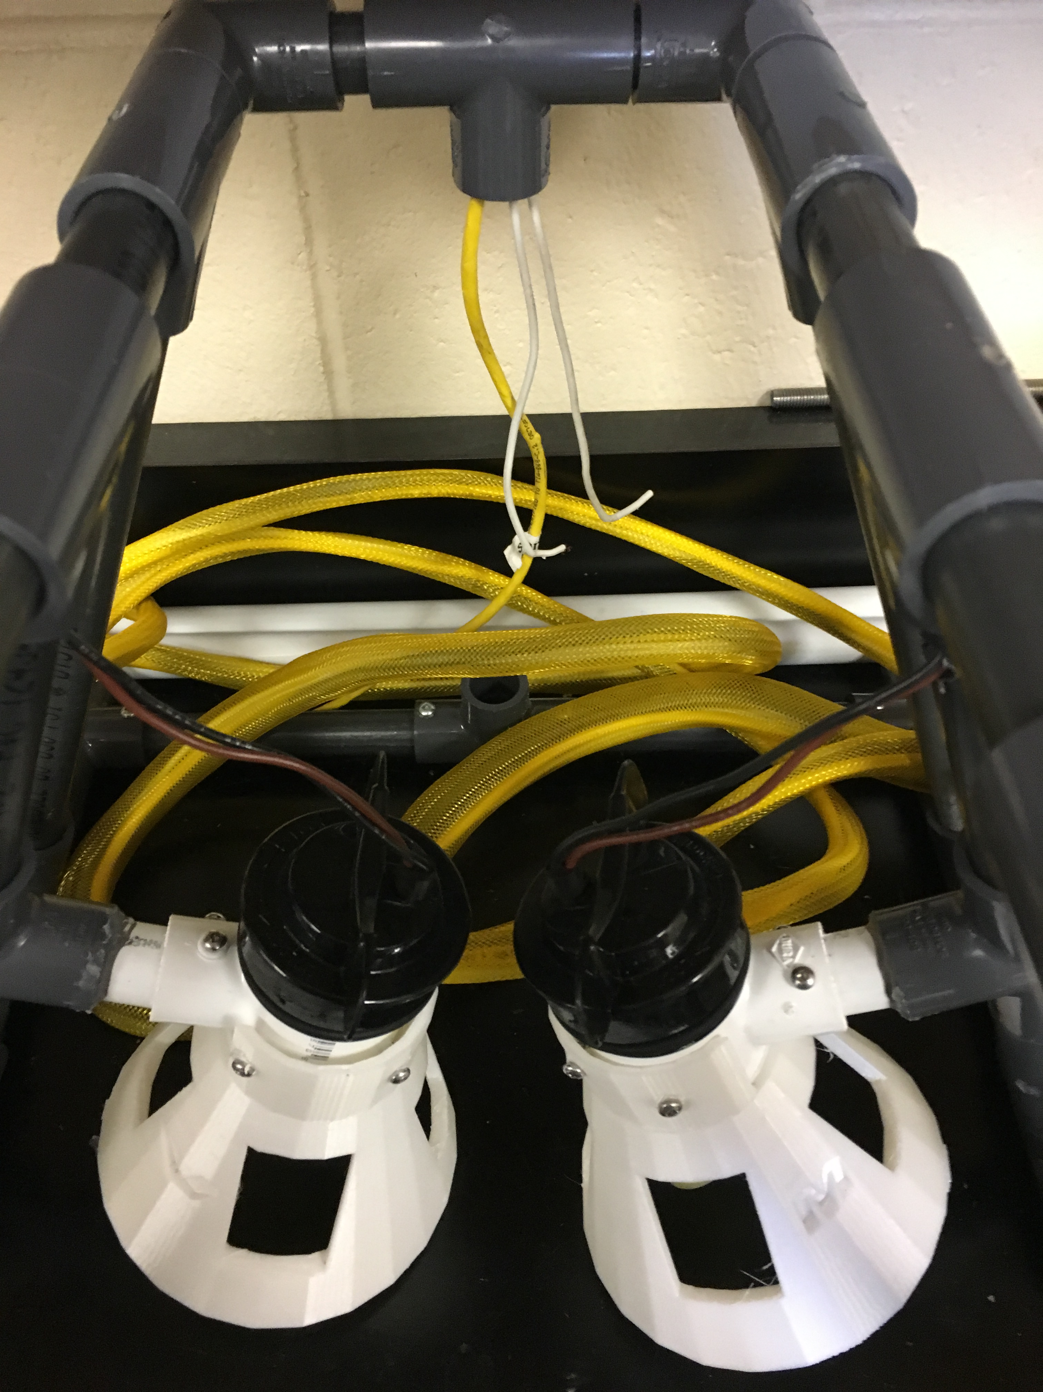
Summary
Main focus
- camera
- Rewire the entire ROV
- feed the wires through the machine and not the outside

Slide 3
Main Problems
Where the last group left off
Wires were too short
Test dive failed....
Controller controls were backwards.
Messy and weak wires

Slide 4
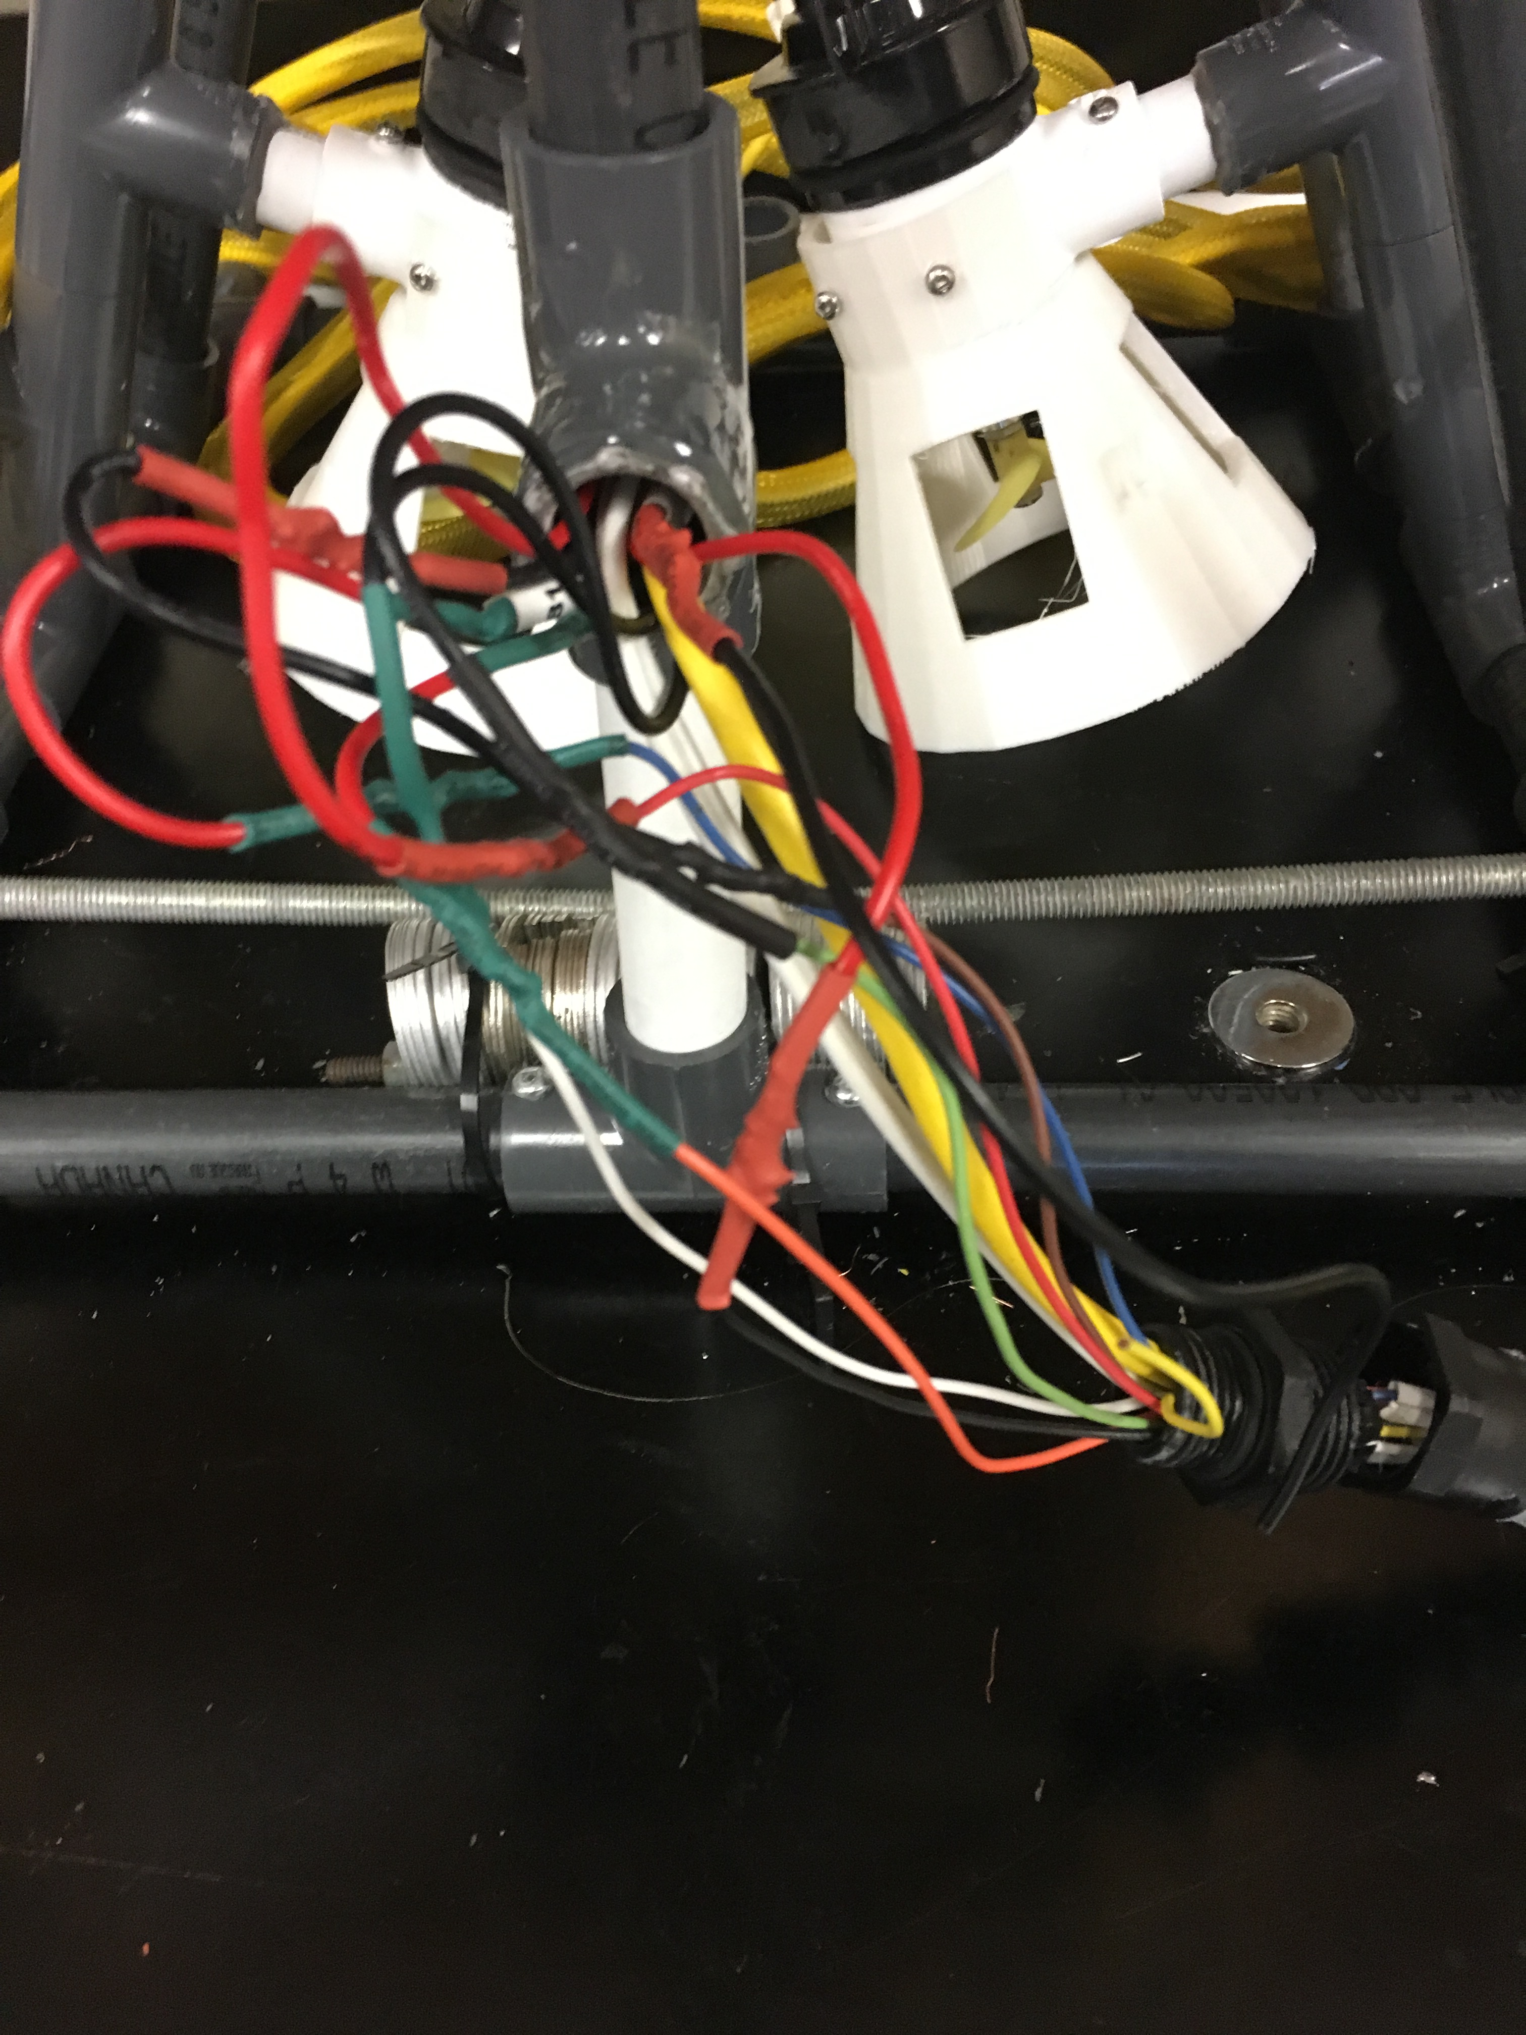
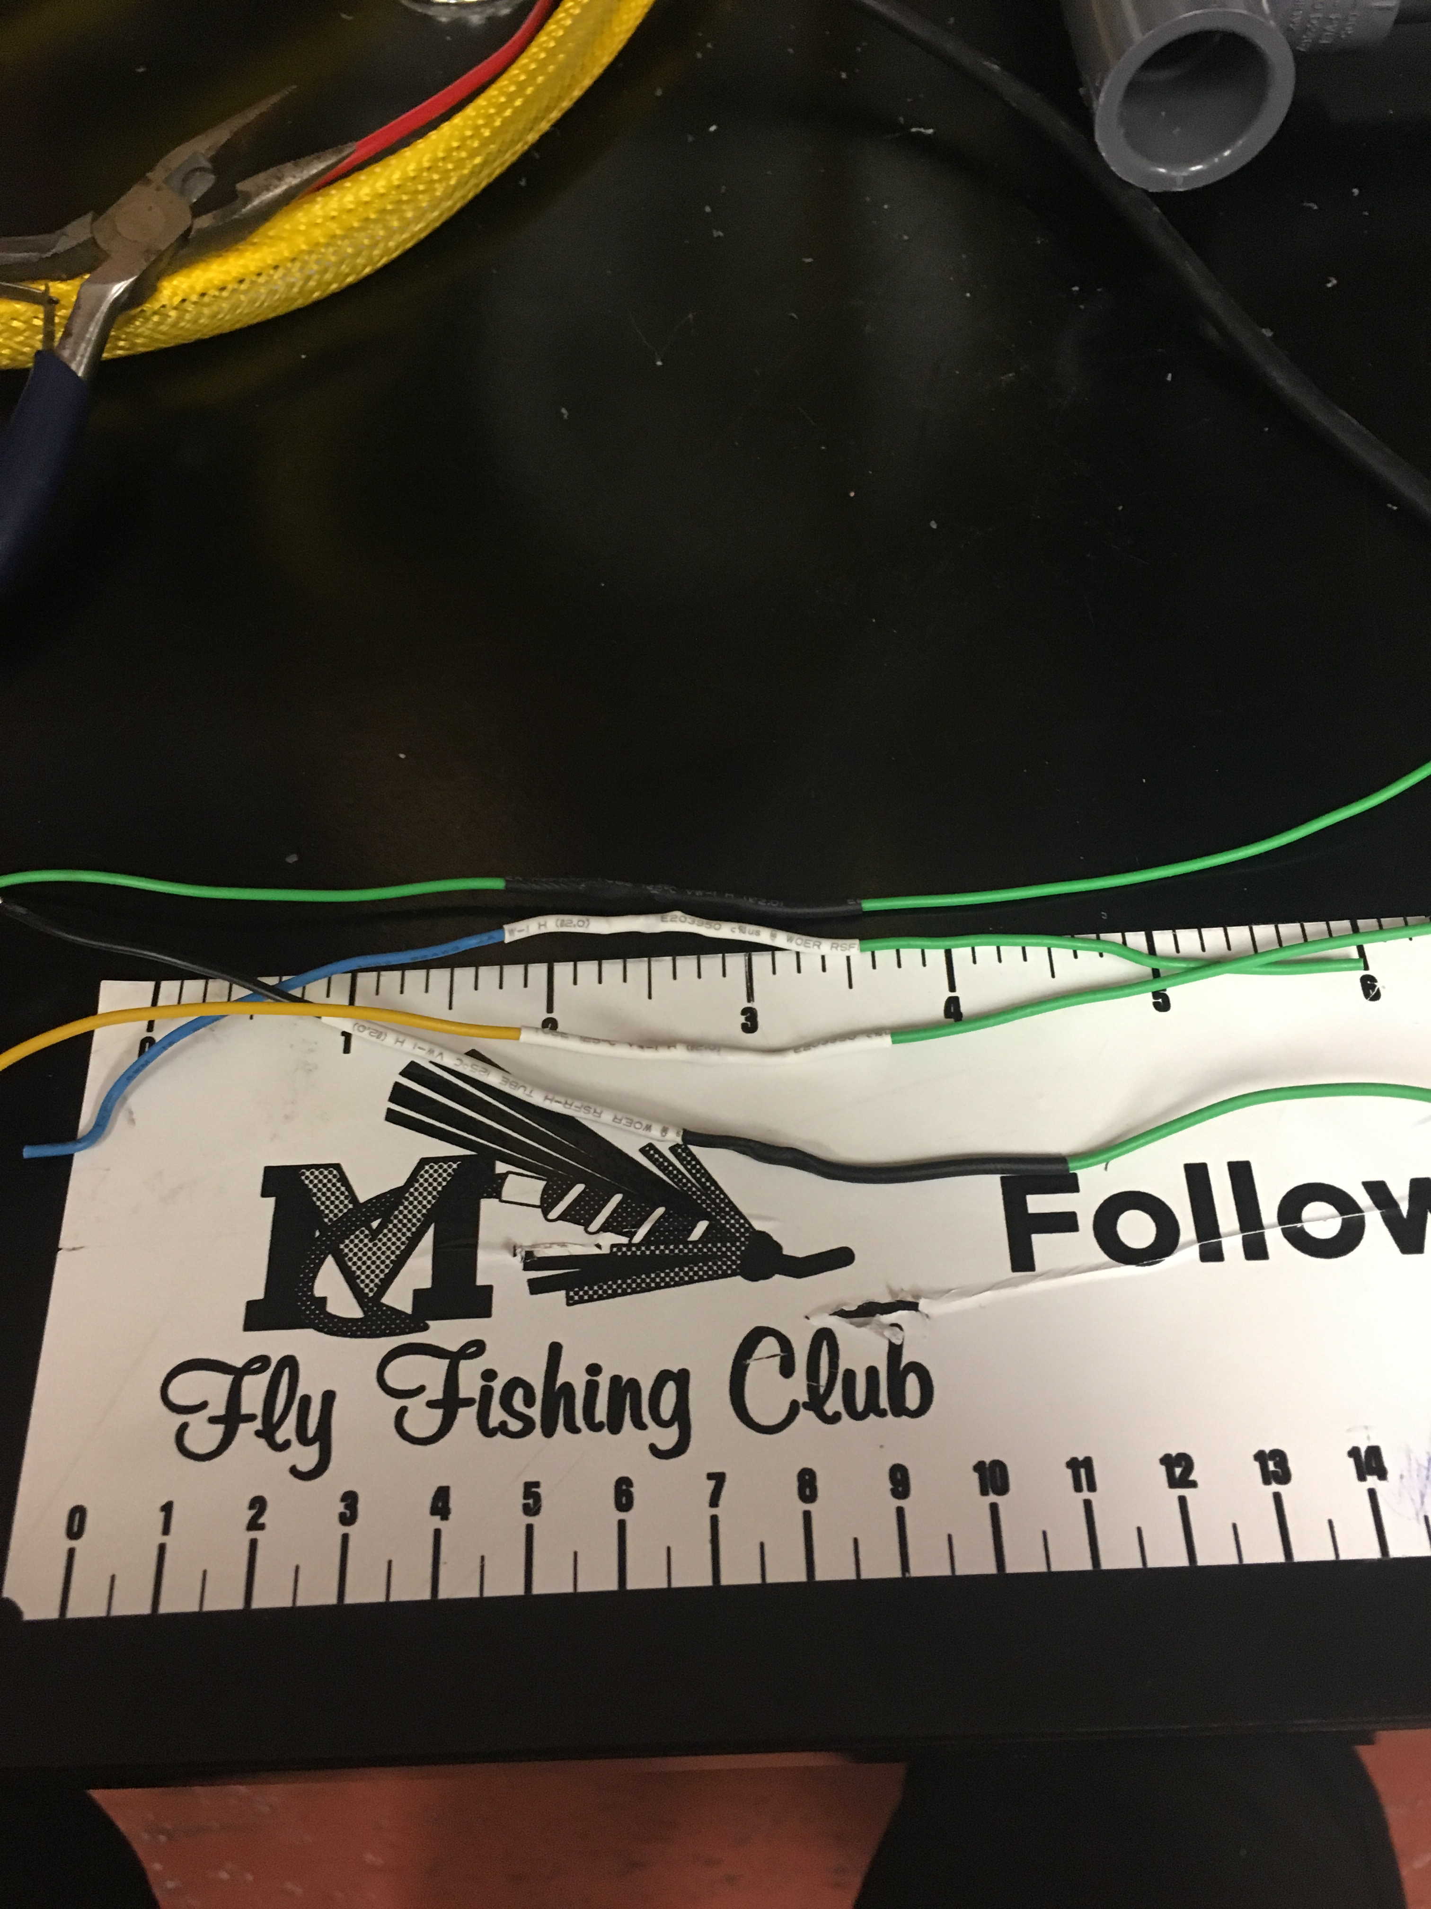
Highs....
Solder
Wires were easy to match and manage
Wires through the pipes
No more air sockets
We have power!

Slide 5
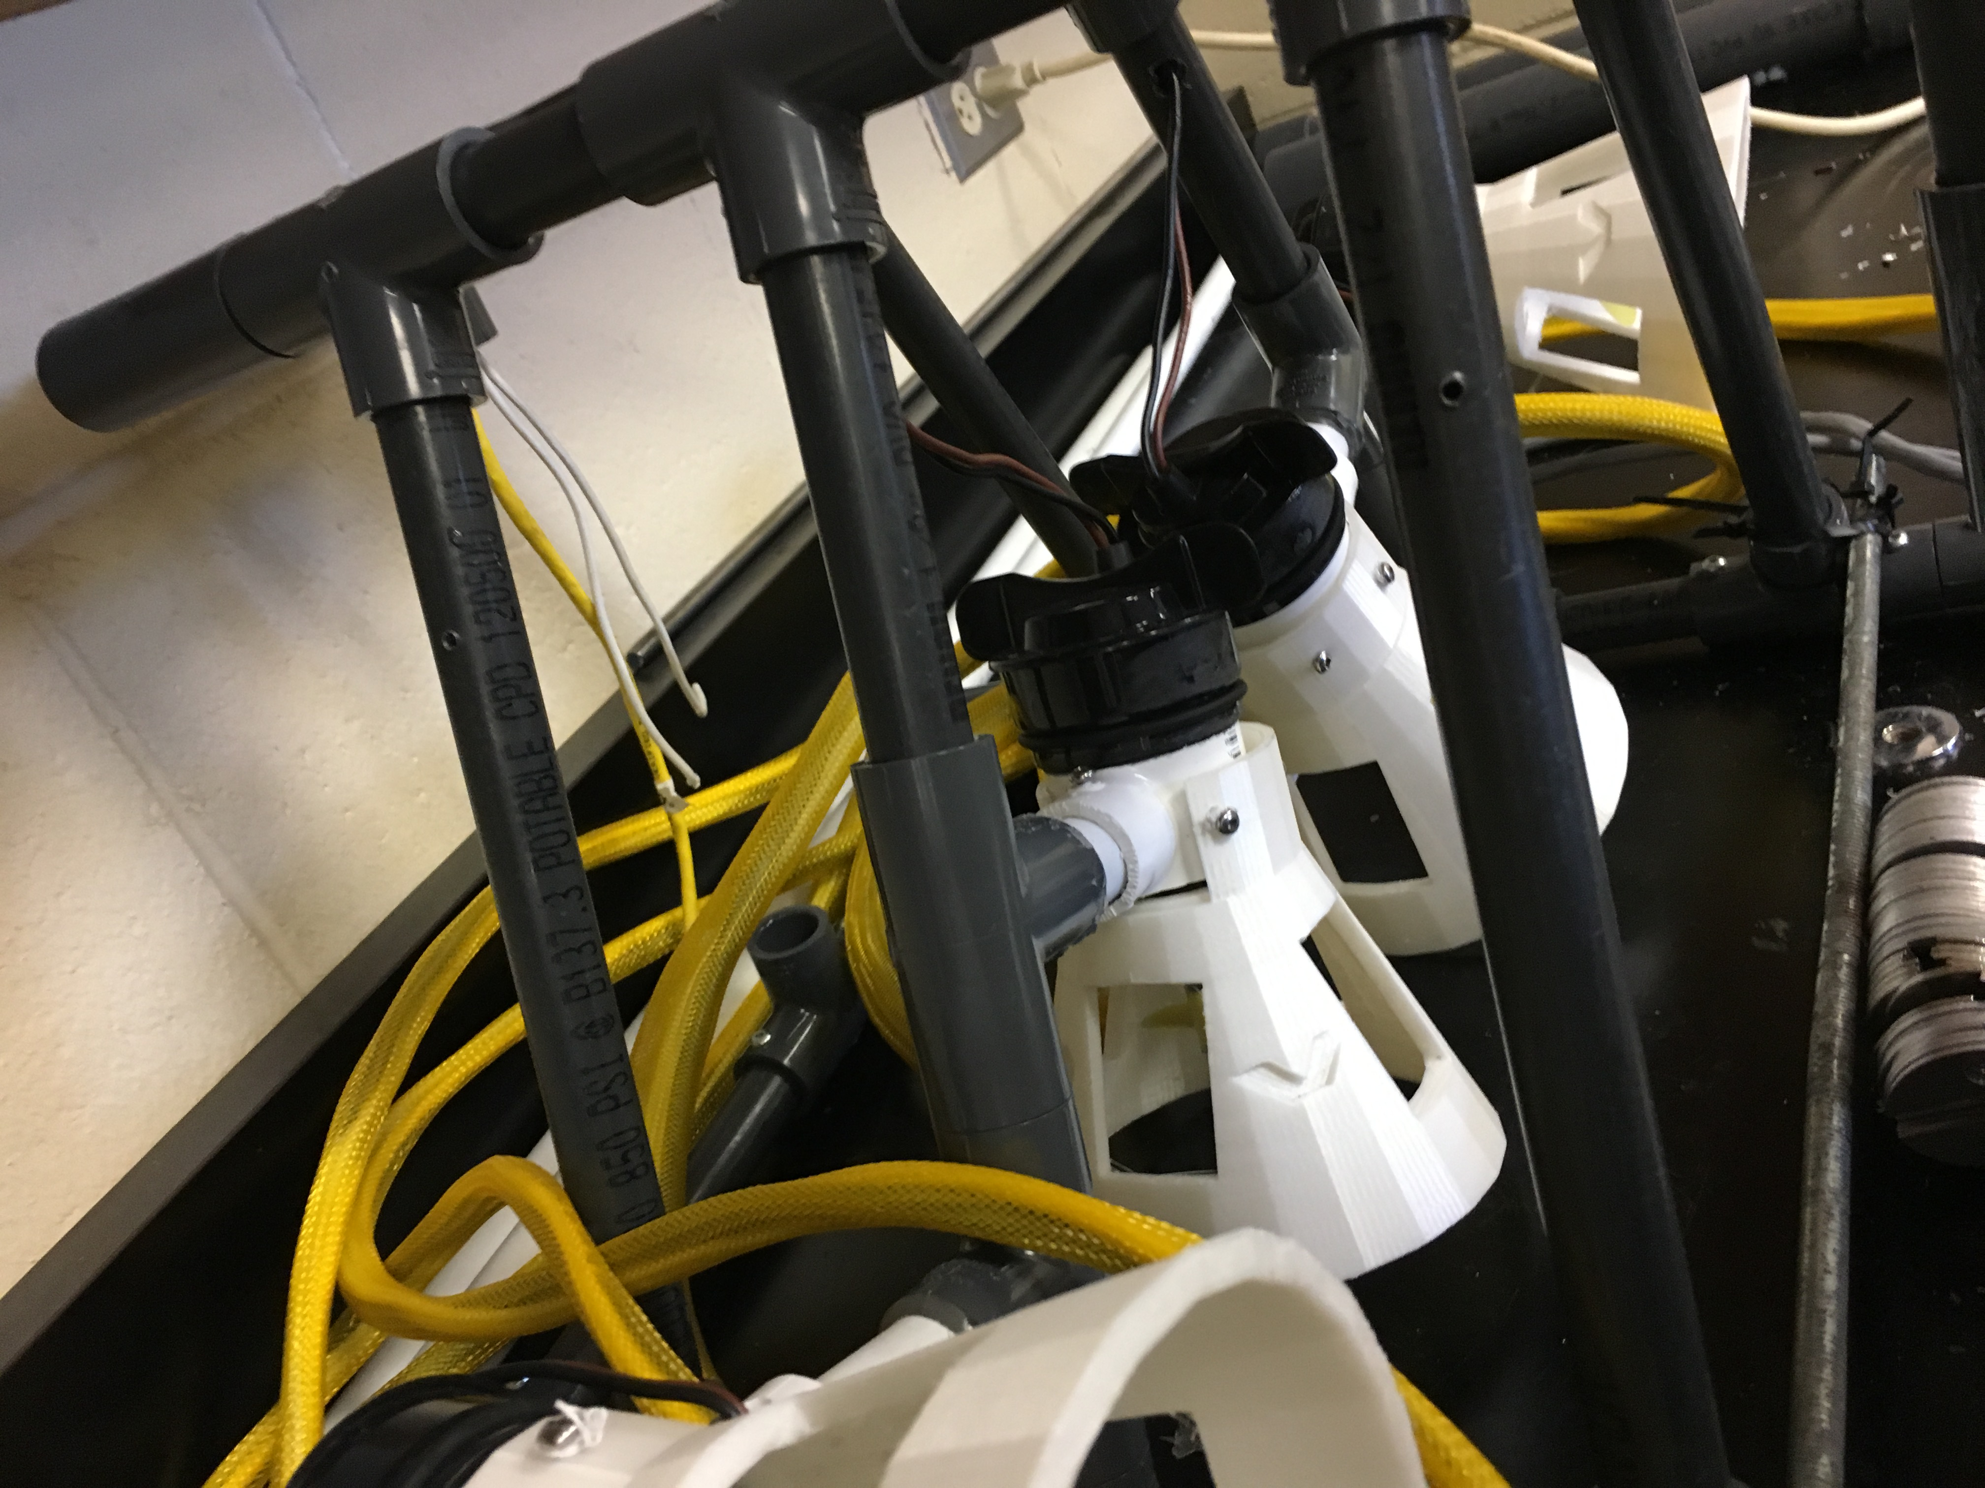
Lows
When we first started
Short wires
Hard to maneuver wires
Small pipes for all that wire
Soldered wires wouldn’t hold

Slide 6
https://www.youtube.com/watch?v=aIVB0Br712g
https://www.marinetech.org/how-to-build-the-triggerfish-rov-2/

