Slide 1
mBots
Ryan, Justin & Matthew

Slide 2
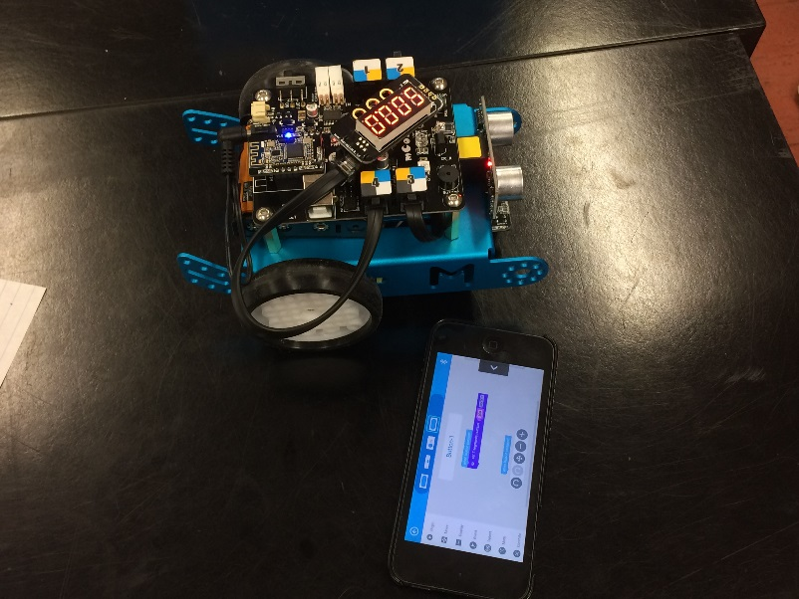
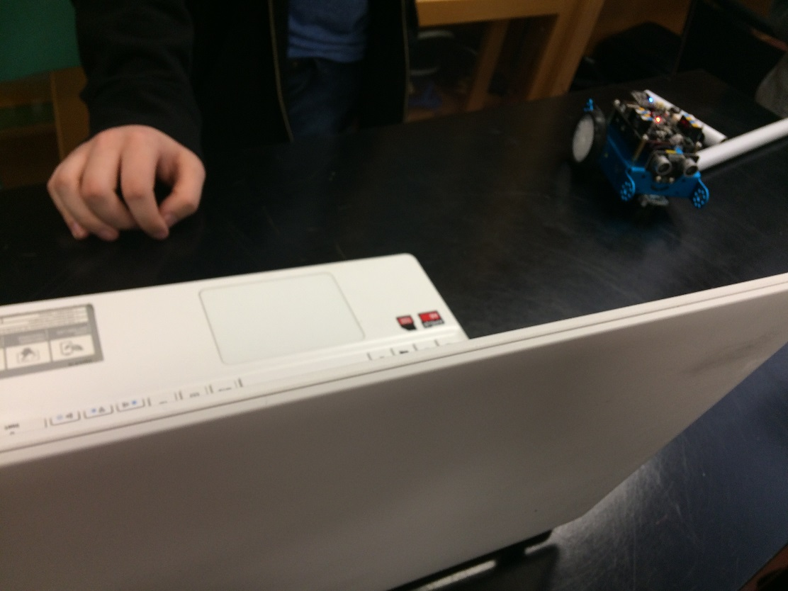
Bluetooth
Wireless Bluetooth chip
Make Block App

Slide 3
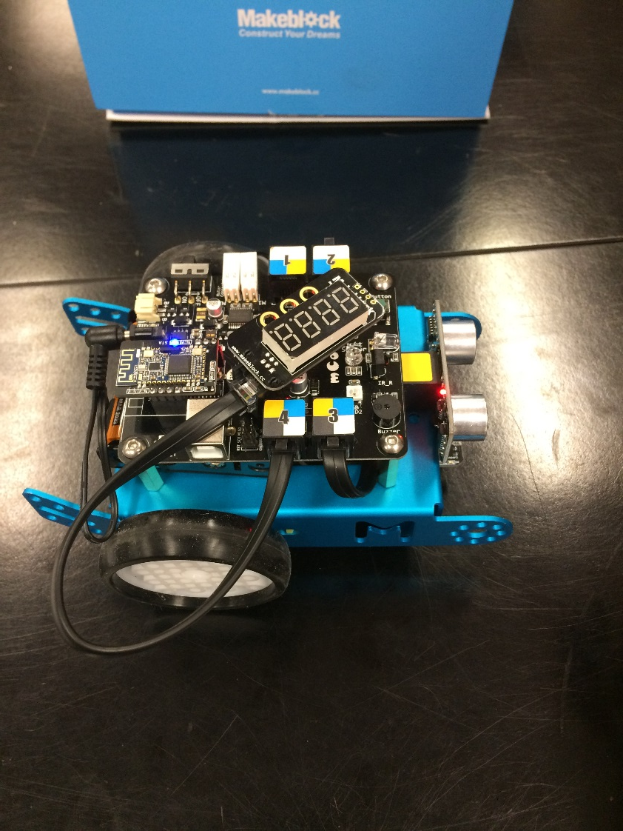
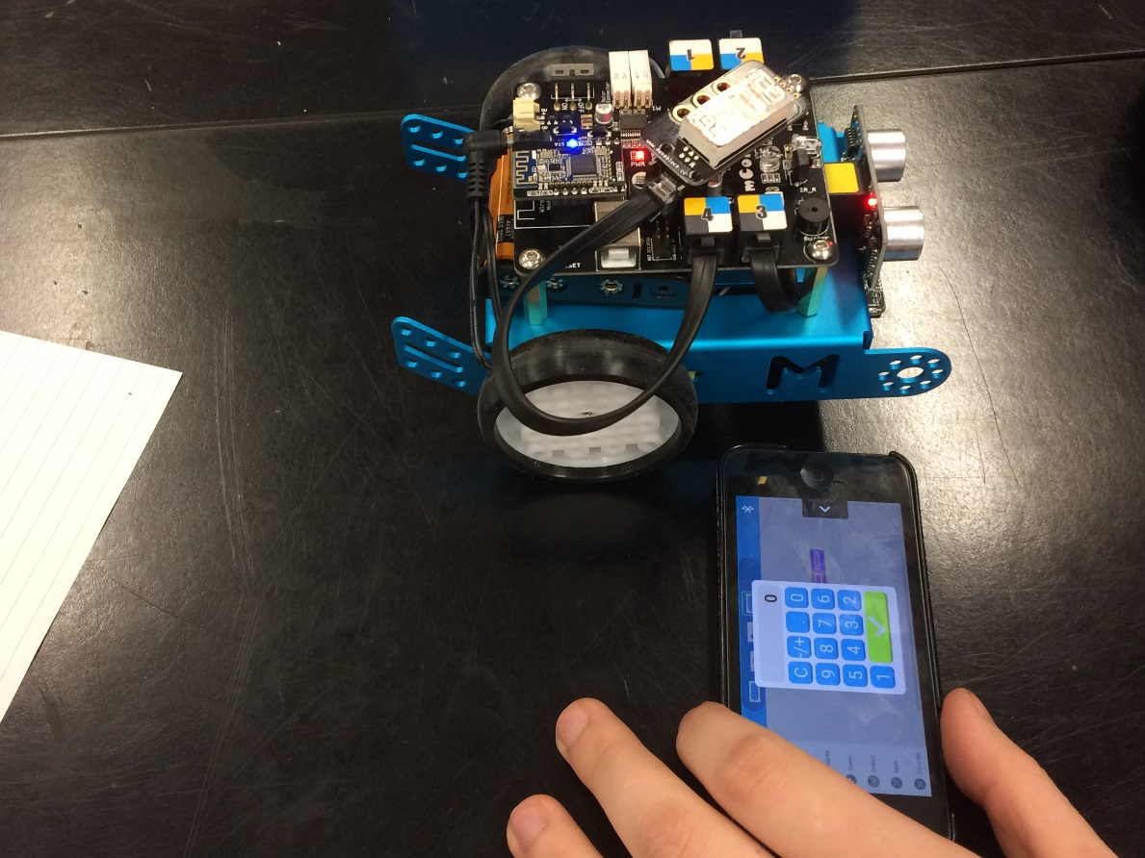
Countdown timer
Coded a timer to countdown the length of the match
Using the 6-Segment module

Slide 4
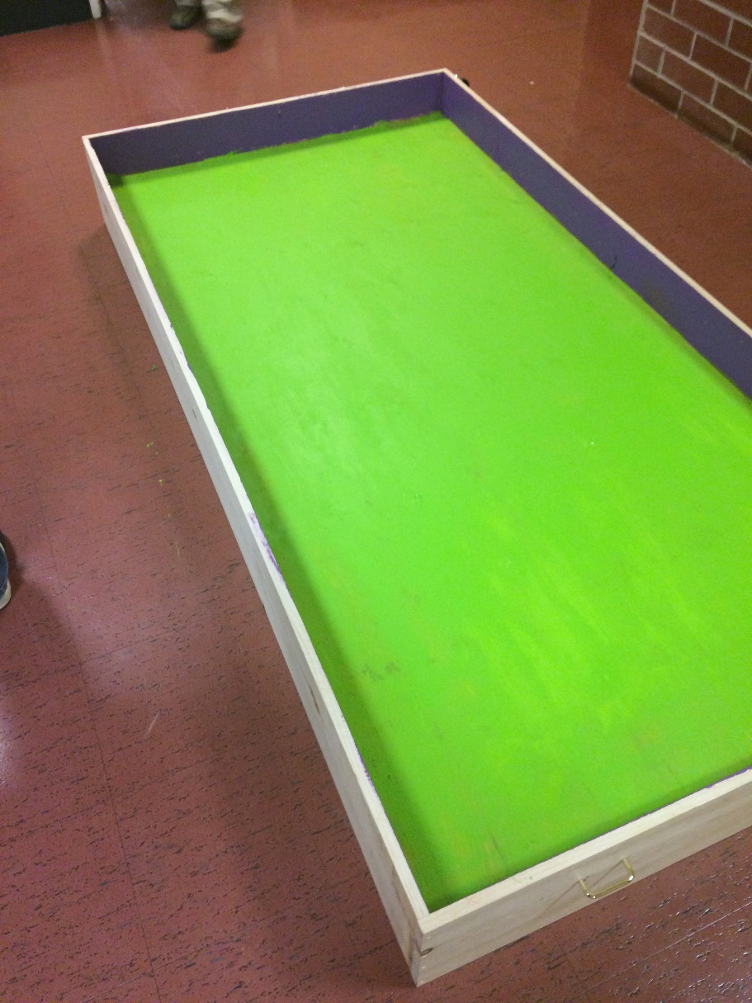
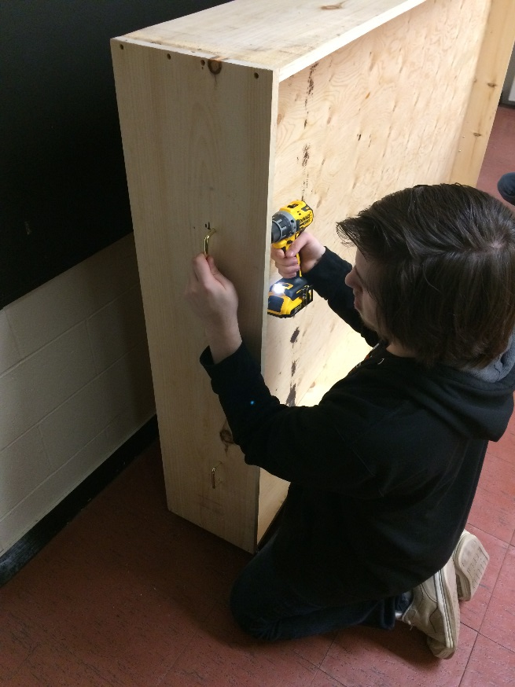
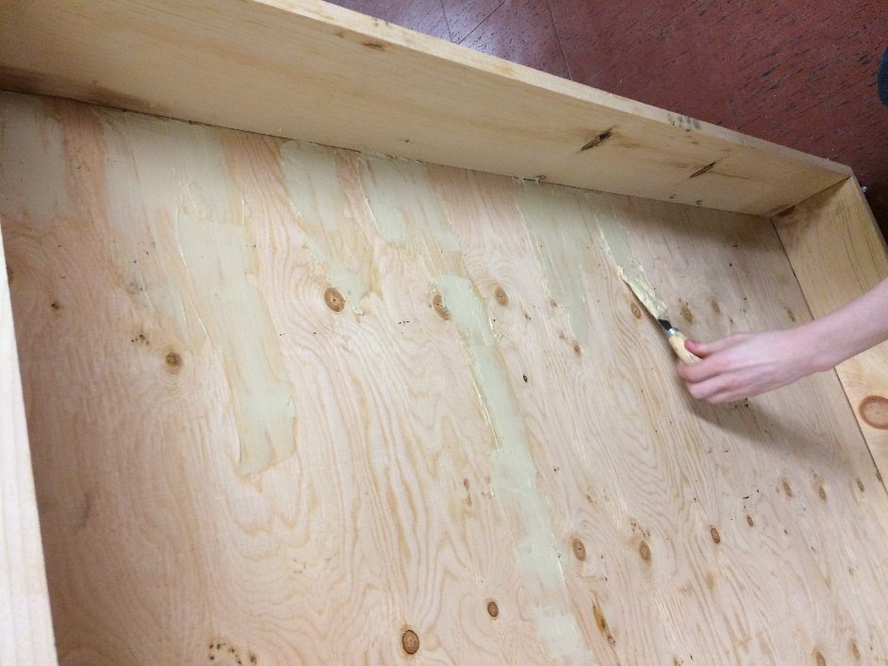
Creating the Soccer Field
8X4 Soccer field with boards
Painted the playing field green and the boards purple
Wheels on the side board
Handles on both sides

Slide 5
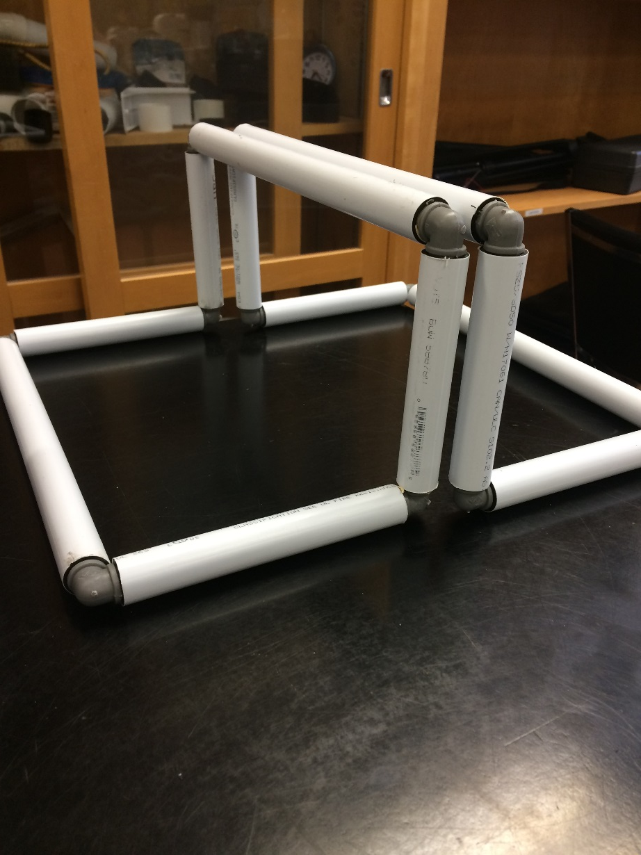
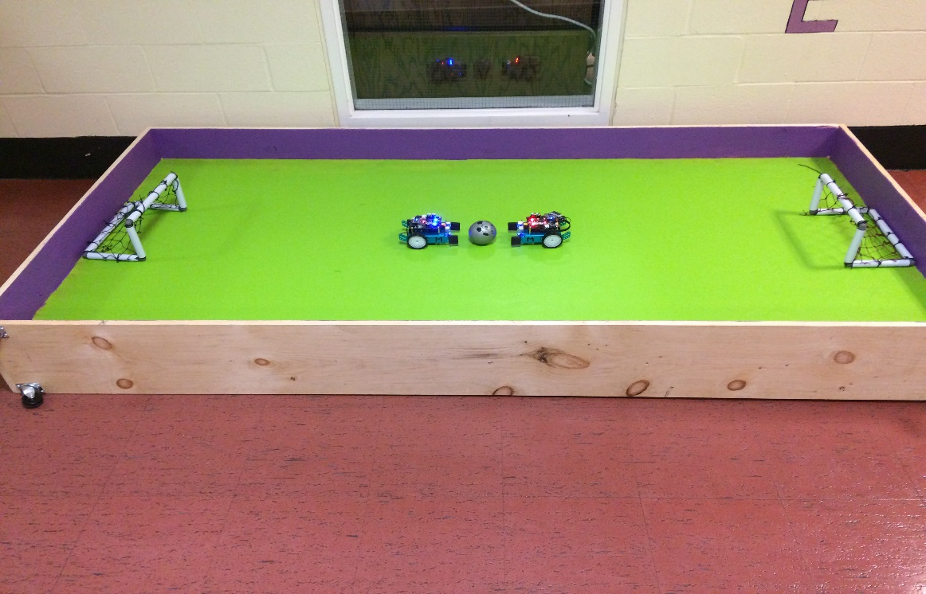
Nets
White PVC pipes and grey corner pipes
Spray painted netting red and blue
Tried using PVC cement
Used tape to hold the net together

Slide 6
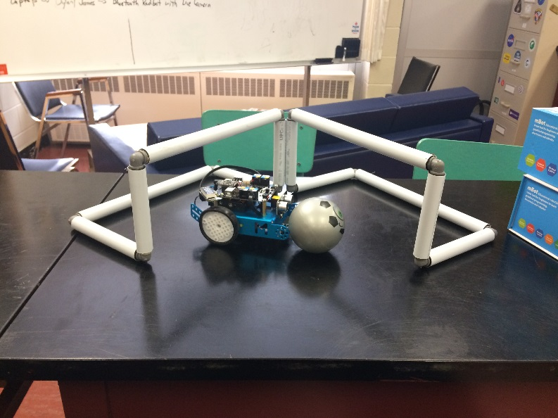
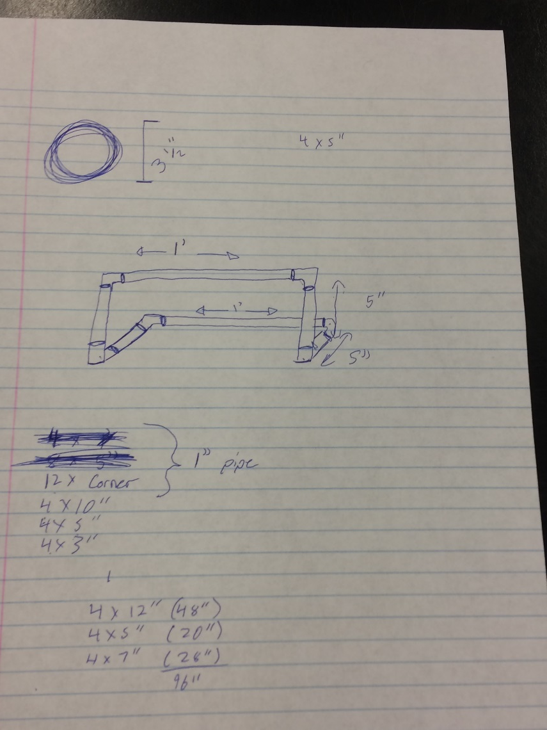
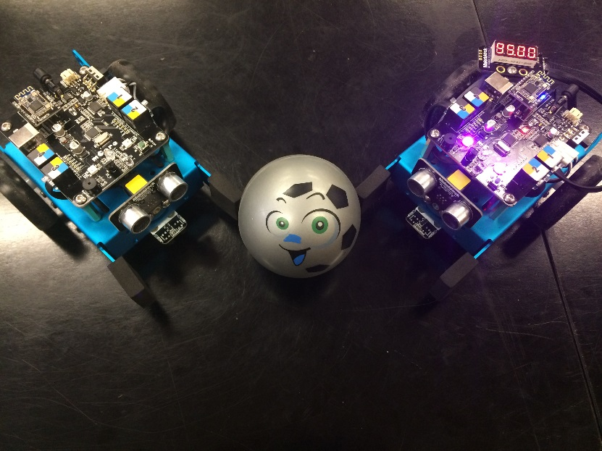
Finale

