Slide 1
The BLE Device

Slide 2
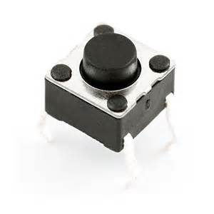
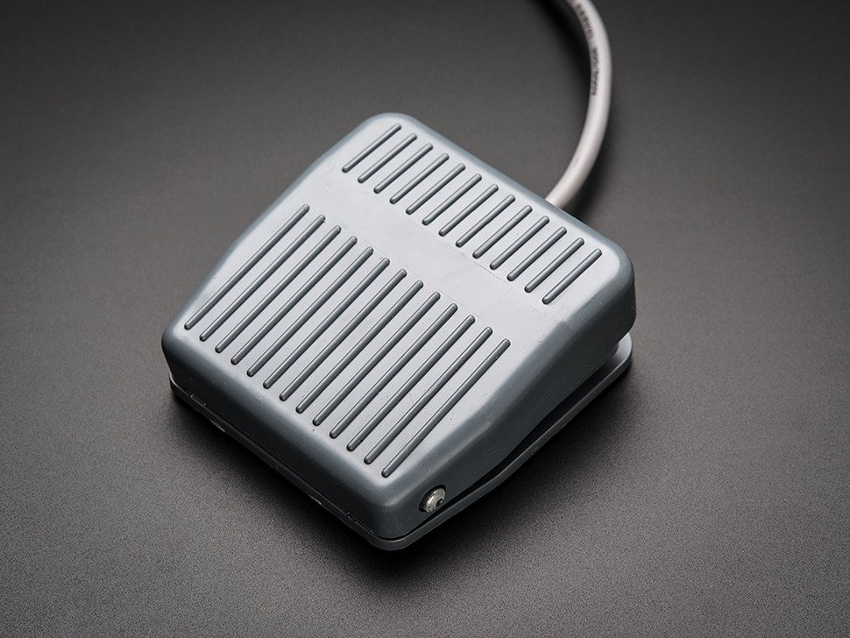
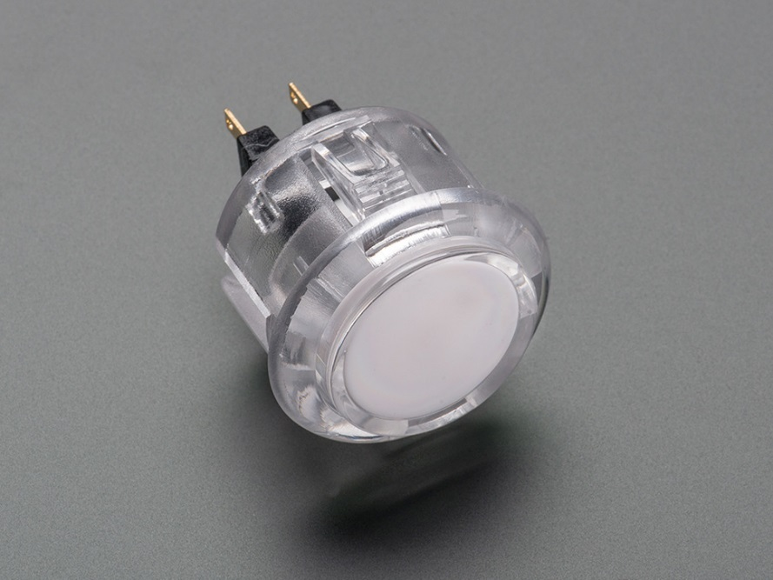
What it does
Button control

Slide 3
Who will use it?
Parkinson's
Mental handicap
Barry Amos

Slide 4
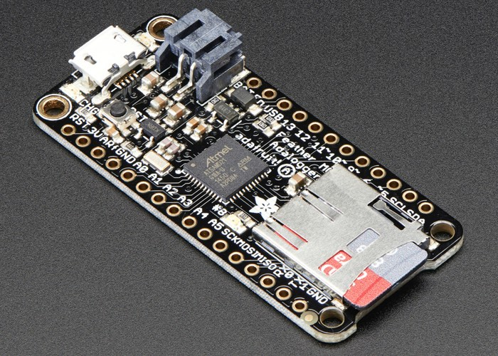
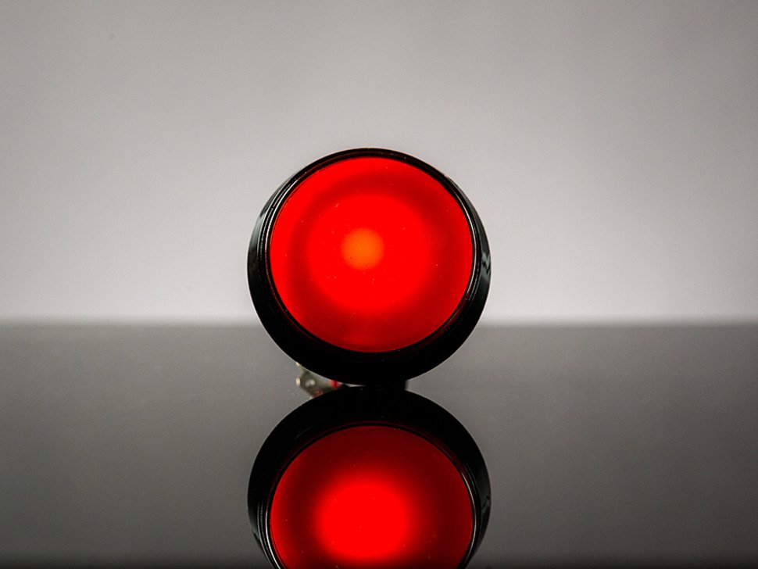
How it works
Buttons
Feather M0
IOS Control

Slide 5
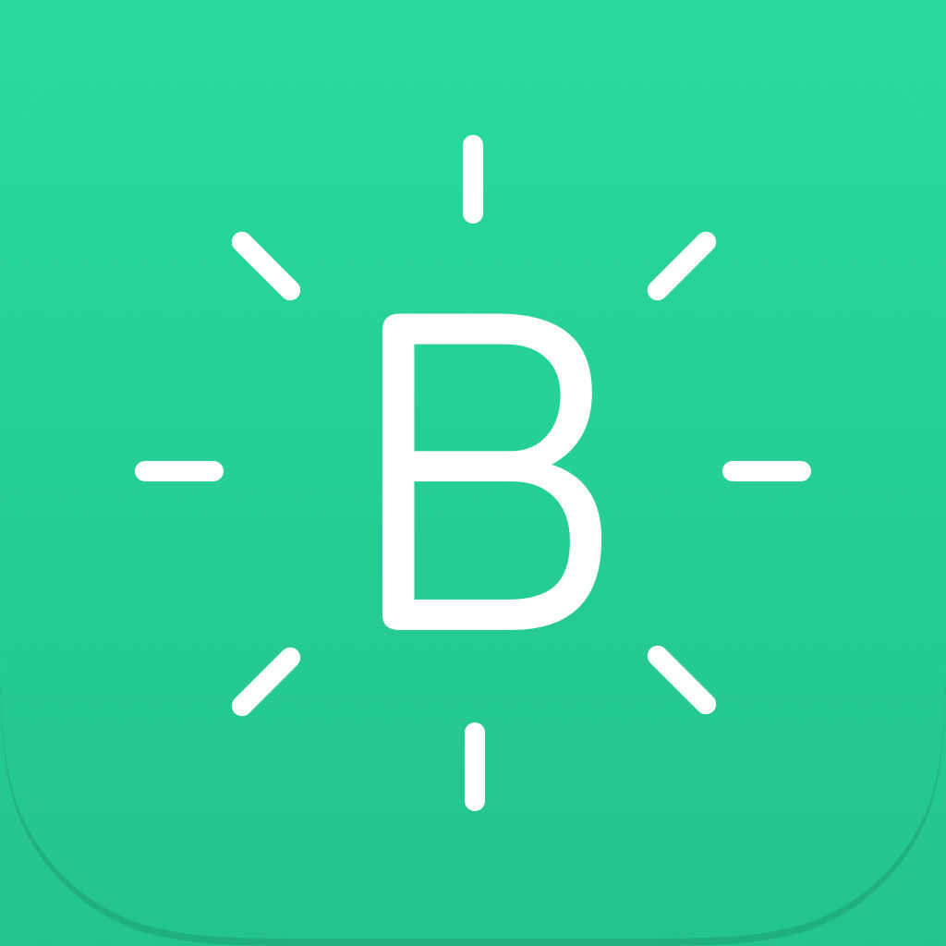
The beginning
Original project
Research
Getting the parts

Slide 6
Why I built it
Looked fun
Can be used to help people

Slide 7
Where I'm at now
At the coding part

Slide 8
Highs and lows
Code was not working
Finding the error in the code
Error compiling

Slide 9
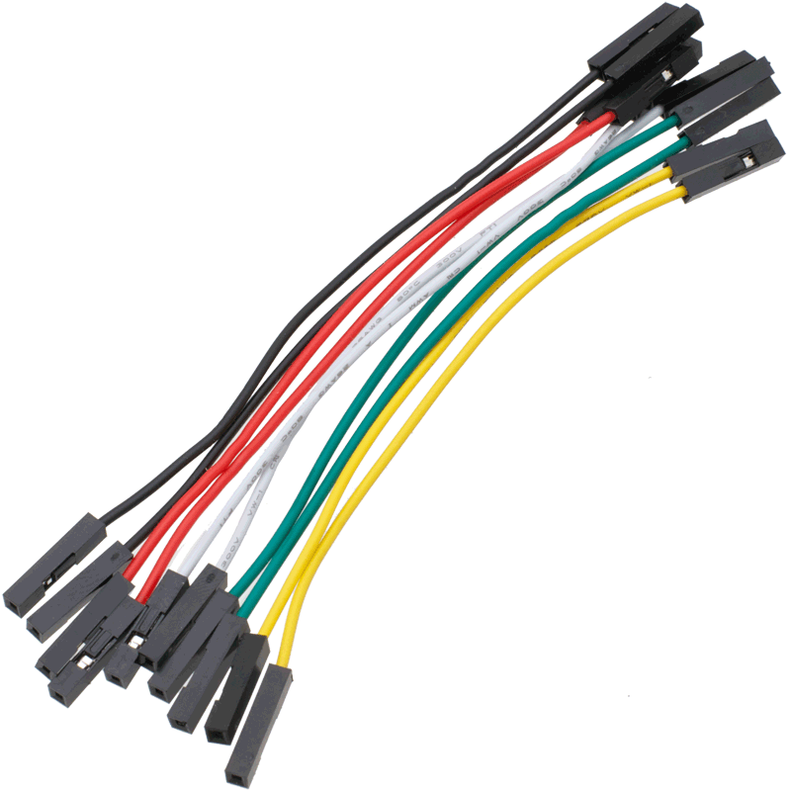
The End
Connect the buttons to the Feather
Test the project
Solder pins onto the feather

