Slide 1
Vinyl Innovations
By: Emily McCabe and Joshua Benoit

Slide 2
Explanation?
Things that you can do : Stickers
Drawings
Stencils
Cut outs
Invitations
You can expand on these and create your own ideas (ex..signs)

Slide 3
Purpose
Just a credit needed to graduate…
Work on Millerton signs to educate ourselves with this field of technology
Use our knowledge to expand our project ideas (ex.stencils for painting)
To educate others to take projects further within this field of technology

Slide 4
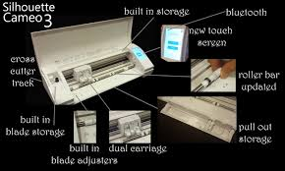
How?
New features such as the automatic blade and the markers
New silhouette program
New silhouette cameo machine
Materials: Markers
Blade
Vinyl/card stock
Transfer tape

Slide 5
Millerton Signs
Purpose ( to learn about and get new cameo)
Procedure: Cutting
Peeling
Transfer
Signs made by carpentry students
As well, we plan to get an updated staff sign in the lobby

Slide 6
Small Jobs
Made signs for Dylan and James
Made stickers for journal

Slide 7
Conflicts
No knowledge with the Cameo
Ordering New/More vinyl
Signs were too long
Printing one at a time…
Border for easier peeling
Time restrictions due to snow days

Slide 8
Consequences
A new hobby ( fun, time consuming, easy to do)
A better education with computer programs
Extra funds for MVHS makerspace
Getting projects completed for others
Getting the benefits of working and learning with the newest cameo model
Took part in STEM fair

Slide 9
Thank you for listening! ☺
The End

