Slide 1
Adafruit Circuit Playground
By: liam richardson

Slide 2
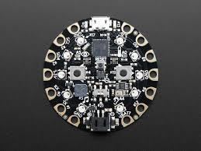
The Board
The Board is what is considered the “playground” because of all the different features. Those features are…
LED Lights
Motion Sensors
Microphone
Thermometer
Speakers

Slide 3
How it works
To have something work on the Circuit playground you have to follow a simple four step process.
Find Code
Paste Code
Verify Code
Upload Code

Slide 4
Problems
When I used the Circuit Playground I ran into a constant problem with codes that are online, one or two lines of the code are wrong. That was the problem when I found my final project.

Slide 5
What I’ve Done
I only got to use the circuit playground for about 3 weeks, after the raspberry pi plans didn’t work. For a week I had to learn about the board and how it worked. After learning about the board I looked and found a project I wanted to do as my final. The code didn’t worked so I just decided I don’t have time to make a final project. I used most of my time learning about the playground and how to download code.

