Slide 1
Vinyl cutting & heat pressing
By. Jonah Simon

Slide 2
Vinyl cutting explained:
Vinyl cutting is when you take or make a design and use a program called silhouette studio to edit it and send it to the vinyl cutter, the vinyl cutter then takes the design and cuts it out of material like heat transfer vinyl or sticker vinyl. Then you can put it on whatever you like.

Slide 3
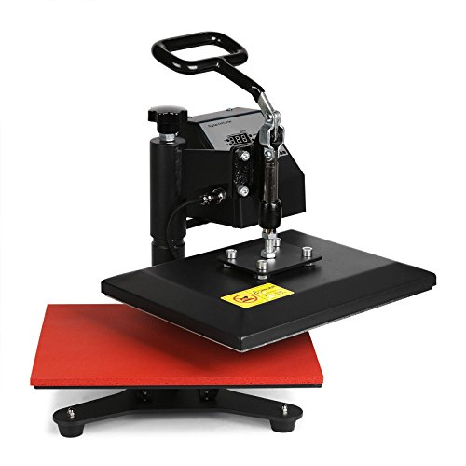
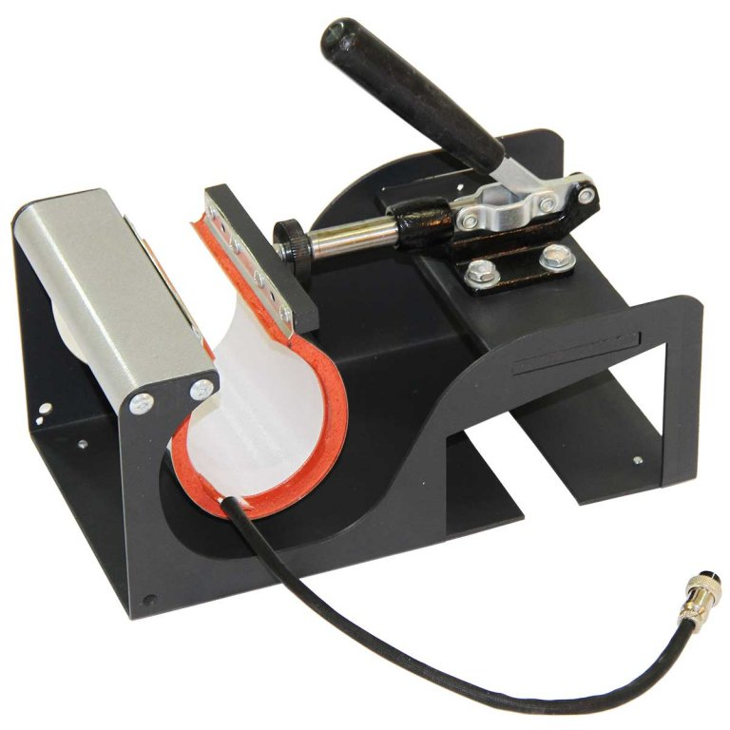
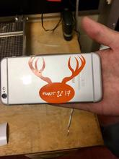
My projects
My first project using heat transfer vinyl was with a mug, I had to use a special attachment made to fit around the mug to press the vinyl onto it.
My most recent project was with shirts where I had to use the flat surface heat press
With heat transfer vinyl you have to do a few more steps differently then sticker vinyl

Slide 4
Heat press vinyl
With heat press vinyl you have to do some steps differently, you have to first flip the image you’re using, change the setting to the material you’re using, then with the material you have to make sure the shiny side is facing down and make sure you’re blade is set at the correct depth of cut.

Slide 5
Reasons to get into vinyl cutting
Vinyl cutting can be a good skill if you are thinking about either making you’re own small business or just want to personalize you’re own clothing.
You can pretty much put vinyl onto anything from your clothes to your vehicle
If you don’t want to permanently paint or color something you can put the color you want with vinyl and if you don’t like it you can peel it off.

