Slide 1
Different creatures with different adaptations
Hannah Manderville

Slide 2
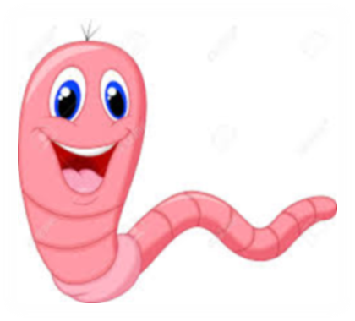
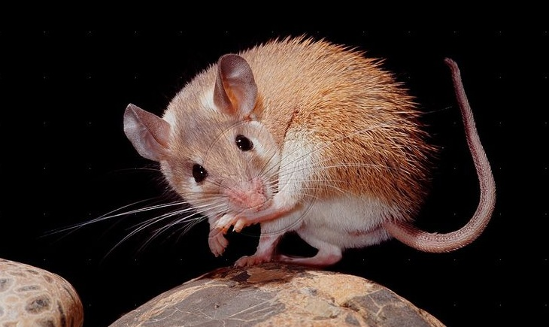
Structural Adaptations
The Earthworm has little hairs all over its body called chaetae (setae) to provide grip when moving through the earth.
The African Spiny Mouse has super thin skin which helps them survive by speeding up the healing process of cuts because it’s so thin. This also makes blood loss minimal.

Slide 3
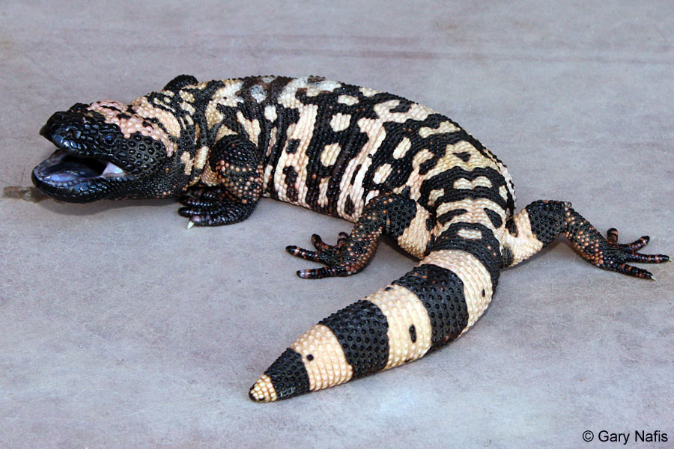
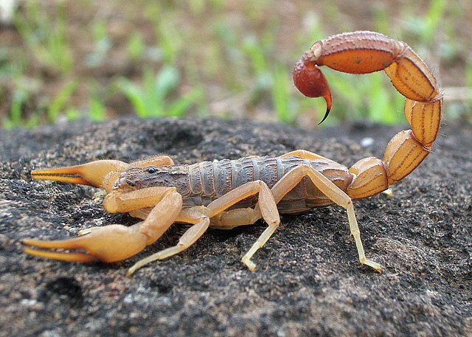
Physiological Adaptations
The Gila Monster spends most of its life underground and can go months without meals because it stores the fats needed for survival in its tail. Like how a camel stores water in its humps.
Scorpions are able to stay alert while hibernating. They ease there way into hibernation by lowering their metabolic system, but they still stay awake enough to sense oncoming prey.

Slide 4
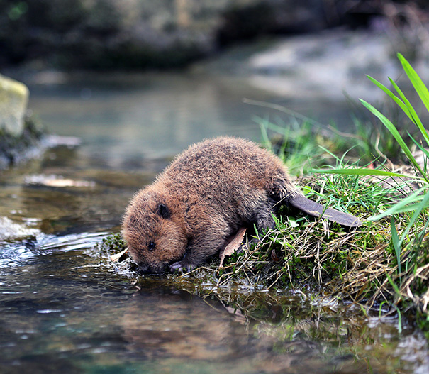
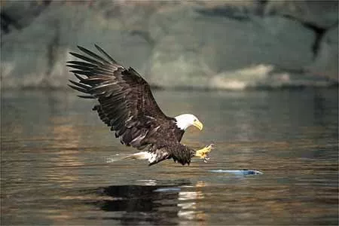
Behavioural Adaptations
Beavers can close their lips behind their front teeth so that they can gnaw underwater and still keep water and splinters out of their mouths.
We all know bald eagles have super sharp talons but on the bottoms of there “feet” they have bumps to help hold on to the prey while flying.

